Slide 1
CAEP Data Dive
May 18, 2021
www.casas.org

Slide 2
Overview
April 28: CAEP Data Dive: Detail CAEP outcomes and services; review CAEP Reports in TE, and what’s new
May 18: Barriers and Equity: Using new and existing TE reporting features to target data, and focus on specific populations that meet statewide and regional priorities
May 25: CAEP Performance Goals: Review key concepts of NRS performance and persistence and apply these concepts to CAEP data reporting.

Slide 3
Agenda
Recap: CAEP Data Dive/Review of CAEP Outcomes
CAEP Reports in TE
  CAEP Summary
  CAEP DIR
  CAEP Hours Report
  Consortium Level Reports
Special Features to Isolate Priority Populations
  Barriers to Employment Reports
  Filtering TE Reports for Specific Subsets
  NRS Ad Hoc Cross Tabs
  I-3 Outcomes and Reports in TE

Slide 4
CAEP Outcomes
Literacy Gains
HSE/HS Diploma
Post-Secondary
Enter Employment
Increase Wages
Transition
Pre/Post Level Completion
Carnegie Units /HS Credits
CDCP Certificate
Occupational Skills Gain
Workforce Preparation
High School Diploma
Passed GED
Passed HiSET
College Degree – AA, AS, BA, BS
Graduate Studies
Training Credential
Occupational Licensure/Certificate
Apprenticeship
Get a Job
Retain a Job
Enter Military
Increase Wages
Get a Better Job
Transition to ASE
Transition to Post-Secondary/CTE
Transition to Post-Secondary/College

Slide 5
Troubleshooting CAEP Outcomes
Outcomes for ABE, ASE and ESL
Outcomes for Workforce Preparation and CTE
Transitions
Short Term Services

Slide 6
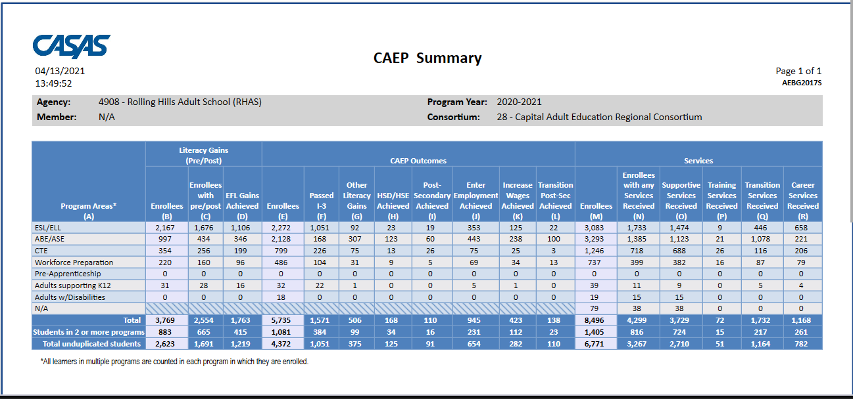
CAEP Summary
Three sections of the CAEP Summary:
Literacy Gains (pre/post)
CAEP Outcomes
Services

Slide 7
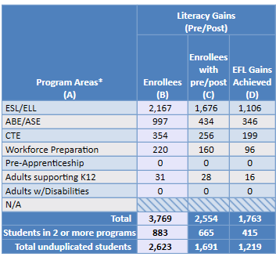
CAEP Summary
Literacy Gains (pre/post)
Includes results from pre-post-test level gains
Column B: Enrollees that meet NRS federal table 4 requirements
Column C: Enrollees with a valid pre/post-test pair
Column D: Enrollees who achieved a level gain on NRS Table 4

Slide 8
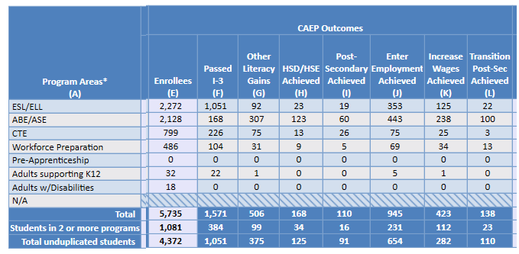
CAEP Summary
CAEP Outcomes
Includes results from AB 104 outcomes outside of pre/post
Column F: (New) Tallies I-3 outcomes (from EL Civics COAAPs)
Columns G-L: Correspond to the 6 categories identified in AB 104

Slide 9
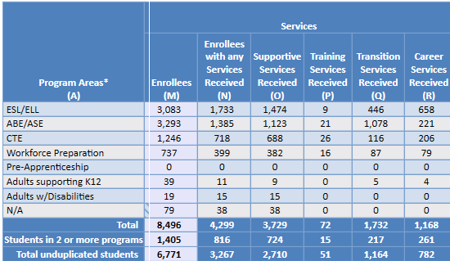
CAEP Summary
CAEP Services
Includes students that received short term services, and/or enrollees that don’t meet basic requirements (such as demographics, 12+ hours)
Column M: Number of enrollees in each CAEP program
Column N: Number in Column M that received services
Columns O-R: Correspond to each of the categories of services

Slide 10
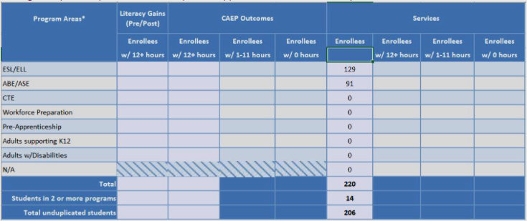
CAEP Hours Report
CAEP Hours Report
New CAEP Enrollees by Hours that itemizes number of CAEP students by 0, 1-11,and 12+ hours.
Participants vs. Adults Served

Slide 11
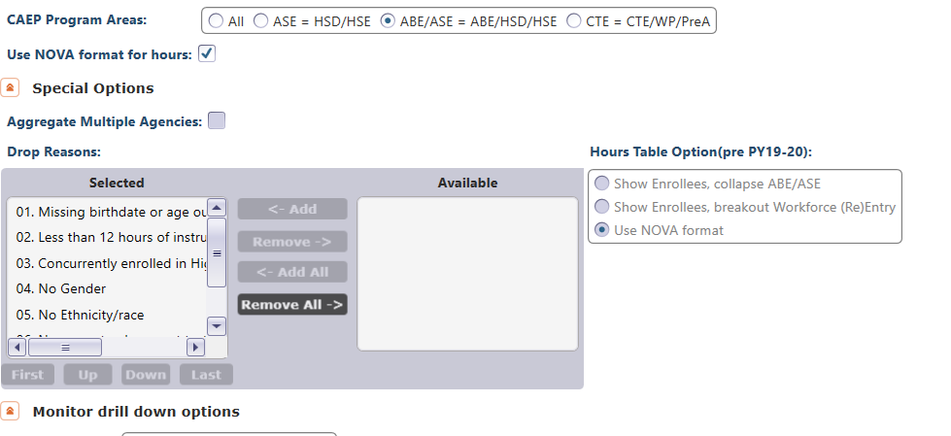

CAEP Summary – Report Setup

Slide 12
CAEP Summary – Report Setup
CAEP Program Areas: Select how TE breaks out ABE/ASE and CTE related programs
Use NOVA format for hours:
Expand to include Total hours vs. Proportional hours, or keep the simpler format for NOVA reporting.

Slide 13
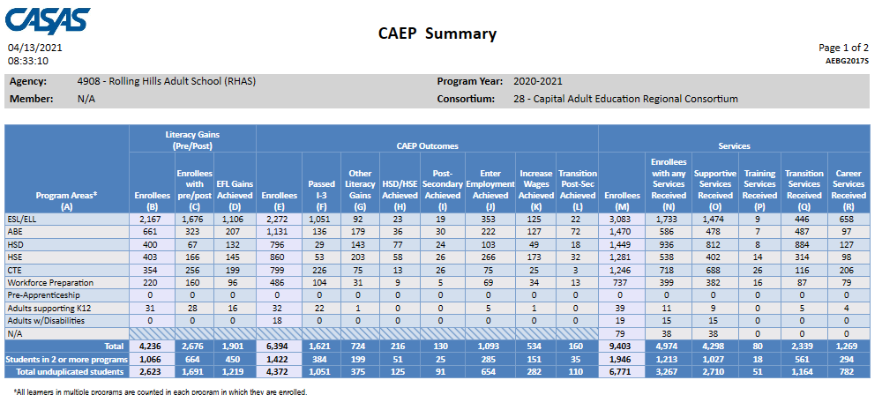
CAEP Summary
CAEP Program Areas: Select how TE breaks out ABE/ASE and CTE related programs

Slide 14
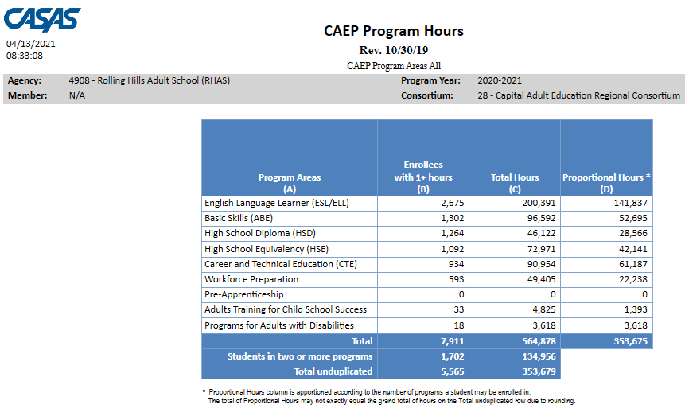
CAEP Program Hours
Use NOVA format for hours:
Expand to include Total hours vs. Proportional hours, or keep the simpler format for NOVA reporting.

Slide 15
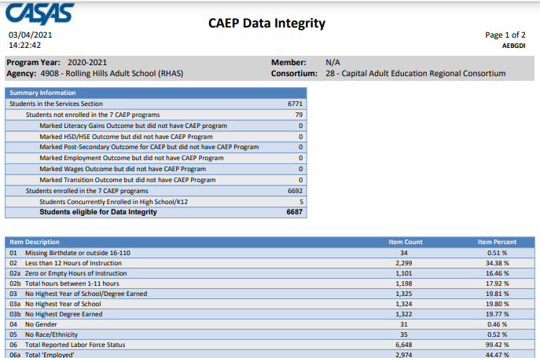
CAEP Data Integrity

Slide 16
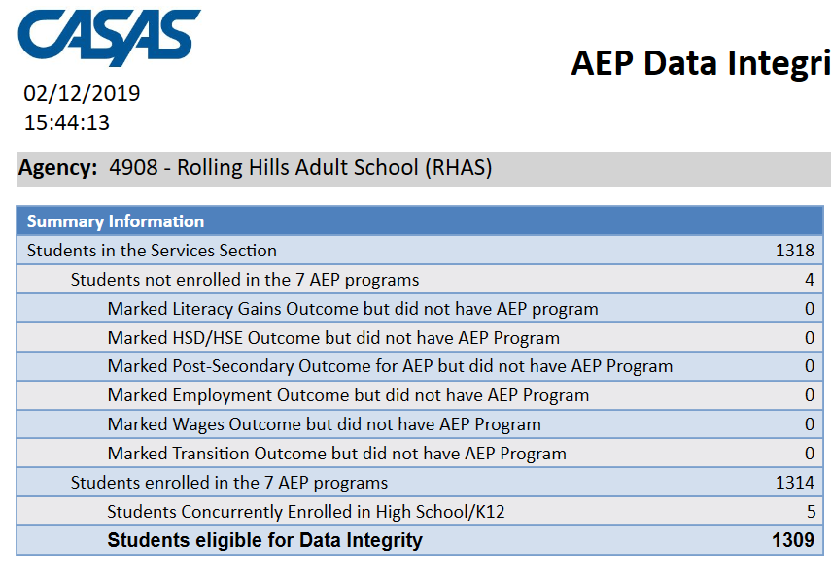
CAEP Data Integrity
Students in the Services Section includes everyone reported for CAEP -- whether for official enrollment or for services only.
Summary Information reconciles all of the students included in AEP reporting.
Students not enrolled in the 7 CAEP programs subtracts those who received services but are not enrolled in one of the 7 CAEP program areas.
The next 6 rows are subsets of those not enrolled in the 7 CAEP programs – showing students not enrolled in program but who earned outcomes and may need enrollment.
Students in the Services Section
− Students not enrolled in the 7 AEP programs Students enrolled in the 7 AEP programs
Students enrolled in the 7 CAEP programs is the total limited to students with official enrollment, and this number serves as the denominator for the 27 DIR items.

Slide 17
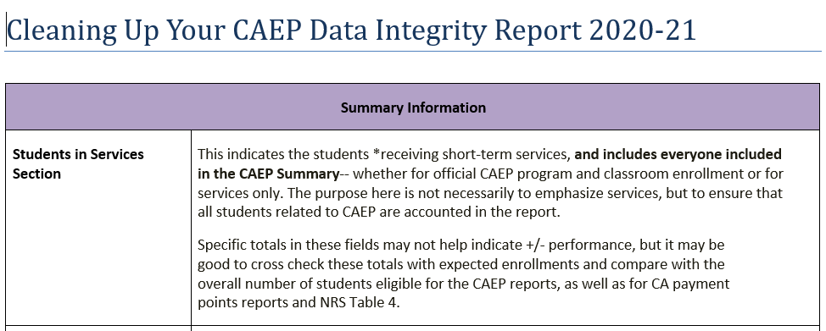
CAEP Data Integrity

Slide 18
CAEP Data Integrity Report: PY 20-21
Some items that may potentially change due to COVID-19 issues:
< 12 Hours of Instruction - Item 02
No Post-Test/Pre-Post-Test pair - Items 09, 10
Earned HSE/HS Diploma - Items 12, 13
Earned outcome but did not qualify for CAEP - Items 23-27a
Achieved CAEP outcome - Items 23-27b

Slide 19
CAEP Data Integrity Report: PY 20-21
Some items that should NOT change due to COVID-19 issues:
Demographics - Items 01, 03, 04, 05, 06
Primary/Secondary Goal - Items 17, 18
Missing Barriers of Employment - Item 19
Earned outcome but did not qualify for CAEP - Items 23a-27a

Slide 20
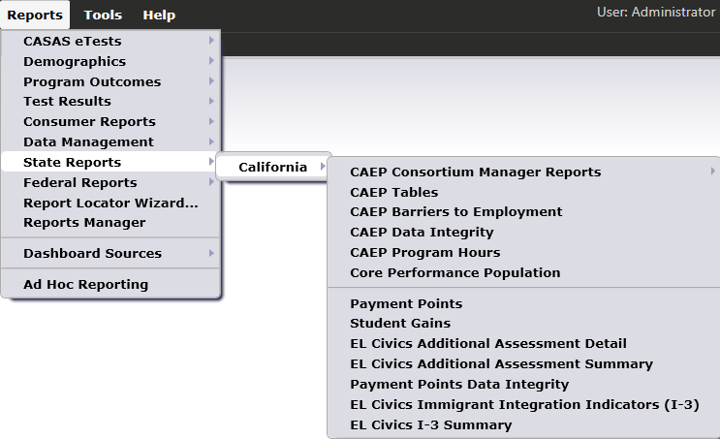

CAEP Consortium Manager Reports allow a consortium level login to compare and contrast outcomes across agencies within one consortium.
Menu currently includes four reports options with this feature

Slide 21

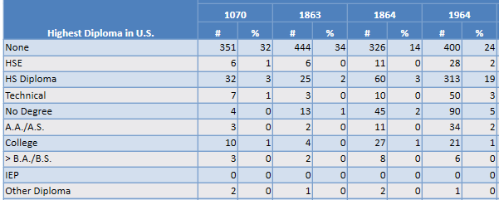
CAEP Consortium Manager Reports allow a consortium level login to compare and contrast outcomes across agencies within one consortium.
Lists item count and percentage by Agency ID
Aggregates results for the entire consortium on the right hand column

Slide 22
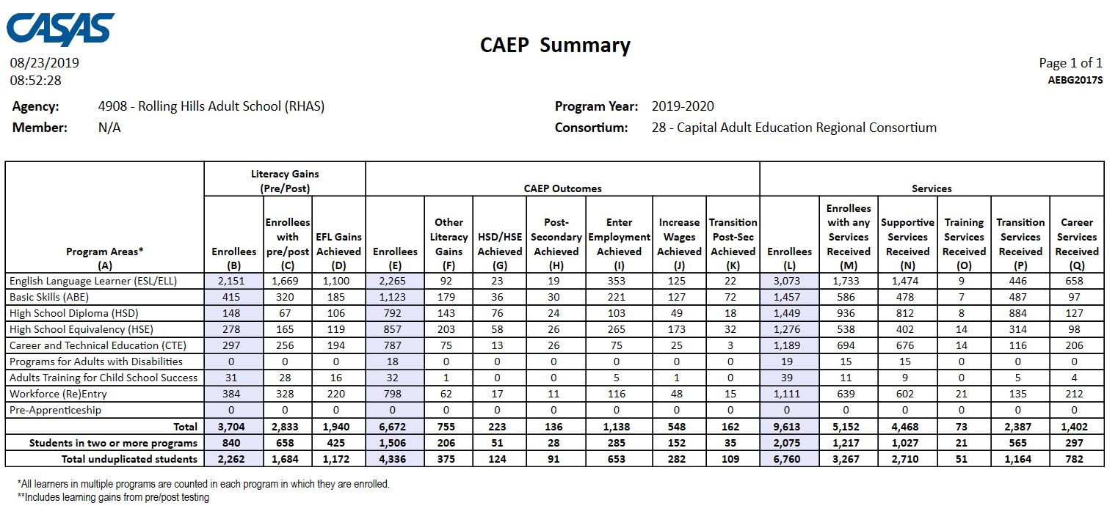
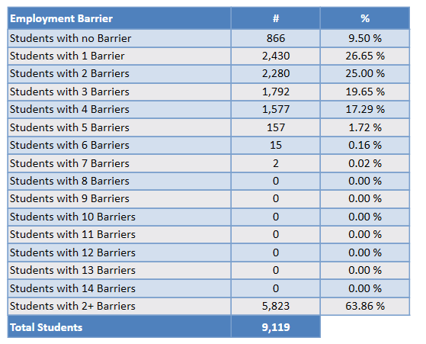

The CAEP Summary and Barriers to Employment also lists information by agency and by consortium.
Click Aggregate Multiple Agencies to run a combined summary of all agencies in the consortium.

Slide 23
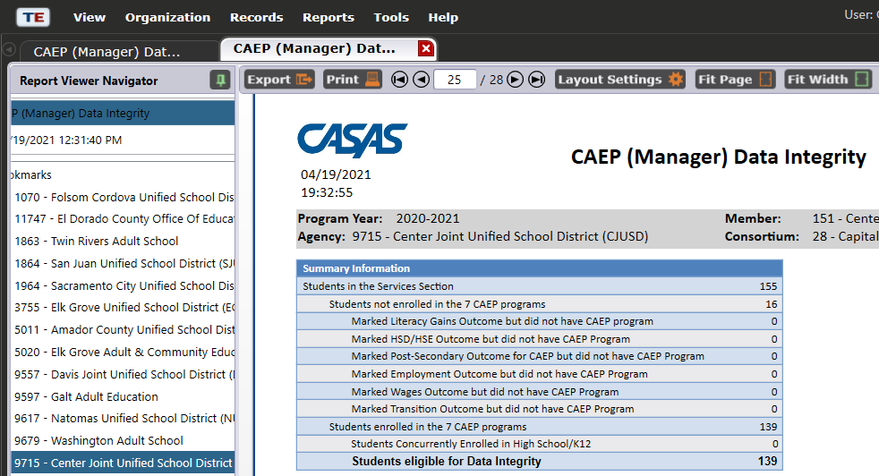
CAEP Consortium Manager Reports now includes consortium level CAEP Data Integrity Report.

Slide 24
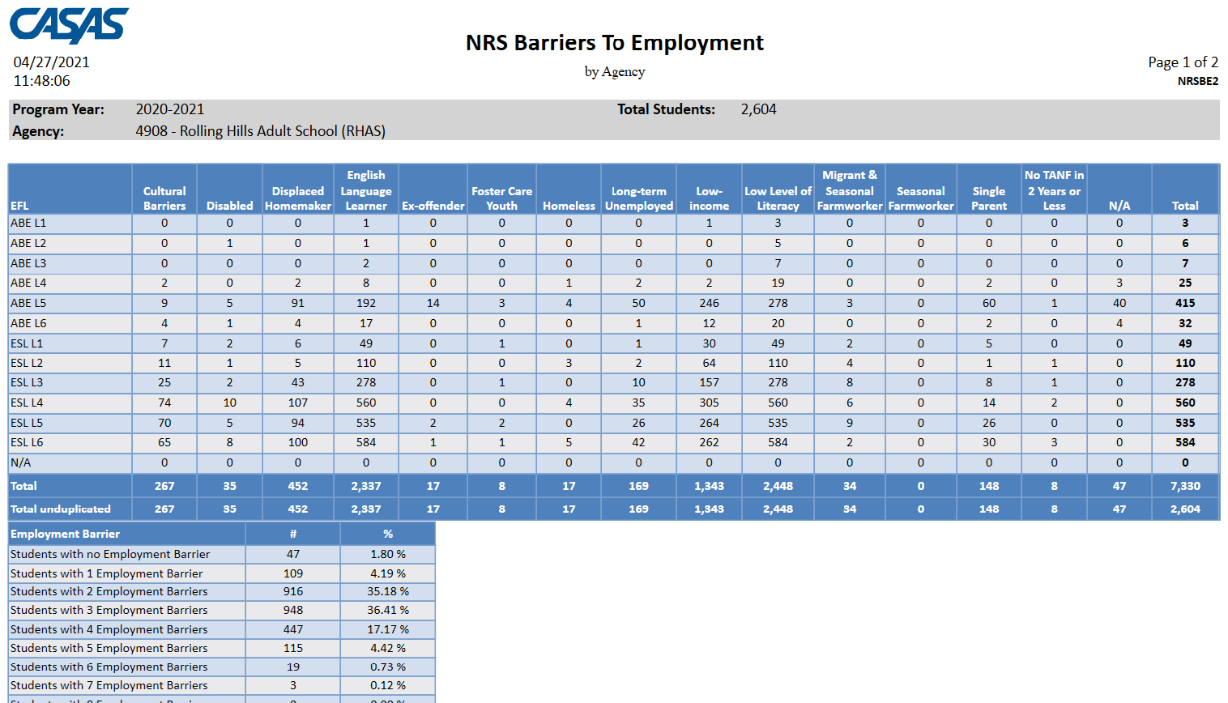
Barriers to Employment
There are two reports in TE that summarize and display Barriers to Employment:
NRS Barriers to Employment (Reports – Federal Reports – NRS Barriers to Employment.)
CAEP Barriers to Employment (Reports – State Reports - California – CAEP Barriers to Employment.)

Slide 25
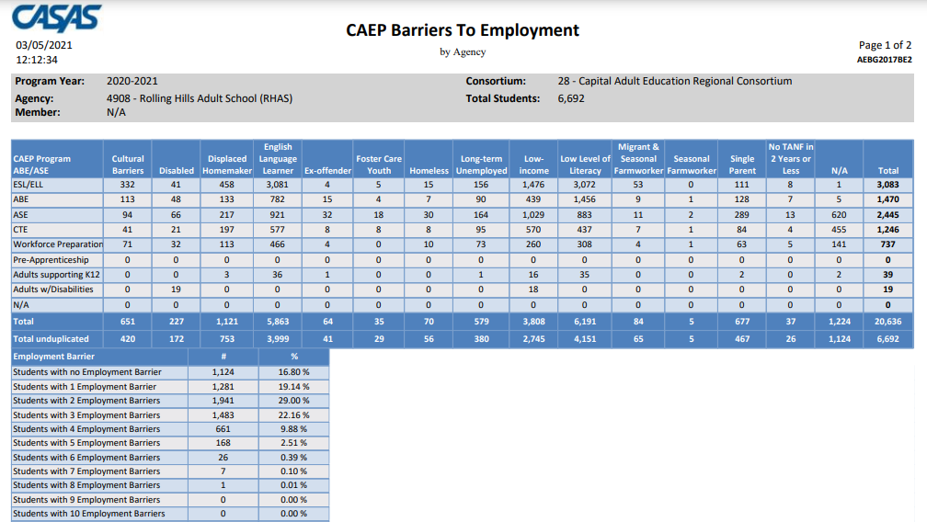
Barriers to Employment

Slide 26
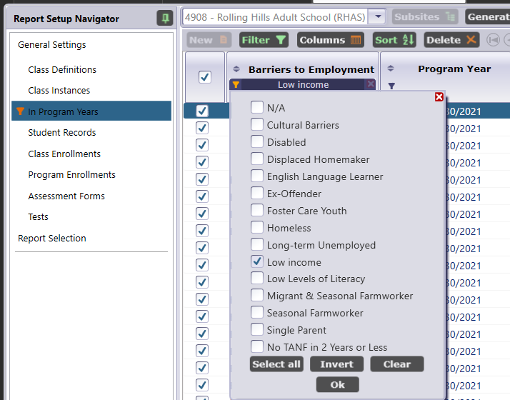
Barriers to Employment
You can also filter any report in TE by specific barrier.
Refer to Report Setup Navigator on the report setup window.
On the Navigator bar, click In Program Years.
Right-click on the top of any column and select Show Barriers to Employment.

Slide 27
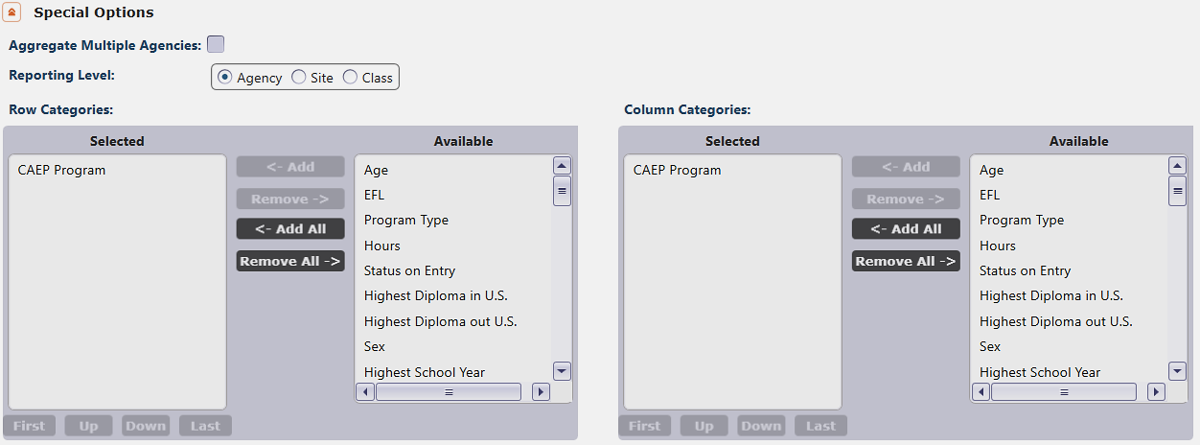
NRS Ad Hoc Cross Tab
Select Ad Hoc NRS Cross Tab from the TE Federal Reports menu.
Refer to Row Categories and Column Categories in the Special Options section of the report setup window.

Slide 28
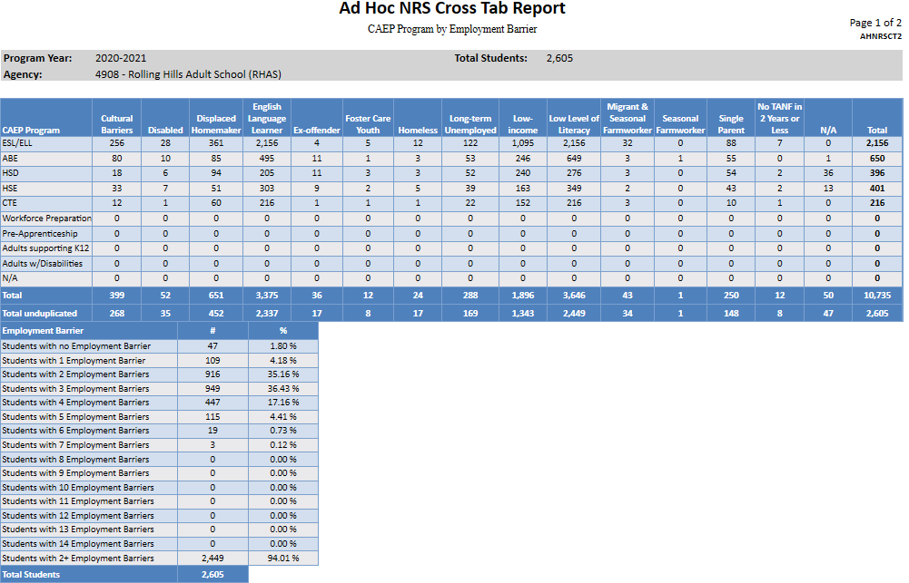
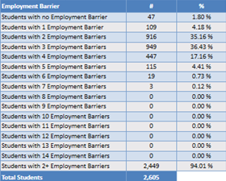
NRS Ad Hoc Cross Tab
Example 1: Generate a report that compares CAEP Program with Barriers to Employment.

Slide 29
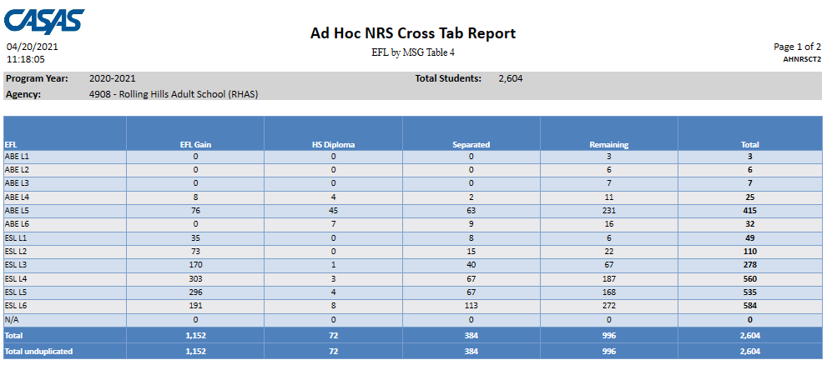
NRS Ad Hoc Cross Tab
Example 2: Compare NRS EFL with NRS Measurable Skills Gains (MSGs).

Slide 30
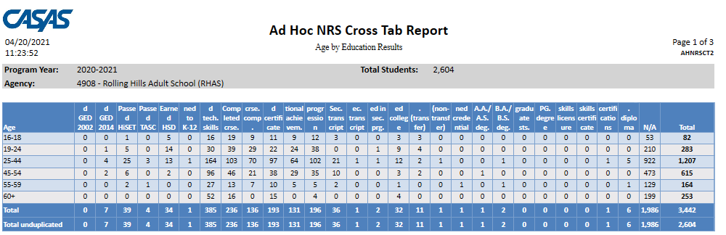
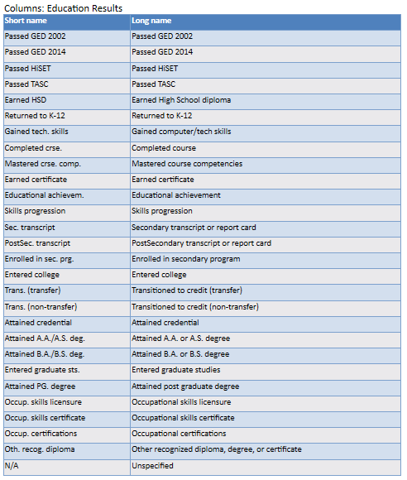
NRS Ad Hoc Cross Tab
Example 3: Compare Age to Education Results.
A legend appears that helps identify each row or column.

Slide 31
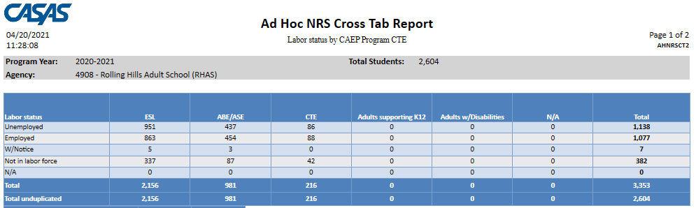

NRS Ad Hoc Cross Tab
Example 4: Compare Labor Force Status with an expanded Program option for all CTE and CTE related programs. This example combines all of these programs into one column.

Slide 32
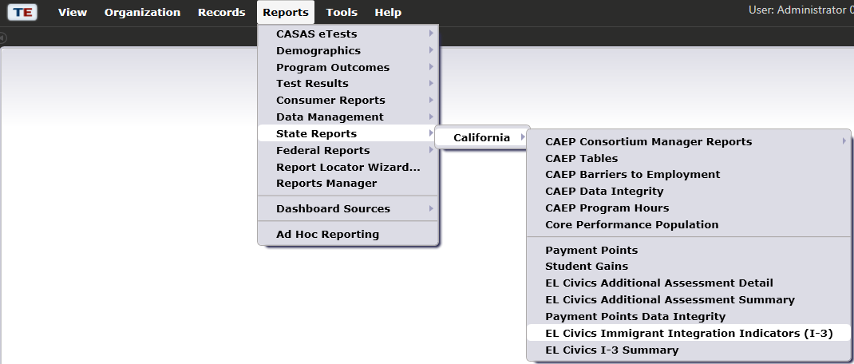
I-3 Outcomes and Reports in TE
EL Civics Immigrant Integration Indicators (I-3)
EL Civics I-3 Summary

Slide 33
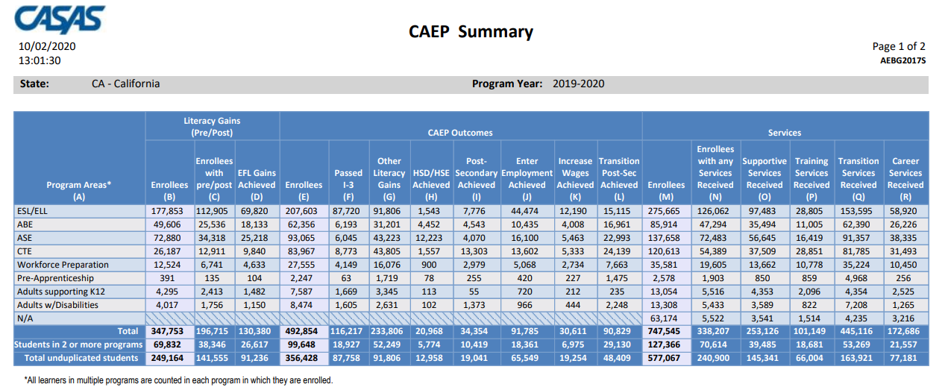

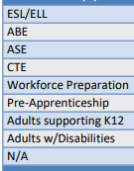
CAEP Summary Report
The TE CAEP Summary Report now includes a new Column F, “Passed I-3”
In PY 2019-20, over 87,000 CAEP students passed EL Civics COAAPs (I-3 outcomes)
All programs can earn I-3

Slide 34
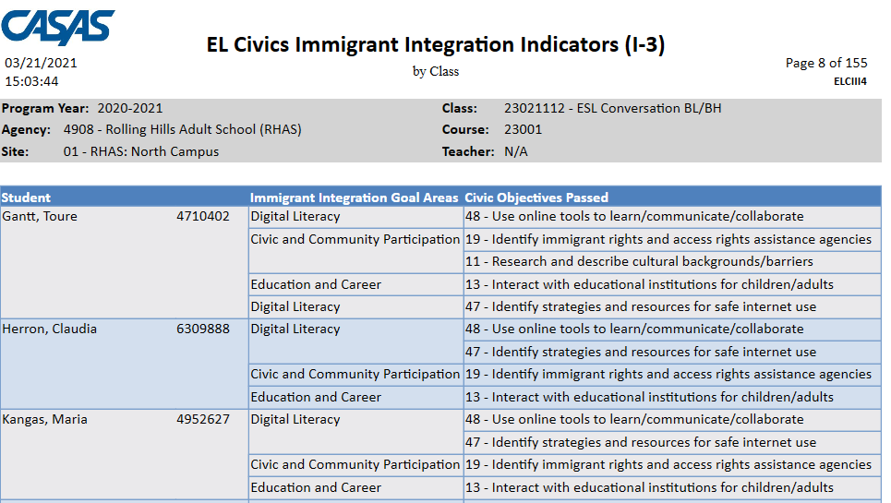
EL Civics Immigrant Integration Indicators (I-3)

Slide 35
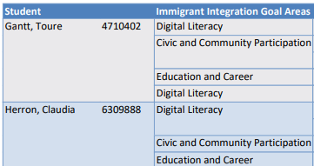
I-3 by Class
Immigrant Integration Goal Area lists one of the 8 I-3 areas identified by AB 2098.

Slide 36
I-3 by Class
This example student has passed five COAAPs that cover three different I-3 goal areas.

Slide 37
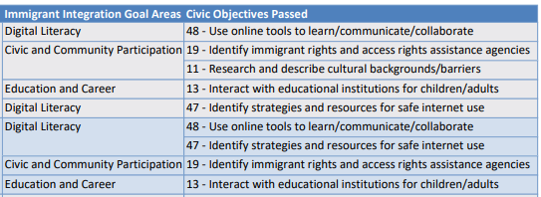
I-3 by Class
Civic Objectives Passed lists the specific COAAPs passed for each student, and relates each COAAP to the I-3 Goal Area.

Slide 38
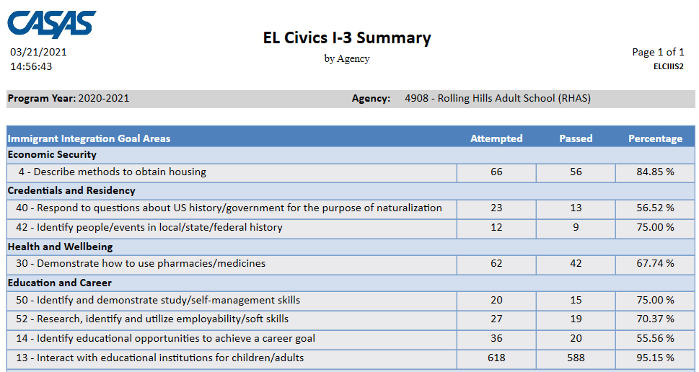
EL Civics I-3 Summary

Slide 39
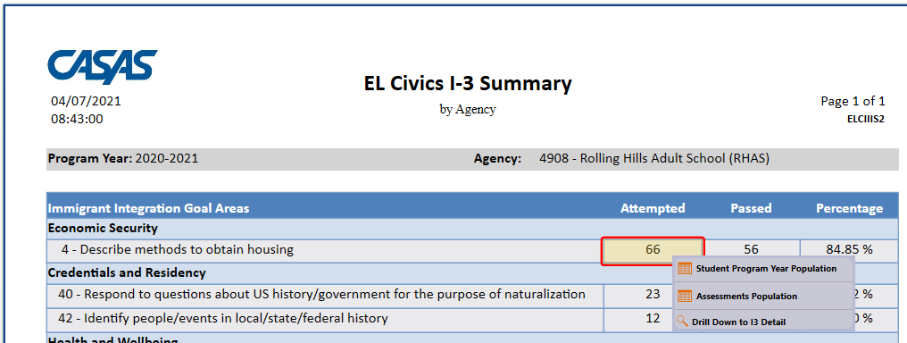
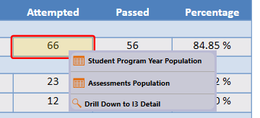
I-3 Drill Down

Slide 40
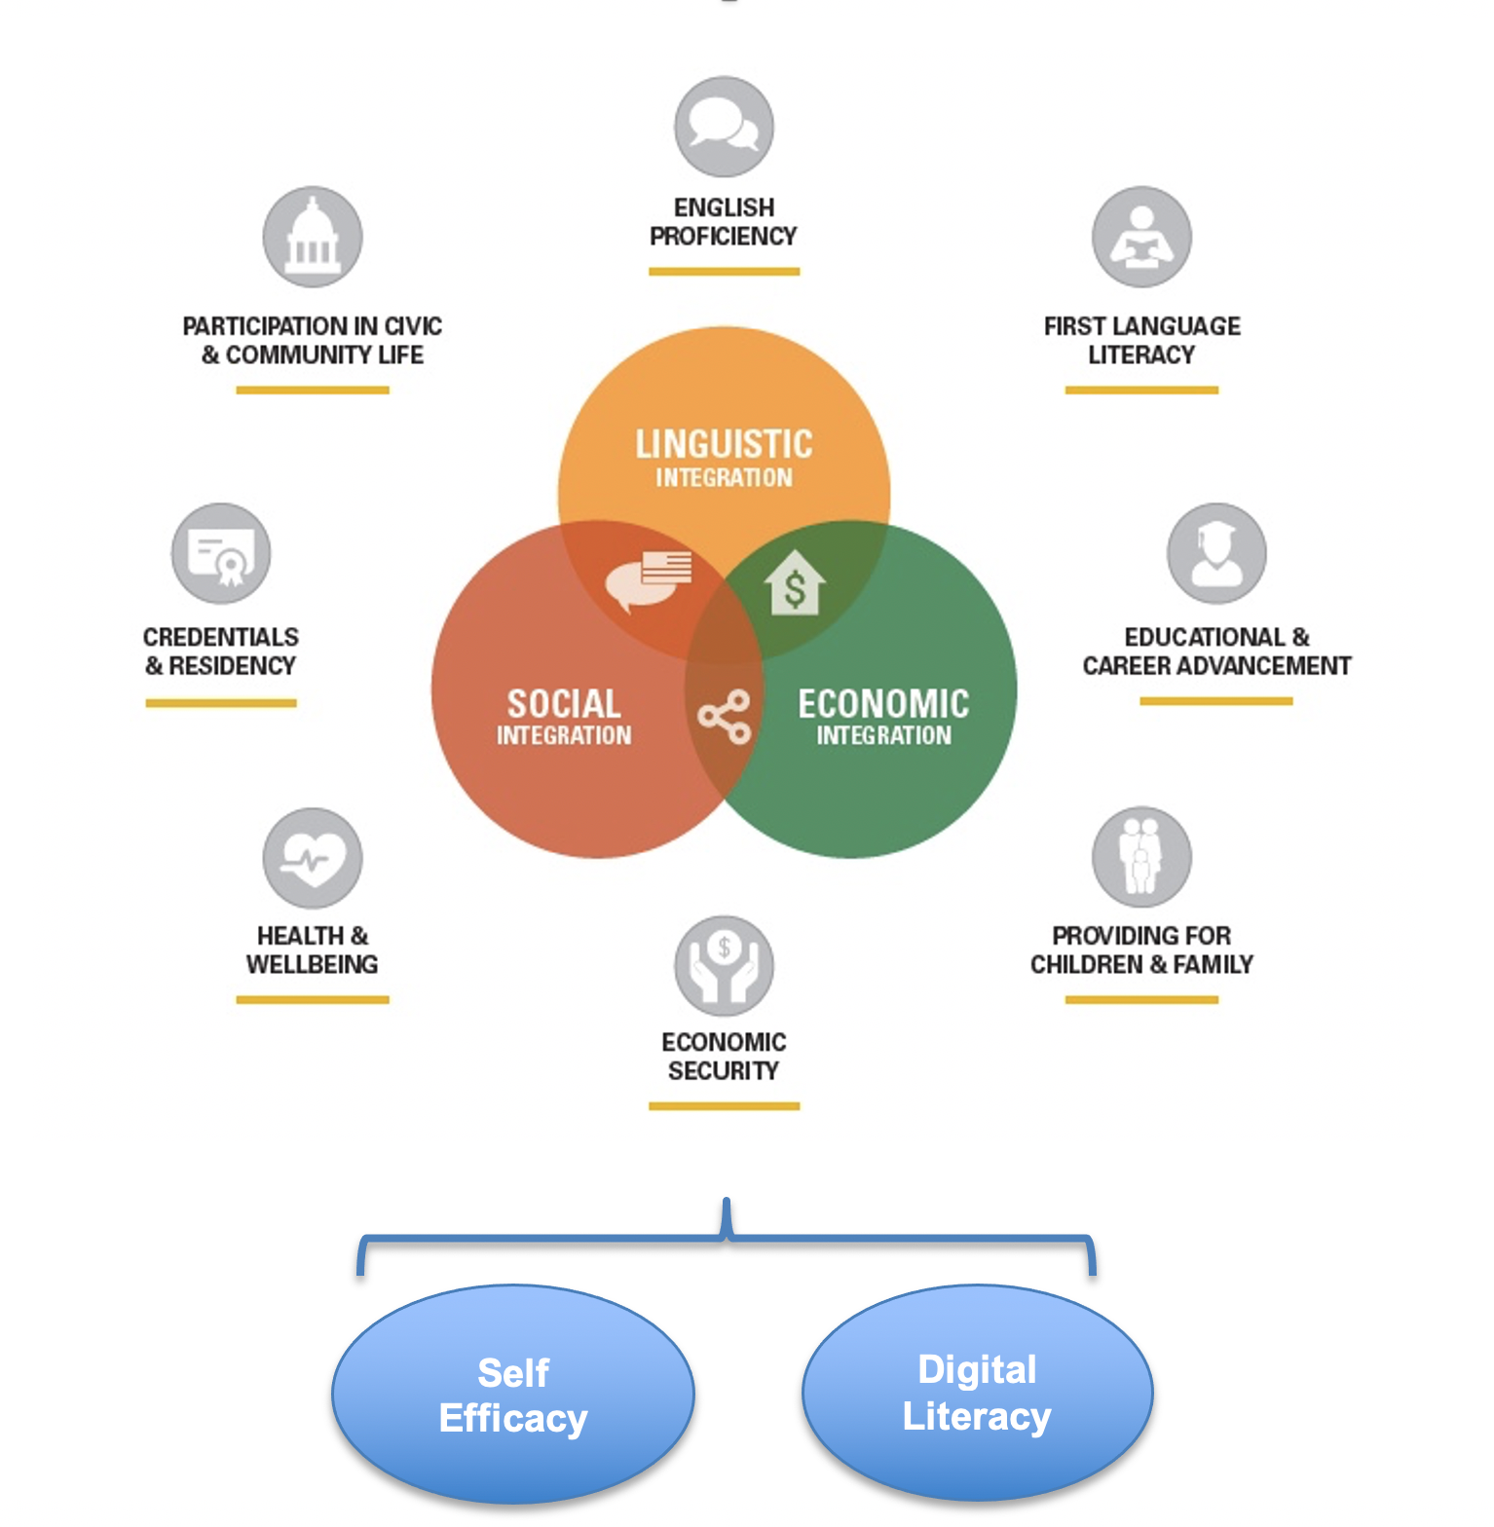
Recap: ALLIES Immigrant Integration Framework
Notes:
Jennie
A tool for CAEP programs and partners
Way of describing and measuring how we participate in process of immigrants’ integration and our growth as a society
AE contributes across the ten elements
A culture, not a program

Slide 41
Immigrant Integration Goal Areas
Economic Security 1,2,3,4,5,6
Credentials and Residency 38,39,40,42,44,45
Health and Wellbeing 15,16,17,26,27,28,29,30, 31, 46
Education and Career 13,14,32,33,34,35,36,37,49,50,51,52,53, 70,71,72,74,75
Children and Family 7,9,18,20,21,22
Civic and Community Participation 8,10,11,12,19,23,24,25,43
Digital Literacy 47,48,73

Slide 42
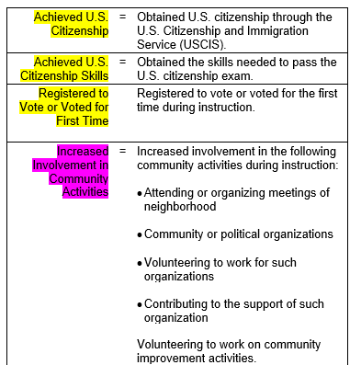
Immigrant Integration: Outcomes
In addition to the work on EL Civics COAAPs, ALLIES and CASAS have also worked together to identify Update Record outcomes that relate to these Immigrant Integration Areas.

Slide 43
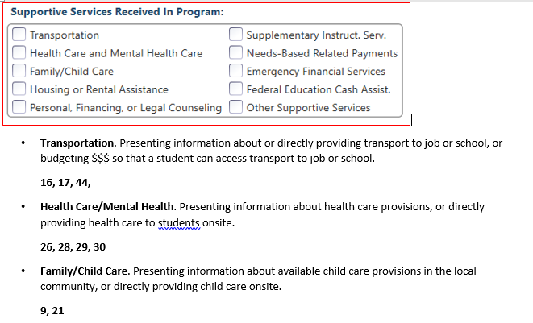
Immigrant Integration: Services
ALLIES and CASAS have also related Supportive, Training, and Transition services.

Slide 44
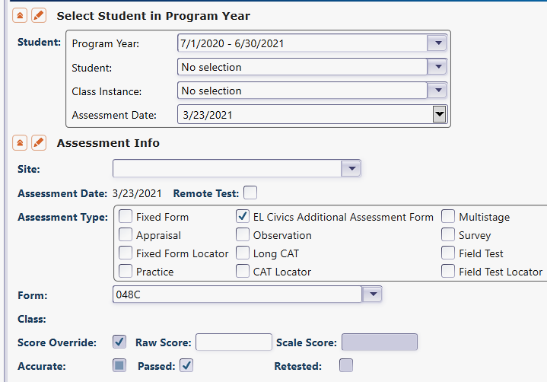
Recording COAAPs in TE
Select Records – Tests
Click New
Select PY, Student, Date
In Assessment Type, check EL Civics Additional Assessment Form
Select COAAP Form number
Check box if COAAP Passed

Slide 45
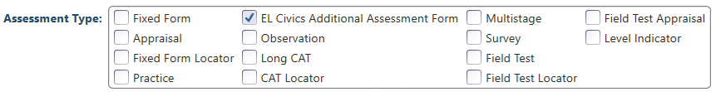
Recording COAAPs in TE
Key step is to check EL Civics Additional Assessment Form to enable manual entry of EL Civics COAAPs rather than pre- and post-test forms.

Slide 46
For 5-25-21
CAEP Goal Setting
Review goal setting for NRS reporting
Identify concepts of NRS performance goals and apply to CAEP reporting
Setting goals for performance using test results and student outcomes
Setting goals for persistence using test data, attendance hours, and enrollment
Identify and establish goals for special populations

