Slide 1
CAEP Data Dive
May 25, 2021
www.casas.org

Slide 2
Agenda
Recap: CAEP Data Dive, Parts I & II
      CAEP Reports in TE
      April 28: CAEP Outcomes
      May 18: Targeting Special Populations
NRS Performance Goals
Adapting Performance Goals to CAEP Reports and Reporting Metrics
Measuring CAEP Performance and Persistence
CAEP Performance Goals Examples
For reference: PY 2019-20 Statewide CAEP Summary

Slide 3
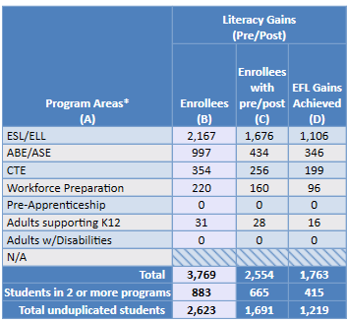
CAEP Summary
Literacy Gains (pre/post)
Includes results from pre-/post-test level gains
Column B: Enrollees from the NRS federal tables
Column C: Enrollees with a valid pre/post-test pair
Column D: Enrollees who achieved a level gain on NRS Table 4

Slide 4
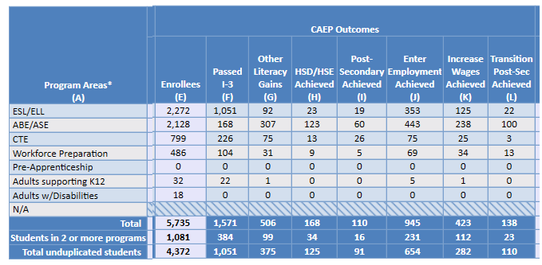
CAEP Summary
CAEP Outcomes
Includes results from CAEP outcomes outside of pre/post
Column F: (New) Tallies I-3 outcomes (from EL Civics COAAPs)
Columns G-L: Correspond to the categories identified in AB 104

Slide 5
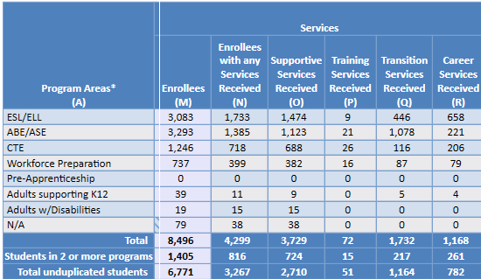
CAEP Summary
CAEP Services
Includes enrollees that don’t meet basic requirements (such as demographics, 12+ hours) including services only students
Column M: Number of enrollees with each CAEP program
Column N: # in Column M that received short term services
Columns O-R: Correspond to each services categories (duplicated)

Slide 6
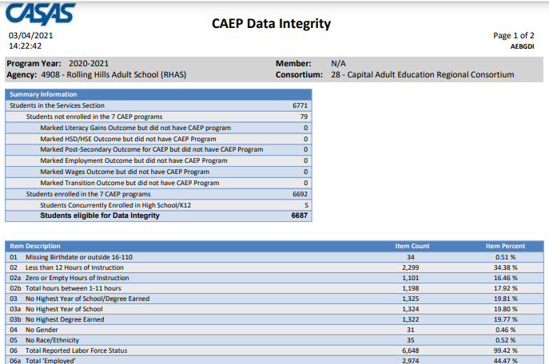
CAEP Data Integrity

Slide 7
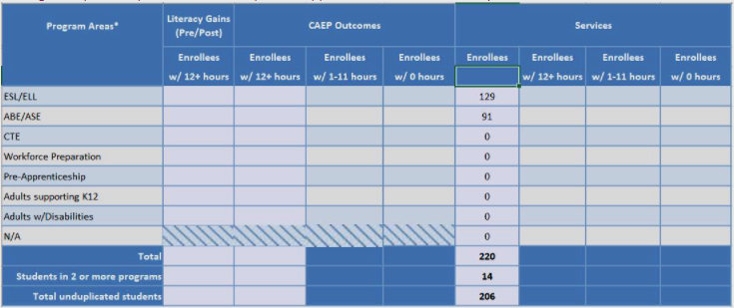
CAEP Hours Report
CAEP Hours Report
New CAEP Enrollees by Hours that itemizes number of CAEP students by 0, 1-11,and 12+ hours.
Participants vs. Adults Served

Slide 8
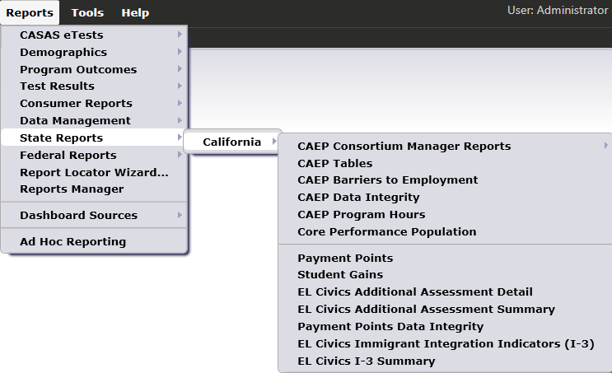

CAEP Consortium Manager Reports allow a consortium level login to compare and contrast outcomes across agencies within one consortium.
Menu currently includes four reports options with this feature

Slide 9
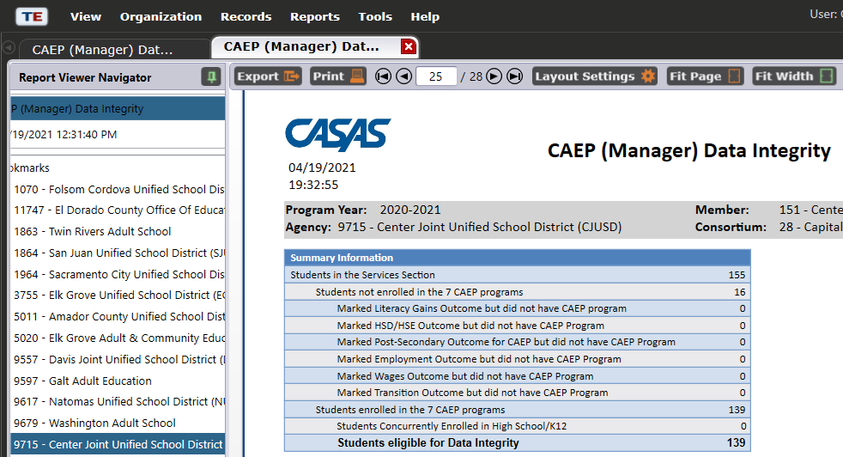
CAEP Consortium Manager Reports now includes consortium level CAEP Data Integrity Report.

Slide 10
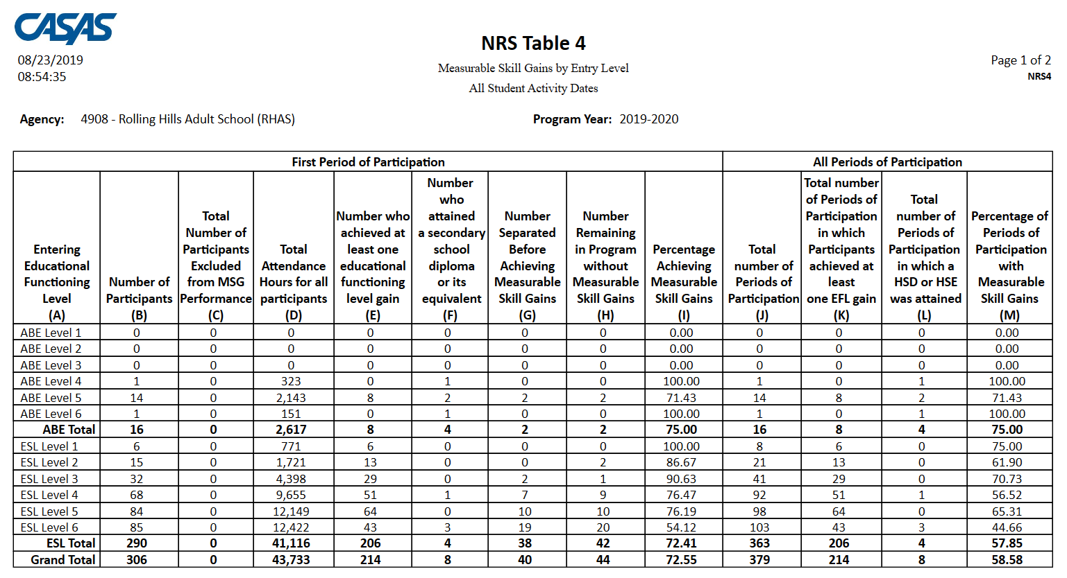
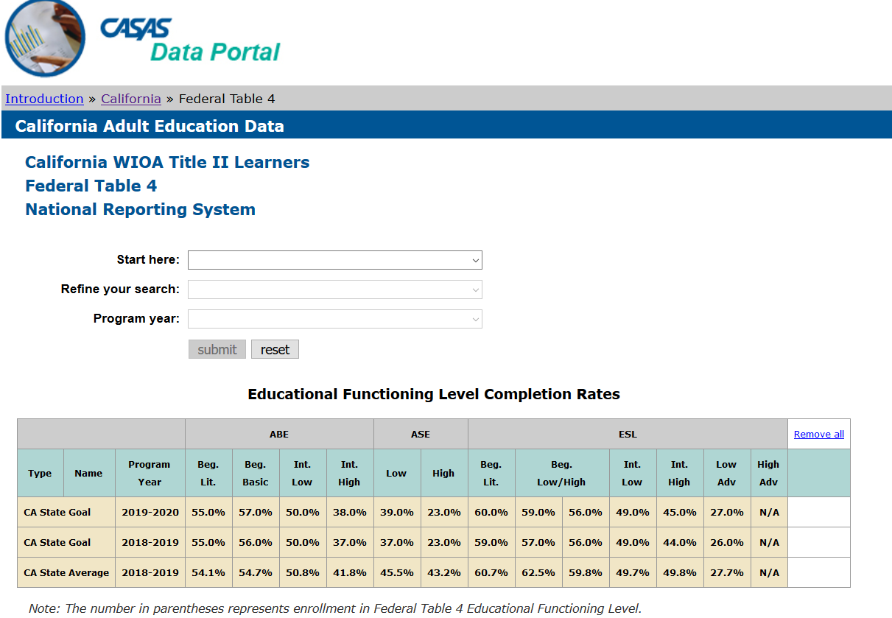
NRS Local Performance Goals
Use TE reports & CASAS data portal to determine performance goals for your local agency
Notes:
Concludes this section.
Transition to Statewide partner discussion.

Slide 11
Review – NRS Table 4
Table 4 = Gains by Educational Functioning Level = Reports learners who entered program at one Instructional Level and finished the program year (June 30) at a higher level.
Notes:
https://www2.casas.org/dataportal/
Table 4, 4b, Persister for agencies plus statewide statistics

Slide 12
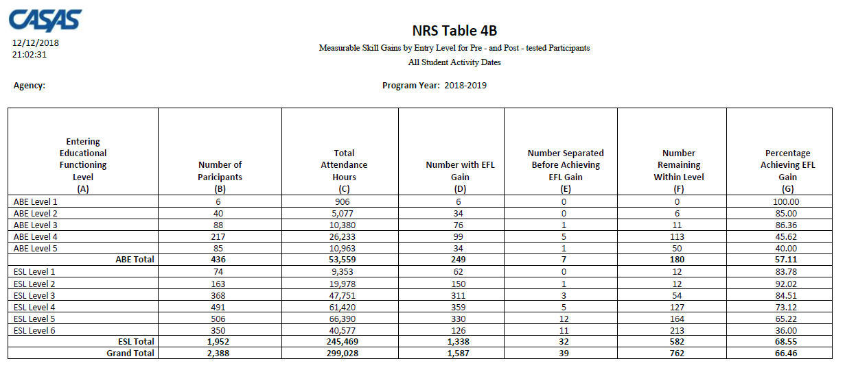
Review – NRS Table 4B
Table 4B = Same level advancement information as Table 4 (but without PoPs)
Only includes learners who completed a valid pre- and post-test.

Slide 13
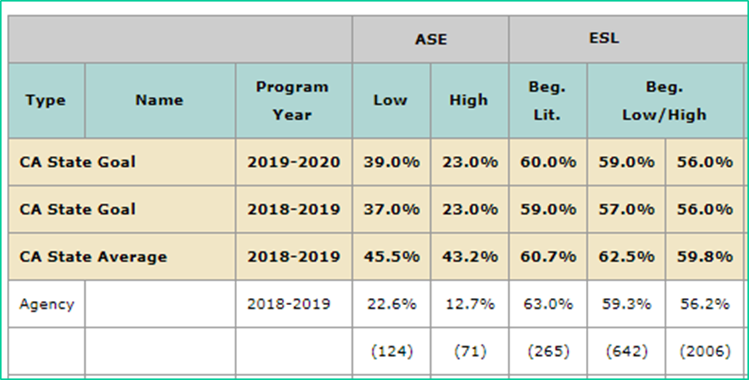
NRS Local Performance Goals
Identify EFL’s that represent areas of strength versus others that may need improvement.
ASE Low is an area where this agency may need improvement
ESL Beginning Lit is an area where this agency is performing well.
Notes:
Concludes this section.
Transition to Statewide partner discussion.

Slide 14
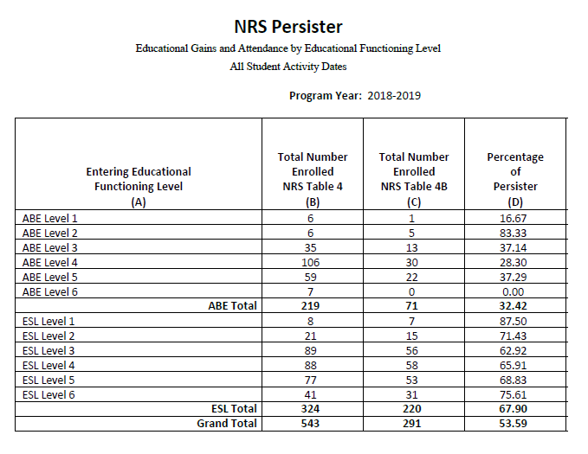
Review – NRS Persister
The Persister looks at the percentage of Table 4 students who also qualify for Table 4B – (the percentage of qualified enrollees who have a pre/post-test pair).
Column C ÷ Column B = Column D (% of Persister)

Slide 15
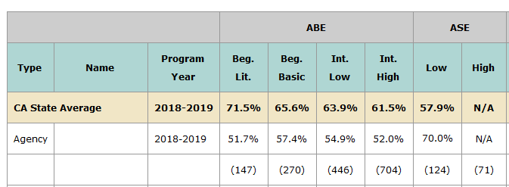
Evaluating Persistence
Focus on the EFL’s with low performance that you targeted in the previous exercise.
ABE Intermediate High is an example where low persistence may be a primary factor in low performance.
ASE Low shows persistence well above average – so most likely there are other reasons for low performance.
Notes:
Concludes this section.
Transition to Statewide partner discussion.

Slide 16
Lo Performance
Hi Persistence
Hi Performance
Hi Persistence
Lo Performance
Lo Persistence
Hi Performance
Lo Persistence
Persistence
Performance

Slide 17
CAEP Goal Setting
Establishing goals for CAEP reporting
Enrollment criteria
Attendance related criteria (“Participants vs. “Adults Served”)
CAEP pre- and post-testing
Targeting CAEP outcomes
Using the CAEP DIR
NRS performance goals
Defining goals for special populations
Consortium level reporting
Defining goals with external stakeholders

Slide 18
CAEP Goal Setting
Enrollment criteria
Use the CAEP Summary (or the new TE CAEP Hours Report) to measure enrollment.
How many reported CAEP students actually make it into a CAEP instructional program?

Slide 19
CAEP Goal Setting
Enrollment criteria
Use the CAEP Summary to measure enrollment.
How many reported CAEP students actually make it into a CAEP instructional program?

Slide 20
CAEP Goal Setting
Enrollment criteria
(Total Unduplicated Enrollees – N/A) ÷
Total Unduplicated Enrollees =
Program Enrollment Rate
6692 ÷ 6771 = 98.8%

Slide 21
CAEP Goal Setting
CAEP Participants
Use the TE CAEP Summary or Hours Report to measure how many adults served become participants.
Of those who enroll in an CAEP program, how many stay long enough to accrue at least 12 hours of instruction?

Slide 22
CAEP Goal Setting
CAEP Participants
Use the TE CAEP Summary to measure how many adults served become participants.
6771-70= 6692
Unduplicated Enrollees in Column E ÷ (Unduplicated Enrollees in Column M - N/A) =
Percentage of Participants
4372 ÷ 6692 = 65.3%

Slide 23
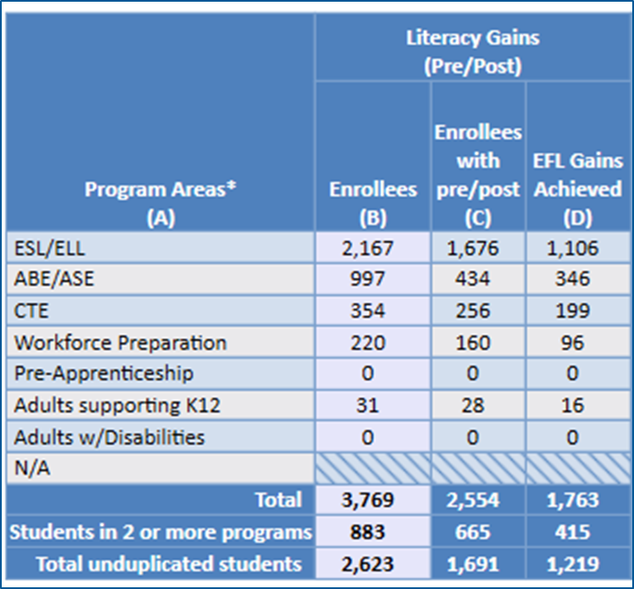
CAEP Goal Setting
CAEP pre- and post-testing
Use the TE CAEP Summary to measure pre-and post-test progress.
Refer to the Literacy Gains (Pre/Post) section of the TE CAEP Summary.
Compare pre/post-test pair with total number of enrollees to compute persistence rate.
Compare EFL Gains (D) with total enrollees to compute overall performance.

Slide 24
CAEP Goal Setting
CAEP pre- and post-testing
Refer to the Literacy Gains (Pre/Post) section of the TE CAEP Summary.
Column C ÷ Column B = Persistence Rate
“Good persistence” = 70% or better

Slide 25
CAEP Goal Setting
CAEP pre- and post-testing
Refer to the Literacy Gains (Pre/Post) section of the TE CAEP Summary.
Column D ÷ Column B = Performance Rate
This shows the percentage of students in each program that achieved an EFL gain.

Slide 26
CAEP Goal Setting
Targeting CAEP outcomes
How many students enrolled in an instructional program are progress as defined by CAEP metrics?

Slide 27
CAEP Goal Setting
Targeting CAEP outcomes
Sum of Columns F, G, H, I, J, K,L ÷ Column E = Outcomes Attainment Rate
3861 ÷ 5735 = 67.3 %

Slide 28
CAEP Goal Setting
Targeting specific CAEP outcomes
Use the same approach to target any specific CAEP outcome for specific programs
For example: ESL learners who “Passed I-3”
Column F ÷ Column E = I-3 Attainment Rate
1051 ÷ 2272 = 67.3 %

Slide 29

CAEP Goal Setting
Using the CAEP DIR
Target specific items on the CAEP DIR for performance improvement.

Slide 30
CAEP Goal Setting
Using the CAEP DIR
Download a document that contains 10 quarters of statewide DIR performance:
https://www.casas.org/training-and-support/casas-peer-communities/california-adult-education-accountability-and-assessment/training-and-networking/networking-meetings

Slide 31
CAEP Goal Setting
Using the CAEP DIR
Example: Agency will improve from 34.3% of eligible students missing 12+ hours of instruction to the 2018-19 statewide average of 24.1%

Slide 32
CAEP Goal Setting
NRS performance goals
Agencies that are funded for WIOA Title II may use NRS metrics and reports to establish CAEP goals.

Slide 33
CAEP Goal Setting
NRS performance goals
ASE Low is an area where this agency may need improvement
Example: Agency will improve performance in ASE Low from 22.6% to 25% in PY 2021-22.

Slide 34
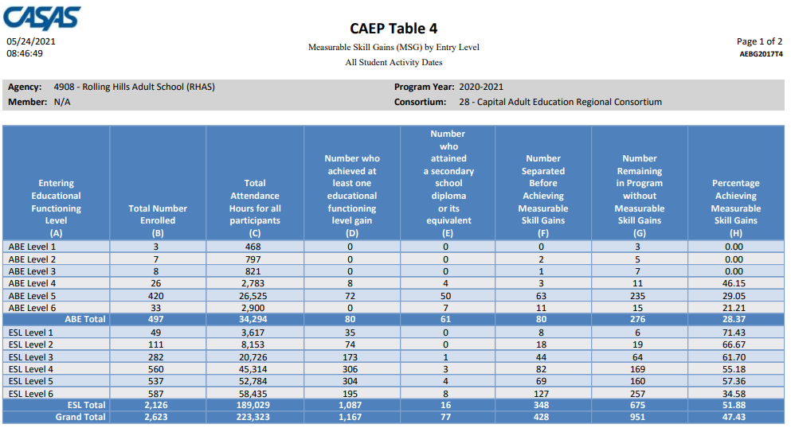
CAEP Goal Setting
NRS performance goals
Agencies can use the TE CAEP Tables to reflect NRS metrics, that apply for all 7 CAEP programs instead of just NRS programs.

Slide 35
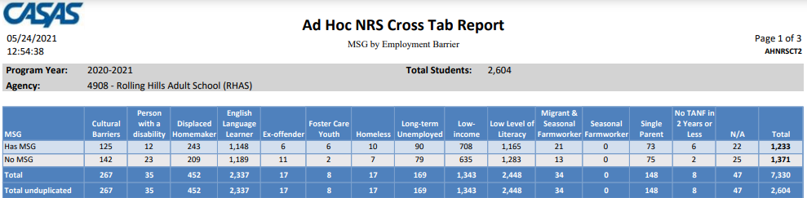
CAEP Goal Setting
Defining goals for special populations
Four examples for identifying special populations in TE were covered 5-18-21.
In TE use the new Ad Hoc NRS Cross Tabs report.

Slide 36
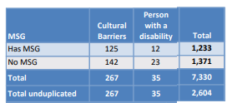
CAEP Goal Setting
Defining goals for special populations
Example: Agency will serve at least 36 or more learners with disabilities % in PY 2021-22.
Example: Individuals with Disabilities at this agency will improve from 34.3% attaining MSG’s to 40% in PY 2021-22.

Slide 37
CAEP Goal Setting
Consortium level reporting
Use TE consortium level reports to set goals for the entire CAEP consortium.
Example: All agencies in Consortium X will have no more than 27% of learners missing 12+ hours of instruction in PY 2021-22
Example: Consortium X agencies will achieve an aggregate pre/post-test persistence rate of 70% or better in PY 2021-22

Slide 38
Other Considerations
Defining goals with external stakeholders
Integrated Education and Training (IET)
Geographic data
WIOA MOU/CAEP three year planning
Reports from FPM, WASC or other accreditation
Aligning to Regional Priorities

Slide 39
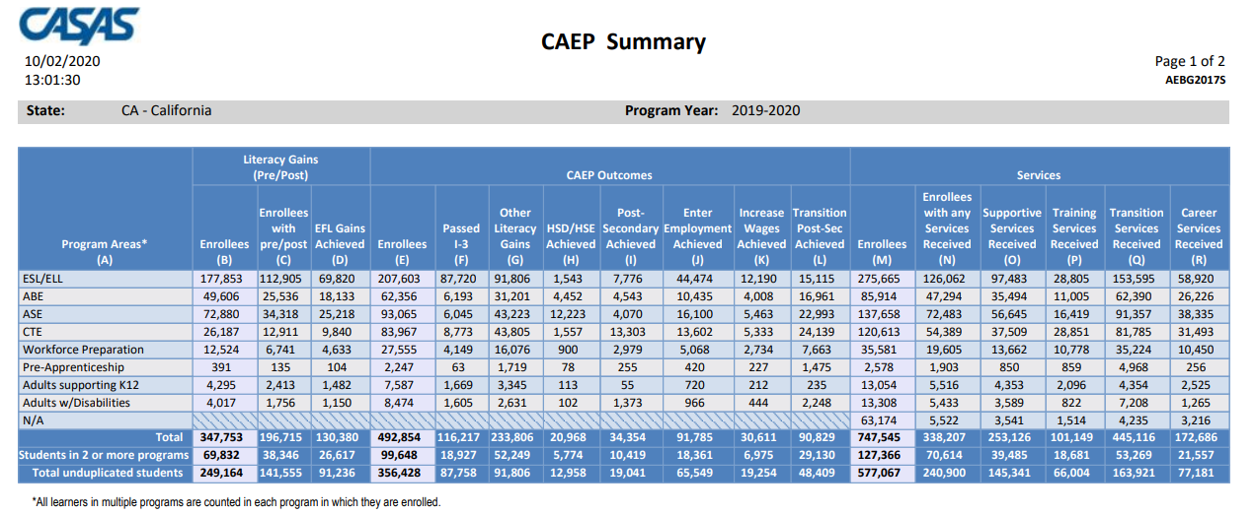
Statewide CAEP Summary

Slide 40
Statewide CAEP Summary
Statewide Persistence Rate = 56.5%
(196,715/347,753)
Statewide Performance Rate = 37.5%
(130,380/347,753)

Slide 41
Statewide CAEP Summary
Statewide Outcomes Rate = 96.7%
(344,775/356,428)

Slide 42
Statewide CAEP Summary
Statewide Enrollment Rate = 89%
Statewide Participants Rate = 69%

