Slide 1
CAEP Supplemental Handout
Spring 2019 Data Dive
Updated Spring 2021

Slide 2
Examples of Agency Level Data Evaluation
Agencies: Use TE drill down features
Example 1: Basic DIR drill down illustration
Example 2: CAEP Summary self-reported outcomes trouble shooting
Example 3: Using CAEP specific numbers from the DIR
Example 4: CAEP Program enrollment calculation
Example 5: CAEP Program persistence calculation
Example 6: Combined CAEP outcomes calculation
Example 7: Pre/post-test evaluation when persistence is low
Example 8: Pre/post-testing when persistence is good but pre/post performance is low

Slide 3
Example 1: the number of students missing an important data element is high, especially when compared to the number of reported students in the DIR overall. enrollees.

Slide 4
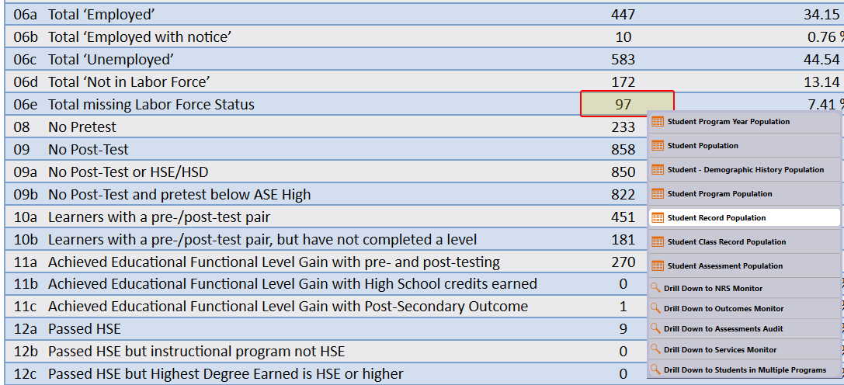
Solution: Right click the number of students missing Labor Force Status and drill down to “Student Record Population.”

Slide 5
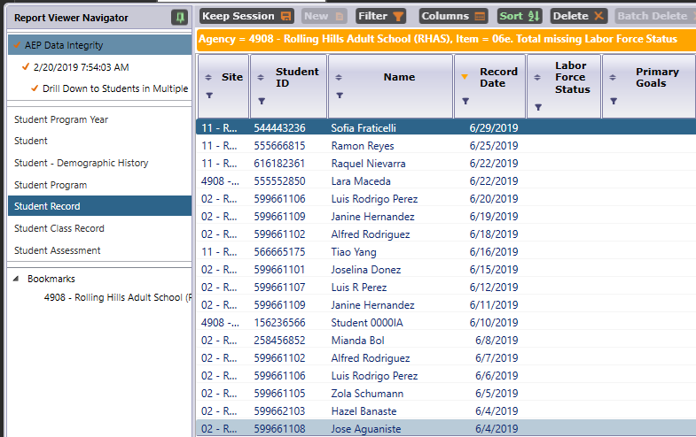
Solution: This takes you to the Records – Students – Records lister in TE – that is the lister that includes the records with Labor Force Status.

Slide 6
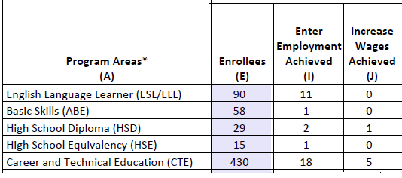
Example 2: the number of CAEP outcomes is lower than expected, and low when compared to the number of enrollees.

Slide 7
Example 2: Right click the figures displayed in Columns E, I, and J, and generate the CAEP DIR for the three different groups of students.
Compare the three reports to identify students with missing demographics and less than 12 hours of instruction.
Review DIR items specific to the outcome in question – in this example look at items 25a/25b for Employment and items 26a/26b for Wages.
High totals in 25b and 26b suggest “data clean up” is necessary to improve these outcomes.
Low totals in 25b/26b in relation to totals in 25a/26a suggest that the data is “clean” – but you may just need to input more positive outcomes.

Slide 8
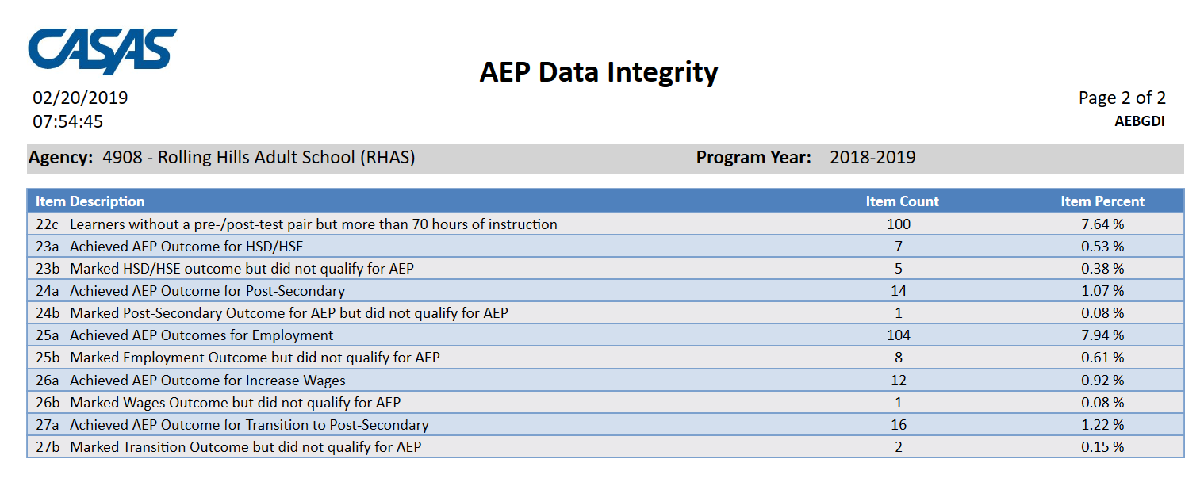
Example 3: the number of CAEP outcomes is lower than expected, and low when compared to the number of enrollees.
Use the CAEP DIR items 23-27 to evaluate the likely source of the problem.

Slide 9
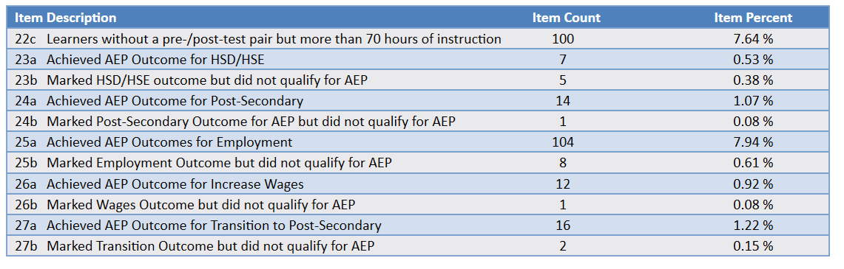
In 23a-23b for HSD/HSE, there are almost as many who marked the outcome & did not qualify as there are those who achieved the outcome.
In 25a-25b for Employment, almost all who marked an employment outcome qualified for the CAEP outcome.

Slide 10
Example 3: Compare item counts in 23a-27a to item counts in 23b-27b
If the large majority who marked CAEP outcomes achieved the outcome (that is the b item count is much lower than the a item count) then the likely issue is the need to review and mark more outcomes for students.
If the number who marked the outcome but did not qualify is close to or exceeds the number who achieved that outcome (high item count in b) then the likely issue is the need to review drop reasons.

Slide 11

Example 4: CAEP Program Enrollment
Compare numbers of Enrollees across Column L
Subtract number in “No Designated Program” from “Total Unduplicated Students”
Divide that result from number in Total unduplicated students.
(8043 – 700) ÷ 8043 = 91.2%

Slide 12
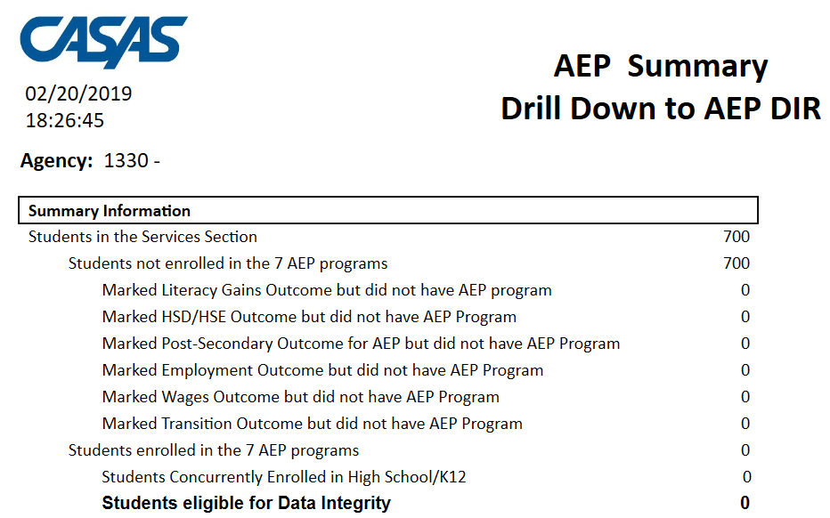
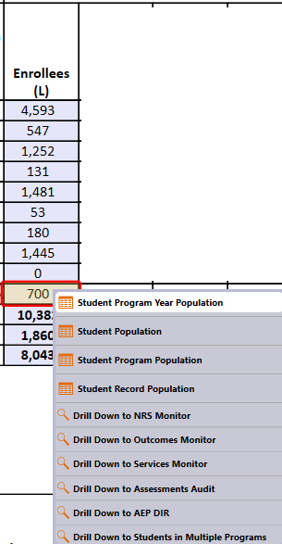
Verify “No designated program” item count by right clicking and drilling down to CAEP DIR.
Identify “No designated program” students by right clicking to the In Program Years lister.

Slide 13

Example 5: CAEP Program Persistence
Compare number of Enrollees in Columns E and L.
For services students in Column L, subtract the number in No Designated Program.
Divide the total in Column E with that result from Column L.
5119 ÷ (8043 - 700) = 69.7%

Slide 14
Example 5: CAEP Program Persistence
Compare number of Enrollees in Columns E and L.
Look for specific areas where these numbers are different. In this example, 1) HSD/HSE, 2) CTE.
Right-click areas of concern:
  Select NRS Monitor to review instructional hours for each student
  Select CAEP DIR and then investigate the students in DIR item #2 less than 12 hours
  Select Students In Program Years lister for both Columns E and L and compare the two lists.
5119 ÷ (8043 - 700) = 69.7%

Slide 15
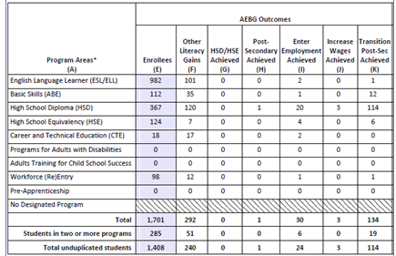
Example 6: CAEP Program Outcomes
Add up total number of outcomes across the 6 CAEP outcomes areas (Columns F-K)
Divide this total by total Enrollees in Column E
(240 + 0 + 1 + 24 + 3 + 114) ÷ 1408 = 27%

Slide 16
Example 6: CAEP Program Outcomes
Review the total number of outcomes in each of the 6 CAEP outcomes areas (Columns F-K)
Look for areas that may need to improve (Column F looks good; others may need improvement)
Right click the cells that are areas of concern:
  Select Outcomes Monitor to review more specific outcomes earned
  Select CAEP DIR and compare items 23-27 like in Example #2
(240 + 0 + 1 + 24 + 3 + 114) ÷ 1408 = 27%

Slide 17
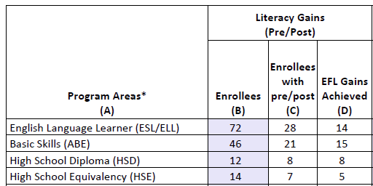
Example 7 & 8: the number of pre/post-test learning gains is low as compared to the number of enrollees.

Slide 18
Solution:
Compare the number of enrollees (Column B) with the number of enrollees with pre/post (Column C).
If these numbers in Columns B and C are far apart (like in the example above) then you need to ensure all students complete a pre/post-test pair.
If Columns B and C numbers are similar (rule of thumb: Column C should be equal to or greater than 70% of Column B) then you have done well completing testing for your students, but you should review students test scores and learning gains, and evaluate performance in the classroom to improve individual test results.

Slide 19
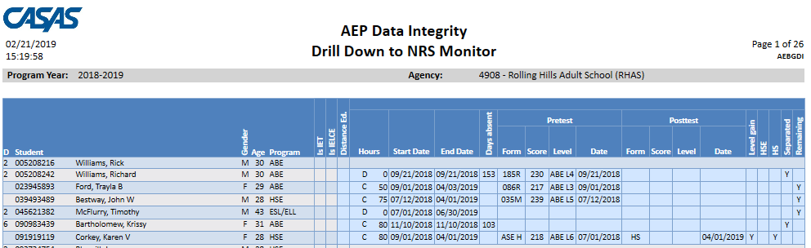
Solution: Generate NRS Monitor
If these numbers in Columns B and C are far apart (like in the example above) then you need to ensure all students complete a pre/post-test pair.
  Right click to generate NRS Monitor to identify students who have qualified enrollment but no pre/post-test pair.
If Columns B and C are similar (rule of thumb: Column C should be equal to or greater than 70% of Column B) then review students test scores and evaluate performance in the classroom to improve test results.
  Right click to generate NRS Monitor to identify students test performance and highlight students with zero or minimal gains.

Slide 20
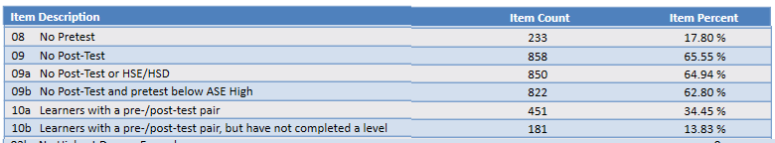
Solution: Drill down to CAEP DIR and review DIR items 8, 9, and 10
If these numbers in Columns B and C are far apart (like in the example above) then you need to ensure all students complete a pre/post-test pair.
  Right click to generate CAEP DIR and investigate items 8 and 9 to identify students who have qualified enrollment but no pre/post-test pair.
If Columns B and C are similar (rule of thumb: Column C should be equal to or greater than 70% of Column B) then review students test scores and evaluate performance in the classroom to improve test results.
  Right click to generate CAEP DIR and investigate items 10a-10b to identify students with pairs/and who have not achieved a level gain.

Slide 21
Examples of Consortium Level Data Evaluation
Consortia: Convert TE consortium reports to Excel
Example 1: Filter by agency and program
Example 2: Isolate for a specific CAEP outcome area
Example 3: CAEP Program enrollment calculation
Example 4: CAEP Program persistence calculation
Example 5: Combined CAEP outcomes calculation
Example 6: Use Excel to compute consortium wide performance and persistence percentages
Example 7: Create charts and graphs

Slide 22
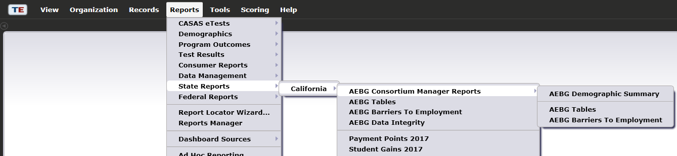
CAEP Consortium Manager Reports allow a consortium level login to compare and contrast outcomes across agencies within one consortium.
Menu currently includes three reports options with this feature

Slide 23
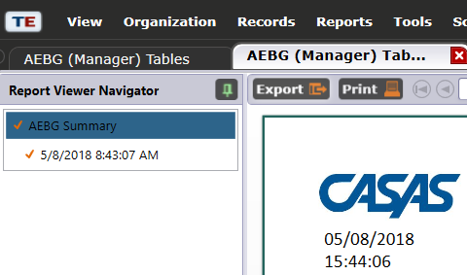
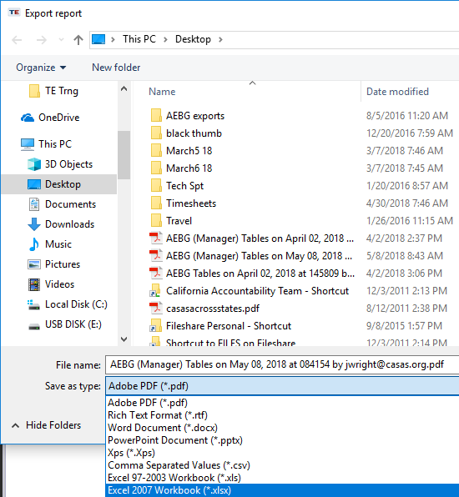

Creating Excel Spreadsheets in TE
Convert any TE report into an Excel spreadsheet by clicking Export, then Save As Excel.

Slide 24
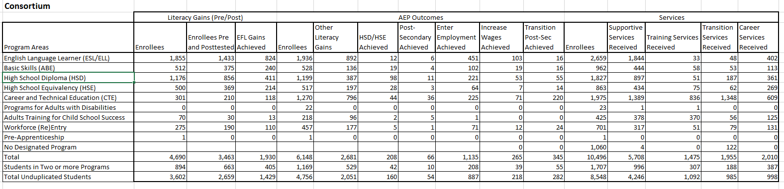
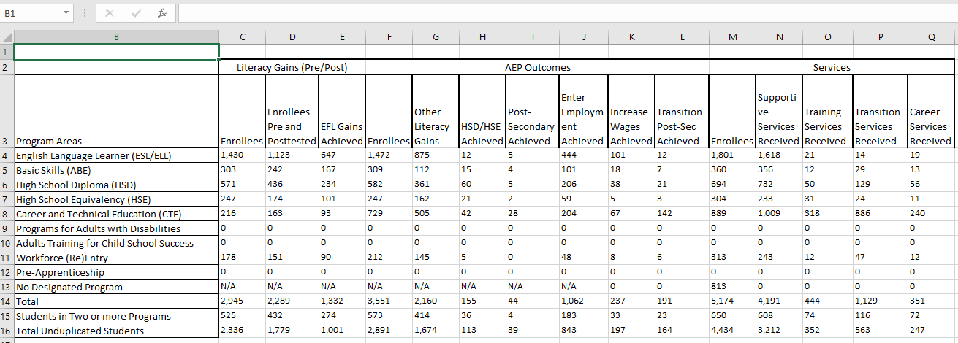
Making Simple Calculations in Excel
Using the consortium level CAEP Summary, you can convert the consortium wide or individual agency level CAEP Summary reports into Excel.

Slide 25
The resulting Excel worksheet includes all data elements from the CAEP Summary.

Slide 26
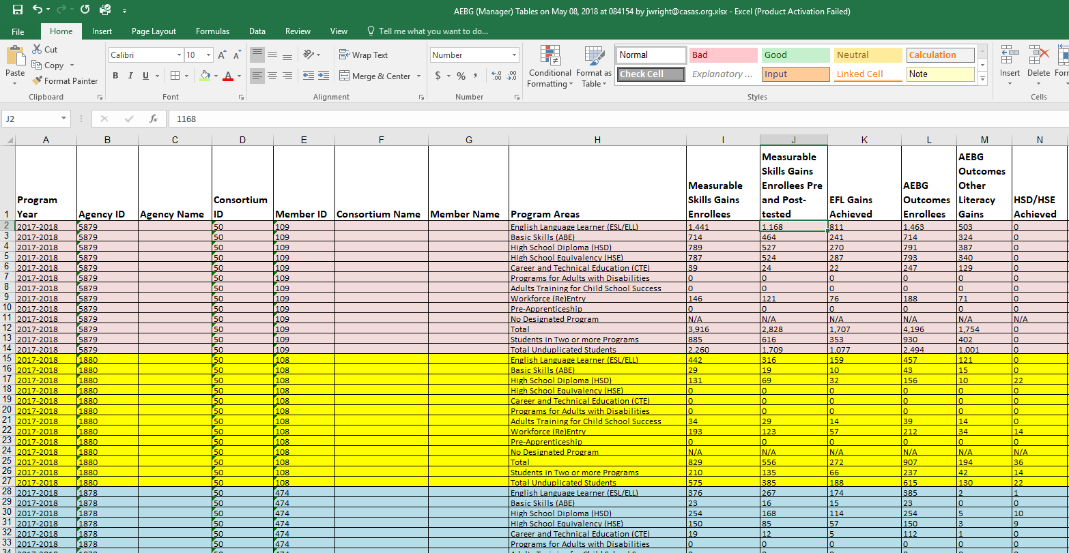
Use features in Excel to highlight key data points from the CAEP report in TE.

Slide 27
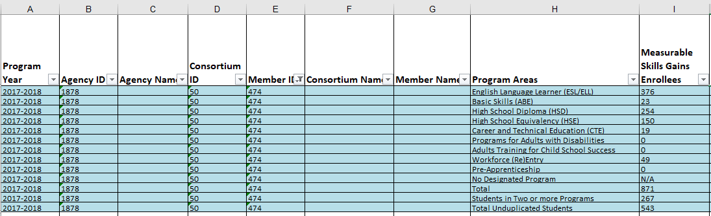
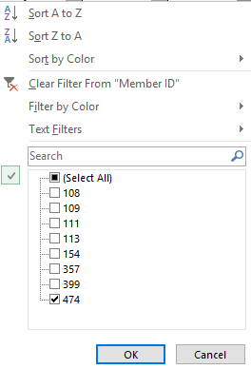
Example 1: Filter the spreadsheet by individual agency.

Slide 28
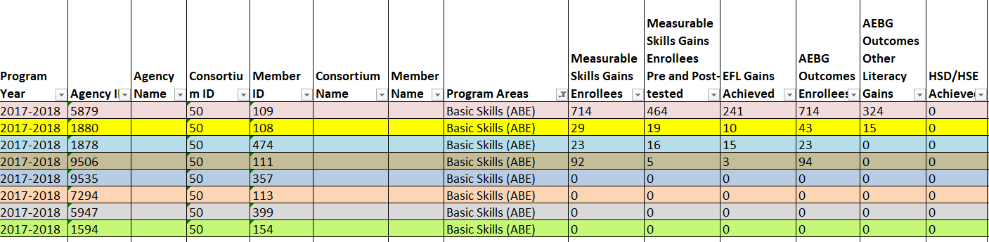
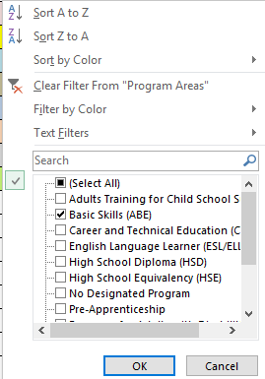
Example 1: Filter by instructional program area across all agencies.

Slide 29
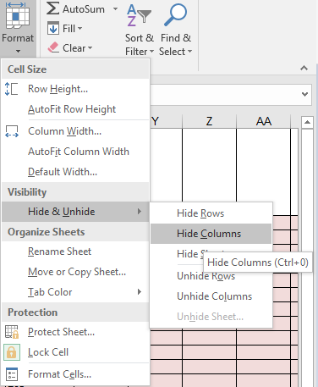
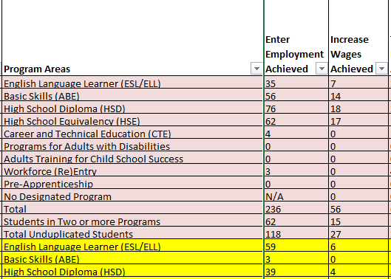
Example 2: Format cells to isolate key data points.

Slide 30
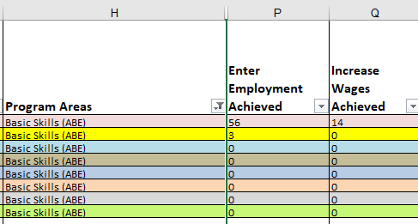
Example 2: In this example, the document uses filtering and formatting to isolate specific data results.

Slide 31
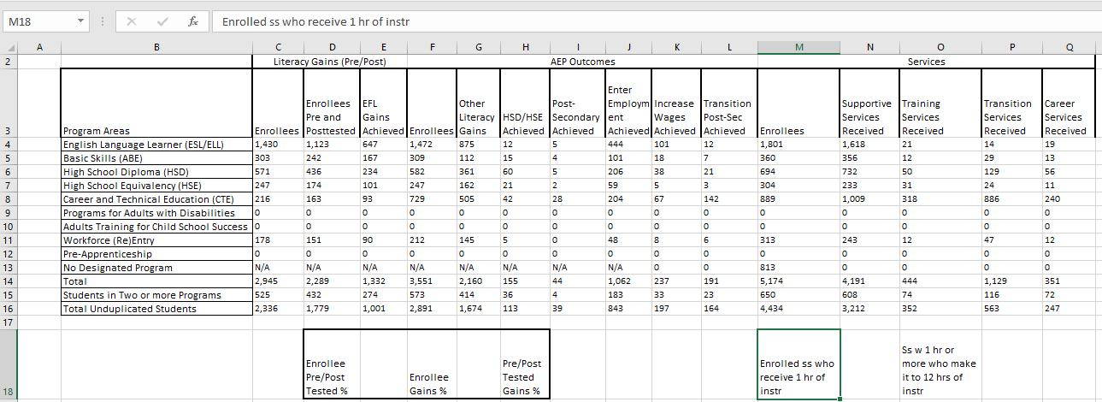
Example 3: CAEP Program Enrollment
Compare numbers of Enrollees across Column M (Excel columns may be different than what’s in TE)
Subtract number in “No Designated Program” from “Total Unduplicated Students”
Divide that result from number in Total unduplicated students.

Slide 32
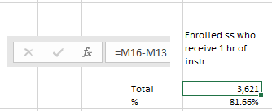
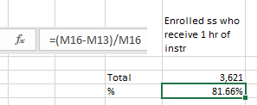
Example 3: CAEP Program Enrollment
Compare numbers of Enrollees across Column M
Subtract number in “No Designated Program” from “Total Unduplicated Students”
Divide that result from number in Total unduplicated students.
4434 ÷ (4434-813) = 81.6%

Slide 33
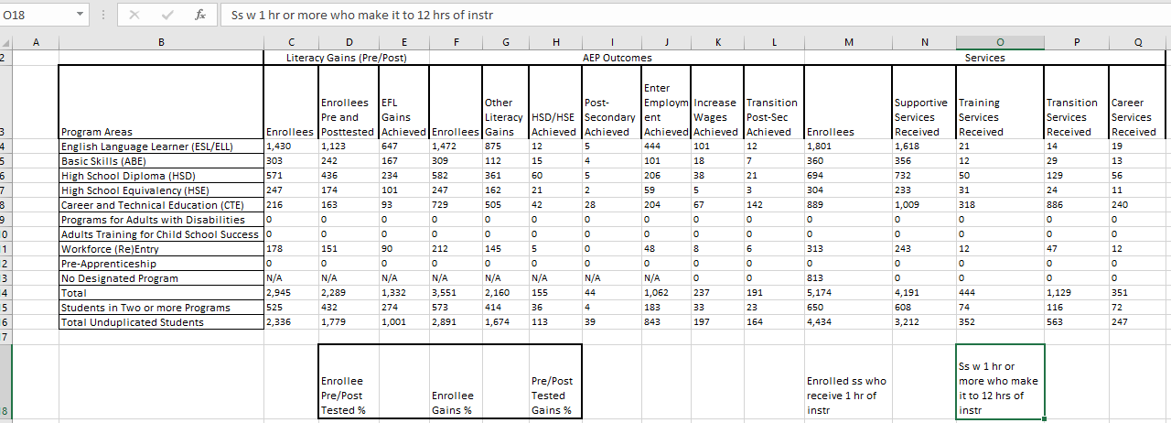
Example 4: CAEP Program Persistence
Compare number of Enrollees in Columns F and M (E and L on the TE CAEP Summary).
For services students in Column M, subtract the number in No Designated Program.
Divide the total in Column E with that result from Column M.

Slide 34
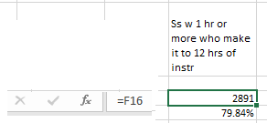
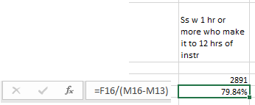
Example 4: CAEP Program Persistence
Compare number of Enrollees in Columns F and M (E and L on the TE CAEP Summary).
For services students in Column M, subtract the number in No Designated Program.
Divide the total in Column F with that result from Column M.
2891 ÷ (4434-813) = 79.8%

Slide 35
Example 5: CAEP Program Outcomes
Add up total number of outcomes across the 6 CAEP outcomes areas (Columns G-L in Excel)
Divide this total by total Enrollees in Column F

Slide 36

Example 5: CAEP Program Outcomes
Add up total number of outcomes across the 6 CAEP outcomes areas (Columns G-L in Excel)
Divide this total by total Enrollees in Column F
(1,674 + 113 + 39 + 843 + 197 + 164) ÷ 2891 = 104.8%!!!

Slide 37
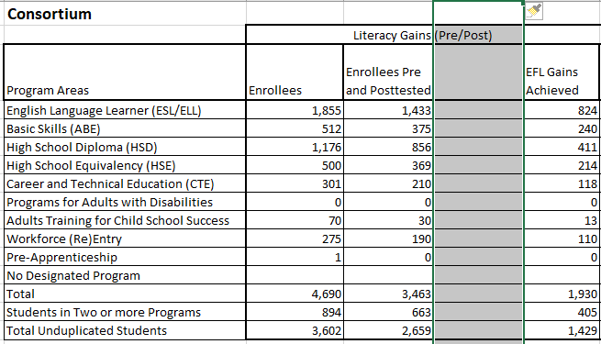
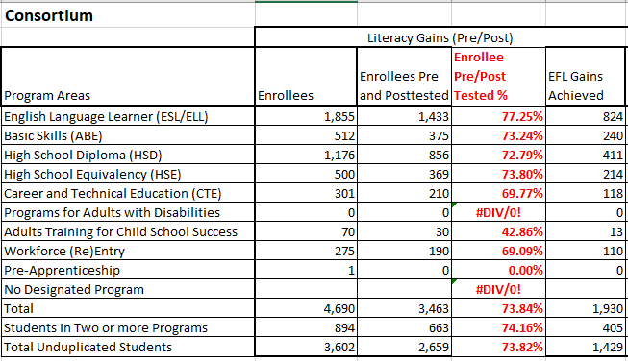
Example 6: Making Simple Calculations in Excel
Example 6: This example calculates the pre/post persistence rates for each CAEP program.

Slide 38
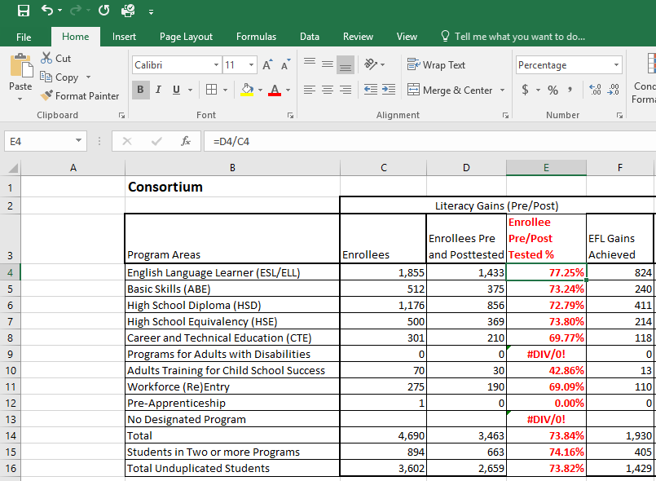
Making Simple Calculations in Excel
Divide the number of students who pre/post-tested in Column D by the total number of enrollees in Column C
Once you type in the first formula, you can drag that cell down to view the same calculation for all rows in the spreadsheet

Slide 39
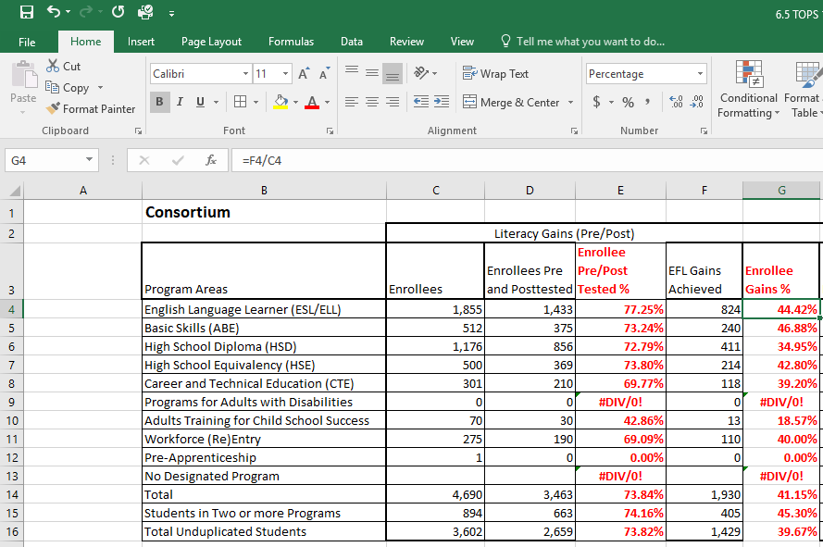
Making Simple Calculations in Excel
Add another column next to EFL Gains to make the same calculation for pre/post-test performance rates by program.

Slide 40
Making Simple Calculations in Excel
Divide the number of students who achieved a pre/post-test EFL gain (Column F in this example) by the total number of enrollees in Column C

Slide 41
Making Simple Calculations in Excel
Use this same technique to calculate percentages for other CAEP outcomes – this example compares Transitions outcomes totals to totals of Enrollees in Column F.

Slide 42
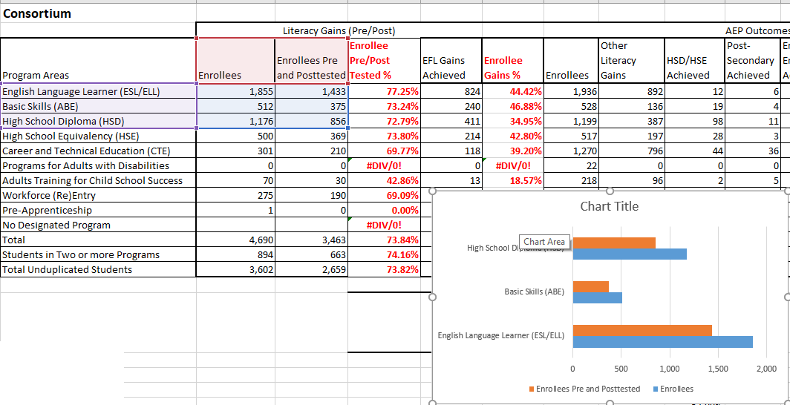
Example 7: Creating Charts and Graphs in Excel
Highlight the cells for which you wish to create the chart
In Excel, go to the Insert menu to select the specific chart or graph

Slide 43
Creating Charts and Graphs in Excel
Once you create the chart, you can use additional features to further customize it.
In this example, we added a title, changed the color of the bars, and added item counts to each

Slide 44
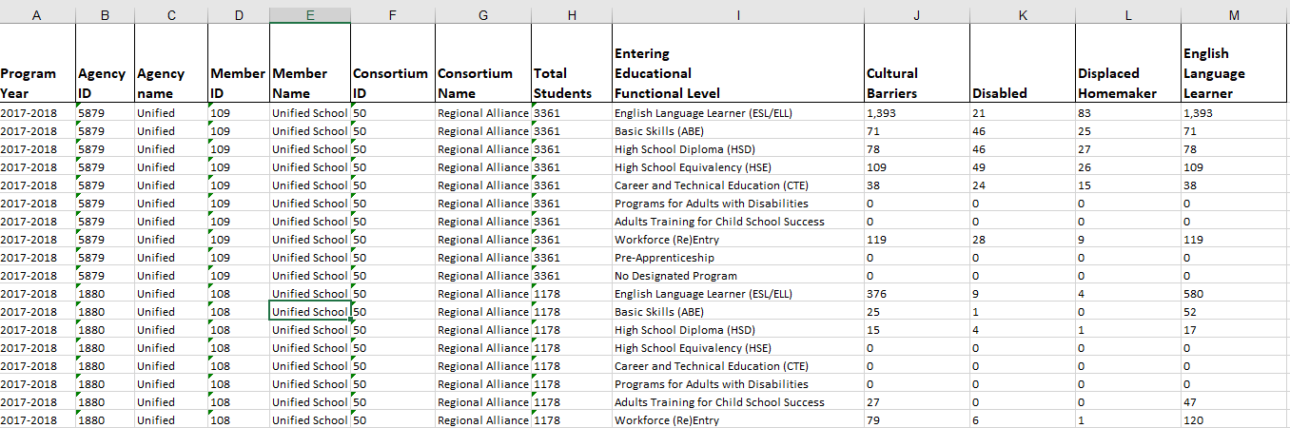
This example uses TE and Excel to evaluate results from CAEP Barriers to Employment.

Slide 45
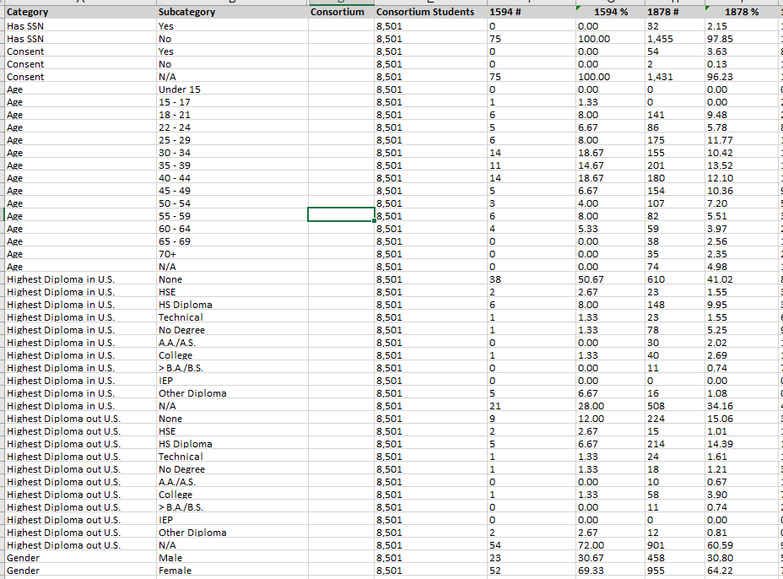
This example uses TE and Excel to evaluate results from the Demographics Summary.

Slide 46
Basic Questions:
Of those students with any CAEP activity, how many enrolled in an instructional program? (Column L on CAEP Summary)
Of those with program enrollment, how many students reached at least 12 hours of instruction? (Compare Columns E and L)
Of those who qualified for outcomes with 12+ hours, how many students achieved outcomes? (Columns E-K)
Of those who qualified with 12+ hours, how many students completed a pre/post-test pair? Of those, how many achieved a level gain? (Columns B-C)

