Slide 1
CAEP Data Dive
April 28, 2021
www.casas.org

Slide 2
Overview
April 28: CAEP Data Dive: Detail CAEP outcomes and services; review CAEP Reports in TE, and what’s new
May 18: Barriers and Equity: Using new and existing TE reporting features to target data, and focus on specific populations that meet statewide and regional priorities
May 25: CAEP Performance Goals: Review key concepts of NRS performance and persistence and apply these concepts to CAEP data reporting.

Slide 3


Data as Culture

Slide 4
Agenda
2020-21 CAEP Programs and AB 104 Outcomes Structure
Distinguishing key CAEP Outcomes
Troubleshooting examples at the Student level
  ABE-ASE-ESL/Literacy Gains
  Workforce Prep and CTE
  Transitions
  Recording Short Term Services
CAEP Reports in TE
Consortium Level Reports

Slide 5

PY 2020-21 CAEP Program Structure: 5 Programs
Adult Basic & Secondary Education
English as 2nd Language
Career and Technical Education (CTE)
Adults with Disabilities
Parents/K12 Success
Notes:
Carolyn

Slide 6
PY 2020-21 CAEP Program Structure:
Primary Programs
Adult Basic & Secondary Education:
Basic Skills (ABE)
HSE (HiSET, GED)
HS Diploma
English as Second Language (ESL/ELL)
Career and Technical Education (CTE)
CTE
Short Term CTE
Pre-Apprenticeship
Workforce Preparation
Notes:
Javier

Slide 7
CAEP Reporting : CAEP Programs Under CTE
Career and Technical Education (CTE)
CTE – Long term/occupation specific
Short Term CTE – short term/occupation specific
Pre-Apprenticeship – Long term/occupation specific
Workforce Preparation – Short term/not occupation specific

Slide 8
CAEP Reporting: Adults Served
CAEP reports the number of “Adults Served” which includes three categories:
  Service only students
  Students receiving 1-11 instructional contact hours
  Participants who received 12 or more instructional contact hours over a single program year.
Notes:
Javier

Slide 9
WIOA Alignment to AB 104
The WIOA Performance Indicators, along with the 5 types of MSG, comprise the framework for the six AB 104 outcomes:
Indicators:
Employment
Wages
MSGs:
Literacy gain
Secondary
Post-Secondary
Training Milestone
Skills Progression
AB 104 Outcomes:
Improved literacy skills
Completion of high school diplomas or their recognized equivalents
Completion of postsecondary
Placement into jobs
Improved wages
Post Secondary Transition
Notes:
CASAS

Slide 10
CAEP Outcomes
Literacy Gains
HSE/HS Diploma
Post-Secondary
Enter Employment
Increase Wages
Transition
Pre/Post Level Completion
Carnegie Units /HS Credits
CDCP Certificate
Occupational Skills Gain
Workforce Preparation
High School Diploma
Passed GED
Passed HiSET
College Degree – AA, AS, BA, BS
Graduate Studies
Training Credential
Occupational Licensure/Certificate
Apprenticeship
Get a Job
Retain a Job
Enter Military
Increase Wages
Get a Better Job
Transition to ASE
Transition to Post-Secondary/CTE
Transition to Post-Secondary/College

Slide 11
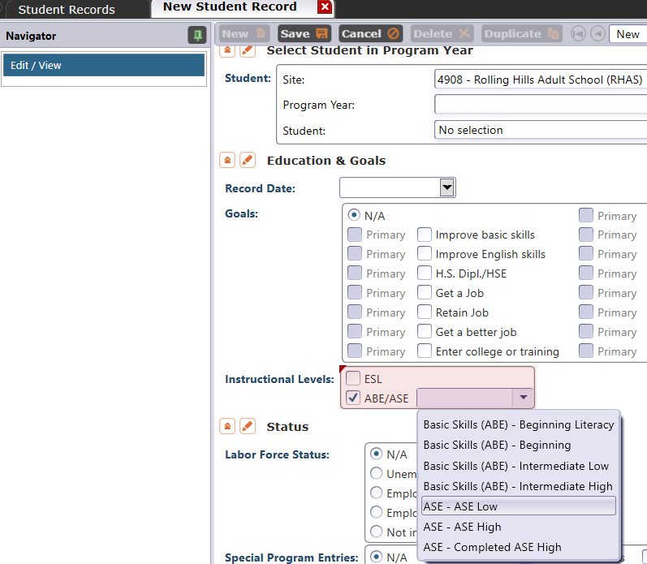
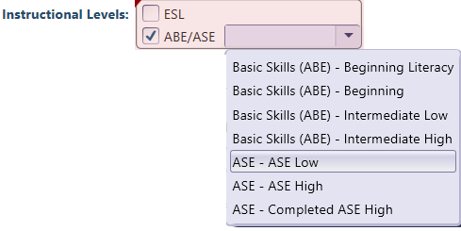
Literacy Gains – HS Credits
In TE, go to Records – Students – Records and refer to Instructional Levels:
Select ASE Low upon enrollment
Select ASE High later in the year once student progresses to the 11th or 12th grade level
Notes:
CASAS

Slide 12
Literacy Gains – CTE Related Outcomes
Occupational Skills Gain:
Usually suggests accomplishment of a portion of a longer term program
Workforce Prep Outcome:
Usually suggests completion of a shorter term program
Notes:
CASAS

Slide 13
Literacy Gains – CTE Related Outcomes
Occupational Skills Gain:
Usually suggests accomplishment of a portion of a longer term program
  For example: a student enrolls in a long term welding program in CTE, which is five semesters/five modules long. The student passes a skills check/written test that indicates the student is ready to finish Module I and enroll in Module II.
Notes:
CASAS

Slide 14
Literacy Gains – CTE Related Outcomes
Workforce Prep Outcome:
Usually suggests completion of a shorter term program
  For example: a student enrolls and completes a 15 hour instructional module on job search strategies. The student earns documentation such as an informal certificate at the end of the instructional module.
Notes:
CASAS

Slide 15
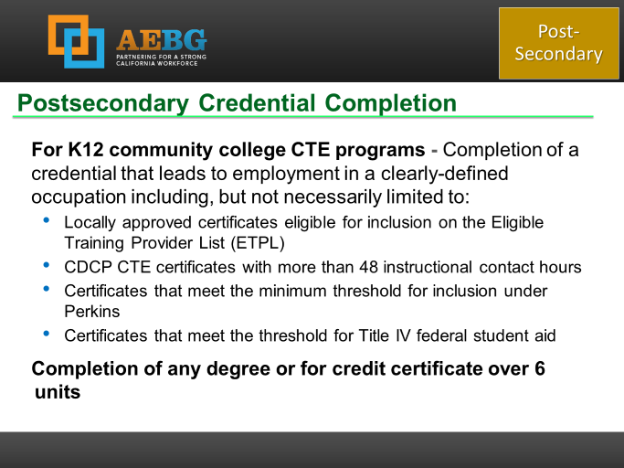
Occupational Outcomes:
Post-Secondary vs. Literacy Gains
Post-Secondary:
Attained Credential
Occupational licensure
Occupational certificate
Literacy Gains:
Occupational Skills Gain
Workforce Prep Milestone
Post-Secondary =
Completion of a longer term program
“Literacy Gains” =
Partial completion of a longer term program
Completion of a shorter term program
Notes:
CASAS

Slide 16
Post-Secondary Credential Completion
          These are potential ways to measure and verify that your IET program comprises a legitimate career pathway:
          Locally approved certificates eligible for inclusion on the Eligible Training Provider List (ETPL) (WIOA Title I)
          CDCP CTE certificates with more than 48 instructional contact hours (CCCCO)
          Certificates that meet the minimum for inclusion under Perkins
          Certificates meeting the threshold for Title IV federal student aid

Slide 17

Post-Secondary Credential Completion
          If there is not a career pathway established from your workforce training, the agency may need to piece together several components to ensure it comprises a pathway.
          Ultimately, it should equate to an “Earned Post-Secondary” outcome.

Slide 18

          WSD 019-03
          Examples of training opportunities that qualify as a post-secondary credential:
            Associate degree
            Bachelor’s degree
            Occupational licensure (such as CNA license)
            Occupational certification (such as Automotive Service Excellence certification).
            Occupational certificate, including Registered Apprenticeship and CTE educational certificates.
            Other recognized certificates of industry/occupational skills completion sufficient to qualify for entry-level or advancement in employment

Slide 19
          WSD 019-03
          Examples of training opportunities that do NOT qualify as a post-secondary credential:
            Occupational Safety and Health Administration 10-hour course on job-related common safety and health hazards (OSHA 10).
            Microsoft Office, Customer Service, and/or General Office.
            National Career Readiness Certification.
            National Retail Federation Credentials.
            ServSafe Food Handler’s Certification.
            Cardio Pulmonary Resuscitation (CPR) Certification.

Slide 20
          WSD 019-03
          Attributes of a quality post-secondary credential:
            Accessible — Affordable and readily available at places and times convenient for working adults
            Transparent — Clearly articulated costs and prerequisites; accurate picture of what skills, knowledge and abilities are benchmarked by a given credential, and the value it carries in the labor market
            Stackable — One of multiple manageable chunks that add up to a more substantial credential and do not require starting over at each new step
            Portable — Transferable between firms, regions and educational institutions
            Meaningful — Has value in the labor market
            Connected — Links to a job or an educational pathway

Slide 21
Transition
To:
K12 Adult Education
(ABE, ASE, ESL)
K12 Adult Ed CTE
CC CTE
Non Credit CC
(ABE, ASE, ESL)
For Credit CC
Transition to CTE
Transition to for credit

Slide 22
Transition to CTE
To:
K12 Adult Education
(ABE, ASE, ESL)
K12 Adult Ed CTE
CC CTE
Non Credit CC
(ABE, ASE, ESL)
Transition to CTE
Transition to for credit

Slide 23
Transition to College
K12 Adult Education
(ABE, ASE, ESL)
To:
For Credit CC
Non Credit CC
(ABE, ASE, ESL)
Transition to CTE
Transition to for credit

Slide 24

Literacy Gains
Employment
Secondary
Wages
Post-Secondary
Transition
Notes:
CASAS

Slide 25
In TE go to Records--Students--Records
Notes:
CASAS

Slide 26
Troubleshooting Examples
Examples for ABE, ASE and ESL
Examples for Workforce Preparation and CTE
Transitions Examples

Slide 27

Troubleshooting Examples
ABE, ASE, and ESL
Recording HS Credits
Recording Distance Learning Outcomes
EL Civics/COAAPs
IET/EL Co-Enrollment

Slide 28
Troubleshooting Examples
Recording HS Credits
Student 1 enrolled in Adult HS diploma program at XYZ Unified District, which requires 180 credits for HS graduation. Student 1 had completed 75 credits at enrollment. At the end of the year the Student had completed 125 credits.
Student 1 earns the HS credits outcome

Slide 29
Troubleshooting Examples
Recording HS Credits
Student 2 enrolled in the same program at the same date. Student 2 had completed 145 credits upon enrollment in the Adult program.
Student 2 does not earn this outcome. The outcome for this student is to earn HS diploma.

Slide 30
Troubleshooting Examples
Recording Distance Learning Outcomes
Use “passage of exam” process for Workforce Prep Milestone and Occupational Skills Gain as a guide for recording student achievement in a virtual environment.
Record when student passes virtual activities such as class assessments, written & listening assignments, or oral interviews

Slide 31
Troubleshooting Examples
Recording Distance Learning Outcomes
Example 1: Learner Mastery. Record when student completes established list of activities and passes assigned quiz required for instructional hours, as defined in Agency’s Local Assessment Policy (LAP).
Example 2: Educational Software. Mark when student completes activities such written & listening assignments, quizzes, and exams in defined units or modules in educational software.

Slide 32
Troubleshooting Examples
EL Civics/COAAPs
For 2019-20: “Completes skills demonstration in workforce preparation activities”
Example: If an ESL class in IELCE focuses on job search, application and interview skills, and administers the COAAPs assessments that relate to these targeted areas
For 2020-21: Passed EL Civics COAAPs now display as I-3 outcomes

Slide 33
Troubleshooting Examples
Integrated Education and Training (IET)
A student completes pre-requisite academic or performance requirements prior to enrollment into the Workforce Training component of Integrated Education and Training (IET).
  Completes required short term course(s)
  Passes a skills check for selected occupation
  Attains minimum required score on placement assessment
  Completes interviews and orientation sessions with union or training provider
Record when requirements being met facilitates enrollment into IET.

Slide 34
Troubleshooting Examples
Integrated Education and Training (IET)
Example 1: As a pre-requisite for enrollment in the workforce training (CTE) component of Integrated Education and Training (IET), the student passes required occupational skills checks.
Example 2: Student completes required short term classes needed to transition to certificated CTE program that qualifies for IET workforce training.
Example 3: Student surpasses minimum required placement scores for Reading and Math on the CASAS Appraisal Form 900.

Slide 35
Troubleshooting Examples
EL Co-Enrollment
EL Co-Enrollment = English Language Learner enrolled in both Title I and Title II.
Record Workforce Prep Milestone or Occupational Skills Gain when student completes activities in the Title I program such as job skills training, job search assistance or career pathways completion.

Slide 36
Troubleshooting Examples
EL Co-Enrollment
Example: Student is enrolled in an ESL class at an Adult Education Program. Student is also enrolled in a WIOA Title I program, she completes 20 hours of job skills training.

Slide 37
Troubleshooting Examples
Workforce Preparation and CTE
Workforce Preparation classes that are Occupation Specific (Short term CTE)
Classes and programs designed to improve the student’s employability, but that do not result in formal certification
Classes required for CTE enrollment or certification that are Occupation Generic
Post-Secondary

Slide 38
Troubleshooting Examples
Workforce Preparation classes that are Occupation Specific (Short Term CTE)
Class that focuses on one occupation, and may result in employment in that field, but that also is short term and does not result in formal certification.
Examples: Phlebotomy, Forklift Operator
Record either Workforce Prep Milestone versus Occupational Skills Gain
Post-Secondary

Slide 39
Troubleshooting Examples
Workforce Preparation classes that are Occupation Specific (Short Term CTE)
Example 1: Student completes 15 hour course on Accounting Principles.
  Record Workforce Preparation Milestone
Example 2: Student completes 15 hour course on Accounting, after completing 2 related courses earlier in the year. The student has enrolled for the fourth and final class next semester.
  Record Occupational Skills Gain
Post-Secondary

Slide 40
Troubleshooting Examples
Workforce Preparation classes that are Occupation Specific (Short Term CTE)
Example 3: Student completes 15 hour course on Accounting. Completing this course enabled the student to enroll in the advanced CTE program for Accounting and Finance.
  Record Occupational Skills Gain
Example 4: Student completes all six Accounting & Finance courses that, as a battery, is recognized by the local workforce board and on
their ETPL.
  Record Occ Skills Gain or Post-Sec Outcome
Post-Secondary

Slide 41
Troubleshooting Examples
Workforce Preparation classes that help the student’s employability, but that do not earn formal certification
Example: OSHA Food handling, Microsoft Office
Record Workforce Prep Milestone or short term service
Can use 12 hours as a guideline (but not required)
Post-Secondary

Slide 42
Troubleshooting Examples
Workforce Preparation classes that help the student’s employability, but that do not earn formal certification
Example 1: Student completes 15 hour course on Microsoft Office.
  Record Workforce Preparation Milestone
Example 2: Student completes a 2 hour course on Microsoft Excel Basics.
  Record as a Training Service
Post-Secondary

Slide 43
Troubleshooting Examples
Workforce Preparation classes that help the student’s employability, but that do not earn formal certification
Example 3: Student complete 2 hour tour of finance office to learn about accounting principles.
  Record short term service (such as on the job training or work experience)
Example 4: Student completes third successive 15 hour course on Microsoft Office, that enabled enrollment into the CTE Accounting program .
  Record Workforce Prep Milestone
Post-Secondary

Slide 44
Troubleshooting Examples
Classes required for CTE program that are Occupation Generic
Example: OSHA Food handling, Microsoft Office
Record Workforce Prep Milestone or short term service
When the service or accomplishment is the “trigger” that facilitates enrollment or promotion to a higher level or certificated program – then you may record outcomes instead of services even if hours total is low
Post-Secondary

Slide 45
Troubleshooting Examples
Classes required for CTE that are Occupation Generic
Example 1: Student completes third successive 15 hour course on Microsoft Office, that results in “promotion” into the CTE Accounting program .
  Record Workforce Prep Milestone
Example 2: Student completes 6 hour course on workplace safety measures that enables enrollment into Construction pre-apprenticeship program.
  Record Workforce Prep Milestone
Post-Secondary

Slide 46
Troubleshooting Examples
Transitions
Transition to CTE
Transition to College
K12 Adult Education
(ABE, ASE, ESL)
K12 Adult Ed CTE
CC CTE
Non Credit CC
(ABE, ASE, ESL)
For Credit CC
Transition

Slide 47
Troubleshooting Examples
Examples of Transition to CTE
Enrollment in apprenticeship or pre-apprenticeship
WIOA Title I workforce training
Enrollment in workforce training that is approved as workforce training in IET
Examples that are NOT Transition to CTE
Wait listing/Pending application/etc.
Workforce Preparation (or other similar short term or not for credit) classes
Enrollment in IELCE but not IET
Transition

Slide 48
Troubleshooting Examples
Examples of Transition to College
From non-credit CC to for credit CC within the same community college district
From an Adult School to for credit CC
From an Adult School or non-credit CC to enrollment in a university
Examples that are NOT Transition to College
From an Adult School to a non-credit CC program
From an Adult School or non-credit CC to developmental level community college courses
Transition

Slide 49
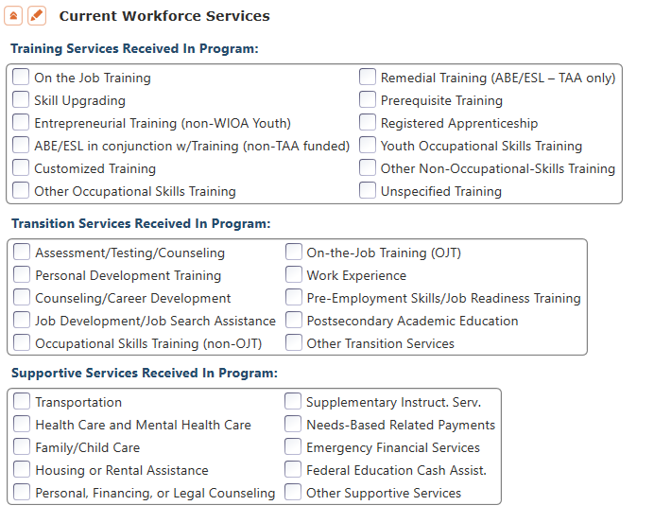
CAEP Short Term Services
Record short term services that may be received outside of the classroom.
Supportive Services
Training Services
Transition Services

Slide 50
CAEP Short Term Services
Common Supportive Services for PY 20-21
Health Care Services
Emergency Financial Services
Financial Counseling
Housing Assistance

Slide 51
CAEP Short Term Services
Training Services
Prerequisite Training
Skill Upgrading
  Skill upgrades to work remotely
  Assist with new software applications
  Digital Literacy/
  “Tech support”

Slide 52
CAEP Short Term Services
Transition Services
Assessment/Testing
  Remote Testing (CASAS & HSE)
  Career Inventory
Job Search Assistance
Occupational Skills Training

Slide 53
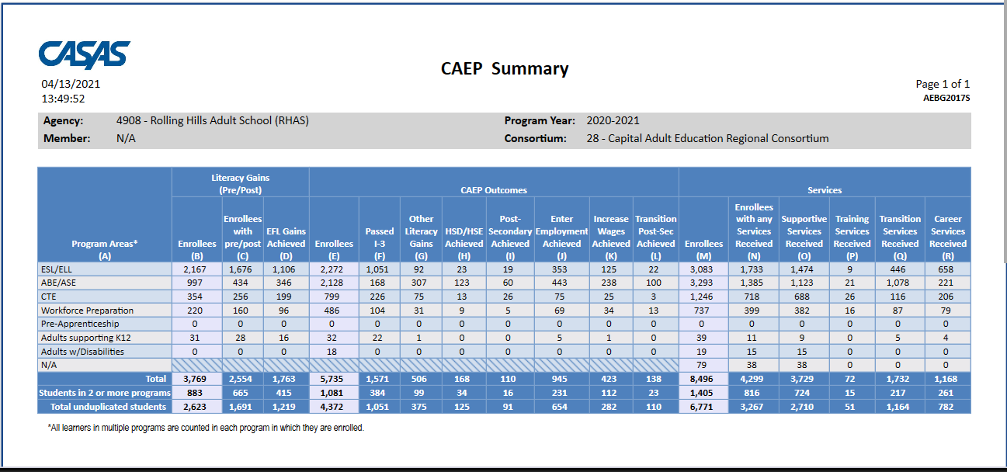
CAEP Summary

Slide 54
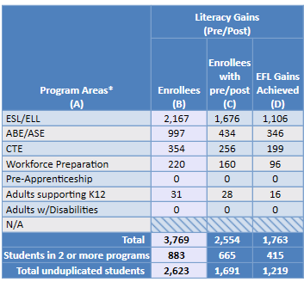
CAEP Summary

Slide 55
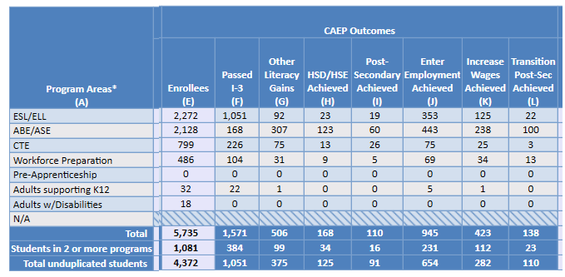
CAEP Summary

Slide 56
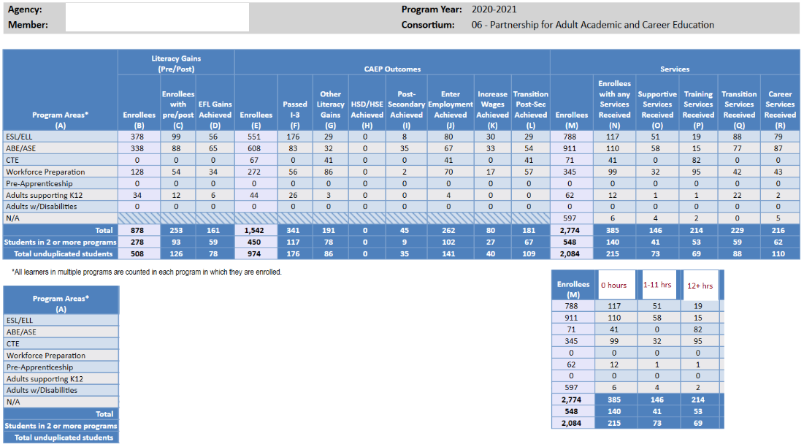
CAEP Summary

Slide 57
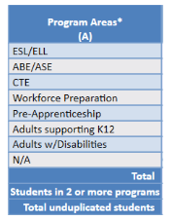
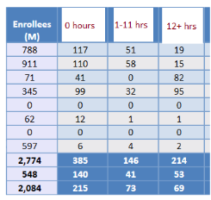
CAEP Summary

Slide 58
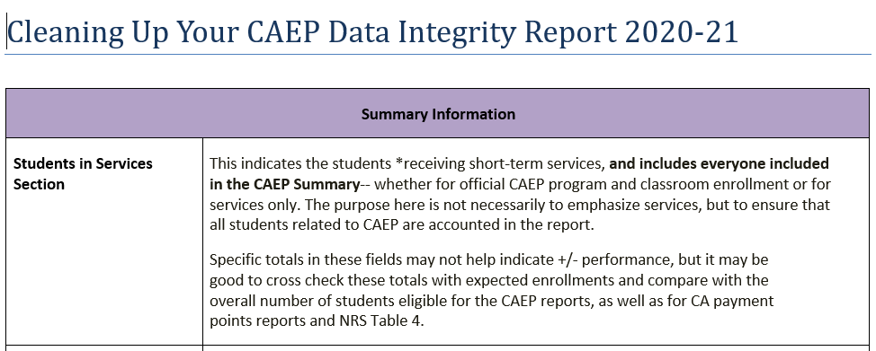
CAEP Data Integrity

Slide 59
CAEP Data Integrity Report: PY 20-21
Some items that may potentially change due to COVID-19 issues:
< 12 Hours of Instruction - Item 02
No Post-Test/Pre-Post-Test pair - Items 09, 10
Earned HSE/HS Diploma - Items 12, 13
Earned outcome but did not qualify for CAEP - Items 23a-27
Achieved CAEP outcome - Items 23b-27b

Slide 60
CAEP Data Integrity Report: PY 20-21
Some items that should NOT change due to COVID-19 issues:
Demographics - Items 01, 03, 04, 05, 06
Primary/Secondary Goal - Items 17, 18
Missing Barriers of Employment - Item 19
Earned outcome but did not qualify for CAEP - Items 23a-27a

Slide 61
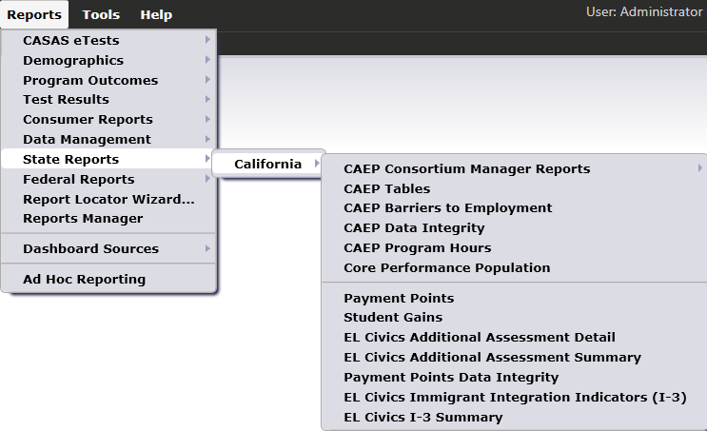

CAEP Consortium Manager Reports allow a consortium level login to compare and contrast outcomes across agencies within one consortium.
Menu currently includes four reports options with this feature

Slide 62
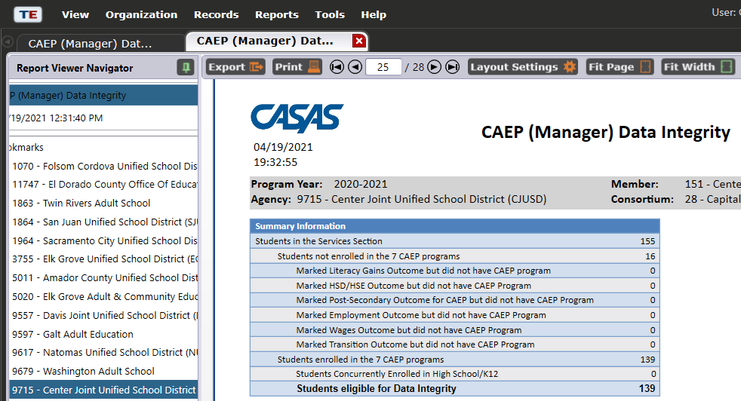
CAEP Consortium Manager Reports now includes consortium level CAEP Data Integrity Report.

Slide 63
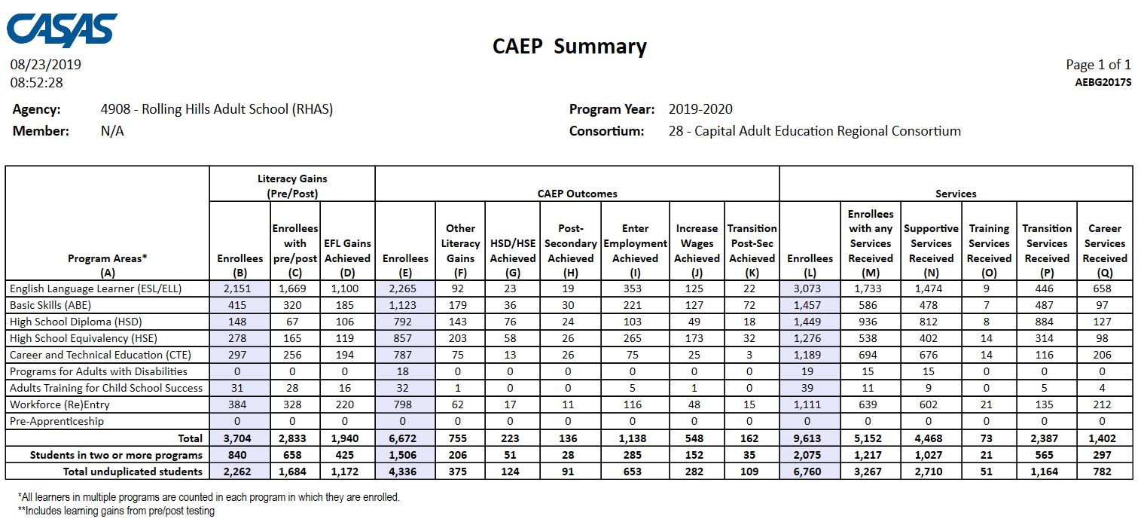
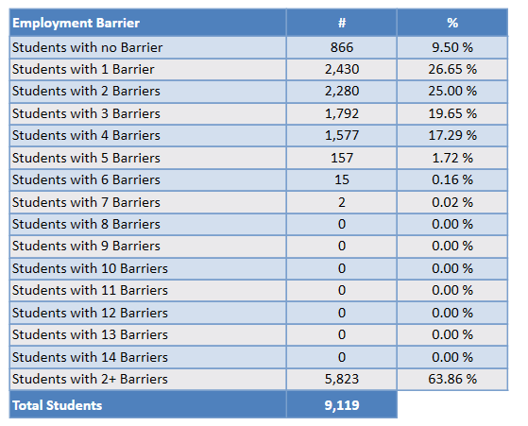

The CAEP Summary and Barriers to Employment also lists information by agency and by consortium.
Click Aggregate Multiple Agencies to run a combined summary of all agencies in the consortium.

Slide 64
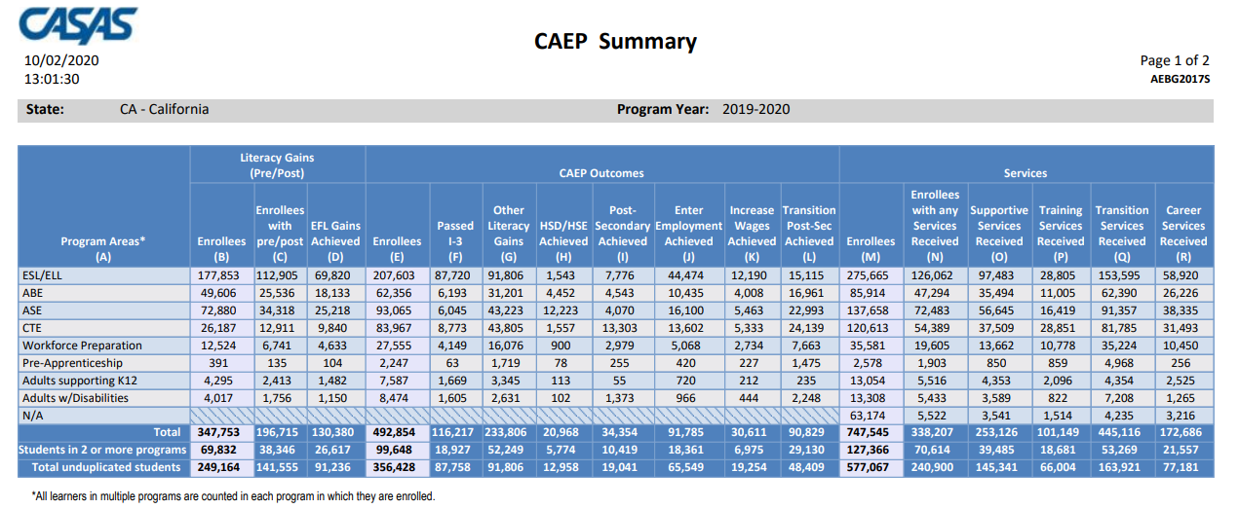
Statewide CAEP Summary

Slide 65

Remember: Everyone need not get to OZ--
But you must build the Yellow Brick Road!

