Slide 1
CAEP State Priorities
Neil Kelly – State CAEP Office

Slide 2
Agenda
Purpose of today’s webinar
Review of the State level goals & initiatives
Discussion of shared goals with adult education
Review of the state priority areas
Connecting priority areas to planning & effectiveness
Questions
Upcoming Webinars

Slide 3
Purpose of Today’s Webinar
The purpose of today’s webinar is to review the State level vision goals and initiatives and how that translates to adult education/noncredit.
Share the structure and priority areas that will assist in the rollout of professional development to support these efforts
Discuss how the our shared goals will drive your planning efforts and push for greater member effectiveness.

Slide 4
State Level Goals and Initiatives
California Department of Education Superintendent’s Initiatives
The California Community College System Vision Goals

Slide 5
Superintendent’s Initiatives
Closing the Digital Divide
Statewide Literacy
Reducing Chronic Absenteeism
Closing the Achievement Gap
Jobs for Tomorrow

Slide 6
Vison Goals
Over five years, increase by at least 20 percent the number of California Community College students annually who acquire associate degrees, credentials, certificates, or specific skill sets that prepare them for an in-demand job.
Over five years, increase by 35 percent the number of California Community College students transferring annually to a UC or CSU.
Over five years, decrease the average number of units accumulated by California Community College students earning associate degrees.

Slide 7
Vison Goals (cont.)
Over five years, increase the percent of exiting CTE students who report being employed in their field of study.
Reduce equity gaps across all of the above measures through faster improvements among traditionally underrepresented student groups.
Over five years, reduce regional achievement gaps across all of the above measures through faster improvements among colleges located in regions with the lowest educational attainment of adults.

Slide 8
Adult Education Shared Goals
Increase credential and high school diploma/high school equivalency obtainment.
Increase transfer to community college credit coursework.
Decrease unit obtainment and help students achieve the 12 hours of instruction milestone.
Increase employment for CTE students (and all CAEP students).
Reduce regional gaps in the 71 CAEP regional consortia.

Slide 9
State Priority Areas
Equity
Leadership
Learner Transition
Marketing
Program Development/Curriculum/Classroom
Program Evaluation
Technology and Distance Learning

Slide 10
Equity
Equity is about being fair and impartial with learners, partners, and the communities we serve. Programs aligned to this area may focus on methods for building cultural awareness and responsiveness, addressing equity in the classroom, addressing the achievement gap, or creating access, success, and transfer opportunities for historically disadvantage populations.

Slide 11
Leadership
Leadership deals with important things leaders need to know about successfully managing a consortium or managing an adult education K-12 adult or noncredit agency. Programs aligned to this area might focus on regional and local policies, developing systems, supervision and management of staff, organizational change, leveraging resources, or capacity building.

Slide 12
Learner Transition
Moving learners along in educational, career, or other paths is one measure of how we determine success. Programs aligned to this area may focus on college and career pathways, transition supports, or counseling and support services. Some examples include short-term CTE, integrated education and training, dual enrollment, pre-apprenticeship, bridges and boot camps, and mirrored courses.

Slide 13
Marketing
Marketing programs and learner recruitment are ongoing responsibilities for consortium members. It is also vital that local communities understand and support regional consortia. Programs aligned to this area should share successful marketing strategies and practices, such as employing social media in marketing, budgeting for marketing, using data to target marking efforts, or strategies for keeping marketing current and effective.

Slide 14
Program Development
Constant program improvement is at the core of building stronger and relevant consortia and agencies. Programs in this area could focus on any of the approved CAEP program areas, annual and 3-year planning, building partnerships, leveraging funding, or implementing specialized programs, such as programs built around the immigrant integration framework.

Slide 15
Program Evaluation
Ongoing assessment of programs is at the core of building stronger and relevant consortia and agencies. Programs aligned to this area could focus on using data to inform consortia annual and 3-year planning, programming, and instruction, evaluation design, or engaging stakeholders in the evaluation process.

Slide 16
Technology and Distance Learning
This state priority focuses on the integration of technology into the educational and work environments as well as the implementation of blended or distance learning programs. Programs aligned to this area might include anything relating to reaching and serving adult learners at a distance, whether synchronously or asynchronously. Programs might also relate to a technology goal(s) that agencies or consortium have identified and implemented.

Slide 17
Planning & Effectiveness
3-Year Plans
Consortium and member effectiveness
Governance
Proposed legislation – data review & carry-over of CAEP funds

Slide 18

Questions

Slide 19
Upcoming CAEP State Priority Webinars
4/20/21: What’s NonCredit Coding Got to Do with It: Getting the Most Out of Your Data (Program Evaluation)
4/27/21: Get Ready for AEP 2021: New Features and Updates to the Adult Education Pipeline Dashboard (Program Evaluation)
4/28/21: CAEP Data Dive (Program Evaluation)
4/30/21: Understanding and Using the Adult Education Pipeline (AEP) Dashboard for Continuous Improvement (Program Evaluation)
5/5/21: Three-year Consortium Planning Using the AEP Dashboard (Program Evaluation)
5/7/21: Utilizing SB554 Deeper Dive (Learner Transition)

Slide 20
Upcoming CAEP State Priority Webinars
5/12/21: Why Do My Data Reports Look Different: AEP Dashboard and CASAS TopsPro Enterprise (Program Evaluation)
5/14/21: Regional Recruitment Deeper Dive (Marketing)
5/18/21: Barriers to Education (Equity)
5/19/21: What’s it all About: CB 21, NRS Educational Functioning Levels, and Curriculum Alignment (Program Evaluation)
5/21/21: Role of Adult Education in Economic Recovery (Program Development)
5/25/21: Performance Goals (Program Evaluation)
TBD: “Beyond Emergency Remote Teaching: Strategies and Resources to Promote Collaboration and Equity for Effective, Sustainable, Technology-driven Instruction.” (Curriculum)

Slide 21
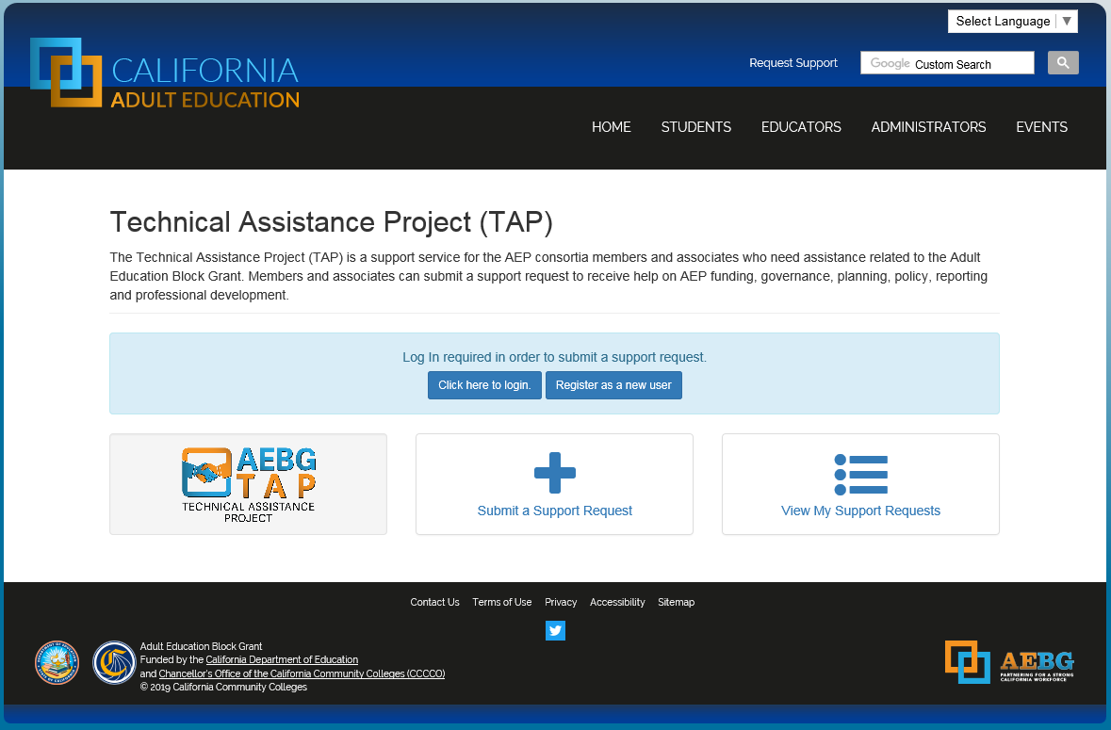
Request Support from CAEP TAP

