Slide 1
Immigrant Integration Indicators
March 25, 2021
www.casas.org

Slide 2
Topics
Review AB 2098, California’s commitment to immigrant integration, and the Immigrant Integration Indicators framework
Review EL Civics in California
Relate Immigrant Integration Indicators (I3) to EL Civics COAAP assessments
Demonstrate how I3 outcomes are included in local and statewide CAEP reporting
Identify the I3 reports in TOPSpro Enterprise (TE)
Use I3 reports to facilitate using results from COAAPs assessment to inform instruction

Slide 3
Recap from March 18
10.6 immigrants in California — 26.8% of population
340,000 English learners served annually by CAEP
CAEP supports language acquisition and so much more… documented now in our EL Civics program Civic Objectives and Additional Assessment (COAAP) metrics and tracking of services received.
In PY 2019-20, approximately 87,000 students achieved I3 outcomes through COAAPs assessments.
Notes:
Peter

Slide 4
Recap from March 18
2015: Statewide Director of Immigrant Integration position established (SB 84)
2018: CAEP directed to measure immigrant integration need and service effectiveness (AB 2098)
2019: AB 2098 Work Group Recommendations

Slide 5
Review: AB 2098
AB 2098 requires the CCCCO and the CDE to identify common measures consistent with, but not limited to, the English Literacy and Civics (EL Civics) Civic Objectives and Additional Assessment Plans (COAAPs) under WIOA Title II, for meeting the needs of immigrant and refugee adults seeking integration.

Slide 6
Review: AB 2098
At a minimum, they must accomplish both of the following:
  Define the specific data each adult education consortium may collect
  Establish a menu of common assessments and policies to be used by each adult education consortia that measure educational needs of adults and the effectiveness of providers in addressing those needs.

Slide 7
Review: AB 2098
AB 2098 requires consortia to report results for immigrant students in the following additional areas:
Increased economic security.
Improved English proficiency.
Increased credentials and residency.
Increased health and well-being.
Increased educational and career advancement.
Increased first language literacy.
Improved provision for children and family.
Increased participation in civic and community life.
*The AB 2098 Work Group added two additional areas in 2019.

Slide 8
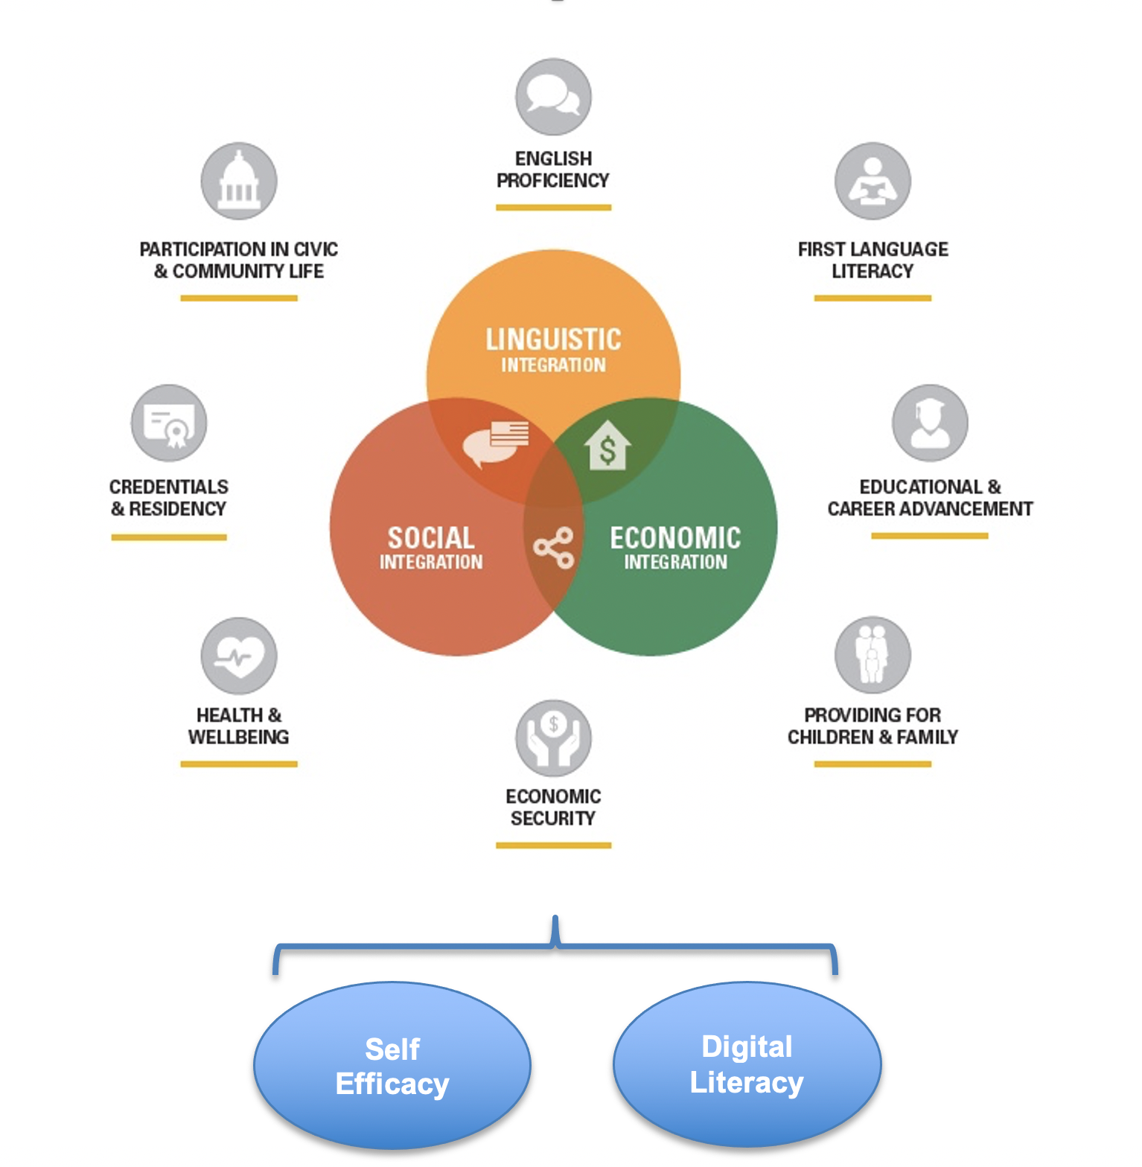
Recap: ALLIES Immigrant Integration Framework
Notes:
Jennie
A tool for CAEP programs and partners
Way of describing and measuring how we participate in process of immigrants’ integration and our growth as a society
AE contributes across the ten elements
A culture, not a program

Slide 9

California EL Civics
1998 Workforce Investment Act (WIA) passed
2001 English Literacy and Civics (EL Civics) first implemented in California
2003 First year of EL Civics focus areas – Civic Participation and Citizenship Preparation
2016 WIOA implementation – added Integrated EL Civics (IELCE) as a third ELC focus area in CA
2017 CA added Integrated Education and Training (IET) component to IELCE
2020 CAEP adopted ELC COAAPs for I-3

Slide 10
California EL Civics
Citizenship Preparation – prepares learners to take and pass the U.S. Citizenship and Immigration Services (CIS) written and oral citizenship test.
Civic Participation – connects literacy to the lives of learners and reflects their experiences as community members, parents, and participants in the workforce
243 Integrated EL Civics Education (IELCE) – combines English language instruction with Integrated Education and Training activities

Slide 11
California EL Civics
Civic Participation and IELCE both use Civic Objectives and Additional Assessment Plans (COAAPs) to document student progress.
Civic Participation – uses all 60 EL Civics COAAPs to measure and verify learner progress
243 Integrated EL Civics Education (IELCE) – uses a select list of “workforce related” COAAPs

Slide 12
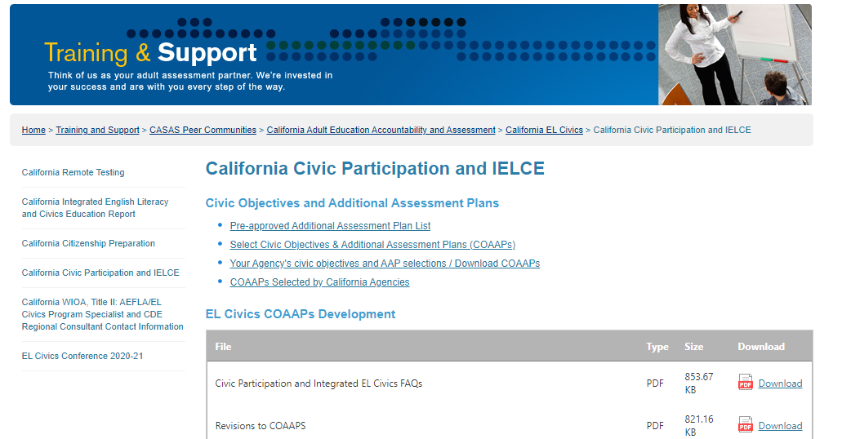
California EL Civics
https://www.casas.org/training-and-support/casas-peer-communities/california-adult-education-accountability-and-assessment/california-el-civics/california-civic-participation

Slide 13
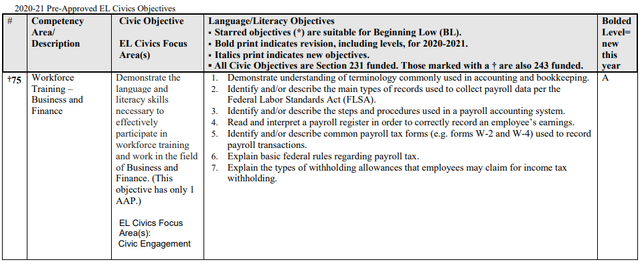
California EL Civics
Click the link below to download a pdf with a detailed list of all 60 EL Civics COAAPs.
https://www.casas.org/docs/default-source/el-civics/pre-approved-civic-objectives-list.pdf?sfvrsn=61102e5a_50?Status=Master
elcivics@casas.org

Slide 14
Linking COAAPs to Immigrant Integration Goal Areas
Economic Security 1,2,3,4,5,6
Credentials and Residency 38,39,40,42,44,45
Health and Wellbeing 15,16,17,26,27,28,29,30, 31, 46
Education and Career 13,14,32,33,34,35,36,37,49,50,51,52,53, 70,71,72,74,75
Children and Family 7,9,18,20,21,22
Civic and Community Participation 8,10,11,12,19,23,24,25,43
Digital Literacy 47,48,73

Slide 15
Linking COAAPs to Immigrant Integration Goal Areas
I3 Goal Areas | California EL Civics Civic Objectives
1. Economic Security | 1 - Identify, evaluate, compare financial services 2 - Access agencies to resolve consumer complaints 3 - Develop a business plan 4 - Describe methods to obtain housing 5 - Interpret housing agreements/responsibilities 6 - Identify housing issues/tenant rights
2. Credentials and Residency | 38 - Identify the organization of local, county, state, federal government and how to access 39 - Identify and discuss the voting process/rights/responsibilities 40 - Respond to questions about US history/government for the purpose of naturalization 42 - Identify people/events in local/state/federal history 44 - Identify, access and complete applications for identification cards and other services 45 - Identify features of the legal system and procedures for obtaining legal help.

Slide 16
Linking COAAPs to Immigrant Integration Goal Areas
IIF Goal Areas | California EL Civics Civic Objectives
3. Health and Wellbeing | 15 - Identify emergency services/legal assistance agencies 16 - Follow procedures and access assistance in case of emergency 17 - Access assistance to prevent or solve family/community problems 26 - Identify and access low cost health services 27 - Demonstrate knowledge of health/safety precautions 28 - Access the health care system/providers 29 - Interpret health insurance coverage and resolve provider issues 30 - Demonstrate how to use pharmacies/medicines 31 - Access resources for prevention/treatment of substance abuse 46 - Access resources for nutrition education and information on healthy foods

Slide 17
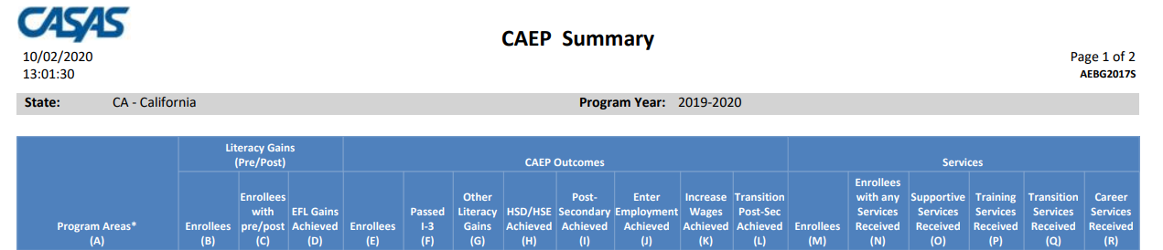

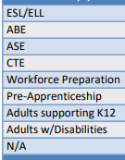
CAEP Summary Report
When qualified CAEP students pass EL Civics COAAPs it appears as a “Passed I-3” outcome on the TE CAEP Summary.

Slide 18

CAEP Summary Report
The TE CAEP Summary Report now includes a new Column F, “Passed I-3”
In PY 2019-20, over 87,000 CAEP students passed EL Civics COAAPs (I-3 outcomes)
All programs can earn I-3 outcomes, not just ESL.

Slide 19
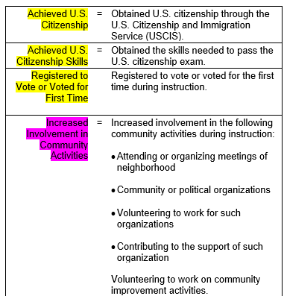
Immigrant Integration: Outcomes
In addition to the work on EL Civics COAAPs, ALLIES and CASAS have also worked together to identify Update Record outcomes that relate to these Immigrant Integration Areas.
These outcomes fall in other categories, not I-3; but they can also be used to document progress in Immigrant Integration.

Slide 20
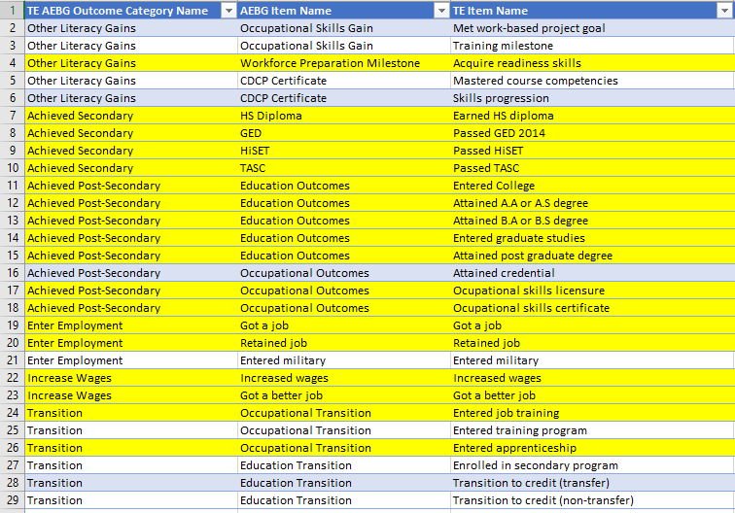
Immigrant Integration: Outcomes
The majority of CAEP AB 104 outcomes directly relate to one of the I-3 Areas.

Slide 21
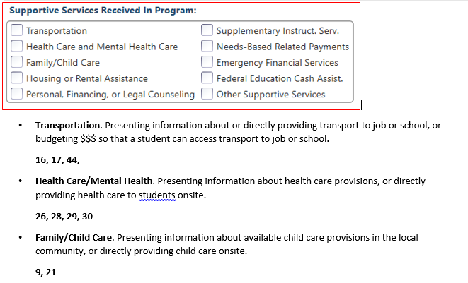
Immigrant Integration: Services
ALLIES and CASAS have also related Supportive, Training, and Transition services to both I-3 areas and EL Civics COAAPs.

Slide 22
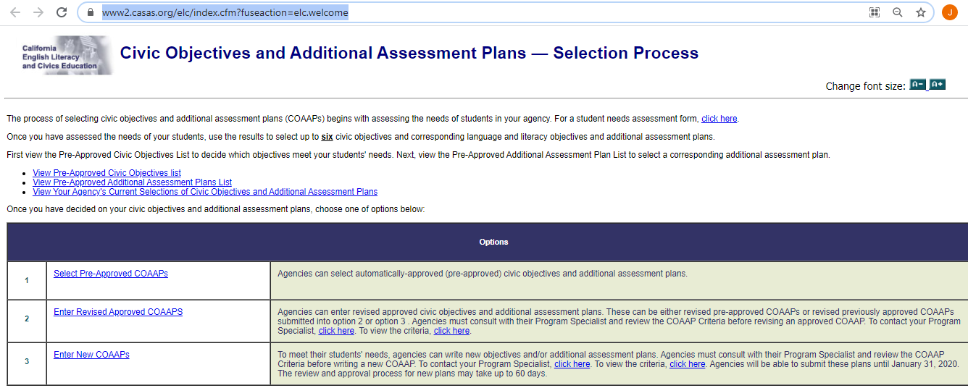
Selecting COAAPs on the CASAS Web site
https://www2.casas.org/elc/index.cfm?fuseaction=elc.welcome
Select Pre-Approved COAAPs

Slide 23
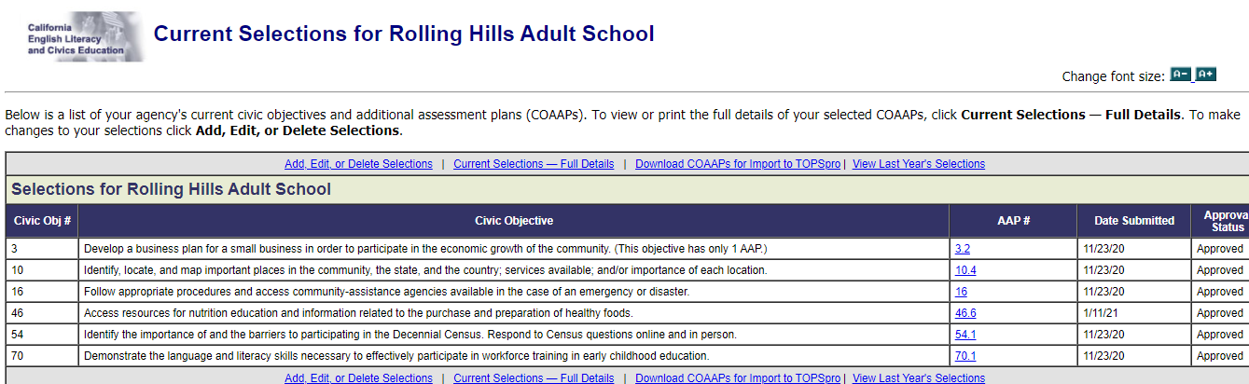
Selecting COAAPs on the CASAS Web site
https://www2.casas.org/elc/index.cfm?fuseaction=elc.welcome

Slide 24
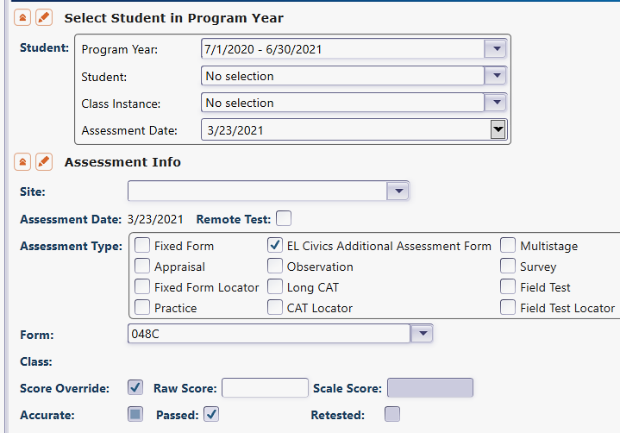
Recording COAAPs in TE
Select Records – Tests
Click New
Select PY, Student, Date
In Assessment Type, check EL Civics Additional Assessment Form
Select COAAP Form number
Check box if COAAP Passed

Slide 25
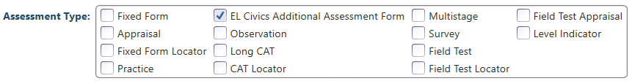
Recording COAAPs in TE
Key step is to check EL Civics Additional Assessment Form to enable manual entry of EL Civics COAAPs rather than pre- and post-test forms.

Slide 26
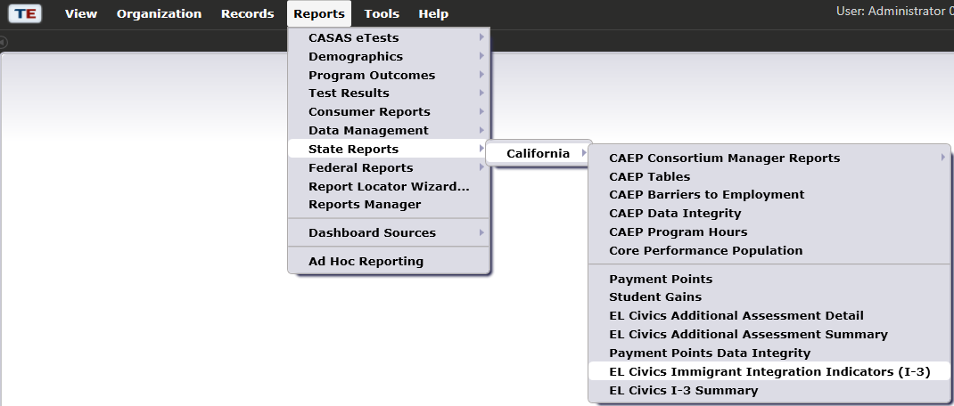
I-3 Reports in TE
EL Civics Immigrant Integration Indicators (I-3)
EL Civics I-3 Summary

Slide 27
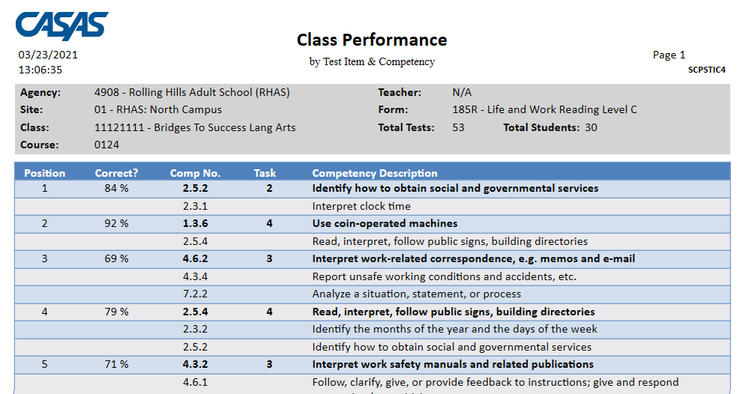
Competency Performance Summary

Slide 28
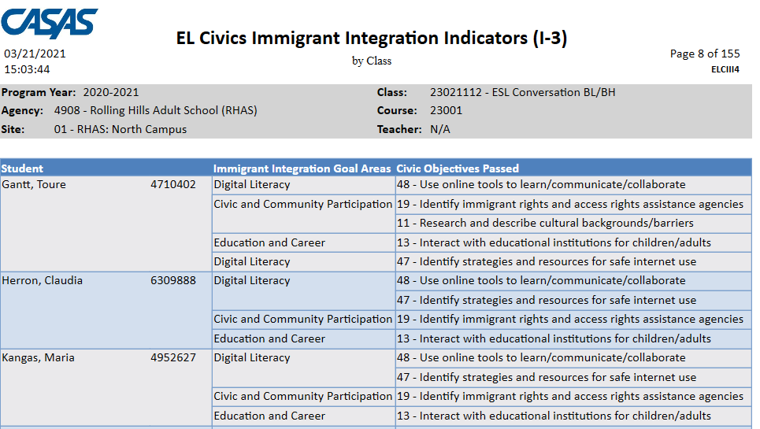
I-3 by Class

Slide 29
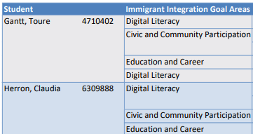
I-3 by Class
Immigrant Integration Goal Area lists one of the 8 I-3 areas identified by AB 2098.

Slide 30
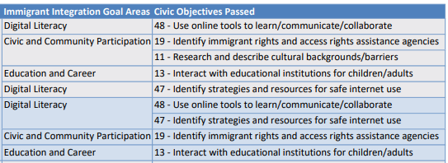
I-3 by Class
Civic Objectives Passed lists the specific COAAPs passed for each student, and relates each COAAP to the I-3 Goal Area.

Slide 31
I-3 by Class
This example student has passed five COAAPs that cover three different I-3 goal areas.

Slide 32
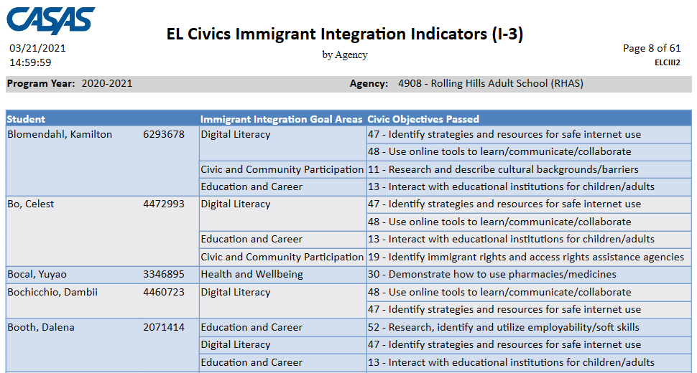
I-3 by Agency

Slide 33
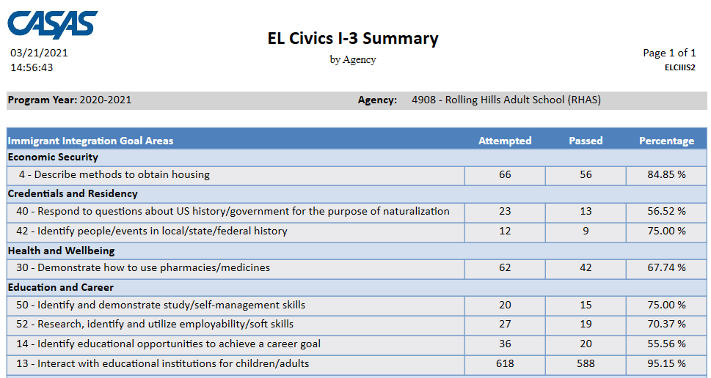
I-3 Summary

Slide 34
Recap
I-3 outcomes are now reported as an official CAEP outcome on the CAEP Summary.
CAEP learners earn I-3 outcomes by passing any EL Civics COAAP that relates to an I-3 goal area.
Many other CAEP services and outcomes also relate to I-3 areas (but do not register as an I-3 outcome in TE).
CAEP agencies can select COAAPs assessments from the CASAS EL Civics Website.
CAEP agencies can record ELC COAAPs in TE.
CAEP agencies can use the ELC Immigrant Integration Indicators and ELC I-3 Summary reports in TE to relate results from COAAPs assessments to inform instruction.

Slide 35

jwright@casas.org

