Slide 1



Education to Workforce Pathways
Smoothing the Route and Finding a Relevant Destination
March 10th, 2021
1 p.m. – 2:30 p.m.

Slide 2

Postsecondary Education & Workforce Group
The Postsecondary Education and Workforce Development Group at WestEd strengthens the role of higher education, workforce, and economic development programs to improve student access and outcomes in higher education and increase economic mobility for low income families and communities.

Slide 3

Some of Our Lines of Work
Data tools and analysis for adult education, K14 pathways, higher education, and workforce development
Pathway development & planning to connect K12, higher ed, adult ed, & workforce programs into regional systems
Assisting colleges on implementation of Guided Pathways and systems that increase student equity and outcomes
Labor market and economic analysis to support local and regional program and pathway systems
Professional Development on the use of data to increase educational success and economic mobility

Slide 4





WestEd CAEP Team
Randy Tillery
Director: Workforce
& Postsecondary Ed
rtiller@wested.org
Blaire Willson Toso
Sr. Program Manager
Adult Ed & Workforce Dev
btoso@wested.org
Allie Bollella
Program Coordinator
Educational Data Systems
abollel@wested.org
Alexandra Lozanoff
Sr. Program Manager
Professional Development
alozan2@wested.org

Slide 5

Today: Strengthening Career Pathways For Adult Learners
Why Career Pathways Matter
Education to Workforce Data Tool
Understanding Career Pathways
Using LMI and Employer Engagement to Build Stronger Pathways

Slide 6
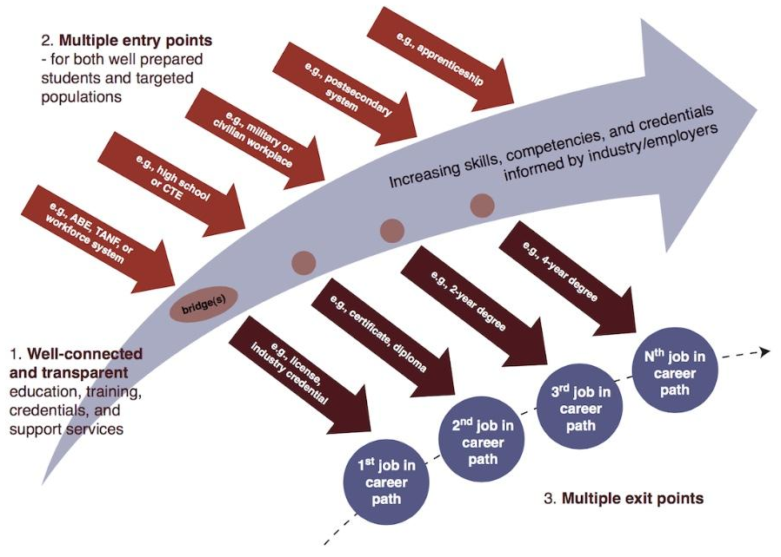
Career Pathway System:
Multiple entry and exit points for entry, middle skill, and higher skilled workers
Aligned to both immediate employment and ongoing education and training
Well developed transition strategies to help learners get from one level or system to the next
Strengthens student capacity for lifelong learning & setting future goals

Slide 7

Case Studies
San Diego/Imperial County Mapping Project
  Creating a regional career navigation system for adult learners using occupational and pathway data from adult education and community colleges
Delta San Joaquin TDL/AM Regional Sector Project
  Using labor market information, employer engagement, & facilitated pathway design workshops to develop a regional sector approach to transportation/logistics & advanced manufacturing pathways to living wage jobs
Notes:
North Alameda Pathway Development: Creating a consistent language and frameworks to inform shared adult education and college pathway design processes

Slide 8
Adult Education to Workforce Data Project

Slide 9
Education to Workforce Data Project
Purpose
Understand the continuum of CTE & career courses offered by NC & adult ed practitioners
Map the relationship between adult ed CTE & career offerings, credit programs, and regional labor markets
Support consortia pathway development and conversations about using labor market and other resources to support CAEP students

Slide 10
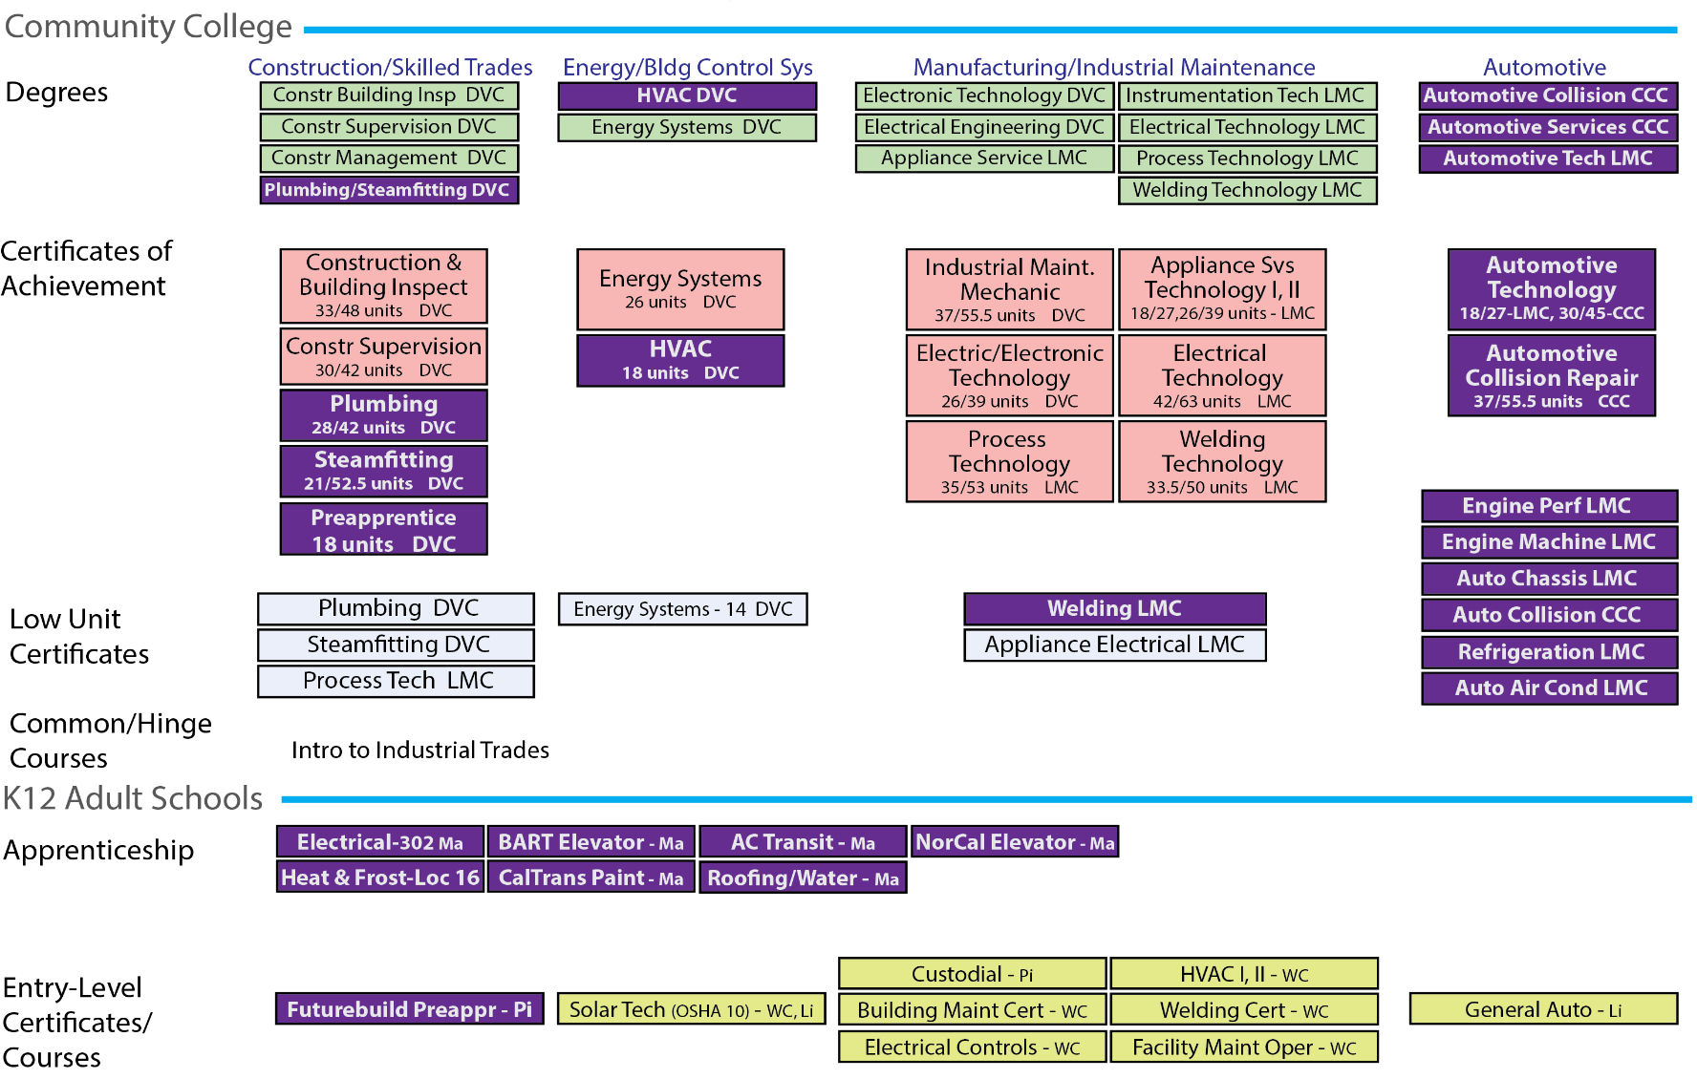
Project
Goal
Map K12 & college offerings & demand for employment to inform local pathway and curriculum development

Slide 11
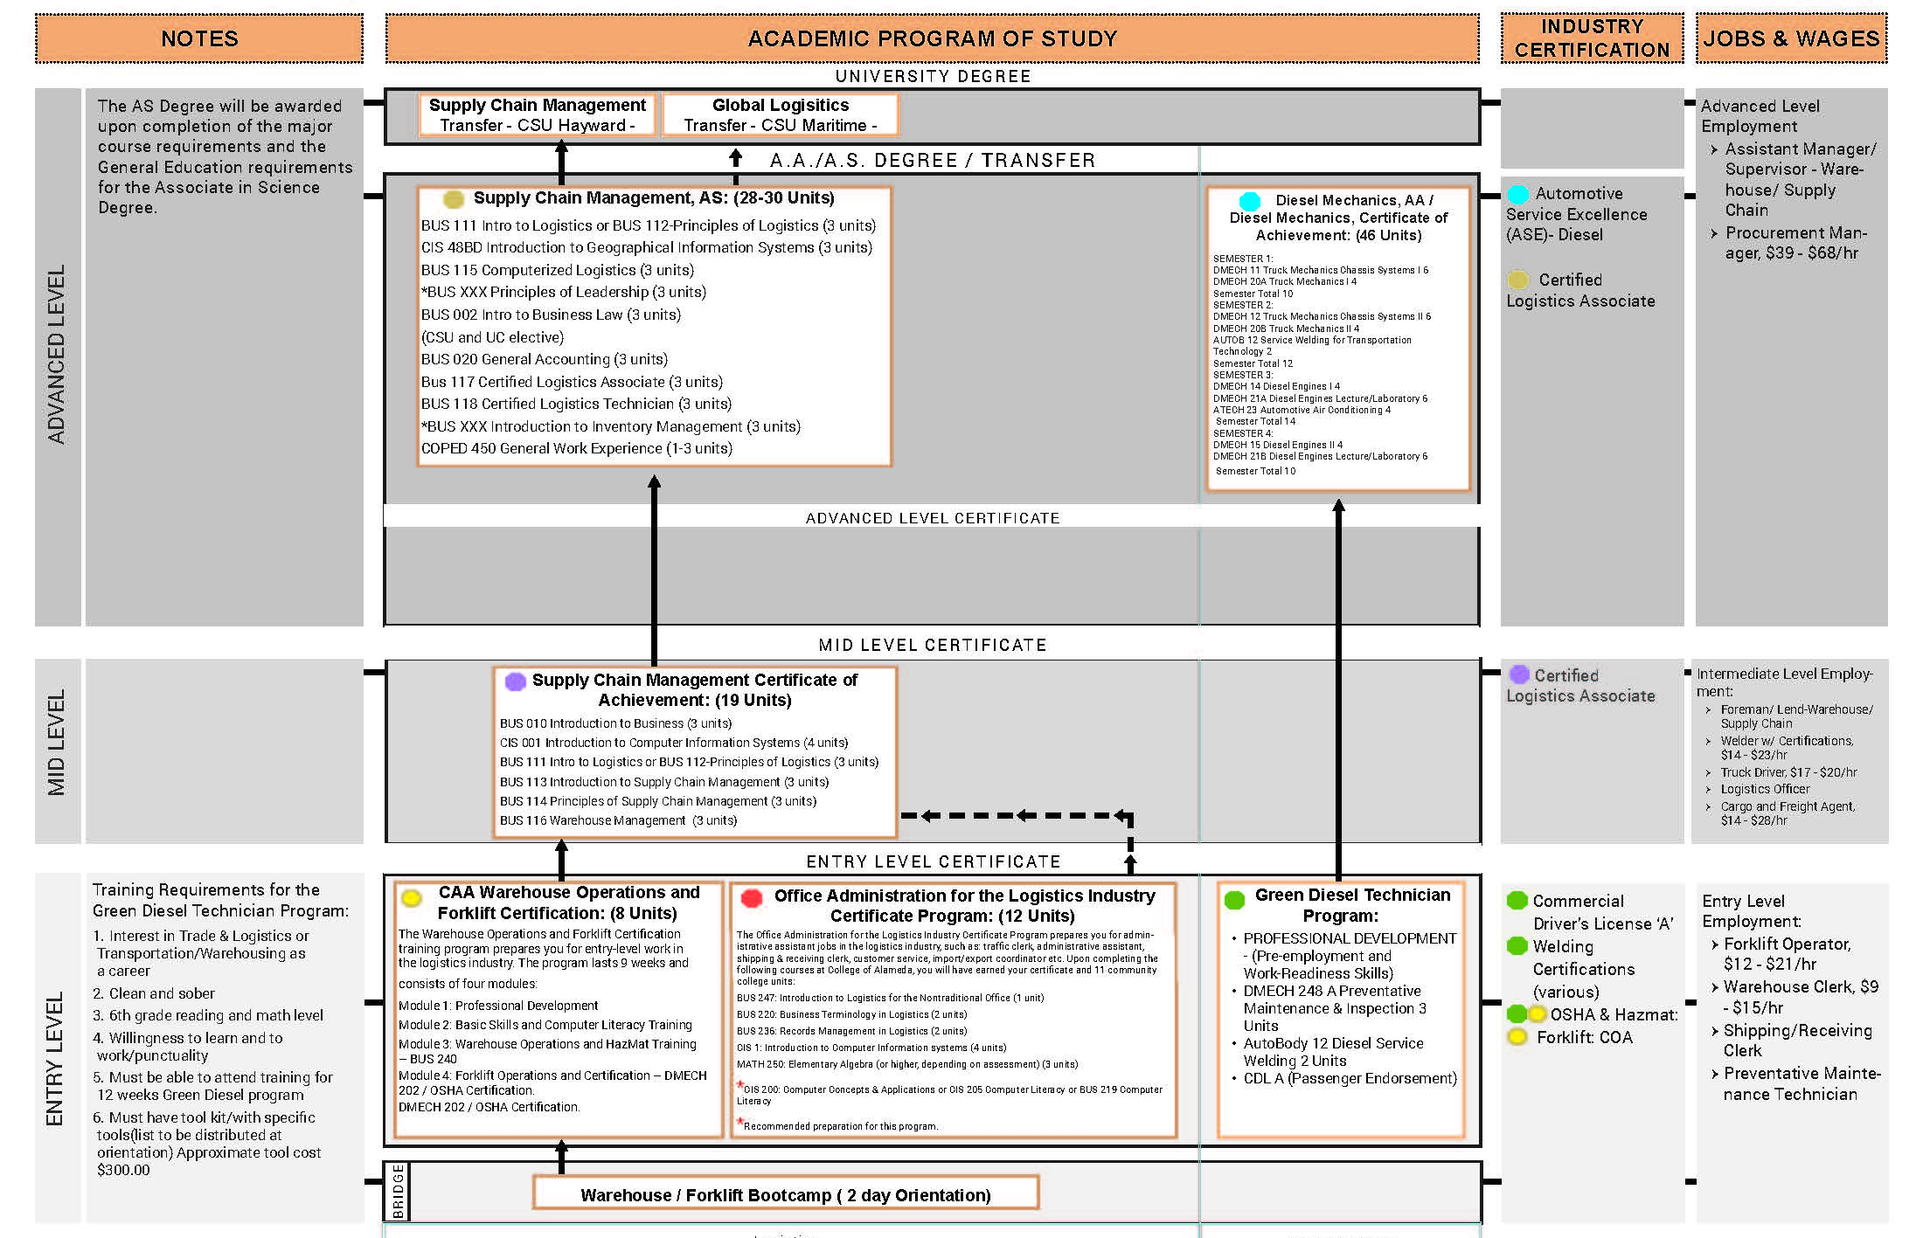
Project
Goal
Map K12 & college offerings & demand for employment to inform local pathway and curriculum development

Slide 12
Scope & Scale
Scanned 521 institutions
225 agencies providing CTE & Workforce Preparation Courses
Includes Over 7000 course offerings

Slide 13
CTE & Workforce Course Types
Workforce Preparation
Workforce Readiness, OSHA, ServeSafe – general skills necessary for success in the workforce
Occupational Skills Builder
Offerings that advance skills related to an industry but that by themselves do not qualify a student for a specific occupation within an industry
Occupational Credential Programs
Programs/courses of sufficient duration and intensity that provide skills for an individual to enter into or advance in a specific occupation and industry

Slide 14
CTE & Workforce Course Types
Workforce Preparation
OSHA 10
Occupational Skills Builder
Blueprint Reading
Occupational Credential Programs
Construction

Slide 15
Organization – Occupational Clusters

Slide 16


Occupational Clusters
Why They Are Important
Keeps the focus on jobs
Connects programs to labor market and wage data
Groups programs into related clusters by industry and skills
Allows you to research knowledge, skills, and abilities for all 800 occupations

Slide 17
Occupational & Skills Builder Courses
Occupational and Skills Builder Courses

Slide 18
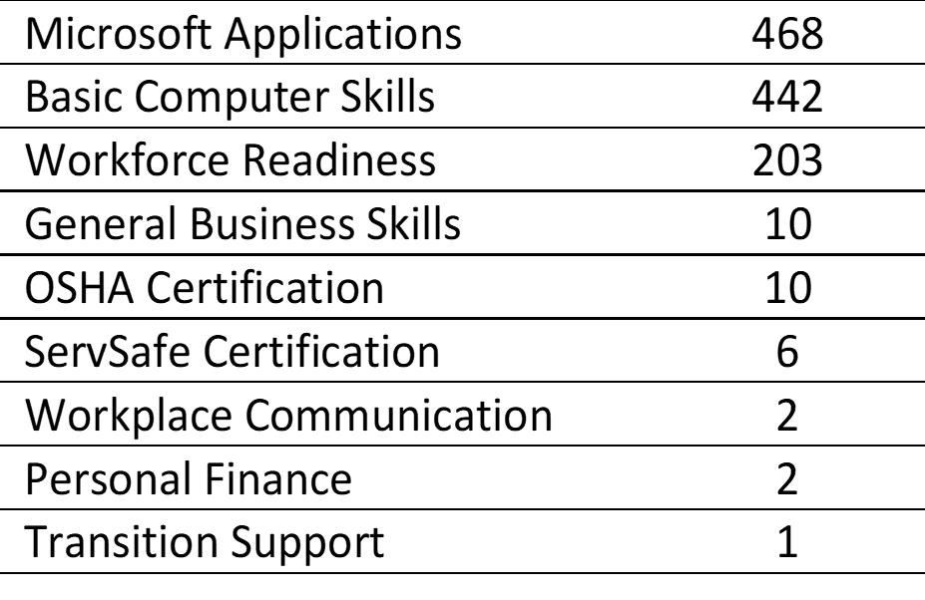
Workforce Preparation Courses

Slide 19
Higher Level Findings
Regions across California had a diverse mix of occupational training courses and skills builder courses, as well as occupational sectors, however statewide approximately 60% of courses were skills builder courses
At least a third of the adult education schools did not have any CTE or Workforce Preparation courses in their catalogues, websites, or associated brochures
From the public information it was hard to identify which schools were offering integrated or IET programs
Emphasis on skills builder courses is strongly aligned with mission of adult education to help adults get skills quickly relevant to their needs

Slide 20
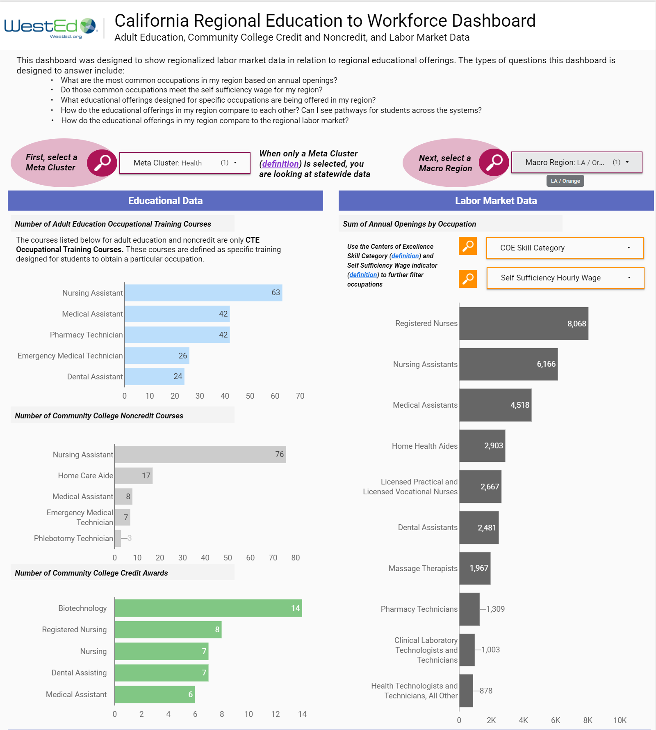
Education to Workforce Dashboard
Critical Framework Issues
Connects Occupational Codes to Pathways
Organizes Pathway Courses into Broader metaclusters
Distinguishes between courses that build occupational skills and courses/programs that lead to postsecondary credentials and jobs

Slide 21
During the Demonstration
Important Questions
How could you imagine using this information to build or strengthen a career pathway?
How could it inform student advising?
What conversations between adult education and college practitioners could you have using this information?
Be sure to share your thoughts in the chat

Slide 22
Live Demo

Slide 23
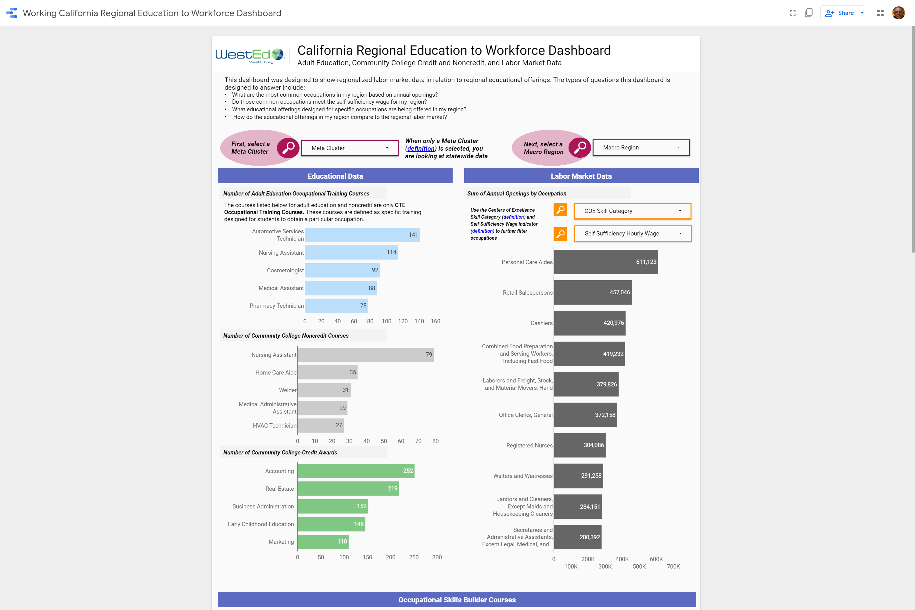
Adult Ed to Workforce Dashboard
Dashboard: https://bit.ly/CAEPcourses
Public Data Set:
https://wested.box.com/v/201920AECourses

Slide 24
Case Study:
San Diego/Imperial CTE Course
Alignment & Career System
Establish common definitions, organize courses and programs, and code courses and programs
Establish processes and a data structure for aggregating and updating course and program data
Implement an adult learner career exploration portal that captures the regional AE career pathways and system
Goal: Organize and classify regional CTE courses to build a career pathway system and career navigation platform across the SDIC Region/Super-region

Slide 25
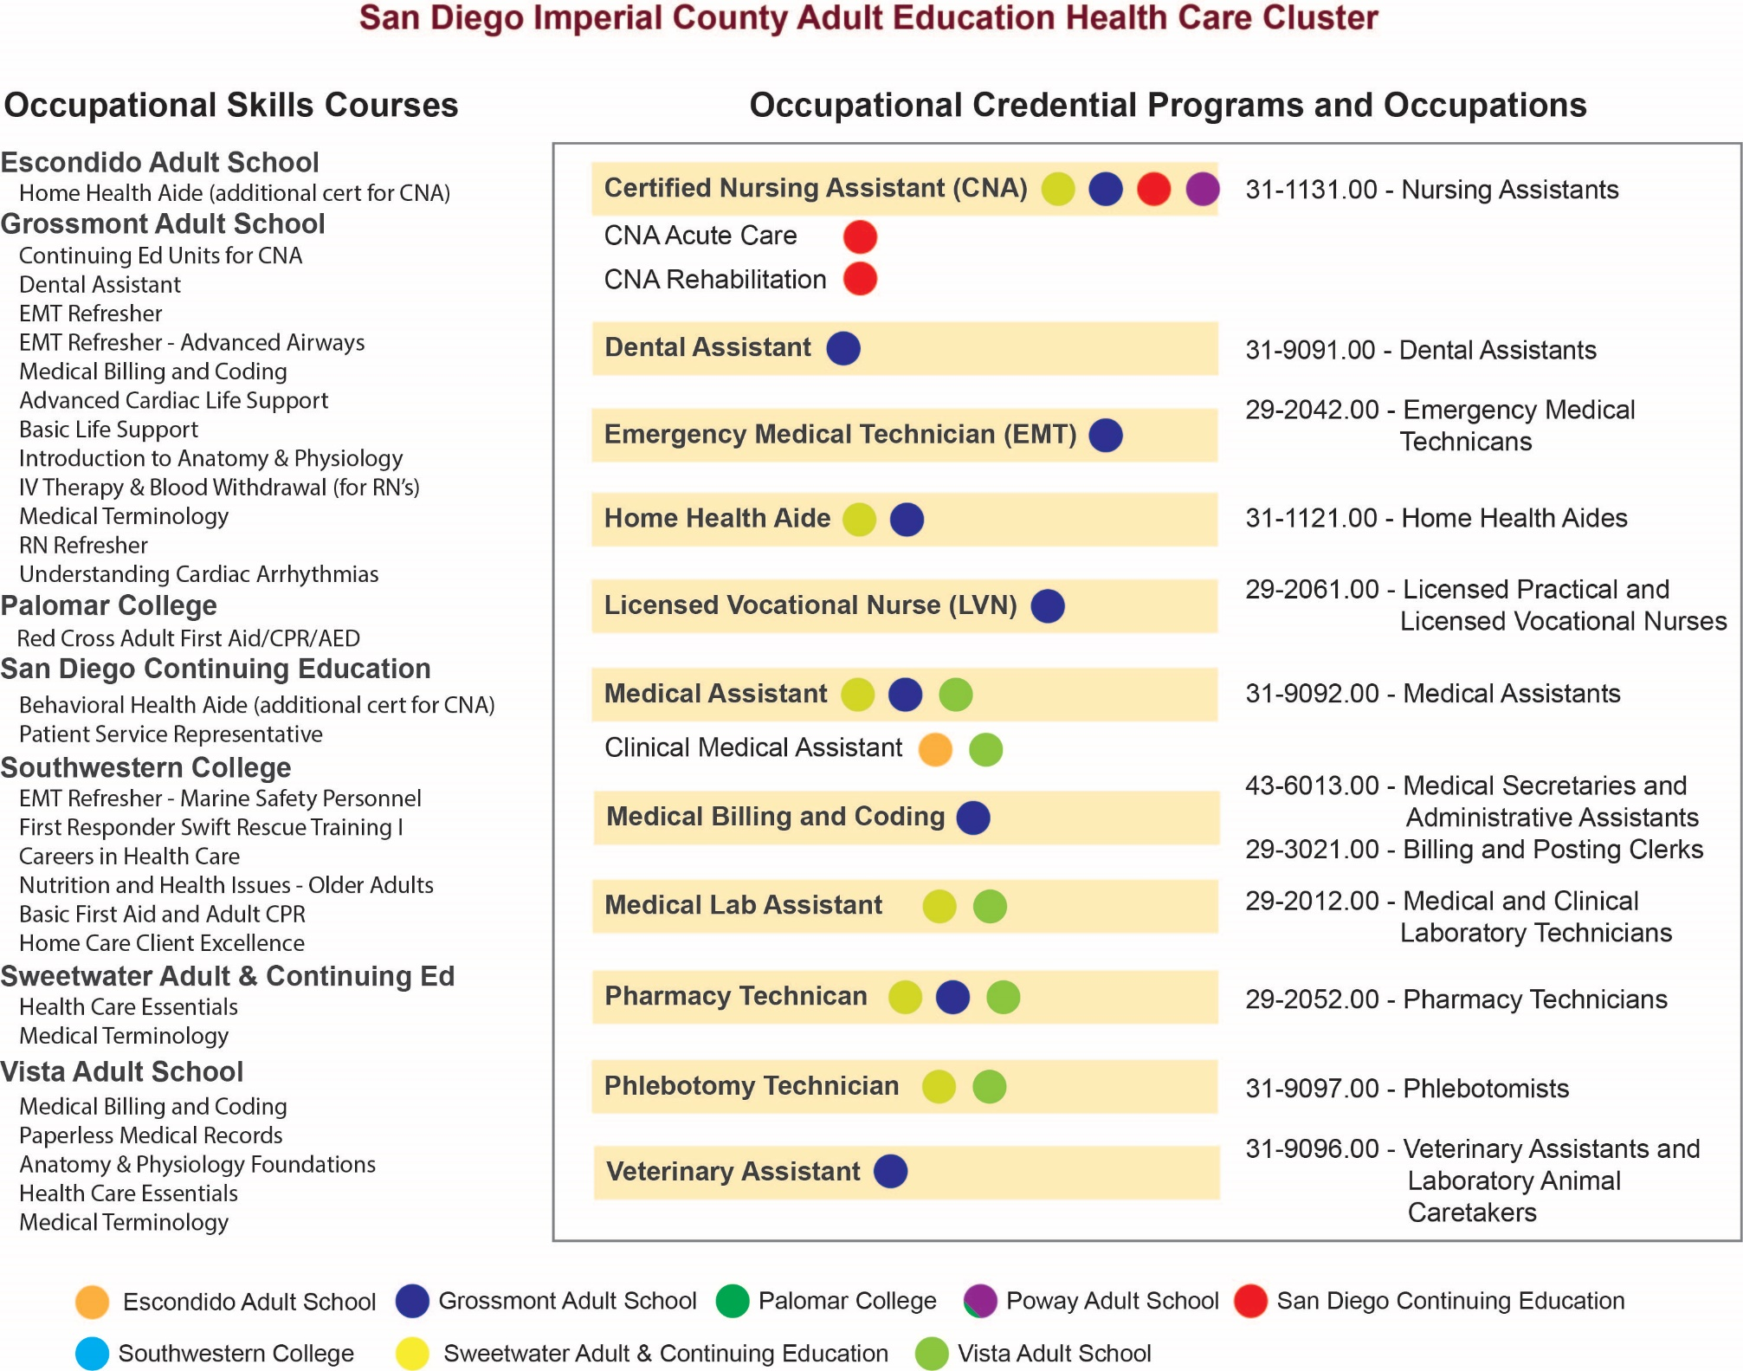
Strategy
Help practitioners organize their programs and courses to assign SOC codes and outline the regional career system.

Slide 26
Structure & Focus
Target Region: Greater San Diego Region
Participants: Super-region adult schools & college noncredit programs
3 Train the Trainer sessions for consortia reps to learn about occupational coding and framework
Consortia course categorizing and SOC coding planning sessions (w support from WestEd)
Developing & populating dataset
Next Steps
  Align with Community College credit pathways
  Explore development of online career platform

Slide 27
Timeline for Mapping and Coding
December
Kickoff and Preparation
Late January
Train the Trainer Event
Feb.–Mar.
Consortium planning to code courses and programs
March
Aggregate course and program information

Slide 28
Questions
How might a similar project benefit your region?
What kinds of support would you need to carry out a similar project?

Slide 29
Career Pathway Design

Slide 30
Career Pathway System:
Multiple entry and exit points for entry, middle skill, and higher skilled workers
Aligned to both immediate employment and ongoing education and training
Well developed transition strategies to help learners get from one level or system to the next
Strengthens student capacity for lifelong learning & setting future goals

Slide 31
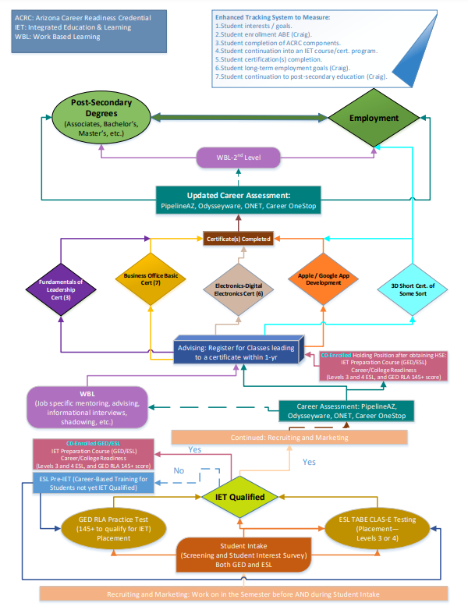
Building Pathway Systems: From Many to Many
Multiple routes and destinations
Connections based on transferable skills
Clear options for students at each stage
Doesn’t have to be within the same industry or occupational cluster
From: Yavapai College Adult Education

Slide 32
Building Pathway Systems:
From Many to Many

Slide 33
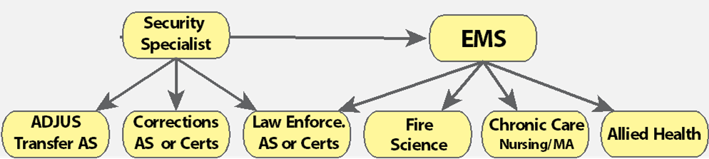
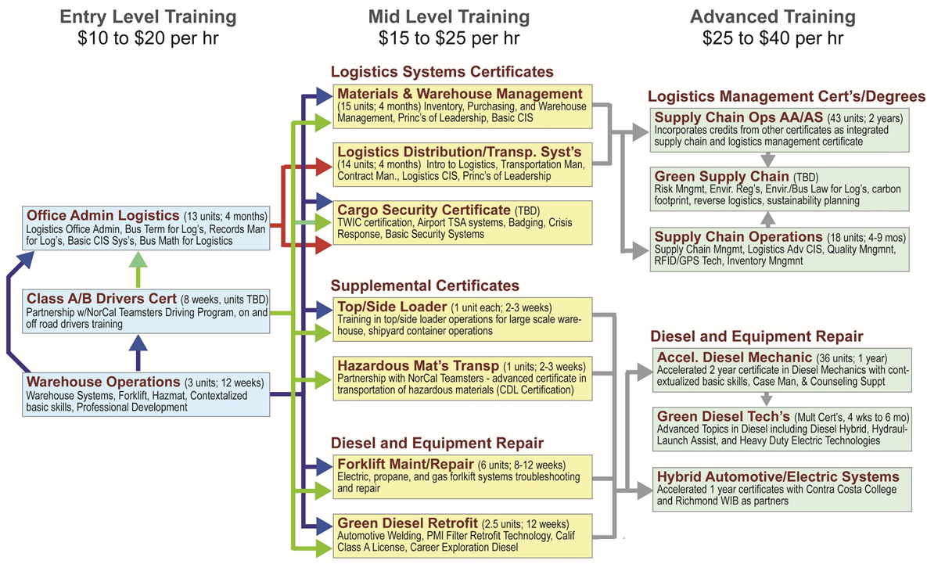
Pathway Lattices can be Simple or Complex
Public/Protective Services & Health Care
Transportation, Distribution & Logistics

Slide 34
Pathway Design Thinking
Identify Your Pathway or Program – Population, Industry, Occupation
Set Up Your Pathway – Partnerships, Shared Plan, Sustainability
Develop Continuous Improvement Plan – Key Measures & Data Collection
Implement Your Pathway Plan
Establish Partners
Create a Shared Plan
Determine sustainability
Develop Aligned Pathway Program – Id Design Team, Design Program/Pathway
Set Up Your Pathway Process – Partners, Shared Plan, Sustainability

Slide 35
Career Pathway Must Haves
Informed by labor market and employer needs
Engages relevant partners
Prepares learner for specific occupation or occupational cluster
Offers:
  Explicit pathway(s)
  Multiple entry, transition & exit points
  Accelerated education & training opportunities
  Employment & bridges to additional training
  Relevant credentials & certification opportunities
Are there other must haves for building a robust Career Pathway. (Please share in the chat)

Slide 36
Using Labor Market & Occupational Data:
Important Questions
What jobs are aligned to your programs?
How well are your programs preparing students for the workplace?
How do skills and competencies transfer across occupations?
What are the skills and competencies needed for target occupations?
What wages can students expect in their target occupation?
For more information see:
Making Use of Labor Market Information: Where to Find Data for Common Community College Decisions (http://www.coeccc.net/COE/media/SupplyandDemandPageDocuments/Making-Use-of-Labor-Market-Information.pdf)
Understanding Labor Market Information Resources: Descriptions, Benefits, and Limitations (http://coeccc.net/COE/media/SupplyandDemandPageDocuments/Understanding-Labor-Market-Information-Resources.pdf)

Slide 37
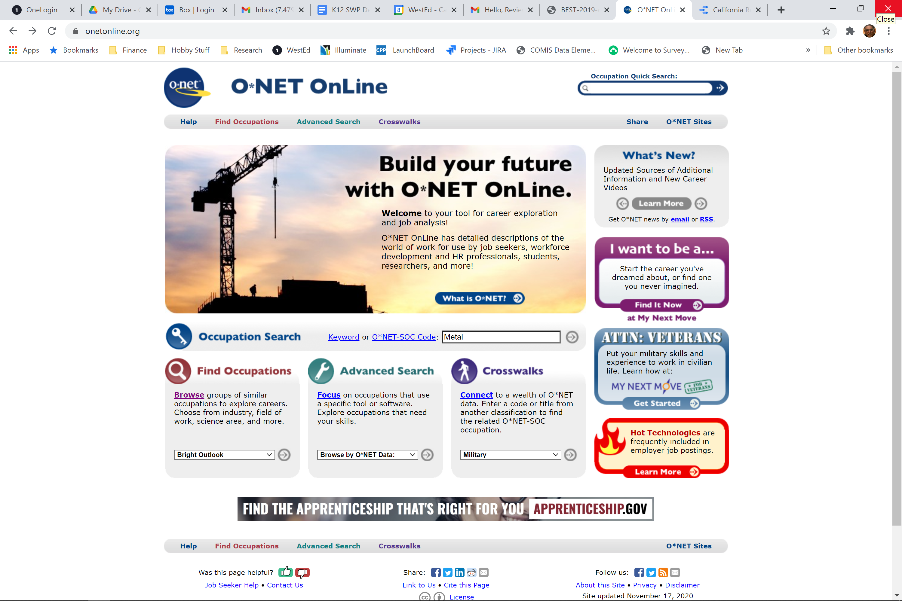
O*Net
Designed by the Employment & Training Administration
Offers detailed descriptions of jobs and skills
Search by Keyword, Job title, SOC Code

Slide 38
Additional Resources
US DOL Education and Training Administration:
The Importance of Workforce and Labor Market Information
CareerOneStop:
State Profile: California Labor Market Information
Corporation for a Skilled Workforce:
Understanding Your Community: Labor Market and Workforce Development System Data Toolkit

Slide 39
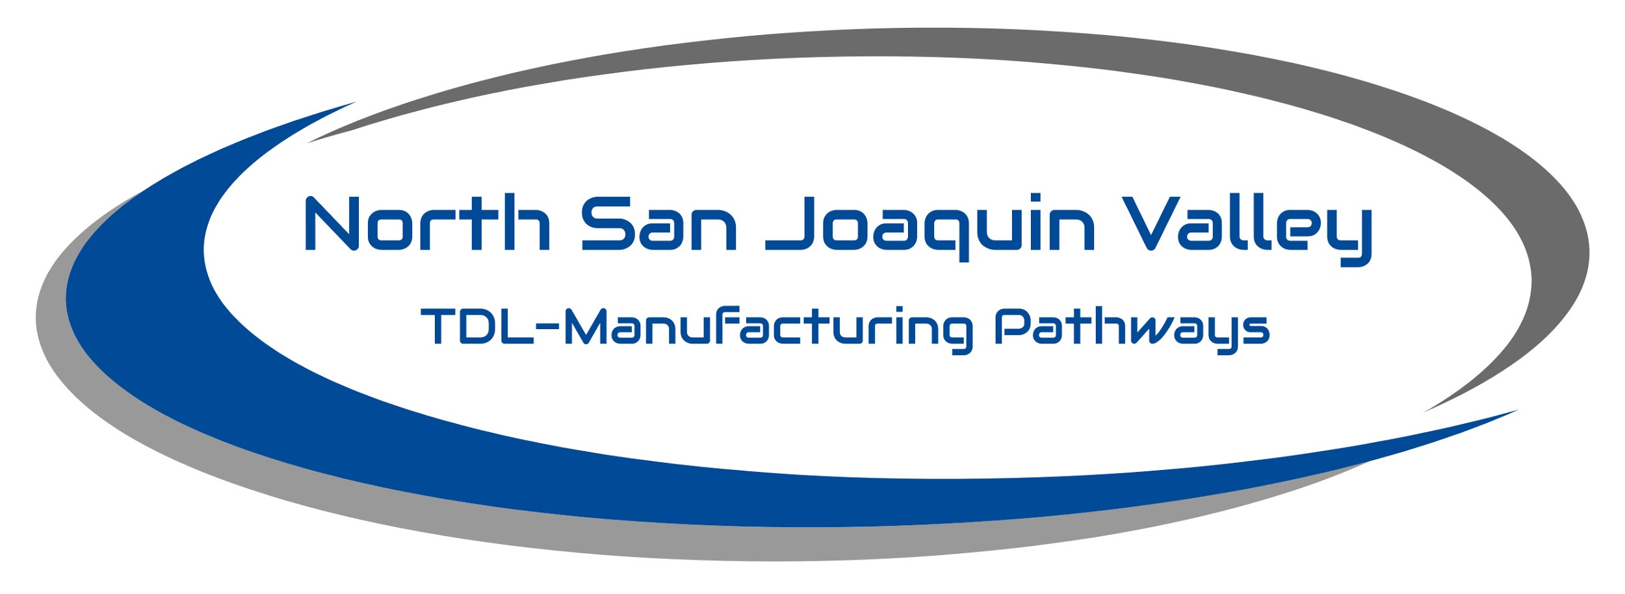
Delta Sierra Adult Education Alliance
Case Study
Mission: To create a qualified workforce for Transportation/Logistics & Advanced Manufacturing employers in North San Joaquin Valley and pathways to family-sustaining careers for area residents.

Slide 40
Goals
Map TDL and AM Industries and Skills Needed for Entry Level & Middle Skill Employment
Map Regional Adult Ed & Community College Programs with Industry Needs
Support Pathway Development with Educators, Industry & Workforce System

Slide 41

Initial Partners
Delta Sierra Adult Education Alliance (DSAEA) | Economic Development | San Joaquin Delta College | Community, Higher Education and Business
Lodi Adult School Manteca Adult School Stockton School for Adults Tracy Adult School San Joaquin Delta College San Joaquin County Office of Education Calaveras County Office of Education Wind River Adult School | City of Lathrop City of Lodi City of Manteca City of Stockton City of Tracy San Joaquin County WorkNet San Joaquin County Economic Development | Economic and Workforce Development Applied Science, Business, and Technology Division | California Human Development Prologis University of the Pacific
Notes:
INITIAL PARTNER LIST → WILL ADD ADDITIONAL AS PROJECT MOVES FORWARD → LEADERSHIP = Strategy Coordination Team – BH/MAS, DH/SJDC, PV/SJWN

Slide 42
Project Description:
WestEd has been asked lead data collection, employer engagement, and a pathway design process to build opportunities for more San Joaquin County residents enter career pathway jobs in TDL/AM industries and strengthen the flow of qualified workers for regional employers.
Labor Market and Occupational Data: Landscape analysis of TDL and AM employers, activity, and employment in San Joaquin County and broader north Central Valley.
Employer Interviews: Interviews 40 employers in San Joaquin County to understand issues related to recruitment of qualified workers and the specific skills possessed by desirable and high performing employees.
Pathway System Mapping: Map education/training programs to build a system map and make recommendations to improve the alignment of regional training systems with industry and employer needs.
Pathway Building: Leading conversations with educators to identify opportunities for building stronger training pathways and initial design work with educators, the workforce system, and regional employers.
Regional Sector Partnership: Support the development of a vision for a regional sector partnership to support ongoing engagement between industry and education to meet the needs of residents and employers

Slide 43
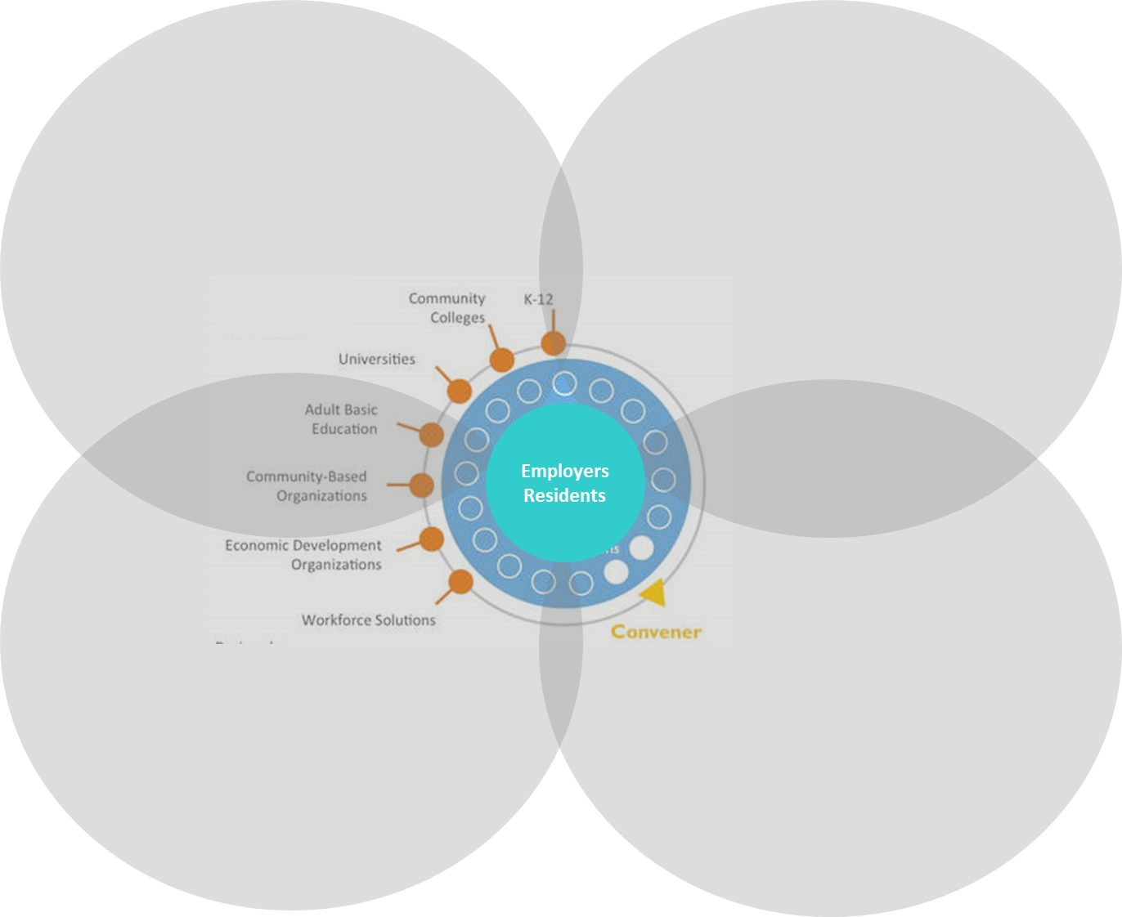


Building a TDL/AM Regional Sector Partnershipwith
Shared table for industry, education, government, workforce, & community to innovate & collaborate
Aligns workforce, education & economic strategies around a specific industry sector
Expand opportunities for economic growth and access to quality jobs and career pathways
Aligns investments and capacity of public, community, and private sectors to increase collective impact

Slide 44
Discussion
Write in the chat or open your microphone to share your response to the following questions:
  What do you need to know to help you make design decision about how to build strategic regional pathways that meets adult learners needs?
  What data would help inform decisions about identifying and developing a career pathway?
  What data would help you identify collaborators and partners for the career pathway?

Slide 45
Thank You!
Randy Tillery
Director: Workforce
& Postsecondary Ed
rtiller@wested.org
Blaire Willson Toso
Sr. Program Manager
Adult Ed & Workforce Dev
btoso@wested.org
Allie Bollella
Program Coordinator
Educational Data Systems
abollel@wested.org
Alexandra Lozanoff
Sr. Program Manager
Professional Development
alozan2@wested.org

