Slide 1
Health+RHT Cross Sector Collaboration for Education, Workforce and Economic Recovery
Infection Control for All Now (ICAN)
Safe Workforce,
Safe Workplace

Slide 2
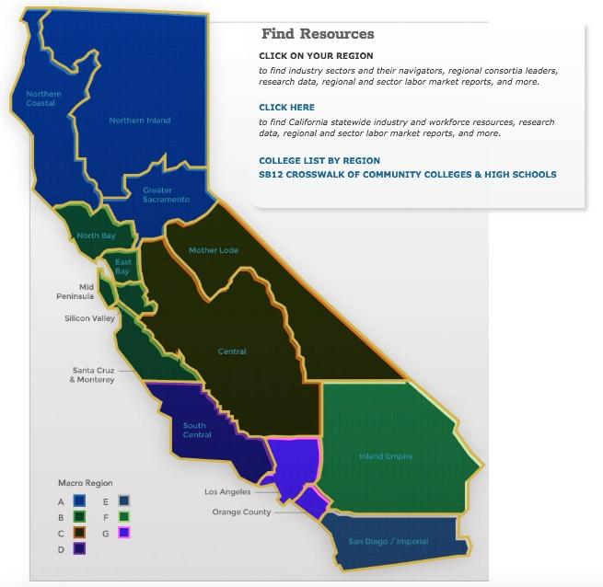

CA Community Colleges
Workforce Economic Development Division
115 colleges in
7 Regions Statewide

Slide 3
Workforce Economic Development Division Goals
Goals:
Student Success
Support Employers
Showcase CCC resources
Support Economic Recovery & Community

Slide 4


Health + RHT Collaboration
John Cordova, BSN,RN, PHN
Statewide Director, Health
Joy Hermsen, MBA
Statewide Director, Retail/Hospitality/Tourism
Public Health Education
Control of Infection Spread
Workforce Training
Consumer Trust & Confidence
HR Tracking of Training
Employer Confidence

Slide 5
Infection Control for All Now (ICAN)
Safe Workforce, Safe Workplace
Free Certification and Training
Digital Badge and Certificate
2 hours or less to complete
CDC and CDPH based information
User Friendly Online Access
Register at ca-hwi.org

Slide 6
Benefits for Employers
Trained employees
Documentation of training
Access to Free CCC Resource
Show customers they are a Safe Workplace

Slide 7
Why ICAN is built into the Canvas LMS
Canvas Learning Mgmt. System
  Used in many schools, colleges & universities
  Easy to replicate for other sectors and pathways
  Trackable
  Exposure for new workers to ease into college work
Hosted by Syn-Ed

Slide 8
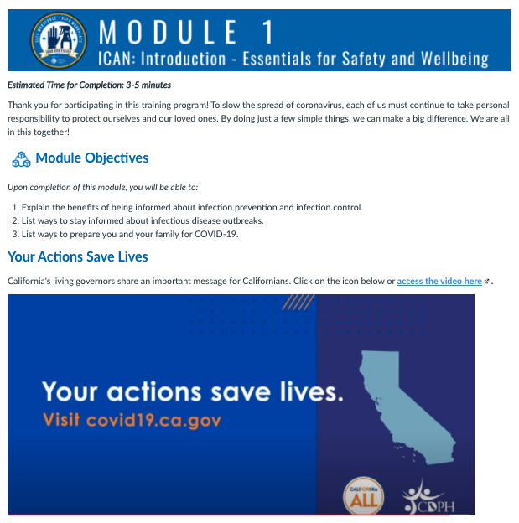
Features for Adult
Learners
Modules are short
Can be completed on computer, mobile phone or tablet
Videos, Photos make info easier to digest

Slide 9
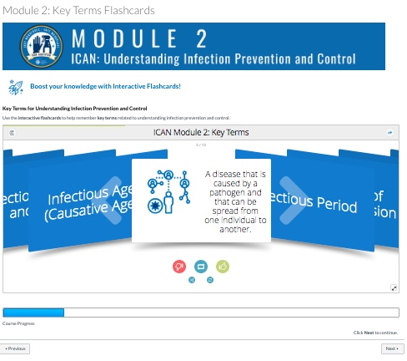
Interactivity Builds Retention
Interactive Flash Cards
Check Your Learning As You Go
Relevant industry information built in

Slide 10
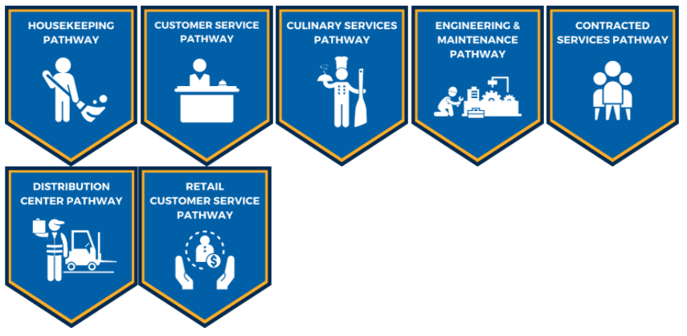
7 Certificate Pathways Available

Slide 11
5 Modules for 7 Certificate Pathways
Modules
Digital Badge/Certificate
Essentials for Well-Being
Infection Prevention & Control
Employee Safety
Workplace Safety
Choose Certificate Pathway
  Pass a 10 Question Quiz

Slide 12
5 Modules for 7 Certificate Pathways
Modules
Digital Badge/Certificate
Essentials for Well-Being
Infection Prevention & Control
Employee Safety
Workplace Safety
Choose Certificate Pathway*
*customize this for other jobs and other sectors

Slide 13
ICAN Next Steps
Share with Industry and Business Owners Statewide
Share with Educators, including CAEP
Seek funding for Spanish version and other languages
Consider finding funding for Educator Pathway
John Cordova: john.cordova@canyons.edu
Joy Hermsen: hermsen_joy@rsccd.edu

Slide 14
Question/Answer Session
Contact us for more information:
John Cordova: john.cordova@canyons.edu
Joy Hermsen: hermsen_joy@rsccd.edu
Thank you for your interest!
Stay safe, wash hands, wear a mask and stop the spread.

