Slide 1
CAEP Fiscal Update
Neil Kelly – State CAEP Office
Veronica Parker – CAEP TAP

Slide 2
Agenda
Governor’s Proposed Budget 21-22
Release of the CAEP Preliminary Allocations & CFAD
Other items for 21-22
CAEP Expenditure Requirements
How to Navigate NOVA (Demo) – filing expenditure reports &close out reports. Plus how to use the forecasting tool.
Questions
Upcoming Events

Slide 3
Governor’s Proposed Budget 2021-22
2020-21 Allocation: $538,564,000
Proposed Increase (1.4999%): $8,078,000
2021-22 Allocation: $546,642,000
All numbers subject to change at the May Revise.

Slide 4
Release of the CAEP Preliminary Allocations & CFAD
February – Release of CAEP Preliminary Allocations for 2021-22
March-April – consortia public meetings to decide allocations
May 2nd – CFAD due in NOVA

Slide 5
Other Items for 2021-22
Member Effectiveness Reminder
3 Year Planning
Governance Certification
Targeted Technical Assistance

Slide 6
CAEP Expenditure Requirements
Planning Process – 3 year plans, annual plans, work plans & budgets
Fiscal Process – work plans & budgets, quarterly expense reporting.
Current NOVA cycle – (2018-19) closing out, (2019-20) funds active until 12/31/21, and (2020-21) funds active until 12/31/22.

Slide 7
CAEP Close Out Process
Break Down of 36 month Cycle – using 2018-19 funds.
2018-19 funds were allocated beginning July 1, 2018.
CAEP members had until June 30, 2020 to spend (2 years)
In order to carry-over funds into Year 3 (beginning July 1, 2020) – members had to complete a corrective action plan in NOVA.
The corrective action plan allows for an extra 6 months (until 12-31-20).

Slide 8
CAEP Close Out Process (cont.)
So far – started on July 1, 2018 – with activities ending by 12-31-20 = 30 months.
Close out process begins 1-1-21.
Members must enter final 2018-19 close out numbers (along with their Q2 expenditure information) into NOVA by 3-1-21.
Consortium Director will certify Q2 and the close out for 2018-19 by 3-31-21.

Slide 9
CAEP Close Out Process (cont.)
If you are returning CAEP funds….
April - State CAEP Office will invoice any members that are returning 2018-19 funds to the State General Fund.
May - Members will remit funds to the State.
June - State Chancellor’s Office and CDE close the books on 2018-19.
Total time = 36 months.

Slide 10
FAQs for CAEP Close Outs
Q: My member needs more time to finalize their close out report in NOVA? What do I do?
A: The consortium has until March 31 to certify Q2 and close outs. Work with your members to provide them additional time, and allow for consortium review & certification within the March 31 deadline.

Slide 11
FAQs for CAEP Close Outs
Q: My member’s accounting office asked if expenditure close outs include encumbrances rather than expenditures?
A: All CAEP activities related to 2018-19 funds ended on 12/31/20. The close out report must include all confirmed expenditures. We cannot allow for open purchase orders or encumbrances for close out certification. Please have them contact TAP if they have questions.

Slide 12
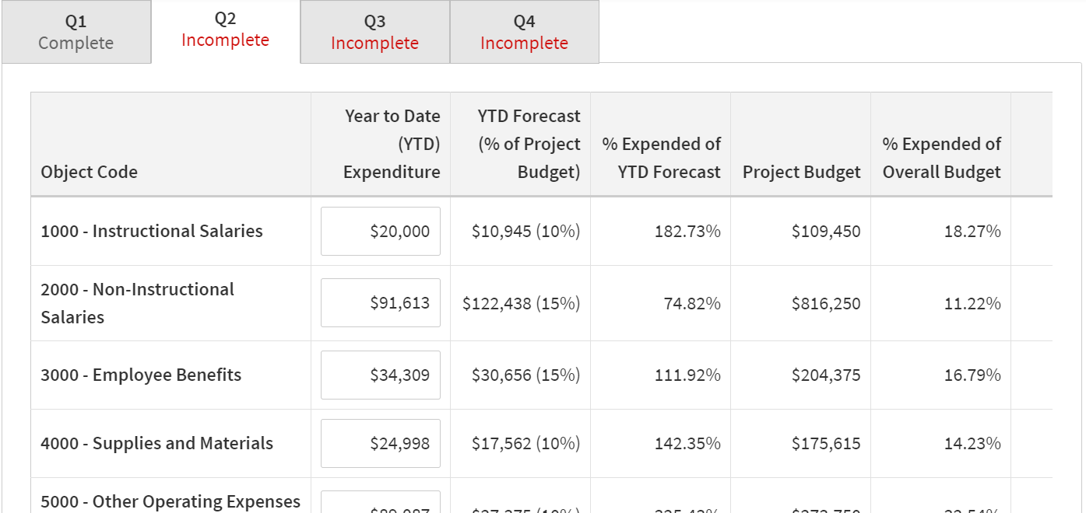
2018-19 Close Out

Slide 13
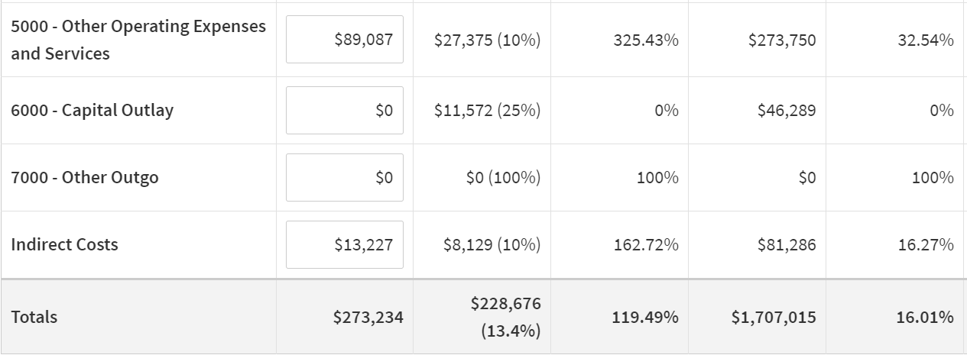
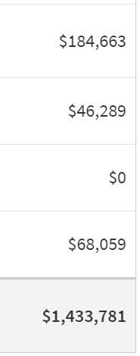
2018-19 Close Out

Slide 14
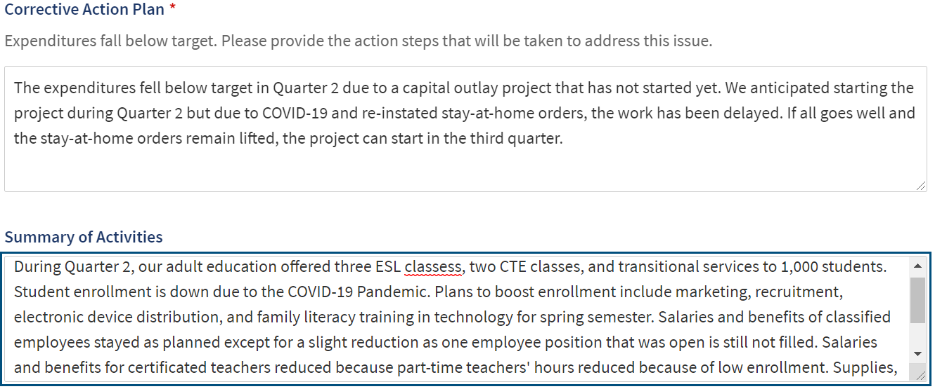
2018-19 Close Out
classes

Slide 15
2018-19 Close Out

Slide 16
2018-19 Close Out

Slide 17
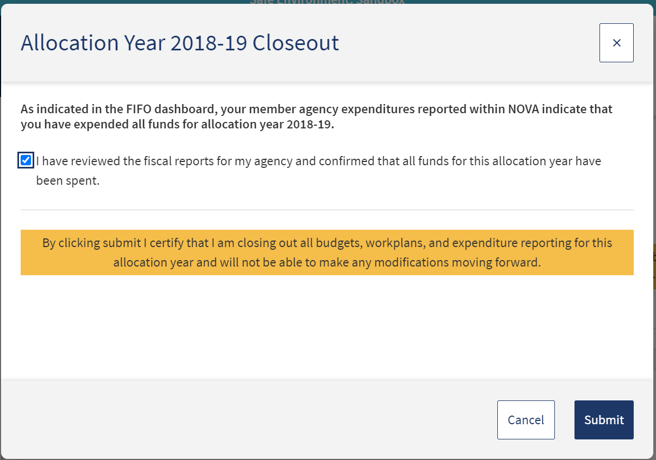
2018-19 Close Out

Slide 18
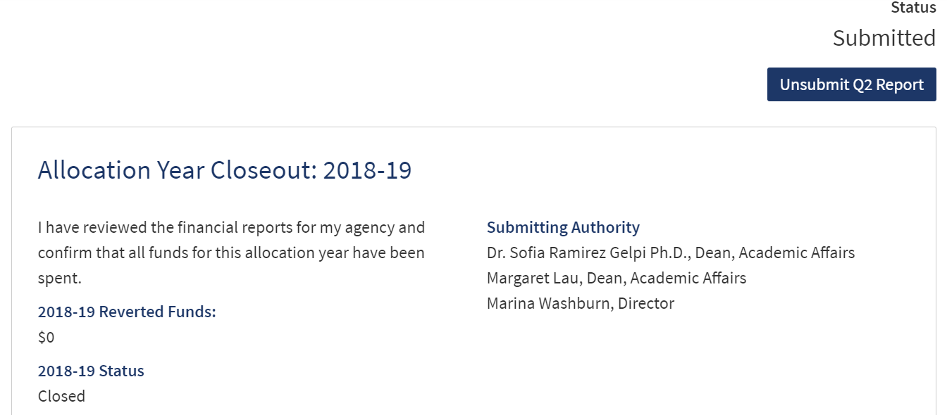
2018-19 Close Out

Slide 19
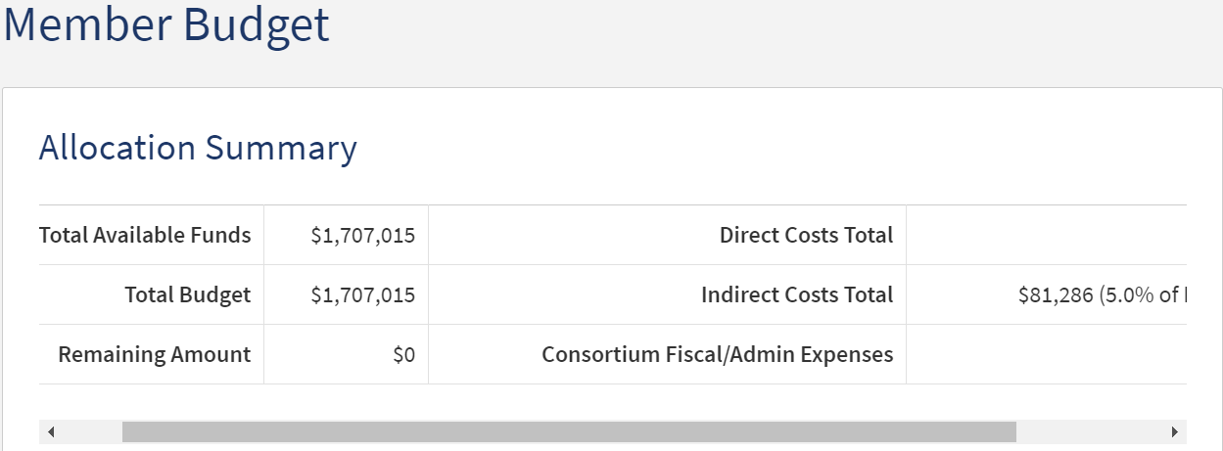
CAEP Forecasting

Slide 20
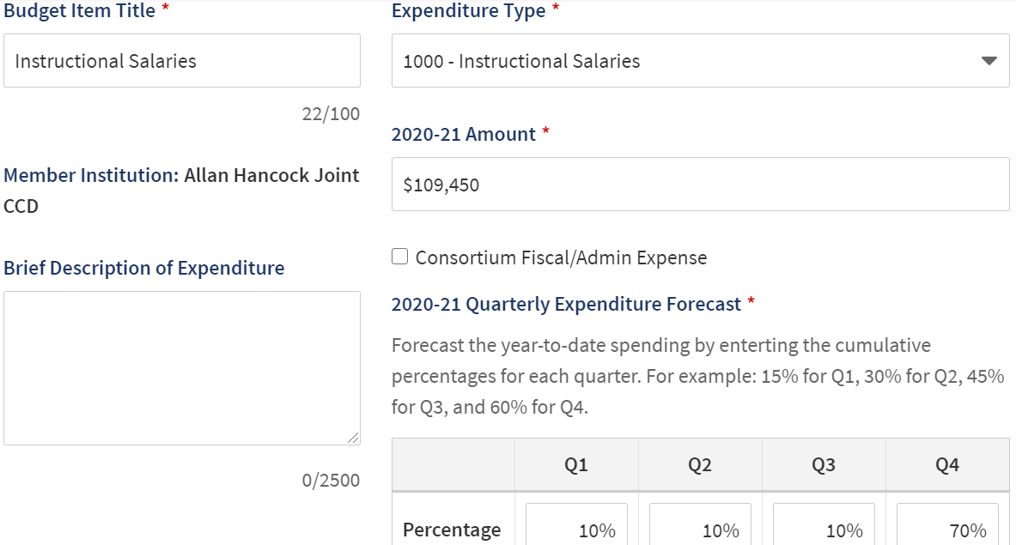
CAEP Forecasting Examples

Slide 21
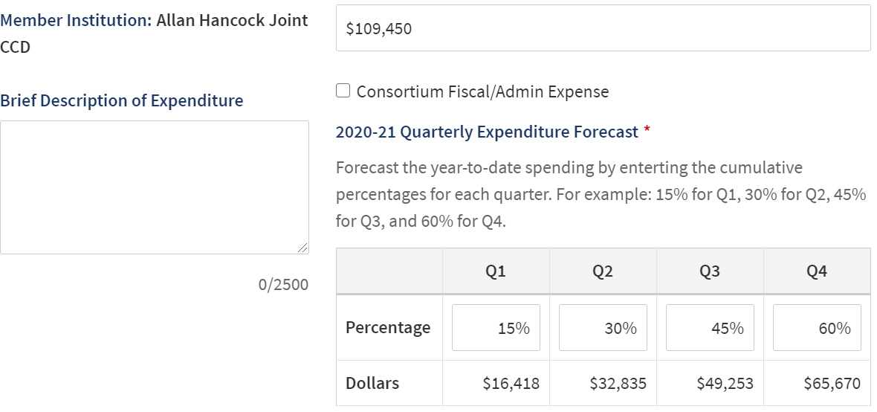
CAEP Forecasting Examples

Slide 22
Upcoming Adult Education Events
2/24/21: ICAN Webinar
3/11/21: CAEP Transitions Brief and Program Showcase
3/18/21: Immigrant Integration Research Brief and Showcase
3/25/21: CASAS I³ Reports
To come…
Quarterly Consortium Director/Lead Workgroup Meetings
State Priority Webinars
Three Year Planning Guidance Webinars

Slide 23
Wrap Up and Questions

Slide 24
Request Support from CAEP TAP

