Slide 1
WAYS TO ENGAGE
Thinking out of the box using Googles

Slide 2
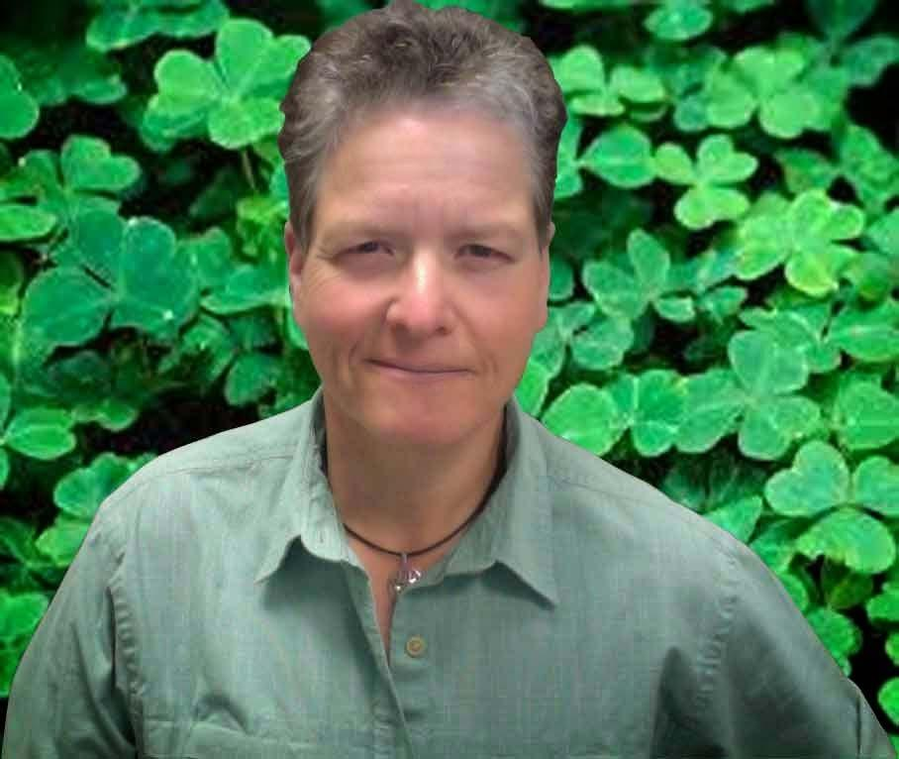
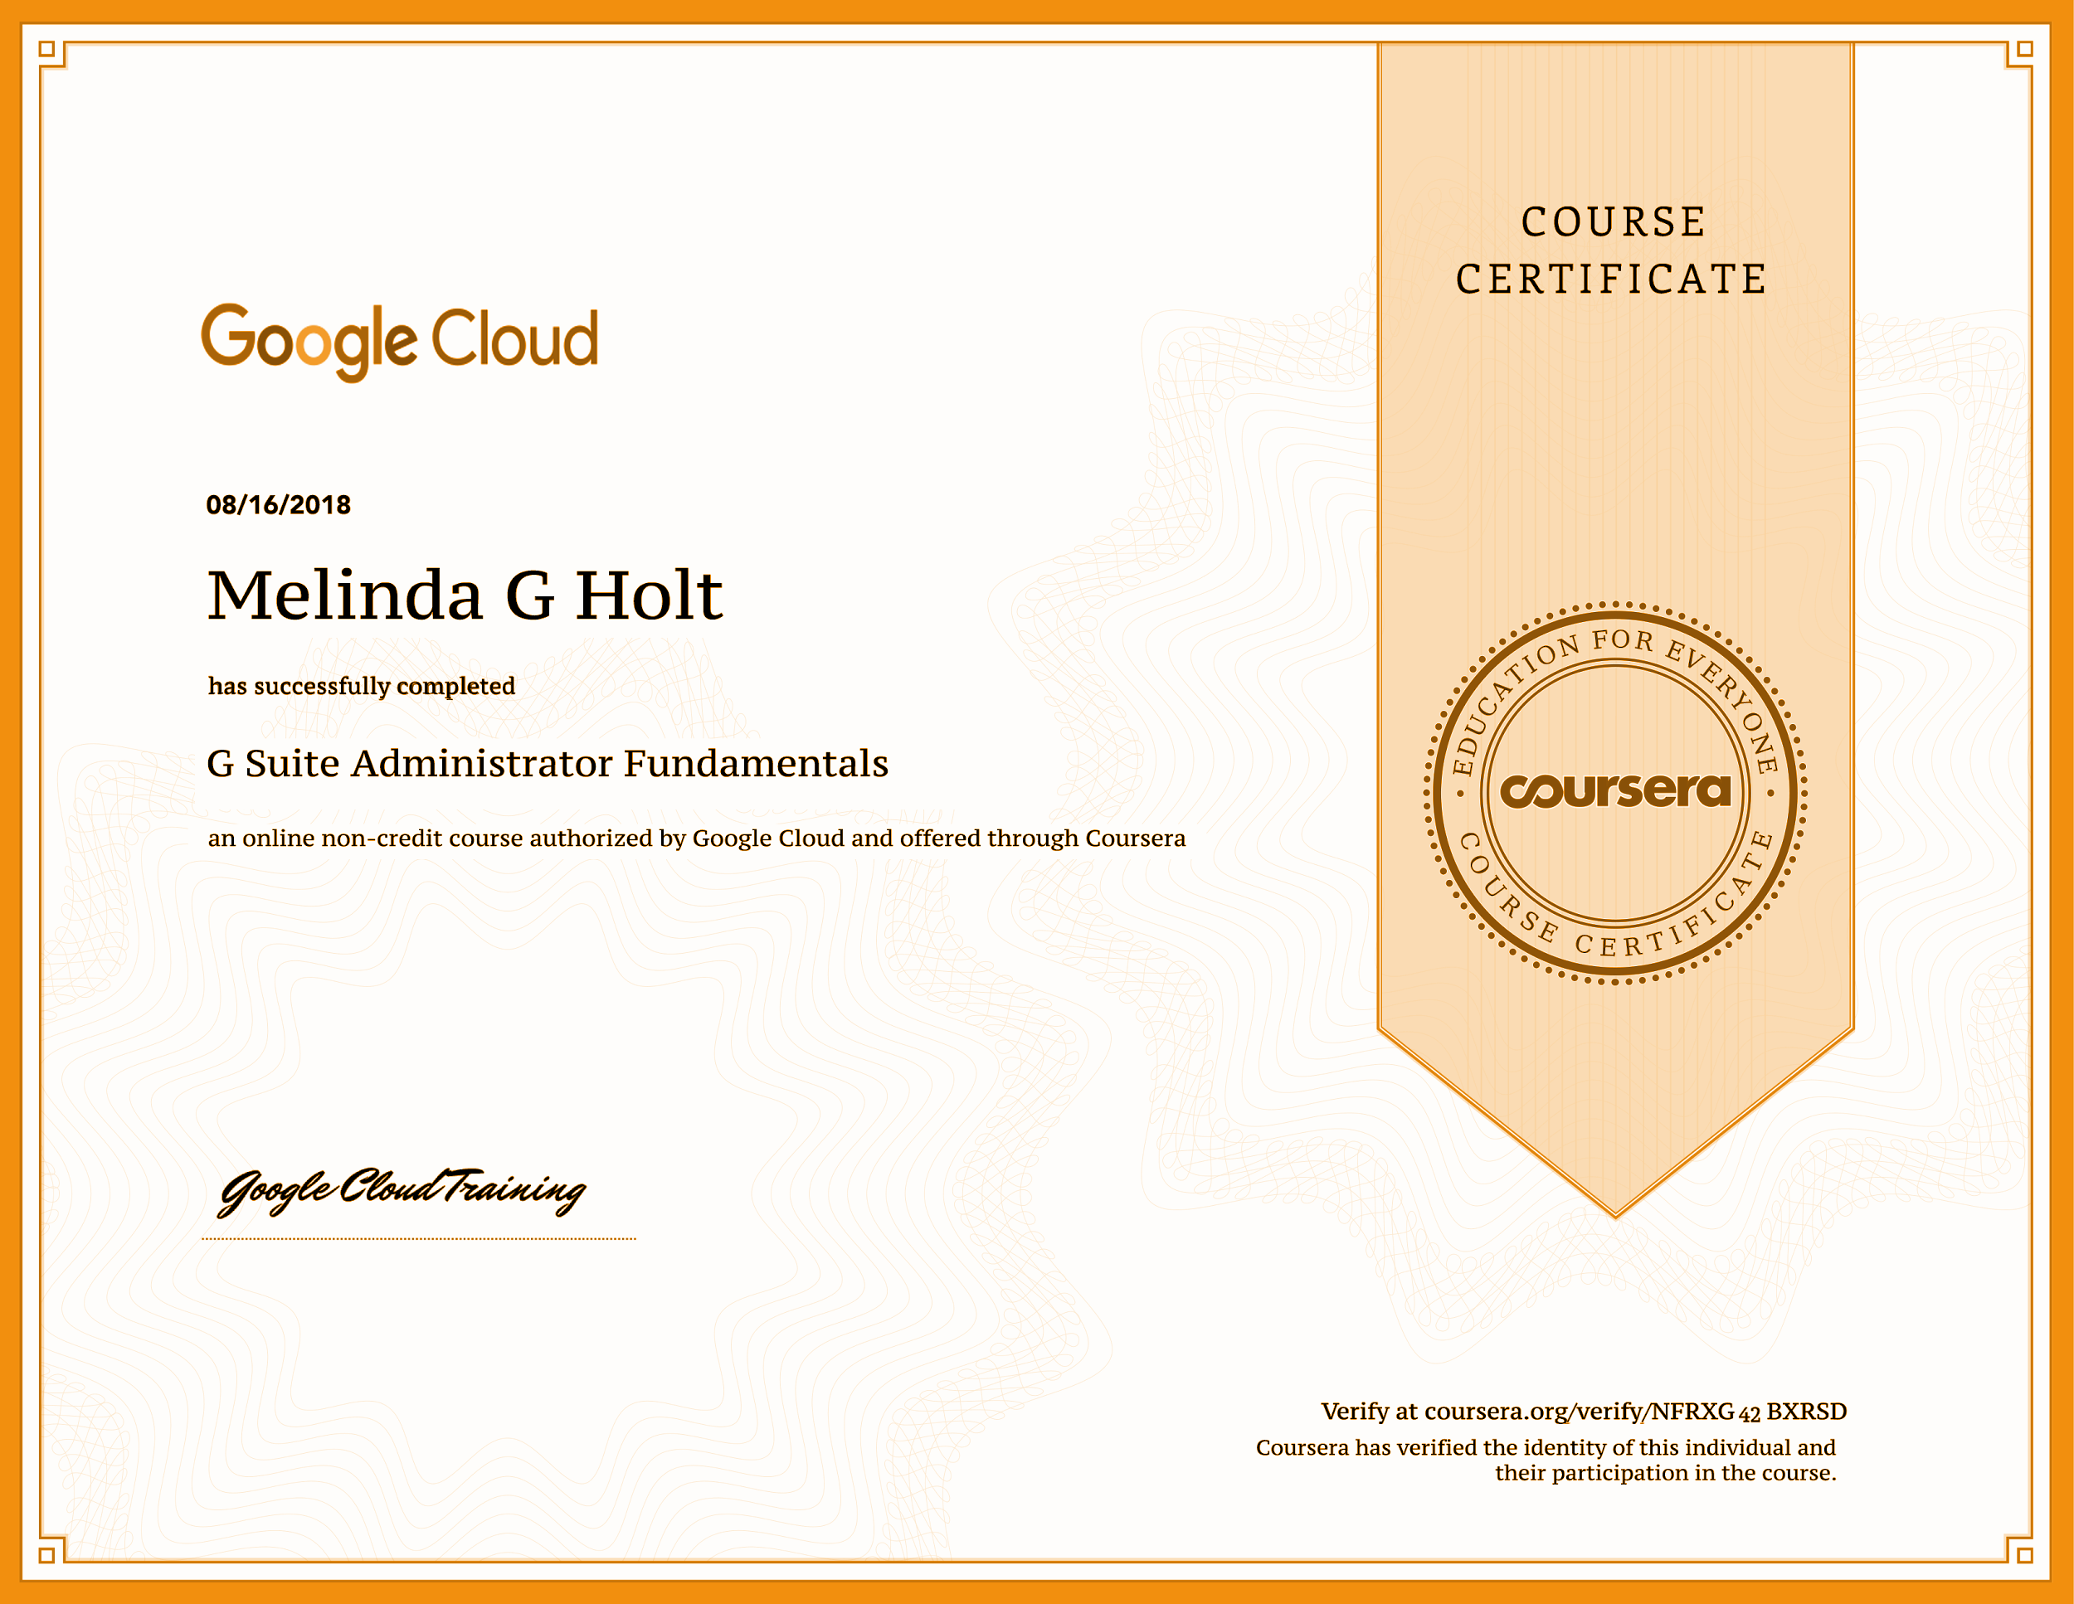
About the presenter
Melinda Holt, PS II - Technology Integration
mholt@scoe.net
or
mholt@otan.us

Slide 3
SOME THINGS
TO PONDER

Slide 4
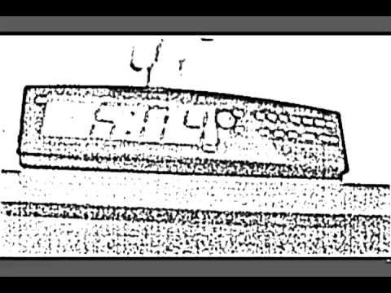
Notes:
Online Student Experience
https://www.youtube.com/watch?v=nWPI35WGsTc&list=WL&index=28

Slide 5
Rules of Engagement for Online Instruction
Be present as more than just text - use videos, images, audio, of yourself.
Keep the online space organized and clean (bad example | better example).
Keep Instructions Simple and Short.
Chunk lessons into smaller parts.
Direct attention (visual cues) using arrows, text, and colors (but refer to rule 2).

Slide 6
Rules of Engagement for Online Instruction
Get daily feedback then taper to weekly and use that info to reassess and redress!
Ask students to use questions that start with How or Explain.
Allow others to answer - its a sneaky way to get involvement and check for understanding.
Have learners create questions for assessments (they become invested!)

Slide 7
Rules of Engagement for Online Instruction
Give personalized feedback when possible
Send text, audio, or video files via message or email.
Enable waiting room to select individuals for early entry.
Assign a “tech helper” each class.
Use the same tech’ as students with your instruction - does it work?
Golden rule
Use humor and creativity whenever possible (always).

Slide 8
USE ONE!
Make classes accessible 24/7 using apps but do not overwhelm. If you or students have to search for the assignment, you’ve lost.
Relatively easy apps to use as central location:
Google Sites
Google Slides
Wix
Classroom
Canvas
Moodle

Slide 9
CREATE
“CLASS”
WITH SLIDES

Slide 10
WELCOME TO CLASS!
GOOGLE TIME
Notes:
Weekly video added - “next slide” would be assignments.

Slide 11
SLIDE ASSIGNMENTS - “CLEAN” Example
Google Time assignments
Assignment 1 - Install Loom into Chrome
You must use Chrome browser.
Use your @gmail.com account
Read and follow these instructions if you use Chrome.
IF you cannot complete Assignment 1 - complete Assignment 1B
Assignment 1B - Install Loom on Computer
Follow these instructions to install Loom on a laptop or computer.
Assignment 1C- Install Loom on iOS device
Follow these instructions to install Loom on iPhone or iPad -sign up for Android updates (Loom coming soon)
RETURN
Notes:
This lesson was created for teachers! Not for students

Slide 12
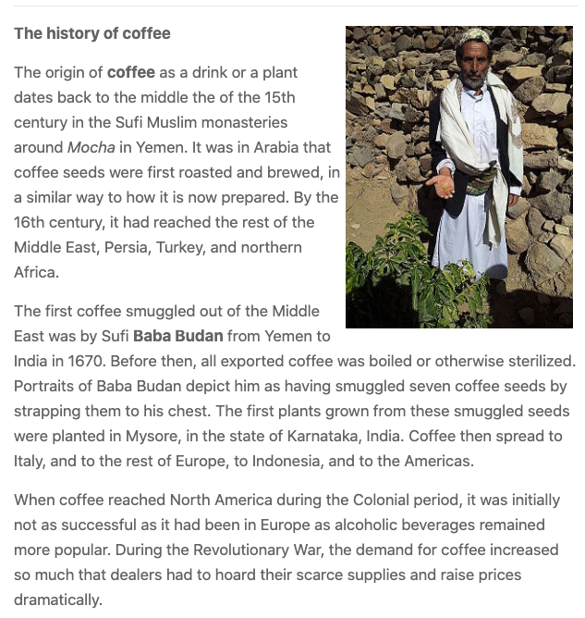
Welcome to Class Monday!
TODAY’s LESSON: COFFEE
Select to read story
Select headphones to hear teacher read story

Slide 13
Welcome to Class Day 2
VOCABULARY: HEALTH
Fitness
Well-being
Healthy
Exercise
Strength
Hydrate
Coffee
Diet
Create audio files per word

Slide 14
Bitmoji Class
CREATE YOUR OWN
View the OTAN workshop - Find Bitmoji Classroom Series (1, 2, 3)
123apps.com
used to create audio files

Slide 15
FORMS

Slide 16
FORMS
Create Escapes (aka: “Get Me Outta Here!”) based on lessons.
Results can be viewed in real time OR a virtual race be won.
!! IDEA 1 !!
Give form link to all students during an online meeting.
Put them in Breakout rooms (Teams).
First team to return to Main room with answer, wins.
!! IDEA 2 !!
Use upload function in forms for students to turn in assignments. Sign In to Google required.

Slide 17
TIME TO TRY
bit.ly/Formescape
IF you are unable to participate, watch the presenter’s screen.
This Formescape will be available until November 20.
Special instructions for those want to participate:
Open the link above - it is case sensitive
The link will be posted in the chat for easy clicking.
Password: spider is case-sensitive
and
A period is required on a sentence.

Slide 18
MORE WITH SLIDES

Slide 19
ENGAGING with SLIDES
E-Book - Preview mode so that copies cannot be made - release “chapters” as you wish.
Flash cards - create and share or have students create
Game Boards (example coming up)
Post-It activities (credit: Sandra Brandeberry)
Bitmoji Classroom (credit: Alisa Takeuchi)
Use the comment feature as chat!

Slide 20
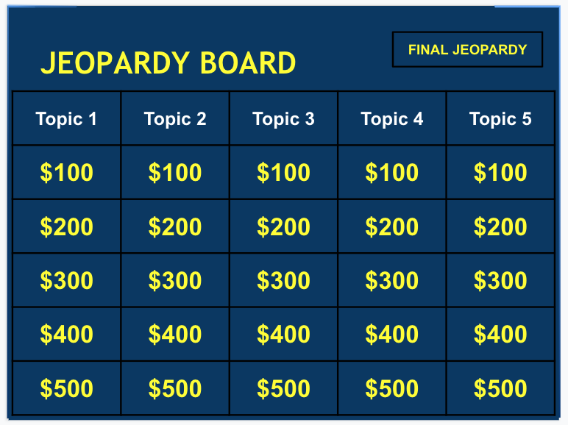
SLIDES: Game Boards
Create your own game board or use the template by selecting the game board to copy.
Let’s see how it works!

Slide 21
SLIDES: Post-It Activity
the
Store
box
there.

Slide 22
SLIDES: Math Activity
Arrange the numbers to create a true equation.
You must use all the numbers.
You can only use ONE operator (plus, minus, divide or multiply)
You must use either the equals or does not equal symbol
9
2
7
0
8
0
Notes:
The numbers are created in Word art
The math symbols are created with Shapes

Slide 23
SLIDES: Use the Draw tools (or Drawings)
Drawings will be clearer. (Zoom Meet example)
Drawings can be resized, recolored, redrawn as needed.
Create your own JPGS or PNGS using Drawings.
Create a library (screen shots, images, drawings, etc) of images at the ready using Slides.
Add images and format in Docs too!
BONUS
bit.ly/MeetZoomTips

Slide 24
ENGAGING with
other GOOGLES

Slide 25
TRANSLATE
Google Translate
Entire sites can be translated.
Entire documents can be translated (check them before distributing!)
IDEA! Have students use translate on a site’s instruction pages (i.e., Canvas).
Use site’s own translated instruction
Some sites, like Zoom, have translated instructions and videos to more languages! Search for language or English (usu. at bottom of page.)

Slide 26
JAMBOARD
Jamboard is a device like a smartboard. Jamboard uses an app with the same name that can be used on any browser as a type of whiteboard.
A “Jam” can be created with any Google account at jamboard.google.com
A Jam can be shared in view or edit mode.
A Jam can have up to 20 frames (slides).
A Jam can be saved as PDF.
Frames can be saved as PDF or PNG (image) files.

Slide 27
JAMMIN’ TIME! - https://bit.ly/ZoomJammin
Pen and Colors
Erase
Select Tool
Add Sticky Note
Add Image
Add Shape
Add Text
Use Laser point

Slide 28
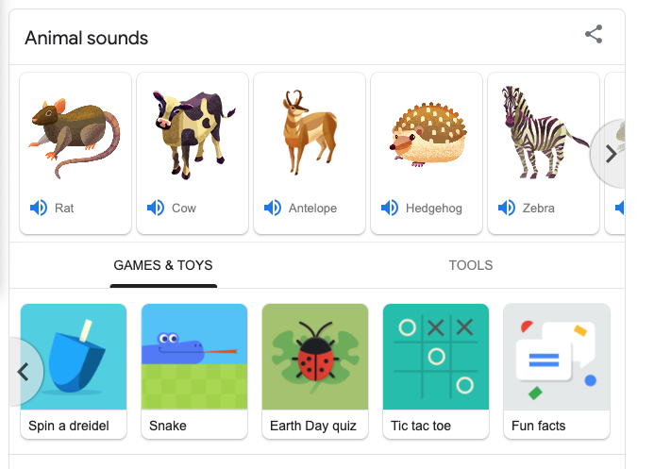
GAMES
Type keywords to find games and other cool tools!
Why games?
They help teach how to use mouse and keyboard.
Mind breaks!
Use for contests!
Keywords
Pacman
Tic tac toe
(then select the arrow under the game)

Slide 29
OTHER SITES

Slide 30
DRAWING SITES
Use during breaks or for projects
Google Slides: share a slides deck and assign everyone a slide to draw on using tools available
Canvas - canvas.apps.chrome
Silk - weavesilk.com
Autodraw - autodraw.com (idea: use as part of online Pictionary game - artist gets points the faster AI recognizes image)

Slide 31
BITMOJI
Create on Phone, add Bitmoji to Chrome, add bitmoji’s to Gmail, Docs, and Slides.

Slide 32
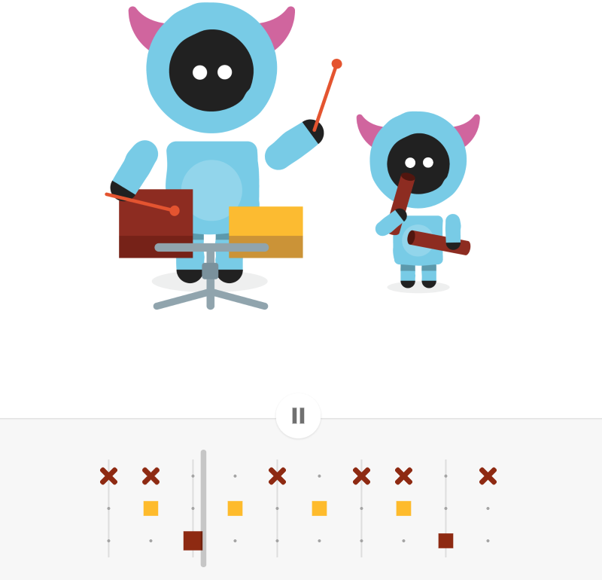
MUSIC
Youtube - Share sound in Zoom or videos in other Meets during breaks, project time, etc. (set to stop at certain point).
IDEAS
Use lyrics as part of English assignment.
Use rhythm, beat, or time (i.e., 4/4) as part of math assignment.
Chrome Music Lab
Create songs as project (think out of box).
Have children play (while adults in class)

Slide 33
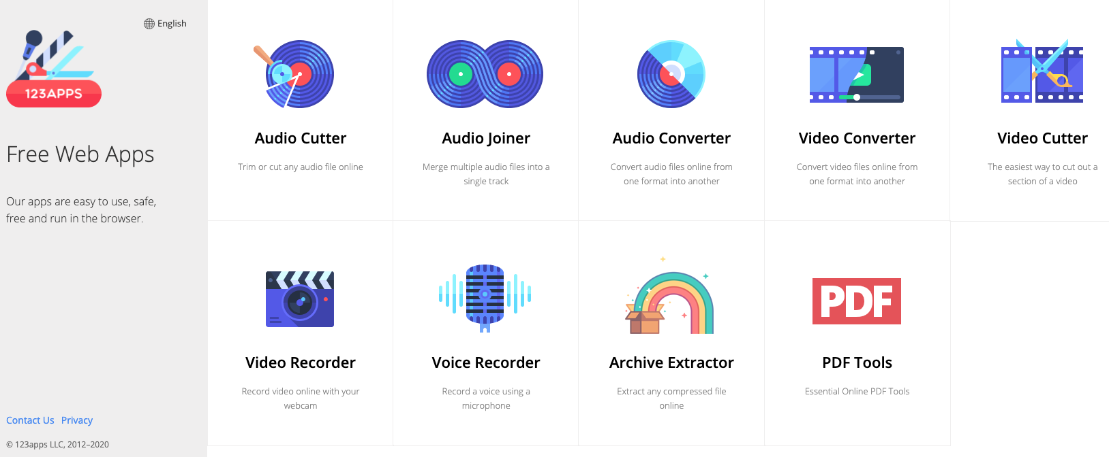
123apps.com
No Sign In or Account needed.
Multiple tools!
Create video and audio files.
Download files to desktop.
Upload to Google Drive or YouTube.
FREE!

Slide 34
MORE
RESOURCES

Slide 35
Teach from Anywhere
A Google-led initiative that gives teachers everything needed to get started and keep going.
Google’s free, secure tools are designed to enable collaborative teaching and learning - anywhere, at any time, on any device. So education can continue, no matter what.
https://teachfromanywhere.google/

Slide 36
Applied Digital Skills
Teach and learn practical digital skills needed for the jobs of today and tomorrow with free video lessons.
Resources include lesson plans, certificates of completion, and posters.
Videos are downloadable! And free!
Some lessons are placed in premade “collections” for certification.
Use the COABE partnership link to let Google know:
“Adult Educators are in the house!”
https://g.co/applieddigitalskills/coabe

Slide 37
Outreach & Technical Assistance Network (you’ve heard of them, right?)
Between March and May ‘20, OTAN barraged the AE field with webinars and workshops related to transitioning to remote teaching.
Those resources are still available at: https://otan.us/resources/covid-19-field-support/
OTAN continues to provide technical assistance with webinars, virtual workshops, Office Hours (every Tuesday and Thursday) and much more! ilable including videos, handouts, and more!

Slide 38
QUESTIONS?

Slide 39
Classroom Assignments and Instructions to use as You Complete the Lessons
Assignment 1 - do this one first as a document and turn it in
Assignment 3 - same as the first
Week 3 - assignment
Project - with your group discuss this and get back to me
Quizzes online
Open and complete.
ASSIGNMENT 6
Did you get the email notice?
FUN VIDEO
Click here
Click here
Click here
RETURN
Notes:
Title is confusing and too wordy
Background lends NOTHING to this page and is distracting
Contrast colors (text) are bad
Bulleted items do not match assignments
Little or no instruction
Video not related to assignments or lessons
Buttons are all different
Click here - for what?

Slide 40
Creative Commons License for Presentation
Attribution (BY): Give credit as “Outreach and Technical Assistance Net”
NonCommercial (NC): You may copy, distribute, display, perform, and use this work for any purpose other than commercially unless permission is given.
Share Alike (SA): You may copy, distribute, display, perform, and modify this work, as long as you distribute any modified work on the same terms.
http://bit.ly/EngageGoogle

