Slide 1

Action Steps for Teachers and Programs Addressing Racial Equity
December 16, 2020, 12:00-1:30 (PT)
Cynthia Peters

Slide 2
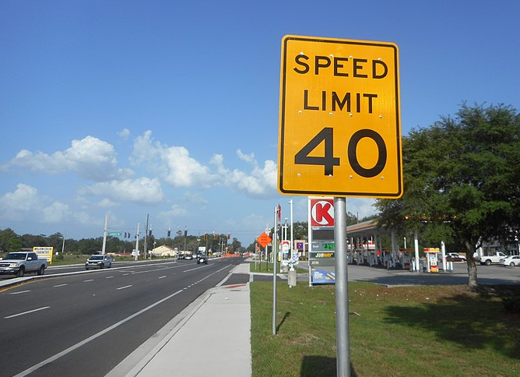

Slide 3
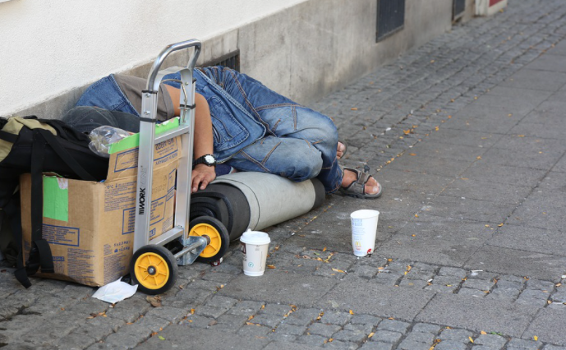

Slide 4



Review
First webinar: we learned that we all have biases, including extremely damaging biases that reflect, for example, deep racism in our society. This doesn’t mean we are bad people (or even explicitly racist), but...we do have a responsibility to address implicit bias. We can do this
through individual actions to raise awareness,
by putting up “guard rails” against it, and
by “changing the water we swim in.”
Notes:
Source about guard rails: From “Can You Train People to Be Less Biased?”
https://whyy.org/segments/can-you-train-people-to-be-less-biased/

Slide 5
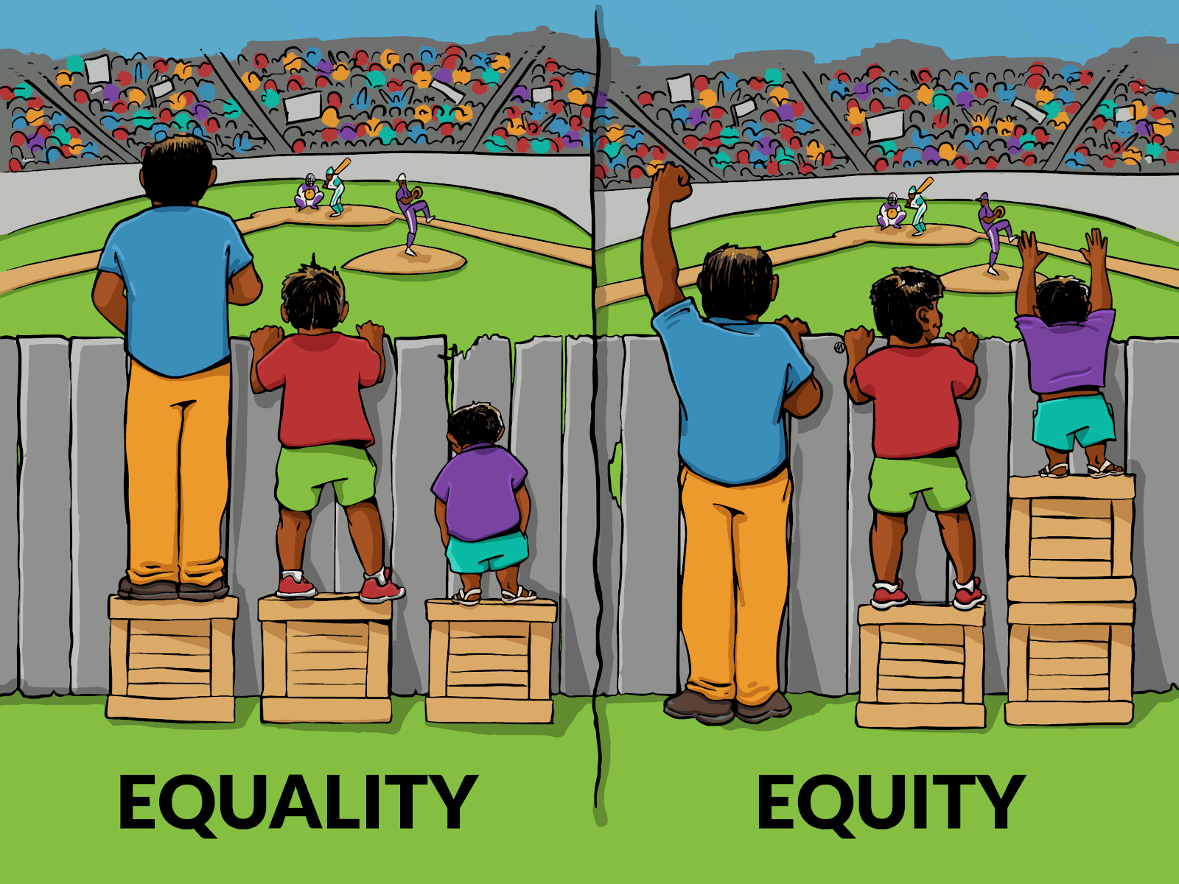
Review
Second webinar: we talked about why and how we should address bias and equity in the classroom. We shared...
classroom strategies for talking about race, and
materials that can help address bias and move toward equity.
…Including a lesson on equality vs. equity.
https://changeagent.nelrc.org/in-the-classroom/lesson-packets/#packet26

Slide 6

Key Tip -- Don’t Go It Alone
Undoing racism is not a private endeavor
See especially “Best Practices for Talking about Race” here:
https://changeagent.nelrc.org/in-the-classroom/lesson-packets/#packet12

Slide 7
In this webinar, we will look at practices we can try that will help us address bias and move toward equity in our programs.

Slide 8

What can programs do to address implicit bias and move toward equity?
Welcome and orientation practices
Classroom practices and teacher supports
Curriculum and materials
Cultural/social norms in your program
Collection of and study of data
Advocacy (at state and/or federal level, specific to adult ed or not)

Slide 9
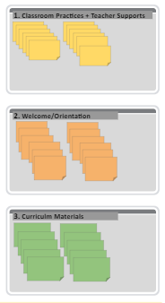
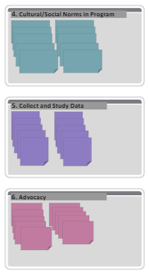
What do you already do in your program…?
To respond, go to this set of Google slides. Pick one or two post-it notes and write down something you already do in your program.
Take 5 minutes.
Notes:
https://docs.google.com/presentation/d/1i-TP1lylqVDA4hSB5-_vj3jZg-v7PuIEkxjGmbTpmYM/edit#slide=id.ga7ea38207b_0_0

Slide 10
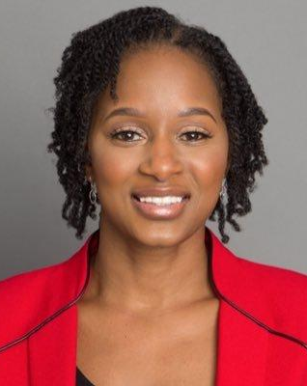
“Focus on impact, not intention”
-- Carmine Stewart
Vice President of Programming
at Seeds of Literacy in Ohio and
CEO of Aspire Consulting and
Educational Services

Slide 11
1. Classroom Practices and Teacher Supports
Introduction of new students and the students are given the opportunity to share about themselves and culture.
Personal calls welcoming the first week and ongoing during term. Pro Dev,
Professional Development from publishers,
Professional Development includes resources for students for basic needs.
Professional Learning Communities with teachers monthly to discuss student progress and look at data regarding student outcomes and determine gaps
Personalizing instruction as much as possible
Providing PD for teachers on strategies to get more student voice into the synchronous online learning sessions.
Particularly in ESL program, but across all, our teachers are deeply committed to helping immigrants and native marginalized students. Most staff are here because they want to help this population

Slide 12
1. Classroom Practices + Teacher Supports
Give teachers paid time to pause, reflect, shift their classroom practices + collaborate with peers to shift.
Provide (mandatory?) PD to teachers that helps them address bias and equity.
Invite feedback from students, support teachers to integrate feedback.
Provide (supportive!) opportunity for teachers to be evaluated and to self-evaluate in terms of addressing bias/equity.
Include addressing bias/equity in lesson planning template.

Slide 13
1a Small Group Notes (Classroom Practices + Teacher Supports)
Discussed equity curriculum in one school & ideas for modules in the ESL program
Discuss equity in the form of instructional strategies that are designed to encourage student voice

Slide 14
1b Small Group Notes (Classroom Practices + Teacher Supports)
Needs assessments! Classroom practice will ask students for feedback on what they need to learn and what they are lacking!! Need help to figure out why students do not follow through with their commitment. Lack of technology, internet services. Teacher support - Meaningful, Useful trainings and

Slide 15
2. Welcome/Orientation
Bilingual Orientation/testing specialist
Have interpreters in Spanish, Vietnamese, Tagalog in the office for support
We have teachers, counselors and our transitions specialist meet with each student to discuss their goals and potential barriers - in English and Spanish
Bilingual Testing Specialist, Virtual orientations, Personal calls to students
Spanish language support in the office.
Our Transitions Team visits classrooms to share the opportunities after adult school. As needed, our Hmong and Spanish speaking transitions specialists will visit and/or meet ESL students
Adult Registration & Orientation Fair. A bilingual event with Welcome in Spanish, a video highlighting our beautiful ag fields/community, cultural/chicano murals, images of adult learners in CTE programs, assistance filling out applications and online platforms. Allow people to see people, interact with Bilingual counselors, family friendly event
Spanish interpreters at event and to do intake
Made Zoom & Schoology “orientations” in Spanish & Mandarin--written & oral.
I would like to see people address reasons/issues students have the cause stop out/drop out.
Registration/Orientation that includes student services at our school and beyond all through the community.
Multilingual student orientations.
The counselors, president and administrator and teachers should be there.
Notes:
From: https://ditchthattextbook.com/google-slides-sticky-note-brainstorming-powerful-planning//
More ideas about using google slides: https://ditchthattextbook.com/8-interactive-google-slides-activities-for-classroom-excitement/#tab-con-25

Slide 16
2. Welcome and Orientation Practices
Ensure students have equitable devices and internet access. Brainstorm creative ways to deal with this. (In Mass., adult ed. system is pushing the k-12 system to allow parents to use kids’ devices that were given out for free by the k-12 system.)
Ensure students have equitable access to training. (In RI, programs are allowing short interludes f2f tech support.)
Set up peer support (possibly paid) -- giving work experience to mentor and real help for mentee -- especially technical support.
Identify and address obstacles (childcare, food insecurity) that get in the way of attending class.

Slide 17
2a Small Group Notes (Welcome and Orientation Practices)
Comprehensive orientation positively affects persistence
Learners make connections with classmates, resources, services.
Goal setting
Visual pathways help learners see possibilities
Access to transition specialist, counseling and advising
Provide answers to the many many questions
Accurate placement (pre test and conversation with staff)
Meet staff, teachers, new classmates
Make connections
Get excited to learn
Resources e.g. Job Center, CalWorks, Food banks, assistance with transportation, health care, other student needs.
Should be fun, nurturing, inviting and suppotive

Slide 18
2b Small Group Notes (Welcome and Orientation Practices)
Teachers bilingual staff call and personally speak to every student. Welcome and ask basic questions. (what tech student will use.)
Connect (online) during phone call.
ConnectIE.org or dial 211 (Connect locally and get program listed.)
Bilingual tech teacher that can follow up. (Mute/unmute)
Multilingual support
Address stop out/ drop out issue from orientation at start of class..
Staff address barriers (childcare, time constraints lack of support) ask students for commitment and share expectations.
Registration/Orientation bilingual fair (Virtual) with warm welcome.
Nonprofit video of area and adult learners - culturally sensitive and friendly opportunity.
Share option in CTE/ Adult Ed/ High School and online platforms for new students. (Canvas and ZOOM)
January 13, 2021 event - soft closing and the counseling with small groups. Potential students can ask questions.
Contact previous students (last 4 semesters) Great opportunity to return to school.

Slide 19
Making all curriculum materials cell phone accessible, not just accessible, but are made for cell phone presentation
3. Curriculum Materials
Providing chromebooks and training students in using them
We have a group of faculty working on Equity Curriculum for use with our adult ESL students.
We started to use The Change Agent which is OUTSTANDING!
Aztec software to address the needs of Spanish HiSET students
Using resources that are cell phone friendly for students who don’t have access to computers.
Adopted Instruction material has culturally responsive/aware passages
IBEST co-teaching program partnering CTE & ESL instructors to support English language learner adult students.
Reflection opportunities for instructors during the semester
We’re making paper packets like old school distance learning for students that do not have tech
Burlington English provides curriculum in many languages
Support teachers to use FREE online materials so students can access easily.
r you !!They love it
Using Quizlet ! I love it all the different things you can do and they set it up fo
Conducted interviews / surveys to determine which students needed Chromebooks to access our online curriculum & created a loaner program. Now starting a digital literacy class.
Notes:
From: https://ditchthattextbook.com/google-slides-sticky-note-brainstorming-powerful-planning//
More ideas about using google slides: https://ditchthattextbook.com/8-interactive-google-slides-activities-for-classroom-excitement/#tab-con-25

Slide 20
3. Curriculum and Materials
Evaluate your assessments for racial bias.
Evaluate how funding pressures us to use certain materials over others.
Assess how people of color show up in materials – whose voice is heard?
Use materials that show people expressing agency, engaged in civics -- in their community and in their workplace, etc.

Slide 21
4. Cultural/Social Norms in Program
Include COAAP on Cultural Differences and let students share about traditions.
Motiva students to presentation about their culture - it will be useful for us as instructors to know our students background.
Student presentations regarding culture and traditions
We are looking at school policies to determine if they are bias - which they are.
Cultural fair where ESL students share with other departments and educate people on their culture
Lots of potlucks and discussions on social/cultural norms. Students are given the opportunity to talk about, bring artifacts, and present on their culture.
Pre Covid we have an annual community diversity event that brings together many students to share food and stories from their culture.
Notes:
From: https://ditchthattextbook.com/google-slides-sticky-note-brainstorming-powerful-planning//
More ideas about using google slides: https://ditchthattextbook.com/8-interactive-google-slides-activities-for-classroom-excitement/#tab-con-25

Slide 22
4. Cultural/Social Norms in Program
Ensure translation and interpretation are readily available.
Ensure adult students’ voices play a role in determining what our programs and our filed looks like?
Create opportunities for students to give feedback; practice the art of constructive feedback; encourage student agency and power in your program.
Celebrate/acknowledge diverse holidays.

Slide 23
4a Small Group Notes (Cultural/Social Norms in Program)
Get to know the culture of your learners
  Intro activities, cultural fairs
  What are your student goals
  Shared access to student information
- Best practices for a classroom setting and environment
- have students participate in creating the rules of the classroom
- student council or a chance for students to voice their opinions with admin or school staff.

Slide 24
5. Collect and Study Data
Data dive on Adult Consortium data looking at WIOA Barrier to Employment from an equity lens (race/gender).
Changed times of day for ESL classes based on survey data from our students.
Data work on program enrollment and learner persistence.
Data review by program, region and compare to others. Regional data sessions
We have begun to look at graduation/ persistence data specific to African American students
Data work group looking at differences across persistence indicators by race/ethnicity. There are limitations in how the data is collected in TE, (especially re: ethnicity) that we hope are changed moving forward.
Data dive: looking for trends regarding success/failure/retention, race, social status, etc

Slide 25
5. Collect and Study Data
Analyze whether you are serving all students equitably? (Some program data show that we are better at serving ELLs than we are at serving those who were failed by the k-12 system. Is there a deserving/non-deserving narrative in play? What other explanations might there be?)
Take steps to ensure that teachers, staff, and board are diverse. (Are your HR policies conducive to building up a diverse staff?)
Analyze students’ access to technology.

Slide 26
5a Small Group Notes (Collect and Study Data)
Looking at how to transition students successfuly

Slide 27
5b Small Group Notes (Collect and Study Data)
Completion rates in High School Diploma program broken down by student ethnicity.
Class completion rates of students broken down by ethnicity

Slide 28
6. Advocacy
Referals to local support services
Partnerships with community programs. Partner outreach.
Offer programs/classes in the community where adults live and in neighborhood based locations
Conduct workshops on various resources available to students
Partnerships with agencies who work with unemployed, domestic violence victims, ex-felons, homeless/foster kids.
Counselor available to help advocate and support students who need resources.
Interpreters provide support on a daily basis
We stay connected to CBO’s to keep updated with available support for students.
Community Connections to support student needs

Slide 29
6. Advocacy
Give time to teachers, staff, & students to advocate for adult ed. funding.
Bring community advocates into classes so students learn about local efforts to address inequity. Build partnerships with community organizations. (In NYC, the Literacy and Justice Initiative is building collaborations between adult ed. programs and social justice orgs.)
Join coalitions to strategize collectively. In Mass., MCAE allied with Raise-Up Massachusetts to fight for paid sick time and to raise the minimum wage.
Support folks to advocate for policies that address inequity lift all boats. (E.g., free/low-cost wifi from your municipality.)

Slide 30
Individual + Small group activity + Post activity
Take 5 minutes to browse all the post-it notes and assess which of the 6 groups you want to work on. Think on your own about what you picked and why? What do you need to move this forward? (Is my program director on board? Are there resources to support this? Who needs to be part of this conversation? What barriers might we face?)
Go into small group and share. Take notes on slide provided.
No report back, but a poll -- what group were you in? So we have a sense of what category people are mostly interested in.
Next steps. Another poll with 3 questions: 1) What do you need to take action steps? 2) How are you feeling…? 3) What topics for more PD?

Slide 31
Individual + Small group activity + Post activity
Take 5 minutes to browse all the post-it notes and assess which of the 6 groups you want to work on. Think on your own about what you picked and why? What do you need to move this forward? (Is my program director on board? Are there resources to support this? Who needs to be part of this conversation? What barriers might we face?)
Go into small group and share. Take notes on slide provided.
No report back, but a poll -- what group were you in? So we have a sense of what category people are mostly interested in.
Next steps. Another poll with 3 questions: 1) What do you need to take action steps? 2) How are you feeling…? 3) What topics for more PD?

Slide 32
Individual + Small group activity + Post activity
Take 5 minutes to browse all the post-it notes and assess which of the 6 groups you want to work on. Think on your own about what you picked and why? What do you need to move this forward? (Is my program director on board? Are there resources to support this? Who needs to be part of this conversation? What barriers might we face?)
Go into small group and share. Take notes on slide provided.
No report back, but a poll -- what group were you in? So we have a sense of what category people are mostly interested in.
Next steps. Another poll with 3 questions: 1) What do you need to take action steps? 2) How are you feeling…? 3) What topics for more PD?
Notes:
What do you need to take next steps on at least one strategy? (check all that apply)
1. more paid hours to move this piece of work forward;
2. more staff development time;
3. more training on some specific piece;
4. not much! I feel ready to start work on at least one strategy
How are you feeling about taking next steps in your program? (check all that apply)
1. There are a lot of worthy ideas to follow up on, but I don't know where I'll find the time and resources to do it well.
2. I don't have the time or resource to be too ambitious, but a couple of strategies could be do-able.
3. I have a couple of strategies I am interested in pursuing, but I need more training on how to implement them.
4. I'm not convinced that I can or should make this a priority right now.
5. My program has the time, resources, and interest to move forward on one or more strategies.
What topics are you interested in getting more PD on? (check all that apply)
How to address my own discouragement/fear around taking this on.
How to address my own implicit bias.
How to think about the role of the field as a whole in replicating inequities and how we can address that.
How to take an in-depth look at policies and procedures on a local level that may be supporting bias.
How to conduct outreach to all demographics, so that no group is underrepresented.
How to talk about experiences with racism.
Unpacking the characteristics of whiteness and its impact on adult education programs.
How to advocate for racial justice professional development to leadership teams.
The historical (and current) context of racism in education.
The historical (and current) context of racism at work.
“Other” with a write in option.

Slide 33
Thank you!
A link to a recording and slides of this webinar will be sent to you.
Cynthia Peters, cynthia_peters@worlded.org

