Slide 1
California Adult Education Program’s Technical Assistance Project (CAEP TAP)
Strategies for Talking about Race in the Classroom
December 3, 2020, 12:00 p.m. – 1:30 p.m. (west coast time)

Slide 2
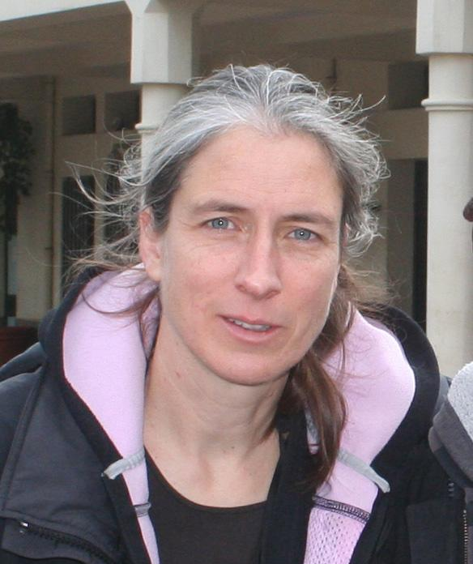
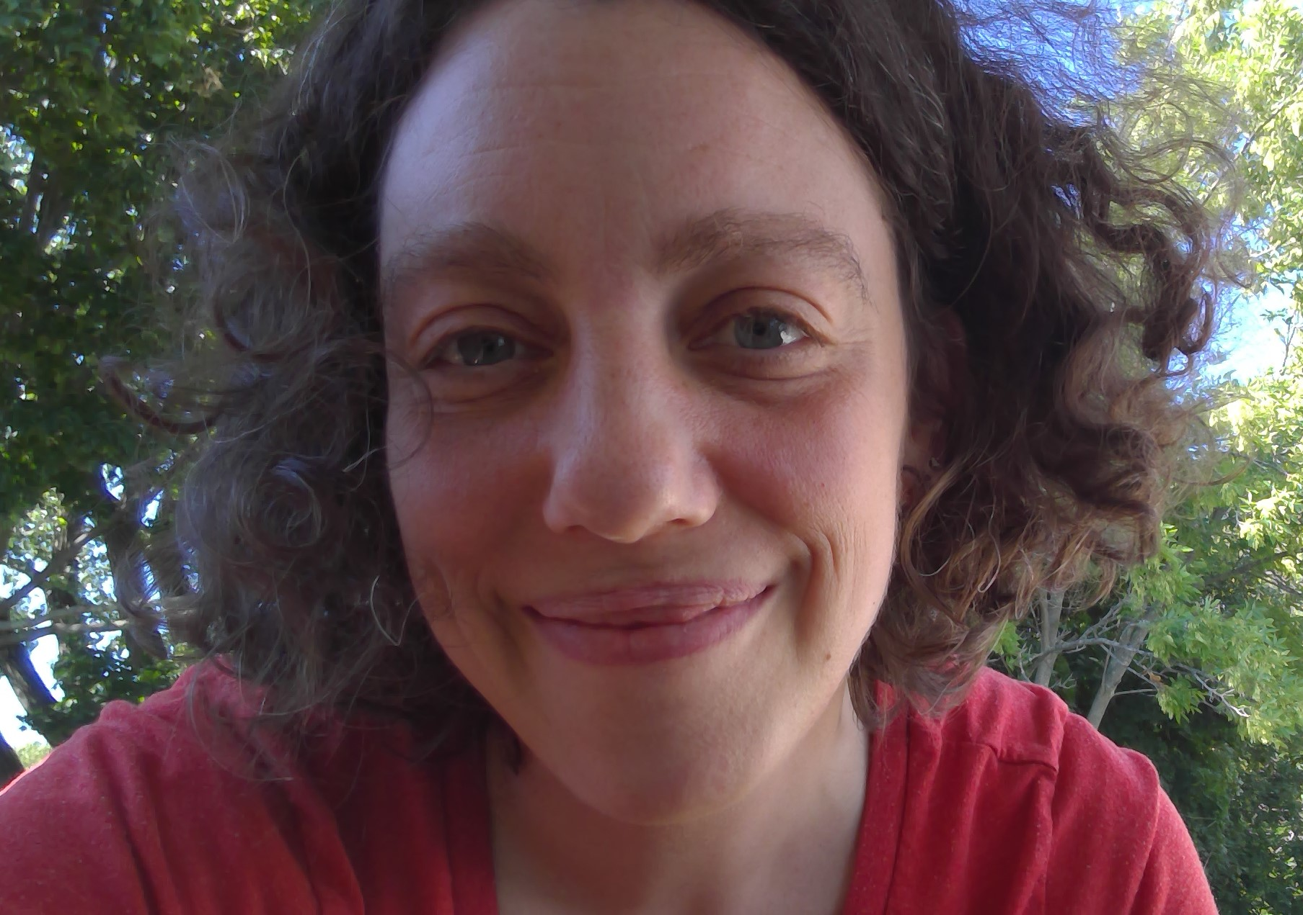
Welcome
Cynthia Peters
Change Agent Editor, Adult Educator, and PD Provider
cynthia_peters@worlded.org
Riva Pearson
ESOL teacher, Jewish Vocational Service, Hyde Park
rpearson@jvs-boston.org
Notes:
We just want to acknowledge that we are two white women leading a webinar addressing racism and bias. We think it’s the responsibility of white people to do anti-racism work, and...also... the fact that we are white people in this role says something about racism that is endemic to every part of life in the U.S., including our field, adult education. We also want to acknowledge our teachers, colleagues, and fellow activists, who we have learned from and who have held us accountable. We are standing on a lot of shoulders here!

Slide 3
Agenda
Introduction/Welcome
Why is it important to address these topics? -- Cynthia
What excites you/makes you nervous? -- Interactive brainstorm
How to talk about race: overview -- Riva
Share the Google slides -- “Field trip”
Discuss strategies that you would like to do in your classroom/ report back -- In breakout rooms
What strategies would you use for instruction?
What strategies for hard conversations?
Best practices
Q and A/Discussion/Evaluation -- Use the chat

Slide 4
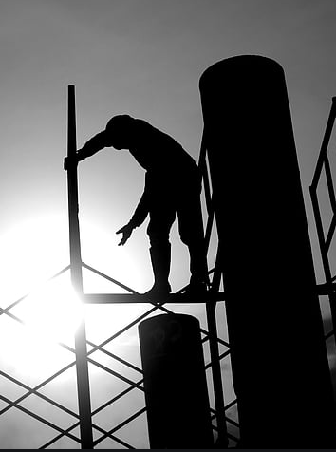
Why talk about race and equity in the classroom?
It’s relevant!
Relevance drives persistence.
High-interest articles act as scaffolding toward more and more complex materials.

Slide 5
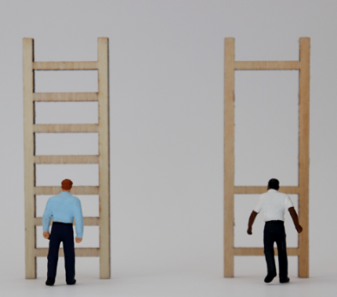
Why talk about race and equity in the classroom?
It addresses obstacles!
Bias (both explicit and implicit) get in the way of learning.
By addressing it (and treating it as something that can be wrestled with), we can empower learners to reach their goals.

Slide 6
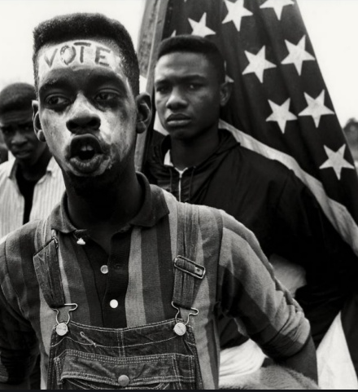
Why talk about race and equity in the classroom?
It’s inspiring!
Featuring the ways people have fought back against racism inspires all of us to see that we can affect the flow of history.
Biases are moveable -- not easily, but with effort -- like a lot of things!

Slide 7
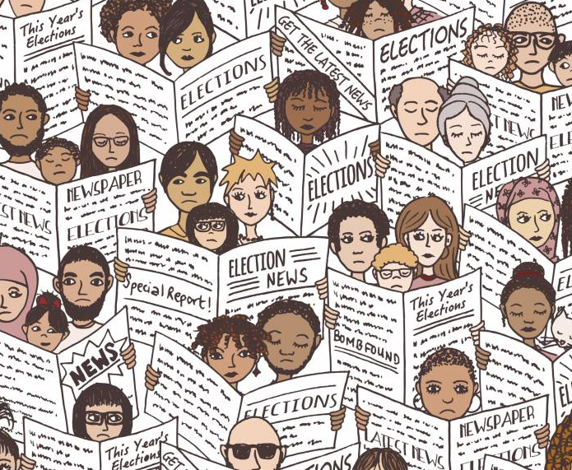
Why talk about race and equity in the classroom?
It teaches key skills!
You can teach critical thinking. E.g., ask: Why do you think that? Do you have evidence for that? Let’s research that further (look for multiple sources).
You can teach basic skills. E.g., how to read for and write with evidence. How to differentiate between opinion and detail, etc.
You can teach civics.

Slide 8
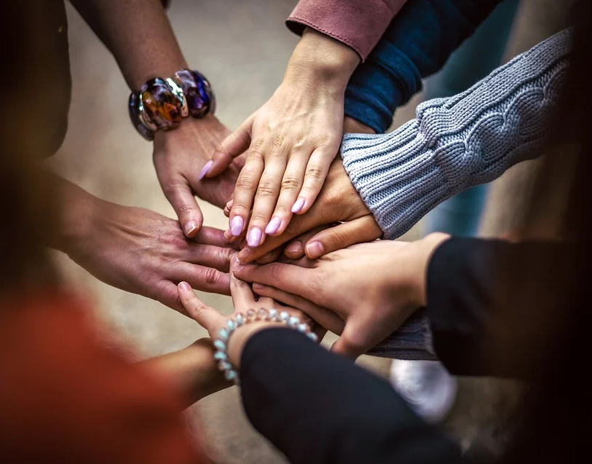
Why talk about race and equity in the classroom?
It builds community!
When you take on something challenging, it’s an opportunity for everyone to grow together.
You might develop ground rules together.
People might show themselves more.

Slide 9
Why talk about race and equity in the classroom?
It is an ethical choice -- but don’t go it alone!
In a society where bias is real and pervasive, choosing to address this in the classroom is an ethical choice... if you can and if you are prepared and supported!
Supporting people to see their agency in the big issues supports participation in democracy.

Slide 10
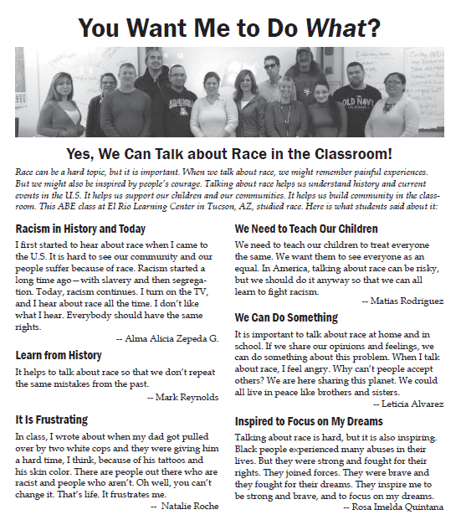
from p. 3 of the “Talking about Race” issue of The Change Agent.

Slide 12
What are you Nervous About?
Accidentally triggering someone with the wrong word choices
Making any students feel on-the-spot
As an administrator, and having read and experienced personal racism and institutional racism, sometimes I don’t know how to START with other administrators or coordinators--dont want to lay on them that this is a CDE, CAEP mandate
The idea that many people are divided ideologically in the nation at this time
Not being able to provide support for the students.
As an administrator, how to deal with racism that is directed at you/
Confrontation between students. How some might react to certain comments.
Retaliation for owning my truth.
Letting my learned bias creep into my public life before I learn to deal with it
Saying the wrong thing.
Being in a conversation in a classroom about race and having a very angry student that gets confrontational.
I get nervous about perhaps not having district support when complaints arrive.
Angry, confrontational students, cross talk that gets away from me moderating
Subversive reprisals for defending equity
Making sure that all students have a voice and not feel left out!
Also dealing with systemic racism in your own district.
Saying the wrong thing. Offending someone. Confrontation amongst students.
In an ESL Classroom: Using appropriate language to communicate and hoping it does not trigger some other trauma that the Ss might have experienced
Daily challenges dealing with teaching anti racist practices to colleagues
In bringing this to my staff I don’t want them to shut down
Keeping my own biases in check.
Notes:
From: https://ditchthattextbook.com/google-slides-sticky-note-brainstorming-powerful-planning//
More ideas about using google slides: https://ditchthattextbook.com/8-interactive-google-slides-activities-for-classroom-excitement/#tab-con-25

Slide 13
The possibility for a dramatic shift in support of equity
What are you Excited About?
Learning and growing in my knowledge, understanding and willingness to take risk 1.
I love learning about people. I hope to relay that to others by hearing their story.
Deep heartfelt discussions.
In the correctional environment we can begin to breakdown many stereotypes and actually address the student needs not simply assuming they learn one way due to their rearing or lack of traditional education or lack of the presence and activity of parents.
It can help with immigrant socialization and integration
Student empowerment to make change, to take action on campus
I’m excited that finally after 33 years in education we are going to address the elephant in the room!
Every comment here is powerful
Seeing the change happen in my lifetime and hoping it last forever!
Storytelling to bring about change in everyone as in impact ripples out.
I am excited to hear the student experiences and point of views. Sometimes the best way to learn is through others experiences.
Openness and willingness to having dialogue about race and racism and individuals evaluating their own bias.
Giving students the opportunity to express themselves!
Possibility of change
I am excited that finally after discussing racism and other hard issues in my doctoral program, I get to talk and listen to people’s perspective personally and professionally about race and racism in America. I already gave out Xendi’s book “ how to be an anti-racist” to one of the adult ed coordinator in our consortium
Excited about learning!
I was nervous when we started a year long PD at the school. But I am excited that it has taken on a life of its own. It is developed and offered by school staff.
Student experiences at the center of learning.
As an athroplogist, this is an exciting topic for me

Slide 14
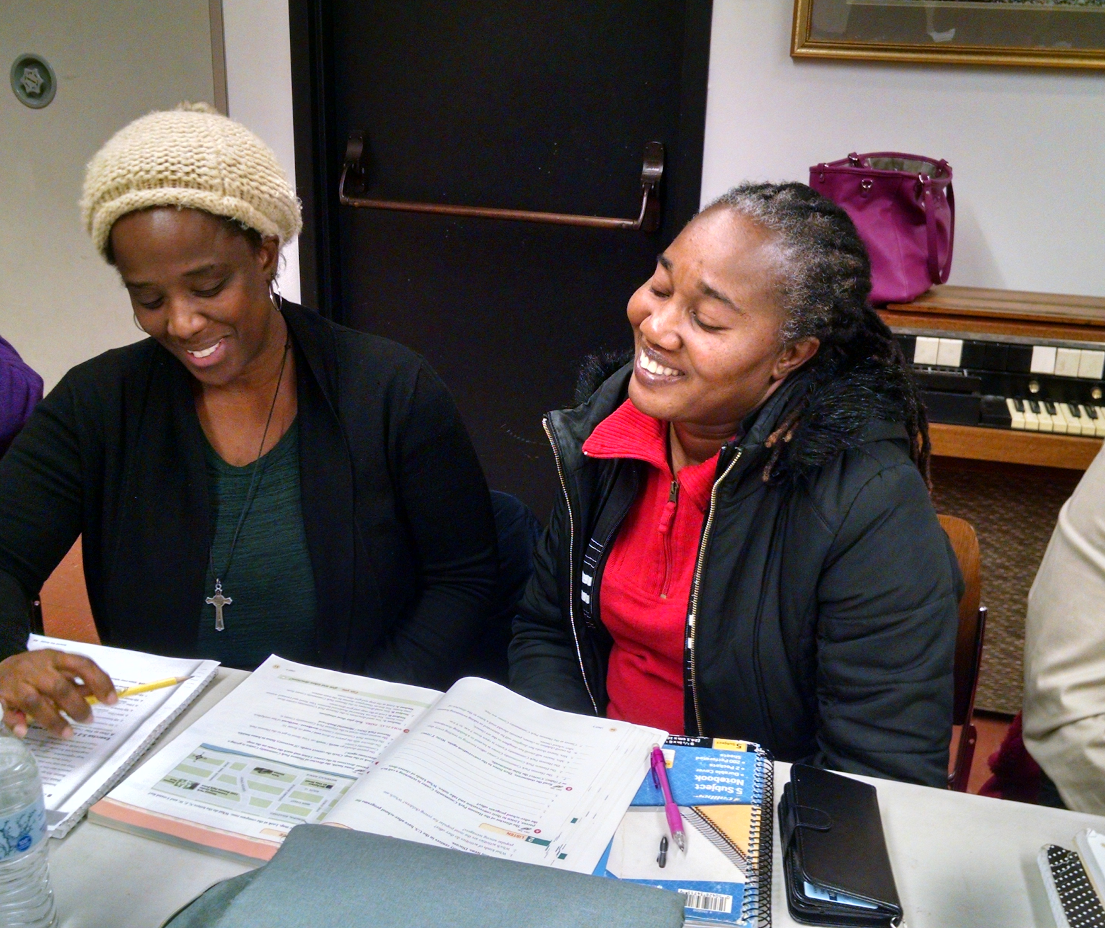
How to talk about race and equity in the classroom
Build community and trust in the class.
Give students a chance to get to know each other outside of hard conversations.
Have the students set ground rules for speaking respectfully about hard topics.
Don’t respond to everything. Let students respond to each other.
Invite students to talk about their experiences of race in the US and issues related to race in their home counties.

Slide 15
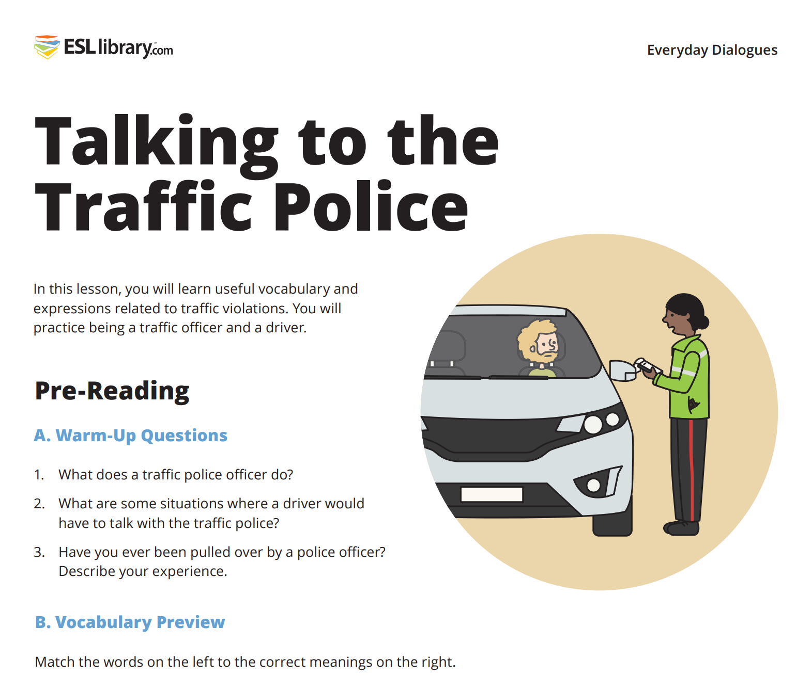
How to talk about race and equity in the classroom
Think of it as survival English.
Issues of race and equity are just as important for survival in the U.S. as being able to go to the grocery store or open a bank account.

Slide 16
How to talk about race and equity in the classroom
Remember that it is everyday English.
Fingerprinted
Up to no good
Humiliation
Border
Speak up
Raise our voices
Allegedly
Discriminate
Hoodie
Acquitted
Warrant
Cooperate
Racial profiling
Institutional
Cuffs
Unite

Slide 17
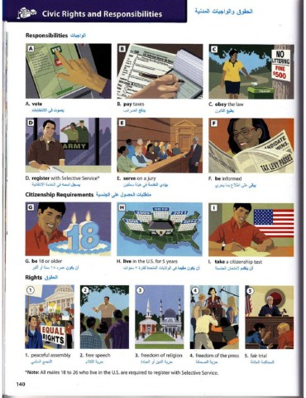
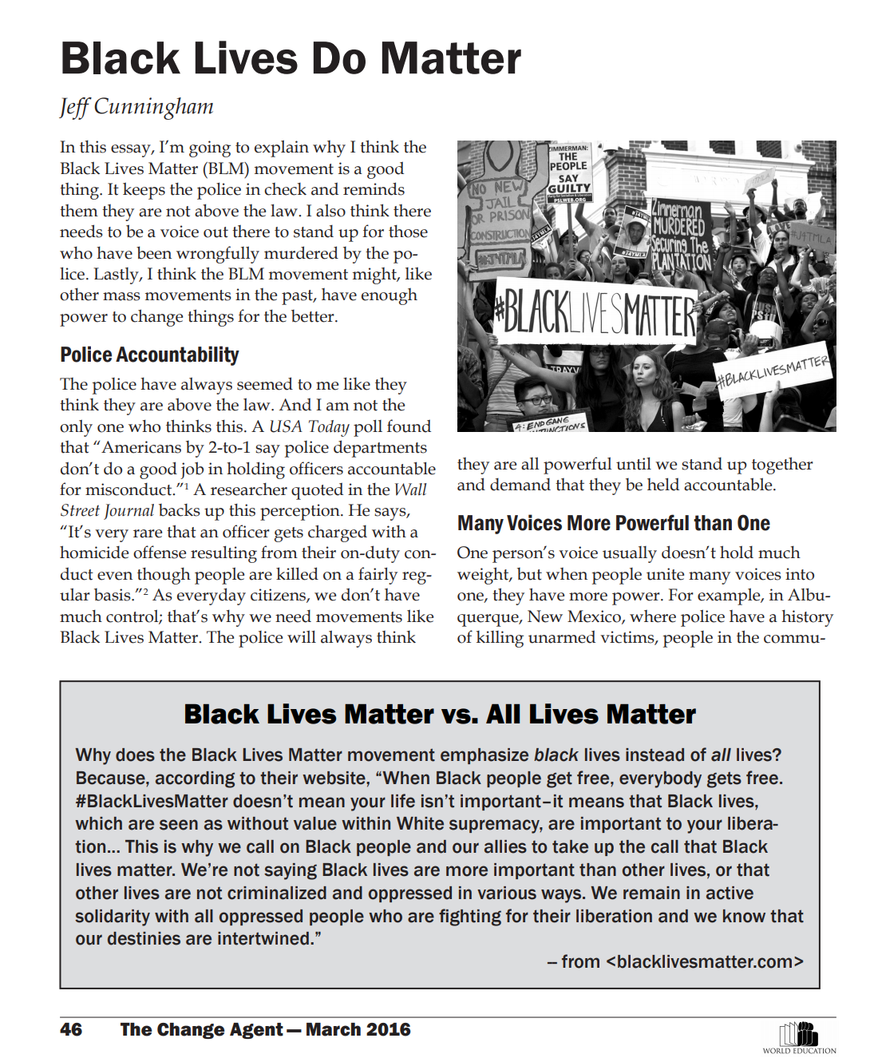
How to talk about race and equity in the classroom
Connect to what you already do. Make small changes so you don’t overwhelm yourself.

Slide 18
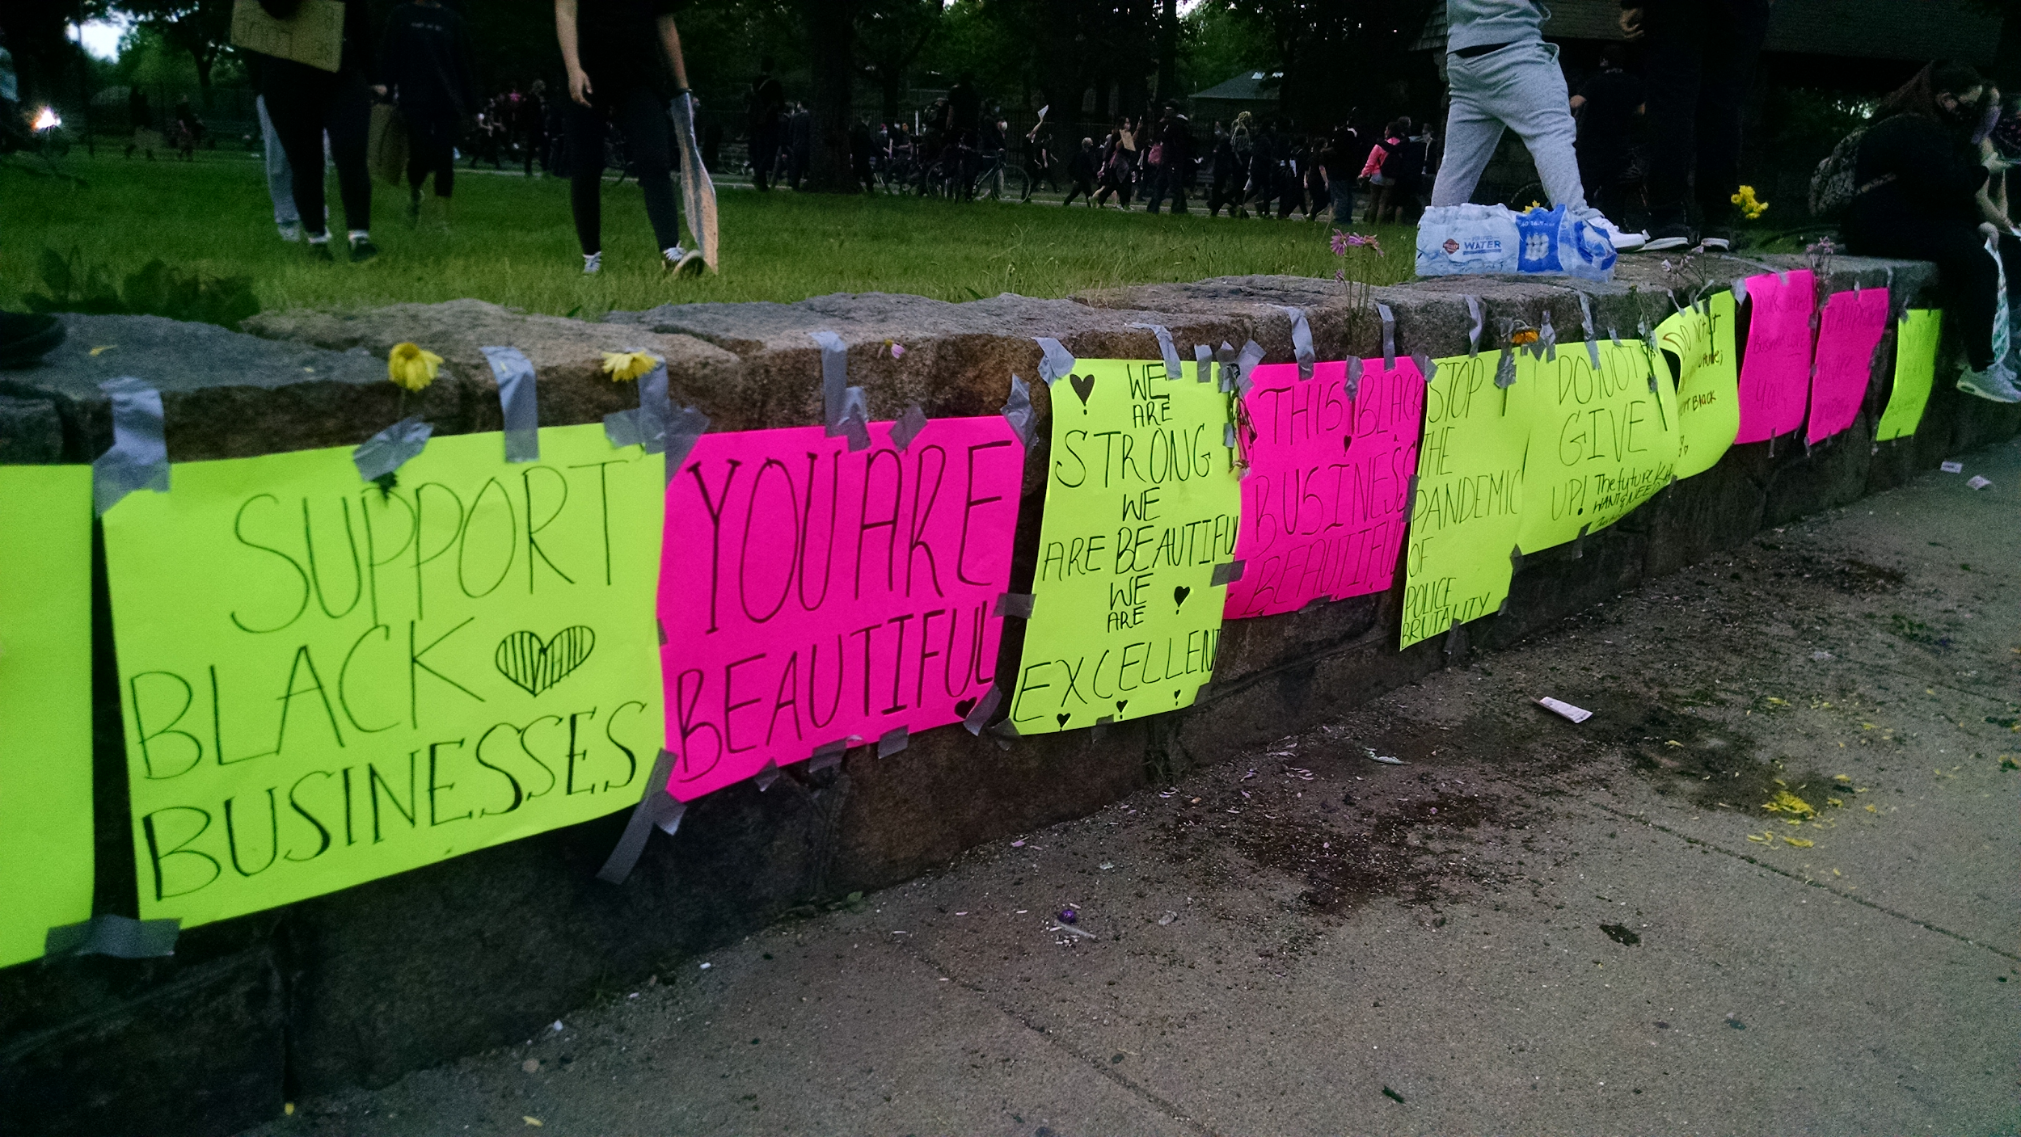
How to talk about race and equity in the classroom
Provide context for what your students might be experiencing.
Incorporate issues of race into your everyday teaching. Don’t wait until something comes up.
Don’t just talk about negatives. Also incorporate stories of fun, celebration, beauty, etc.

Slide 19
How to talk about race and equity in the classroom
Speak from your own experience, and use resources that speak to theirs.
“I eventually got a job in a dry-cleaner’s where they paid me in cash because I didn’t have a Social Security number. I used to work many hours and stress myself to the point that one day I passed out. I always got paid less than everybody else because my boss thought I didn’t have the right to say anything...Now I am trying to get my GED. I have amazing teachers who are helping me achieve my goal. Everyone should be able to have a career regardless of their immigration status.”
-- Patricia Vazquez, “I am a DREAMer” Change Agent: Immigration

Slide 20
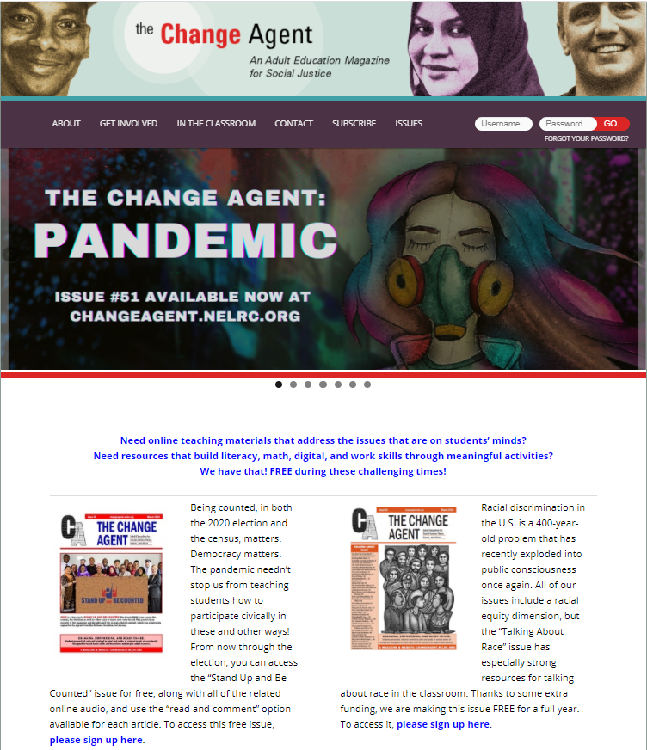
Materials from The Change Agent -- all FREE!
“Talking about Race” issue -- 56-page PDF. Go to main page and click on the link and fill out form.
All the audio versions of articles.
Many “extras,” e.g.: Indigenous Peoples packet, tips for teachers on facing racism in the classroom.
https://changeagent.nelrc.org/

Slide 21
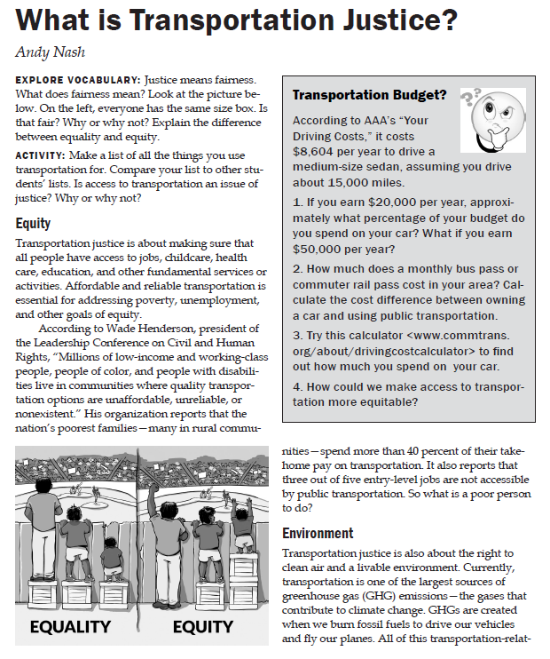
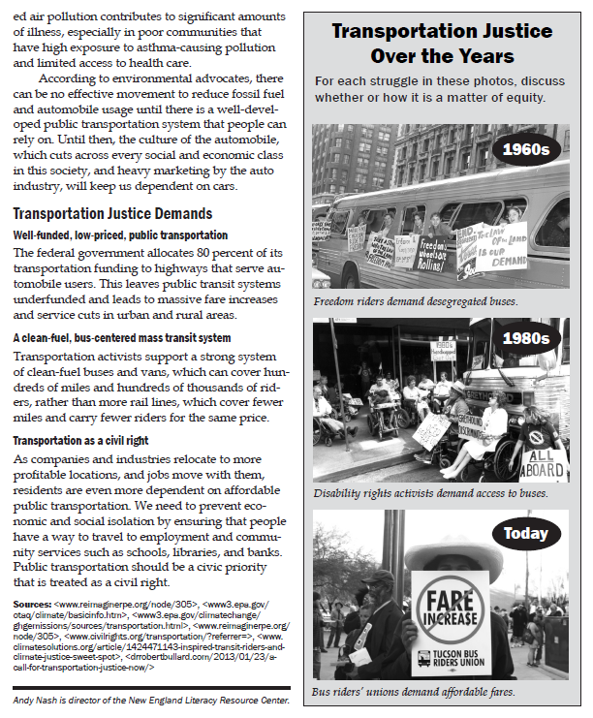
Articles Include Multiple Modes for Teaching

Slide 22
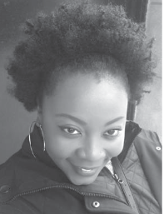
Two Audio Articles about Hair:
“Mine was the Most Kinky”
https://changeagent.nelrc.org/issues/issue-46-march-2018-hair/mine-was-the-most-kinky/
Note: this one has picture story version running along bottom of page.
“Some Fiiiiine Hair”
https://changeagent.nelrc.org/wp-content/ uploads/2018/03/Some-Fiiiiine-Hair.m4a
Note: this audio is a little different from most of our audio; it is read by the author herself! A real treat.

Slide 23
Here are four Google slide presentations that address race
Black Lives Matter — high intermediate ESOL
Talking to the Police — high intermediate ESOL
Intro. to Racism in the U.S. — high intermediate ESOL
Equality vs. Equity — can be adapted for various levels
Instructions: Riva will show you around the BLM one. Then take 5 minutes to explore that one or any of the other three. Note something that stand out and bring that observation back.
All slideshows are located here: https://changeagent.nelrc.org/in-the-classroom/lesson-packets/
Notes:
Black Lives Matter: https://docs.google.com/presentation/d/1mmmB8TUQ4oB3YFqKnALADo3yexqwMwBX-GwW5QjwcHk/edit#slide=id.gada0c383aa_0_33
Talking to the Police: https://docs.google.com/presentation/d/1R65eaoC5eL8d3geK_vLn1Vr4uB4lYG3jzlyNw2MlxpQ/edit#slide=id.p
Introduction to Racism in the U.S.: https://docs.google.com/presentation/d/1tVMkVNPyjR9Mrldx_UJmqTL9J2YNyH4fwGulQKBsz8k/edit#slide=id.gadd976123d_0_58
Equality vs. Equity: https://docs.google.com/presentation/d/1rD3nRysZZZR7GIwDr3fUg4nIo-ALj_9w02WvzV5dW9A/edit#slide=id.p

Slide 24
Breakout Rooms -- about 4 per room; 8 minutes; then come back
What strategies would you use for instruction?
What strategies for hard conversations?

Slide 25
Strategies for instruction
equality/equity image provoked lots of conversation
can use as civic lesson/critical thinking (not just ESOL)
INtro to racism gives teachers a way into the topic, well organized, taught the information and the vocabulary; interaction and students give opinions
build community/build trust -- we need to do it early in class
my breakout partner, Valerie talked about being intentionally inclusive and using inclusive language in her syllabus and other written materials
Student Interactions for the hard question to allow for voice, choice, and empathy
Graphic Organizers for instruction which allows for varied assessments and step by step instruction
you might want to write in the piggy back questions that teachers may want to follow up about "so what about you how do you avoid having negative interactions with the police?"
How about knocking down the walls so everyone can get in the ball field!!!
exactly: cultivating culture of diversity, equity and inclusion not just a curriculum issue!

Slide 26
Strategies for hard conversations
Have community in place from the beginning; students trust that their opinions will be heard, that they matter; we won’t laugh at each other
Make trust-building be a school-wide project -- it’s everywhere, not in a silo. School-wide philosophy: How do we do this together?
Incorporating many voices and perspectives, a book group for ESL staff on Zaretta Hammond's Culturally Responsive Teaching & Brain
Having written working agreement, created with the student, that govern how we will work and function as a group. This is opportunity to create clear expectation for behaviors.

Slide 27
Best Practices for Talking about Race in the Classroom
https://changeagent.nelrc.org/in-the-classroom/lesson-packets/#packet12
Be Intentional about the Topics You Bring to Class
Look for generally excluded groups when doing things in class about holiday celebrations. For example, find Thanksgiving stories from Native American perspectives.
Bring in music, poetry, and literature by people of color.
Work with Material Strategically
Analyze your textbook and other materials before using them in class. How are white people and people of color portrayed differently? What assumptions are made? Whose viewpoints are expressed?
Make sure the races and ethnicities of your students are represented in worksheets, videos, etc.
Notes:
https://changeagent.nelrc.org/in-the-classroom/lesson-packets/#packet12

Slide 28
Can you volunteer?
If you think you might be trying out any of these activities, would you be willing to share a little bit about it at the next webinar?

Slide 29
Questions/Comments/Evaluation
Cynthia Peters
Change Agent Editor, Adult Educator, and PD Provider
cynthia_peters@worlded.org
Riva Pearson
ESOL teacher, Jewish Vocational Service, Hyde Park
rpearson@jvs-boston.org
Next webinar: December 16!

