Slide 1

Program Area Hours and Expenses
NOVA Webinar
November 19, 2020
Veronica Parker and Neil Kelly

Slide 2
Agenda
Review the Requirements
Technical Details
Changes
Recent Reports
NOVA Demo
Open Discussion

Slide 3
Review the Requirements
CAEP members that were active during the 2019-20 program year must submit the required 19-20 program and expenditure data by program area.
Use the NOVA system for data submission (Program Area section)
Submit the total hours of instruction for program year 19-20 provided to students in the seven CAEP program areas (adult education/noncredit).
Submit the total operational cost for program year 19-20 by fund source in the seven CAEP program areas (adult education/noncredit).

Slide 4
Review the Requirements (cont.)
Each consortia member will be asked to certify actual amounts by December 1, 2020 in NOVA.
CAEP members will enter into NOVA their best estimate given the information/data from their local and state level systems.
The CAEP Office encourages members to prorate when necessary if funding sources or programs overlap and/or are too difficult to separate.
Do not confuse this with your NOVA quarterly expense submission.

Slide 5
Technical Details
Use the CAEP seven Program Areas for reporting.
Instructional Hours.
The term ‘hours of instruction” is defined as any reportable individual that has at least one hour of program related instruction in our systems.
The CAEP uses the federal definition for instructional hours (see CAEP Program Area memo for more details).
https://caladulted.org/DownloadFile/1049
Beginning in the 19-20 program year, the CAEP will not track service hours.

Slide 6
Technical Details (cont.)
Follow your agency accounting and fiscal policies that are used to report hours into your attendance system, and the state approved system.
The term “operational costs” is defined as the true cost of running CAEP programs. This includes space, utilities, custodial, overhead, equipment, as well as the normal day-to-day operational costs (instructional, classified, benefits, supplies, etc.).
Operational costs also include administrative costs.

Slide 7
Technical Details (cont.1)
Beginning in the 19-20 program year, for this program area reporting exercise, the CAEP will only track the CAEP funds, the six fund sources listed in the AB104 legislation, and fees and in-kind contributions as define by the WIOA II federal.
Consortium may choose to have their members report additional fund sources if they so desire (but it is not required).

Slide 8
Last Year’s Recommendations:
  Standardize member names across reports. Matching the data from PY 2018 to PY 2019 at the member level required manually matching member names, since these names were spelled differently in the two report submissions.
  Prohibit report certification with zero entries. Twenty-one members submitted certified reports with zero entries for hours of instruction, and 14 members submitted certified reports with zero expenditures.
  Require consistency between hour and expenditure entries at the program level. It should not be possible to certify a report with hours of instruction in a program category but no expenditures, or expenditures but no hours of instruction.
  Link report requirements to records of fund availability at the member level and require reports to provide hours and expenditure data for funded programs in order to be certified.

Slide 9
Changes for 19-20
For CAEP Program Area Hours & Expenses in 19-20, we are not accepting any zero entries by CAEP members. This means if the member has expenses but no hours of instruction (or has hours of instruction and no expenses), they are excluded from the reporting process.
There should be consistency between hour and expenditure entries at the program level. It should not be possible to certify a report with hours of instruction in a program category but no expenditures, or expenditures but no hours of instruction.

Slide 10
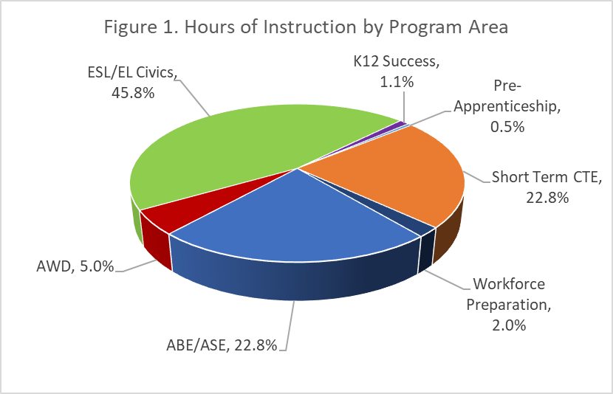
Recent Reports 18-19
Hours of instruction by program area
Notes:
Hours of instruction. The analysis of hours of instruction addresses: 1) what programs have the greatest number of hours, 2) how is this different across different types of providers (K-12 Schools vs Community Colleges and Others), and 3) how do the PY 2019 results compare to the PY 2018 results?
Figure 1 shows the percentage distributions of hours of instruction by program area. Taken together, ESL/EL Civics, Short-Term CTE, and ABE/ASE account for 91.4 percent of all instructional hours during PY 2019

Slide 11
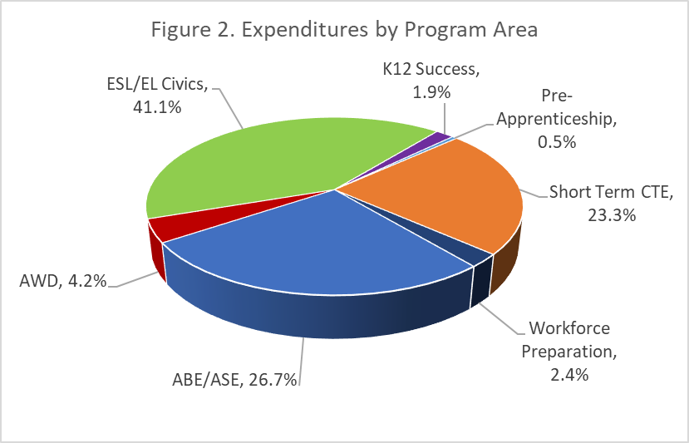
Recent Reports 18-19
Expenditures by program area
Notes:
Expenditures. The analysis of expenditures addresses: 1) what programs have the highest expenditures, 2) what fund sources have the highest expenditures, 3) how do expenditures vary across the different types of providers (K-12 Schools vs Community Colleges and Others), and 4) how do the PY 2019 results compare to the PY 2018 results?
Figure 2 shows the percentage distribution of expenditures by program area. As was the case for hours of instruction, almost all the expenditures also fall into one of three categories: ESL/EL Civics, Short-Term CTE, and ABE/ASE. The distribution of expenditures across program categories is very similar to the distribution for hours of instruction.

Slide 12
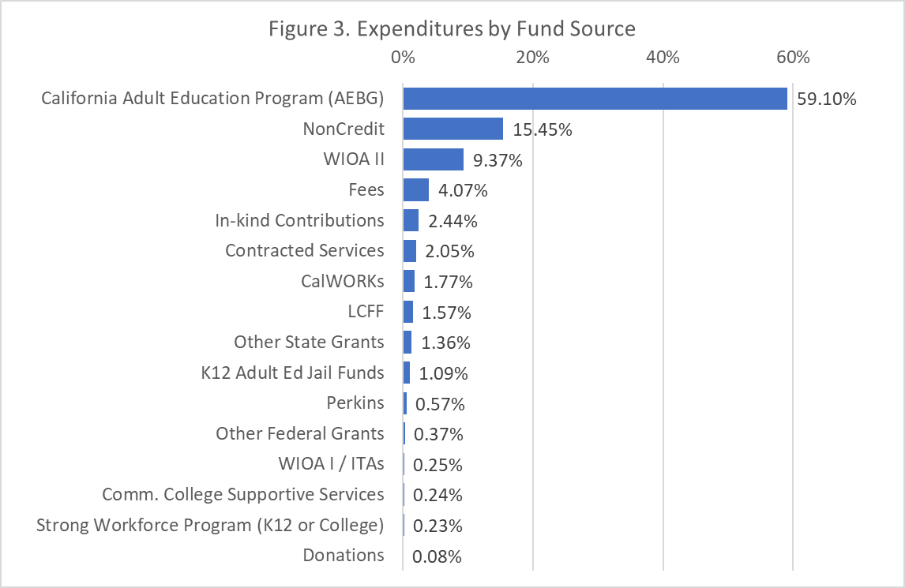
Recent Reports 18-19
Expenditures by fund source
Notes:
In addition, to reporting expenditures by program area, the State CAEP Office reporting policy requires consortia to allocate expenditures for each program area across the various funds that contributed to these program expenditures, so that CAEP can have a more complete picture of how locally-available fund sources are being leveraged to support the operation of CAEP programs. Figure 3 shows the percentage distribution of expenditures by fund source type. Nearly 84 percent of all expenditures fall into one of three fund types: California Adult Education Program (formerly AEBG), Noncredit apportionment, and WIOA Title II AEFL funds. Reporting of expenditures associated with each of these fund types is required, as is reporting for Fees, In-Kind Contributions, CalWORKs, LCFF, K-12 Adult Ed Jail Funds, and Perkins funds. Reporting of expenses for the other fund type categories is optional under the revised reporting policy for PY 2019.

Slide 13
Recent Reports 18-19
Data quality
Notes:
Consistency within reports for members: Are the underlying values that would be used to create a cost per value (hours of instruction and expenditures) related to each other in a predictable manner? In other words, do members with high reported hours of instruction also have high reported expenditures, and do those with low reported hours have low expenditures? Figure 4 plots total hours of instruction and total expenditures for each member on a log scale. This plot suggests that the relationship between expenditures and hours of instruction is closer for K-12, than it is for Community Colleges. This is a pattern in the expenditure and hours data that was also observed with the initial PY 2018 data. All scatterplots in this report exclude cases with zero values on either axis.

Slide 14
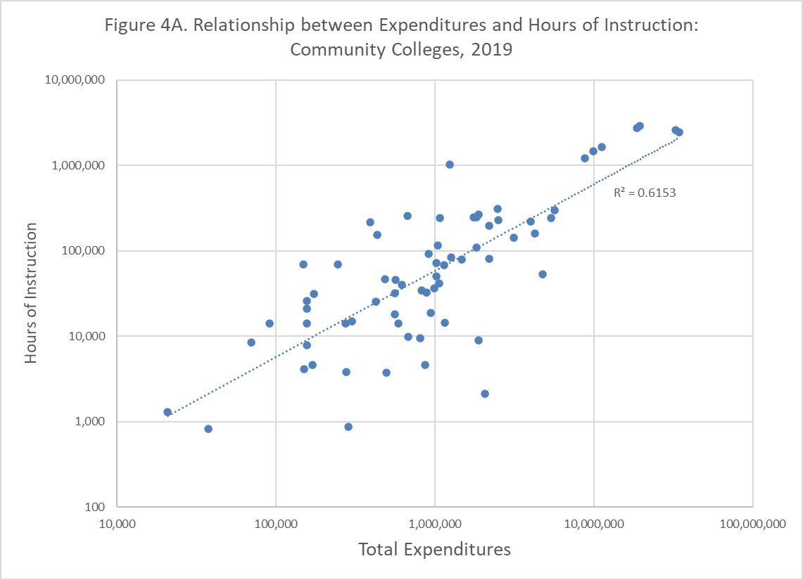
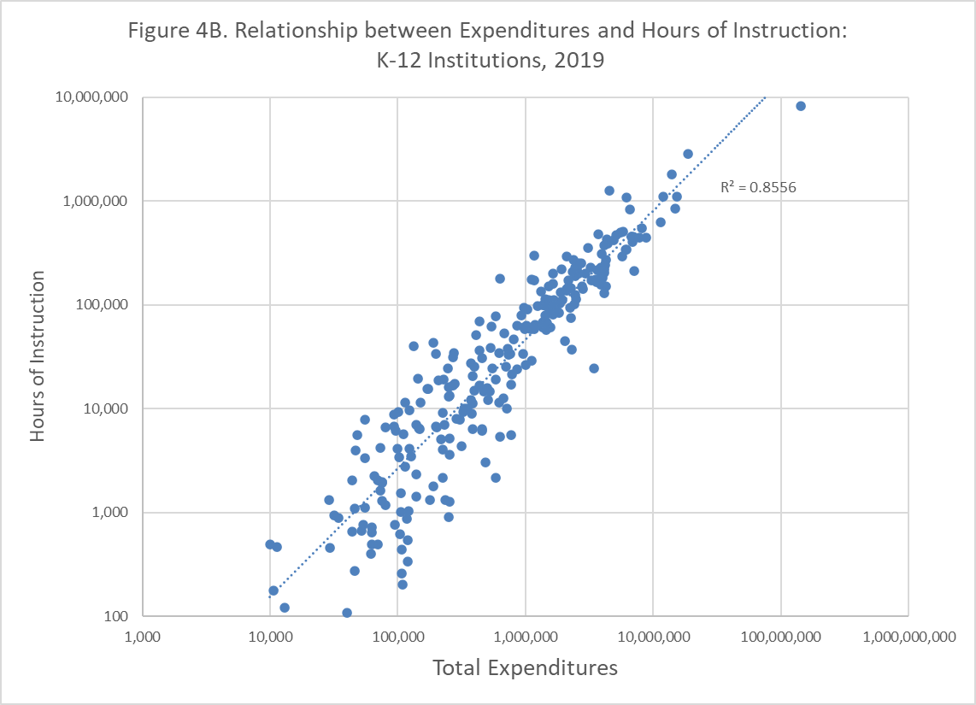
Recent Reports 18-19
Data quality
Notes:
These figures present the same data as Figure 4, but separately for community colleges and K-12 providers.

Slide 15

NOVA Demo

Slide 16
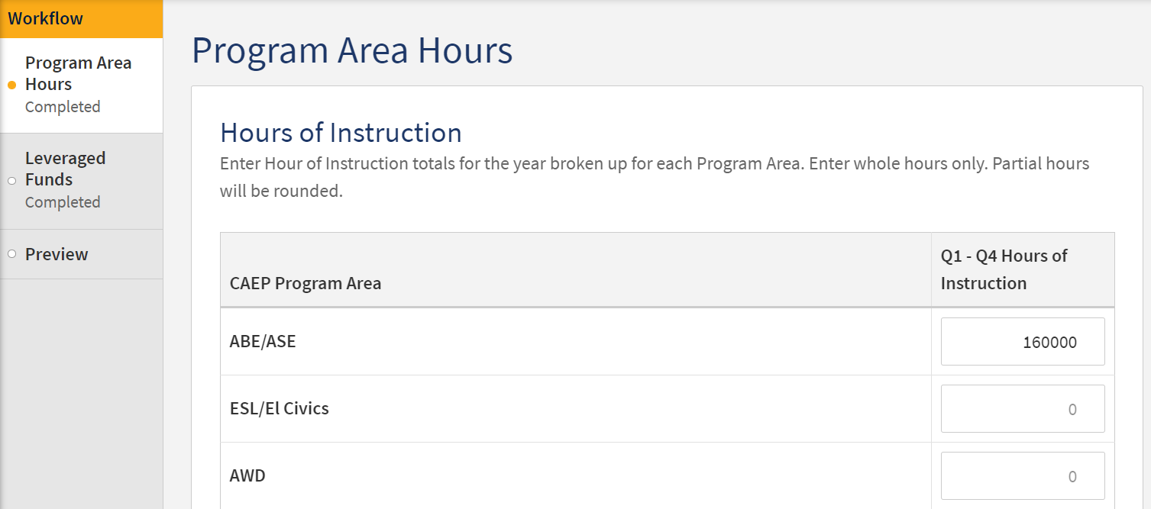
NOVA Demo
After logging in to NOVA, accessing the CAEP, then Program Area Reporting, select your consortium and begin entering the hours of instruction by Program Area.

Slide 17
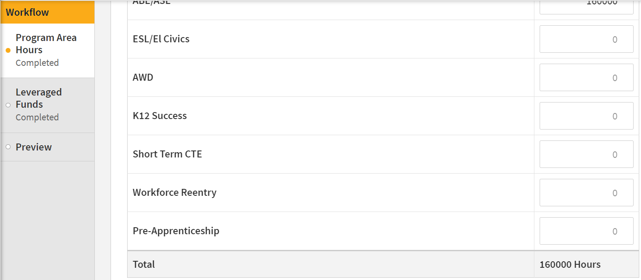
NOVA Demo
As you are entering the hours of instruction by program area, the system is calculating a total.
Once you have finished entering the hours, you will select the ‘Leveraged Funds’ from the left pane.

Slide 18
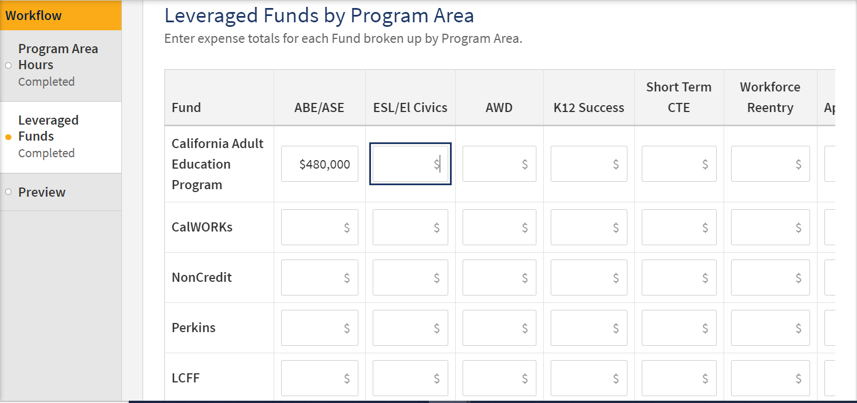
NOVA Demo
Next, enter the expense totals, by program area.

Slide 19
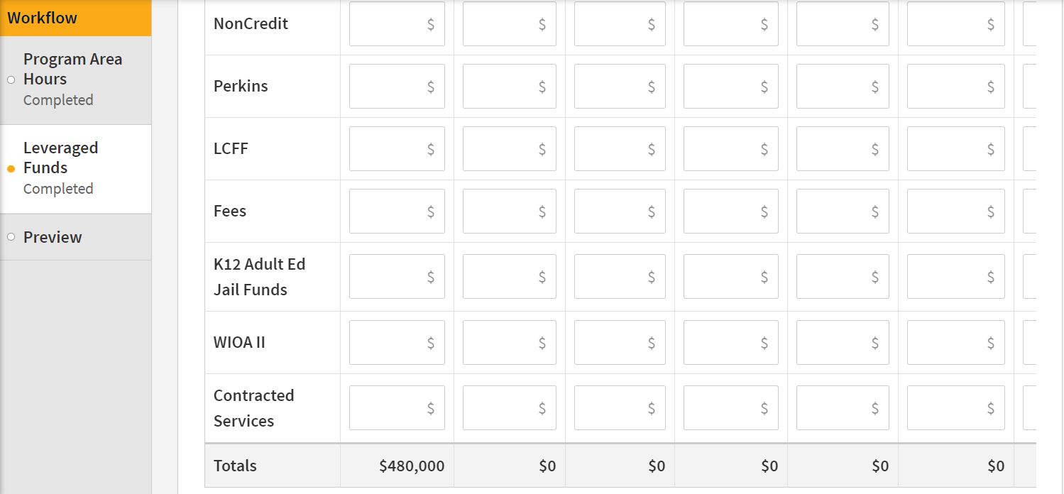
NOVA Demo
As you are entering the total expenses by program area, the system will calculate the total by program area…

Slide 20
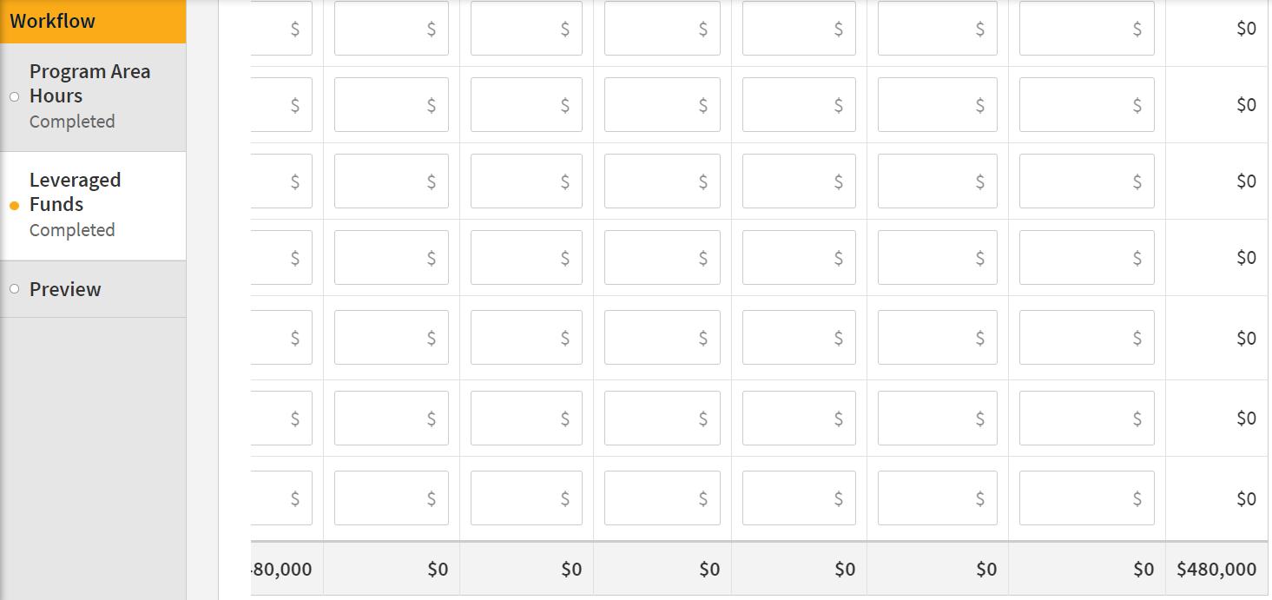
NOVA Demo
…and the Grand Total.

Slide 21
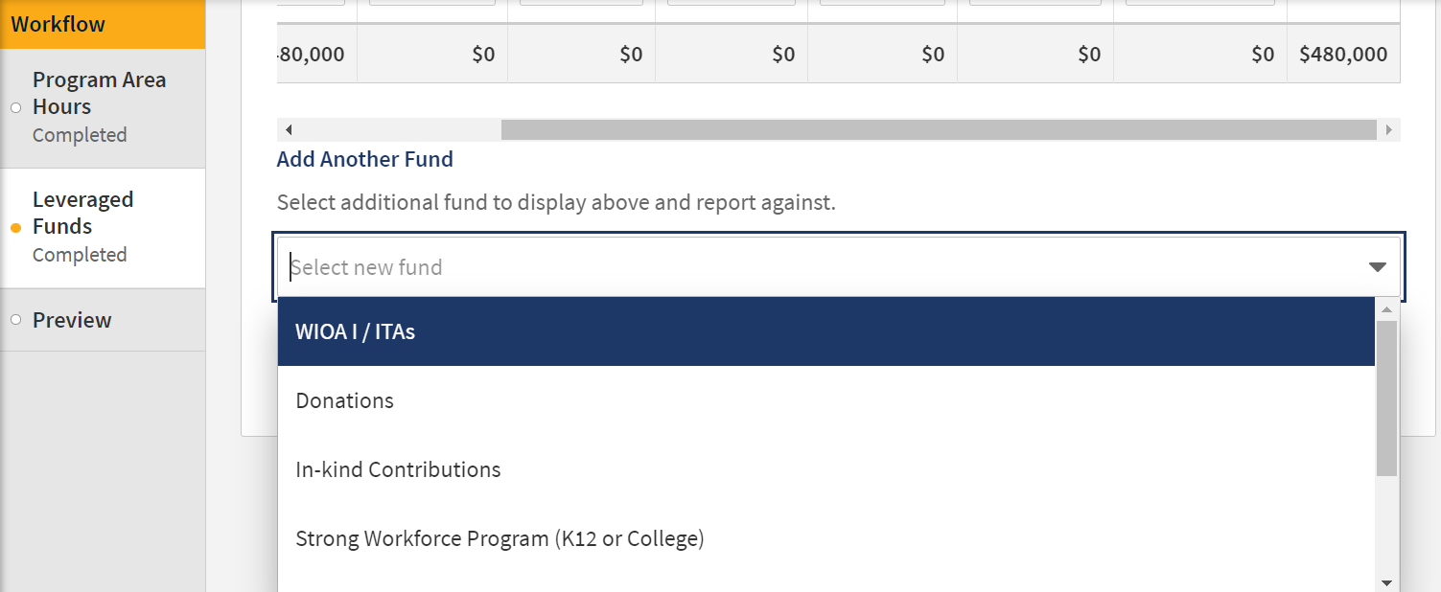
NOVA Demo
If a particular Fund Source is not prepopulated, you can add it by selecting the drop-down menu, selecting the fund source and clicking on ‘Add Fund Source.

Slide 22
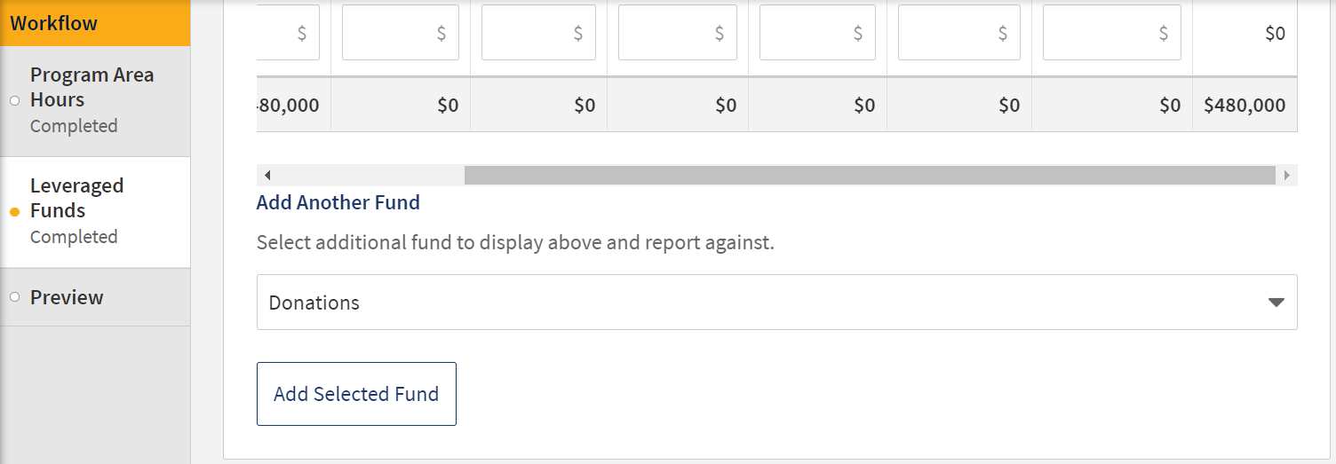
NOVA Demo

Slide 23
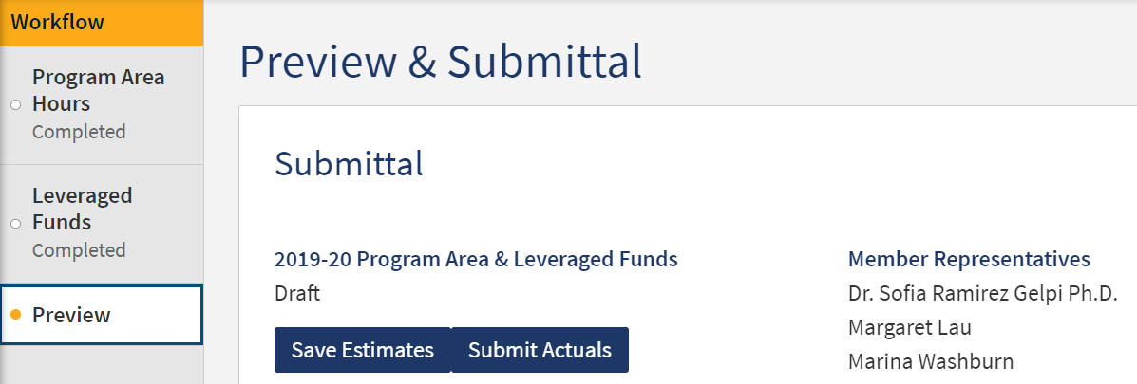
NOVA Demo
After you have finished entering in all information and reviewed, you will ‘Save Estimates’ and/or ‘Submit Actuals.’

Slide 24

Discussion Time

Slide 25
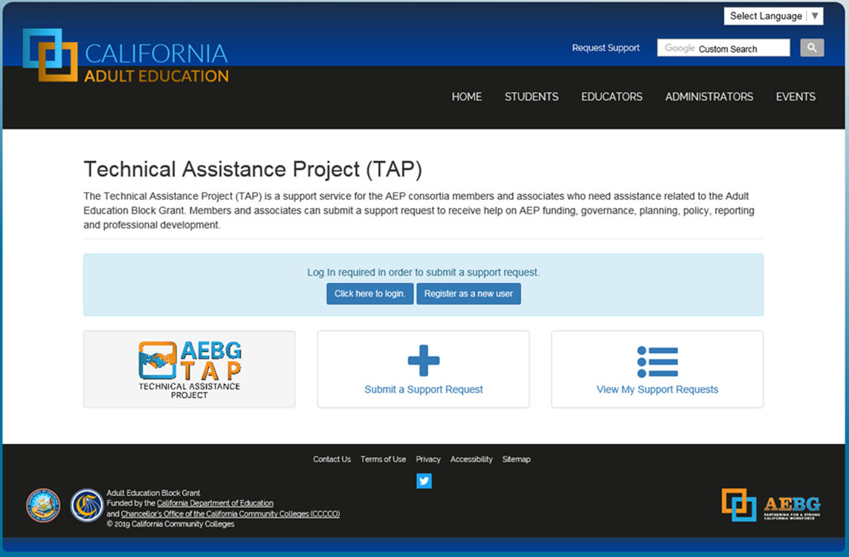
Request Support from CAEP TAP

