Slide 1
CAEP Fall Regional Network Meetings
CAEP Office, CAEP TAP, CASAS, WestEd and OTAN
August 2020

Slide 2
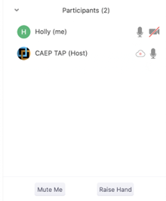

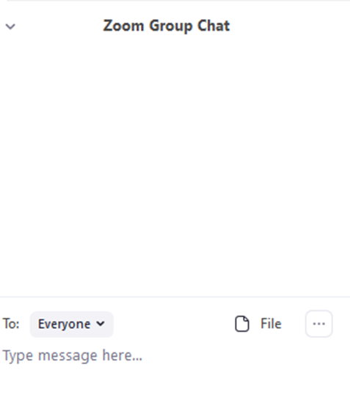


Zoom Room Controls
Everyone has the ability to speak…please raise your hand first
Everyone is muted upon entry
Feel free to communicate via the chat – even share files
You can use your camera…or not

Slide 3

CAEP Office Update
CASAS and Re-opening
WestEd and Re-opening
OTAN and Technology and Distance Learning
CAEP TAP and Student Supportive Services

Slide 4
CAEP Office
Statewide Student Accessibility to Technology
Intake Survey

Slide 5
CASAS
Updated OCTAE memo on May 29, 2020
Continues to require federal reporting and continues to leave it to the states to determine own testing policy.
Memo 20-5 allows for self reported placement into one of the 12 federal EFL’s without a pretest.
To get a MSG, however, the participant still needs to complete a pretest and a post-test, like usual.
https://www2.ed.gov/about/offices/list/ovae/pi/AdultEd/octae-pm-20-5-covid-faqs-final.pdf

Slide 6
Remote Testing
The CDE has decided to permit California WIOA II agencies to implement remote testing. Agencies that choose this must have procedures to ensure:
  The student testing can be properly identified
  Any approved test that is administered to students is properly secured
  The remote proctor can properly administer the test
  For more information, access the CDE Memorandum on Remote Testing:
  https://www.casas.org/docs/default-source/caacct/california-remote-testing/cde-remote-testing-memorandum.pdf?sfvrsn=38c3335a_6?Status=Master

Slide 7
Local Assessment Policy
Appendix C in the statewide assessment policy addresses issues for distance learning.
Appendix C includes:
Definition of Distance Learners
Testing
Curricula
Instructional hours
https://www.casas.org/docs/default-source/caacct/california-assessment-policy-guidelines-2019-20.pdf?sfvrsn=72463d5a_2?Status=Master

Slide 8
Remote Testing Benefits
Pretest new students
  Baseline scores for NRS reporting
  Placement information to guide distance learning instruction
Post-test to achieve MSGs
Add flexibility by developing the capacity to offer multiple testing options, including testing distance learners.
Make remote testing a regular and essential part of your program.

Slide 9
Remote Testing Challenges
Uncertainty about school openings
Equity concerns
  Proctor and student access to technology
  Student test environment may lack privacy and have distractions
High staffing costs due to limitation of test taker to proctor ratio.
  Difficult to test large numbers and maintain test security.

Slide 10
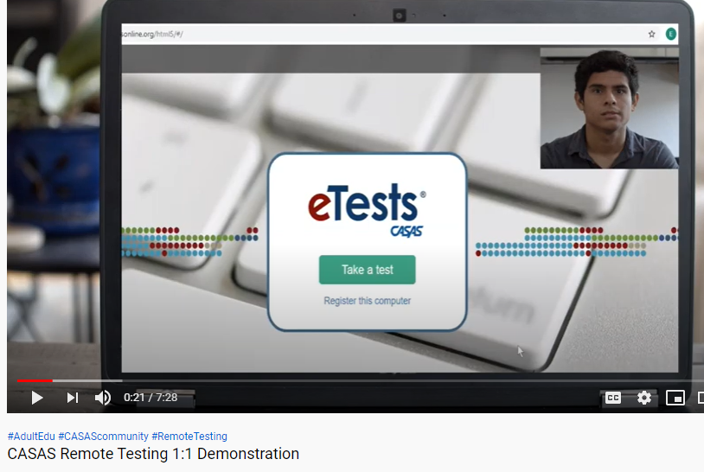
Remote Testing Information
Remote testing 1:1 Demo on video
https://youtu.be/uLoaw-BHo-s
Registering test stations for remote
testing on video
https://youtu.be/1ipRe4-8Tiw
Remote Testing Overview Documents
https://www.casas.org/product-overviews/remote-testing
Agency Remote Testing Agreement for California
Must be completed annually and copy sent to CDE consultant and CASAS Program Specialist

Slide 11
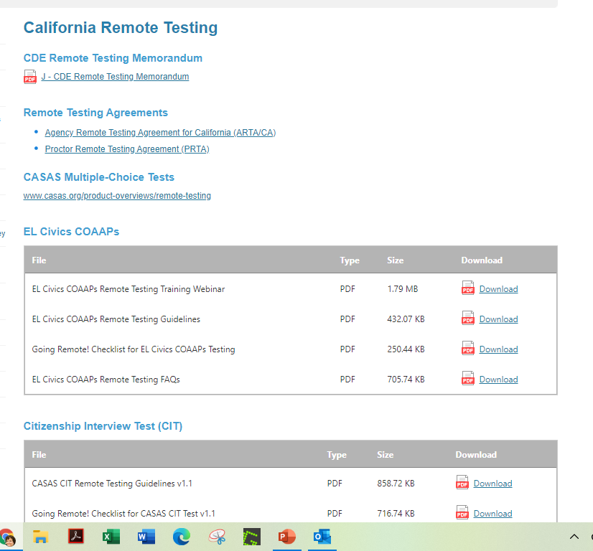
Remote Testing of COAAPs and CIT
Go to the CASAS website and go to the California Remote Testing page
Guidelines
Webinar recordings
Frequently asked questions

Slide 12
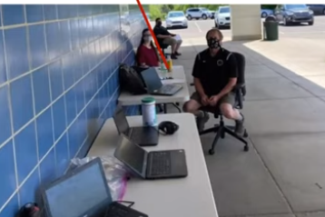
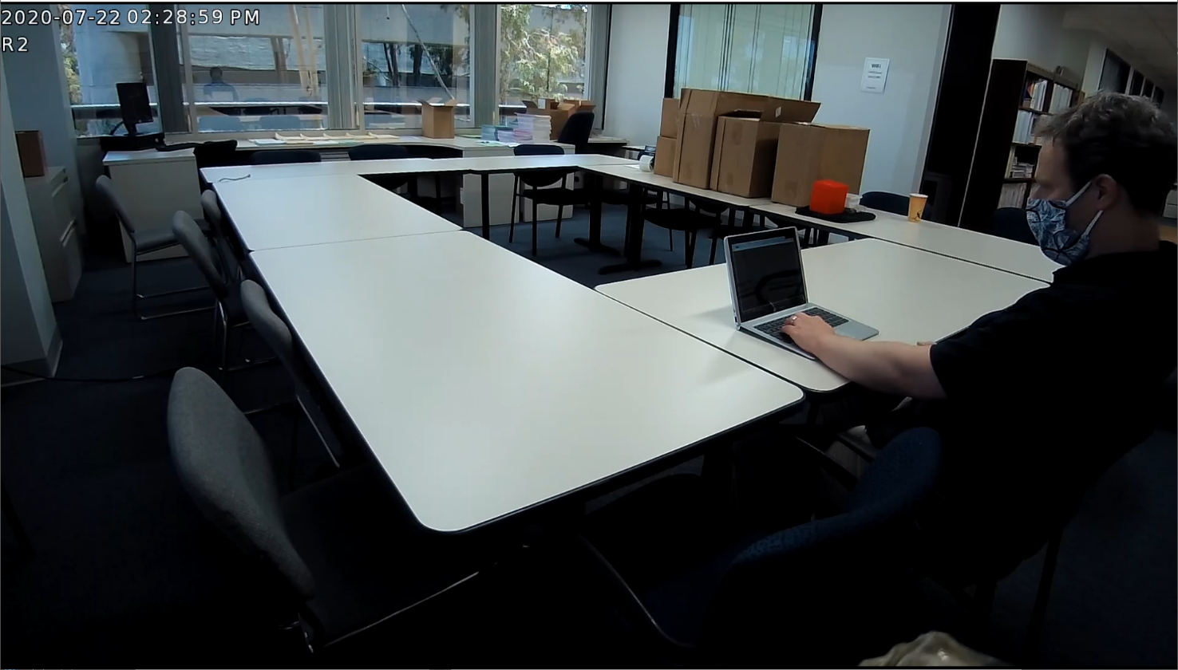
Remote Testing Considerations
Parking Lot testing
  Novi Adult Education-Testing in cars
  YouTube video of the webinar
Remote Operations with On site Proctor
On site testing with social distancing
Updates to current remote testing
options

Slide 13
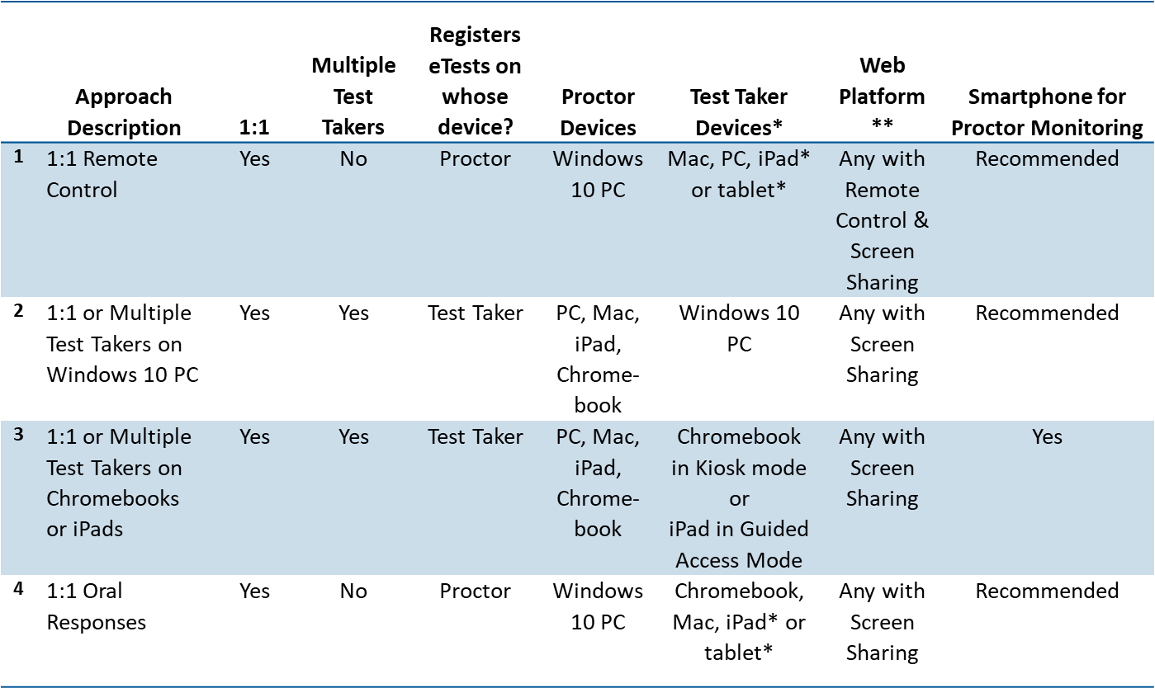
CASAS Remote Testing Summary

Slide 14
NEW: CASAS Reading Level Indicator (RLI)
Available at no cost to eTests/TE users.
  Runs in a browser
  Delivered to a student’s smartphone
  No live proctor required, not “scheduled”
Results are shown as “Estimated NRS EFL” for ABE or ESL. No scale scores are given.
It is NOT an NRS-approved test and may NOT be used for pre- or post-testing to achieve MSGs.
The Reading Level Indicator (RLI) is Form 601R.
The RLI was released in early August (TE Build 82).

Slide 15
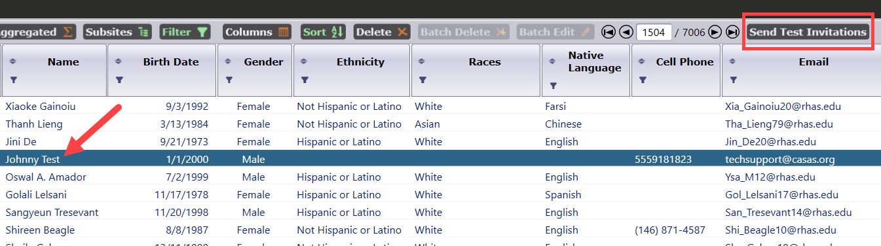
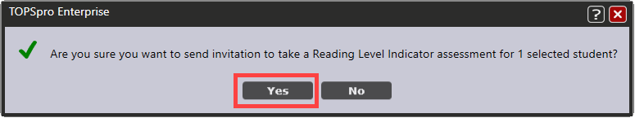
CASAS Reading Level Indicator (RLI)
Initiate the RLI by selecting students in TE’s Student Demographics lister.
Click the Send Test Invitations button.

Slide 16
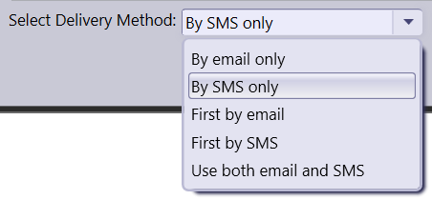
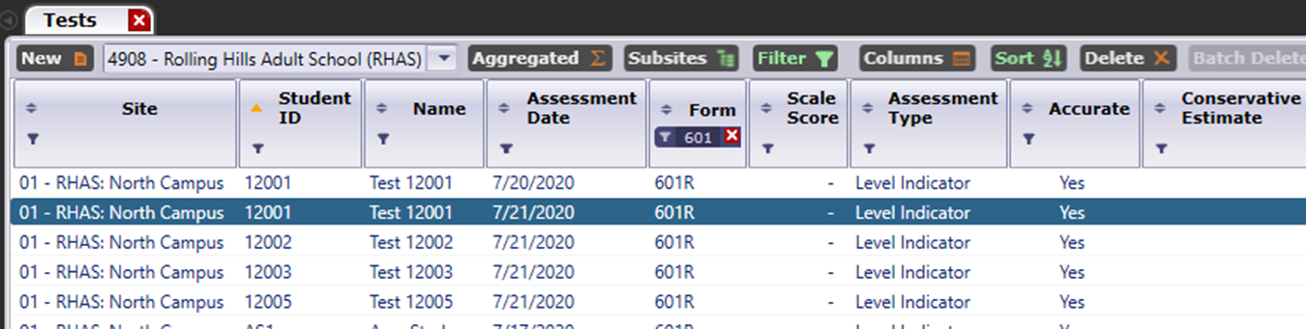
CASAS Reading Level Indicator (RLI)
You can deliver the invitation via SMS text message or email.
Results are seen in Records > Tests

Slide 17
Quarterly Data Submission Wizard
Starting in PY 2020-21, agencies will submit their quarterly data and Data Integrity Report (DIR) using the Quarterly Data Submission Wizard (QDS).
  Includes both CAEP and WIOA agencies.
Agencies will no longer send separate pdf copies of the DIR when completing quarterly data requirements.

Slide 18

New Agency Tool Kit
CASAS has a new toolkit for new agencies, new staff at existing agencies, or anyone else who is interested
  Record keeping and reports
  Assessments (including COAAPs)
  Training Modules
  Contacts (CDE and CASAS)

Slide 19
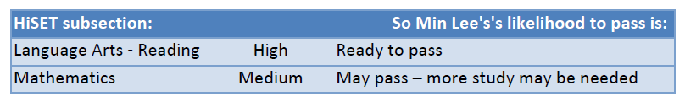
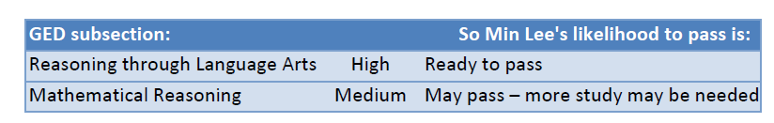
CASAS Studies
CASAS conducted cooperative studies with GED Testing Service and ETS HiSET
An adult learner’s performance on CASAS reading and math assessments predicts readiness to pass the GED or the HiSET
Results appear on the Individual Skills Profile as the “Likelihood of passing…”

Slide 20
CASAS Accommodations Page
CASAS has an updated Webpage that addresses testing accommodations for learners with disabilities.
https://www.casas.org/docs/default-source/special-needs/testing-accommodations-step-by-step.pdf?sfvrsn=de69325a_2?Status=Master

Slide 21
TE I³ Reports
TE has new I³ reports that relay results from EL Civics COAAPs to outcomes for AB 2098 Immigrant Integration.
There will be a new column on the TE CAEP Summary that calculates these new outcomes.
There will be additional TE reports that relate results by class and student, and detail activities represented by the COAAP.

Slide 22
WestEd
User Interface & Resource Improvements
  User Interface support enhancements to improve understanding of metrics and calculations
  Better dedicated AE resources to improve reporting & understanding of data processes and usage
AE Pipeline
2020-21
Build 4 with 2019/2020 Data – March 1, 2021
Professional Development – 20/21
  Using LB Data for Program Improvement and Planning
  Noncredit Code Alignment: Improving noncredit program and student coding to improve outcomes
  CB21 and AB705: Creating stronger course sequences to college level courses and programs
  CTE Pathways: Using the adult ed CTE mapping data to improve adult education career outcomes
Metrics & Data Elements

Slide 23
WestEd
Supervised Tutoring and Study Skills
Basic and Secondary TOP Codes
Colleges using Census for Noncredit
CASAS/CTEO Survey Data
HSE/HSD Award Codes in MIS
COAPPS/Immigrant Integration
Data &
Coding Issues

Slide 24
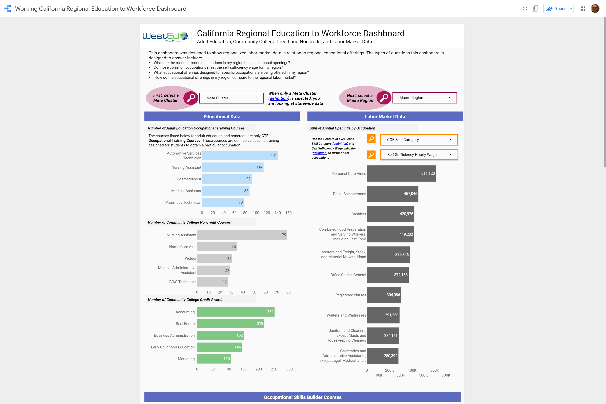
Adult Ed
Education
To Workforce
Dashboard
Archived at
CAEP Pathway Webinars

Slide 25
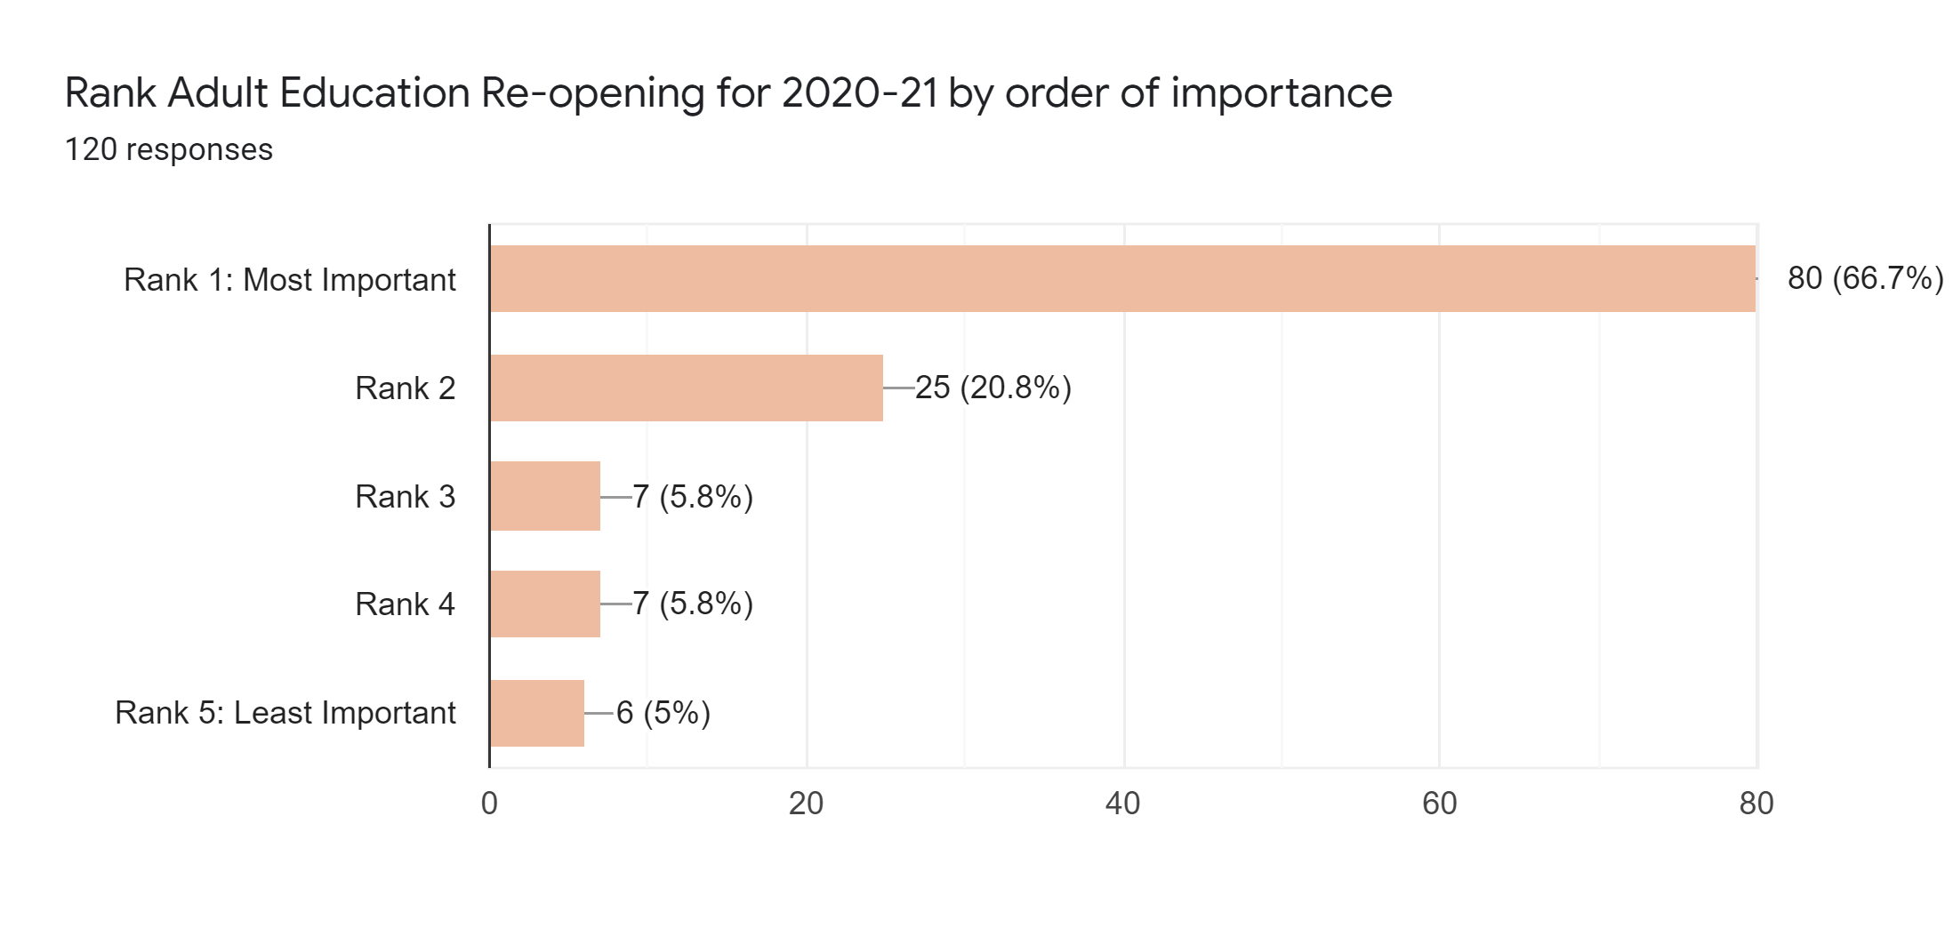
Adult Education Re-opening for 2020-21
Notes:
Statewide results.

Slide 26
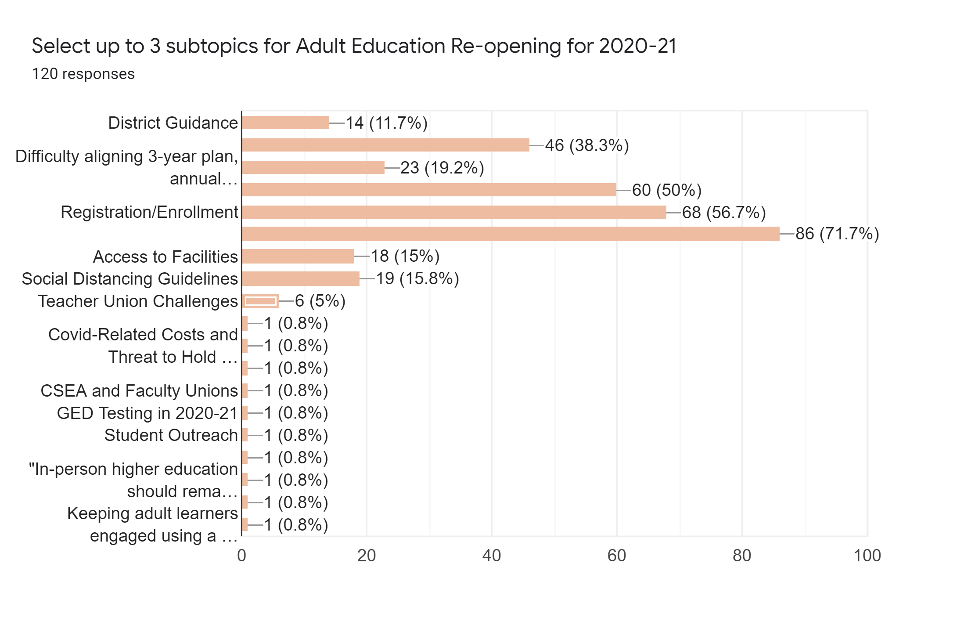
Adult Education Re-opening for 2020-21
Notes:
Statewide results.

Slide 27

OTAN
Resources & Tools
OTAN Website
  COVID-19 Field Support
  Webinars and slides (recorded and future)
  Teaching with Technology resources
  Curriculum Offers
  YouTube and membership
  Social Media ~Twitter, Facebook, and LinkedIn

Slide 28
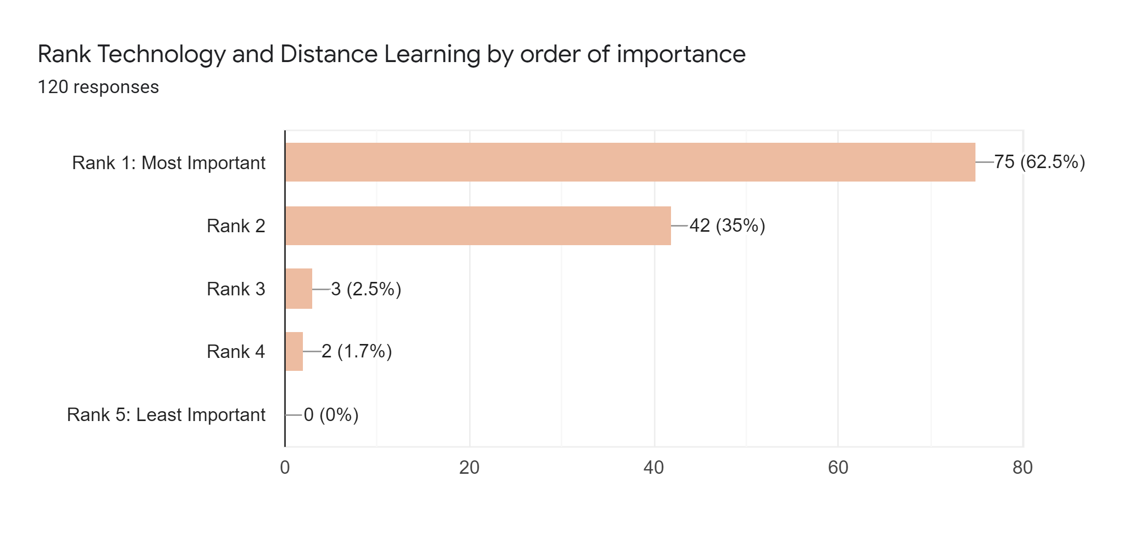
Technology and Distance Learning
Notes:
EdTech Center (WorldEd.org) ​
Ready – set – go ​
https://edtech.worlded.org/wp-content/uploads/2020/04/Ready-Set-Go-FINAL.pdf​
​
Tips for DL: ​
https://edtech.worlded.org/tips-for-distance-learning/​
​
IDEAL Consortium Handbook: ​
https://edtech.worlded.org/professional-development/ideal-consortium/​
​
Proliteracy – COVID Rapid Response Report from the Field​
https://www.proliteracy.org/Portals/0/pdf/Research/COVID-19/COVID-19-Report.pdf?ver=2020-07-31-090141-130&utm_campaign=Programs%20-%20Research%20Briefs&utm_medium=email&_hsmi=92402990&_hsenc=p2ANqtz-866DLweVwNEEihbg4Yg0KIkCLGvBmnQ2bVBTfurb8UnMa4D14bVvIrfl2YUXZjf-gmhjkG24LQJD91i8Tq1-FsHea28OYNoLmjUEAYwrE3rHxcnco&utm_content=92402990&utm_source=hs_email​
​
​
IDEAL Consortium Handbook: ​
https://edtech.worlded.org/professional-development/ideal-consortium/​
​

Slide 29
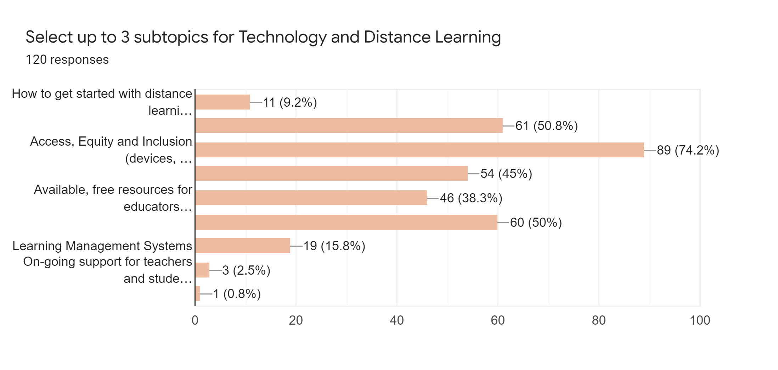
Technology and Distance Learning
Digital Literacy Courses
Adult Education Curriculum
Assessment (formative, El Civics…
Teacher and Student Training
Notes:
Digital Literacy Courses for Teachers: (61 – 50.8%)​
Resources: Google digital literacy, NorthStar, Learning Upgrade​
4/20 – Northstar: Assess, Curricula, and Online Learning​
4/28 – Applied Digital Skills with Google – Virtual Bootcamp​
5/27 – Student Success Online with 21Things4Students​
6/4 – Understanding Digital Equity, Inclusion, and Literacy​
​
​
Access, Equity and Inclusion​
Resources:​
3/25 – Increasing Equity in Online Learning​
6/4 – Understanding Digital Equity, Inclusion, and Literacy​
​
​
AE Curriculum Online Options​
Resources: CK12, CommonLit, HippoCampus, Math resources, ReadTheory, Microsoft products for language practice.​
​
Assessments, formative, ELCivics​
Resources: OTAN COVID page –​
7/15 Tech Tools for Assessments - Anthony Burik (soon to be posted!) Good handout!

Slide 30
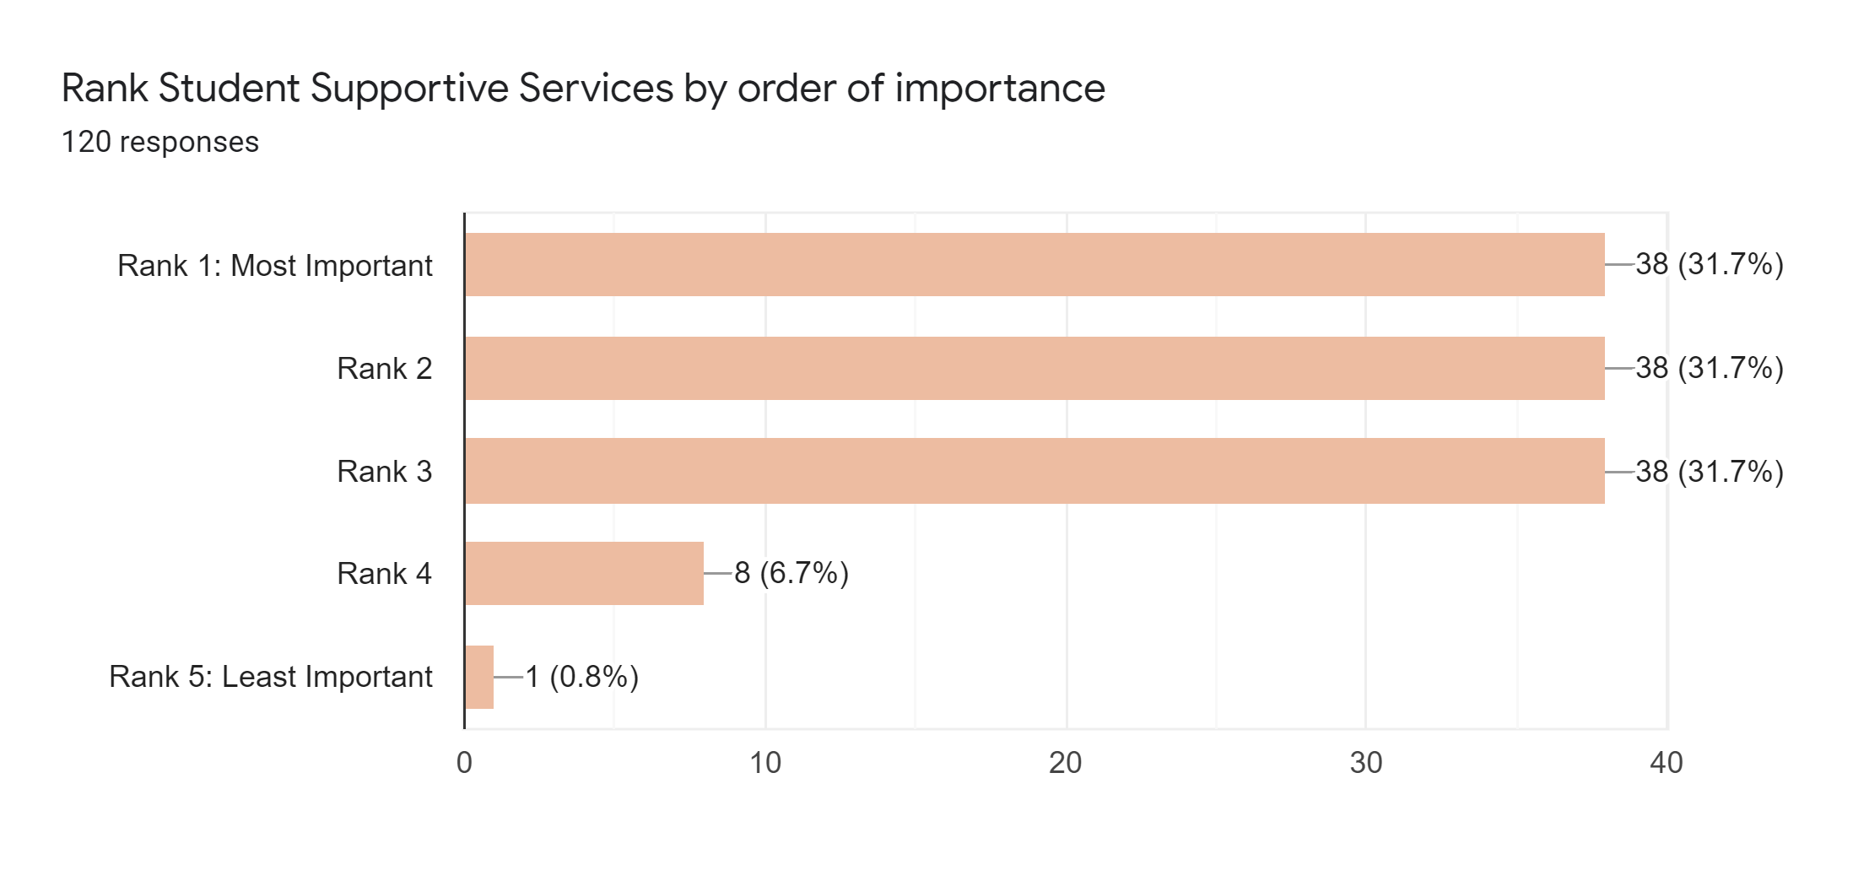
Student Support Services

Slide 31
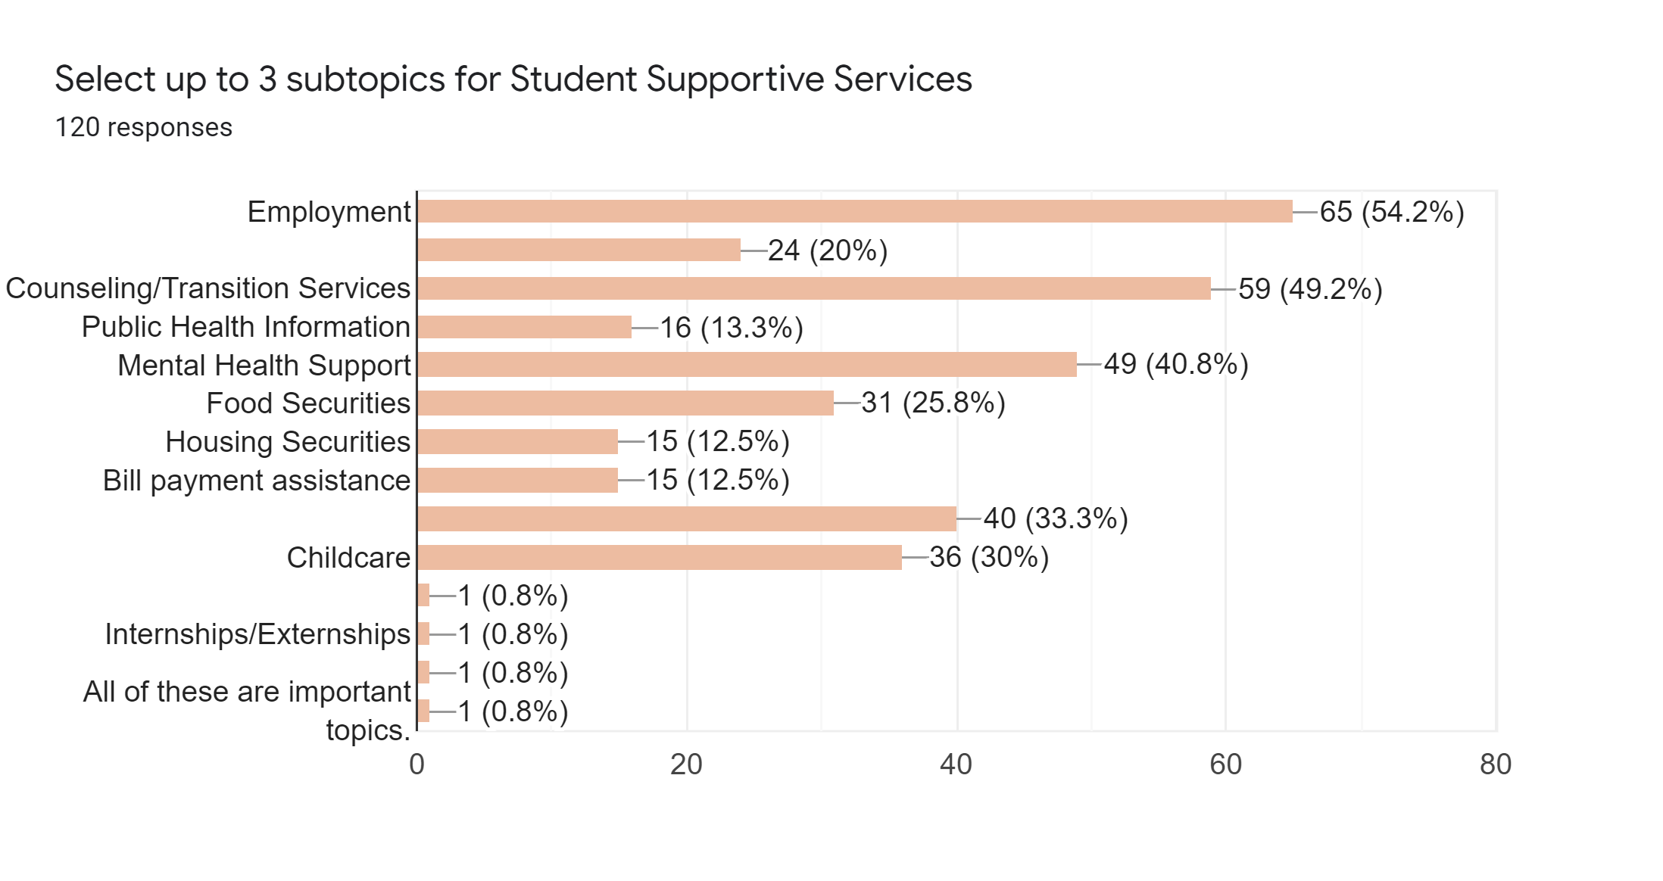
Student Support Services
Public Housing
Resources for Undocumented Immigrants
Transportation
Technology Tools and Internet Access

Slide 32
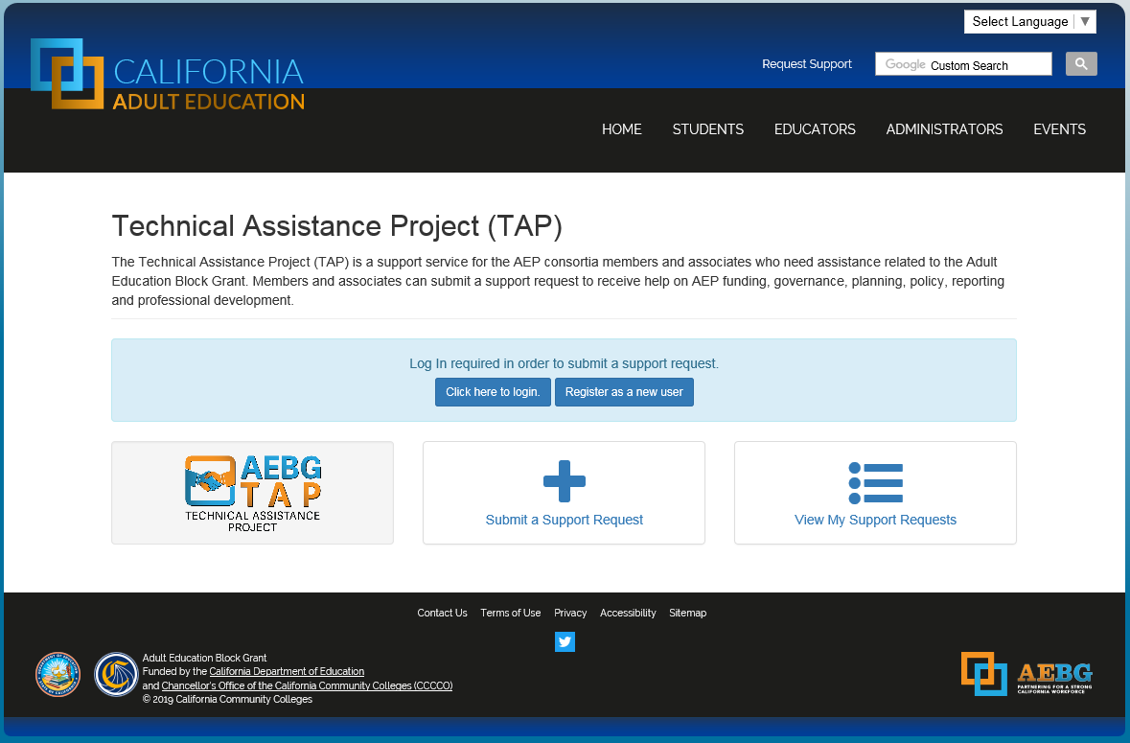
Request Support from CAEP TAP

