Slide 1
CAEP: Data Submission Guidelines
Nicole Jordan
Senior Data Analyst
njordan@casas.org
© CASAS 2020

Slide 2
what deliverables are due?
When are they due?
For Adult Schools*, these reports should include data from July 1, 2019 to June 30, 2020:
End-of-Year TOPSpro® Enterprise (TE) Data
End-of-Year CAEP Data Integrity Report (DIR)
Due August 1, 2020
*CAEP funded Community Colleges submit data through their MIS system. They are not required to submit their DIR.
© CASAS 2020

Slide 3
How to submit the deliverables?
End-of-Year TOPSpro® Enterprise (TE) Data
  Enter data electronically via TE only
  Nothing to send – Data already hosted on our Online Server
End-of-Year CAEP Data Integrity Report (DIR)
  Generate in TE
  Email CAEP DIR to: caep@casas.org
© CASAS 2020

Slide 4

End-of-Year TOPSpro® Enterprise (TE) Data
Quick Checklist:
Review Class Instances – Instructional Programs
Enter/Verify DAILY and UPDATE/Cumulated attendance hours
  Verify data since COVID is being recorded as Distance Learning minutes
Enter/Verify all assessments
  Verify that assessments given since COVID closure were marked as “Remote Test = YES”
Student Information
  Clean-up Duplicated Students
  Mark Services as applicable (Supportive, Training, Transition)
  Mark Outcomes
© CASAS 2020

Slide 5
CAEP Outcomes
Literacy Gains
HSE/HS Diploma
Post-Secondary
Enter Employment
Increase Wages
Transition
Pre/Post Level Completion
Carnegie Units /HS Credits
CDCP Certificate
Occupational Skills Gain
Workforce Preparation
High School Diploma
Passed GED
Passed HiSET
Passed TASC
College Degree – AA, AS, BA, BS
Graduate Studies
Training Credential
Occupational Licensure/Certificate
Apprenticeship
Get a Job
Retain a Job
Enter Military
Increase Wages
Get a Better Job
Transition to ASE
Transition to Post-Secondary/CTE
Transition to Post-Secondary/College
© CASAS 2020

Slide 6
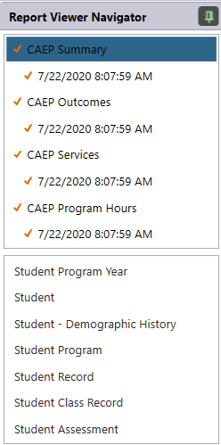
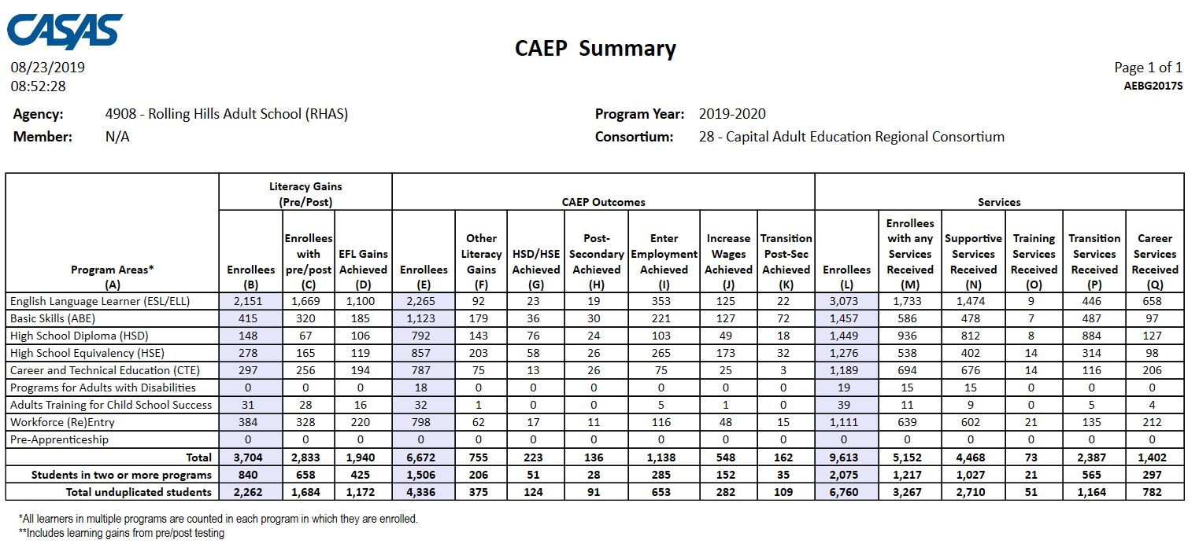
CAEP Summary Report
Generate n TE: Reports > State Reports > California > CAEP Tables
© CASAS 2020

Slide 7
CAEP Summary Report
Displays outcomes in three separate sections:
Literacy Gains (Pre/Post) using NRS Table 4 guidelines
Other AB 104 outcomes using WIOA II reporting requirements but not pre/post
Services Received that do not impose WIOA II reporting requirements
© CASAS 2020

Slide 8
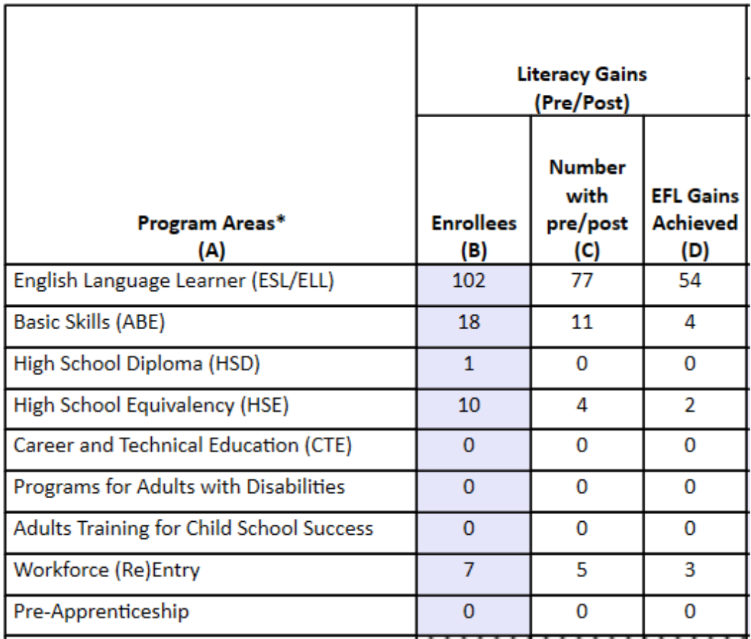
CAEP Summary Report
Click any cell to generate a list of students included in that cell.
© CASAS 2020

Slide 9
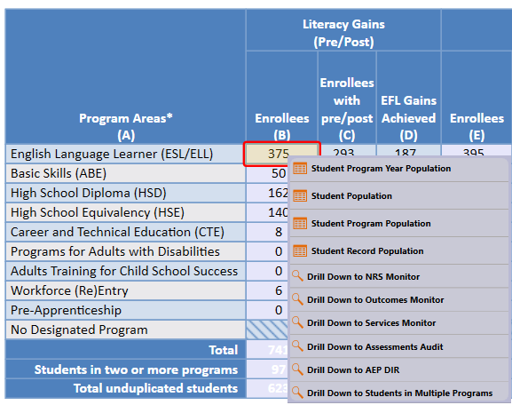
CAEP Summary Report
Right click any cell and select from 6 listers and 6 reports:
© CASAS 2020

Slide 10
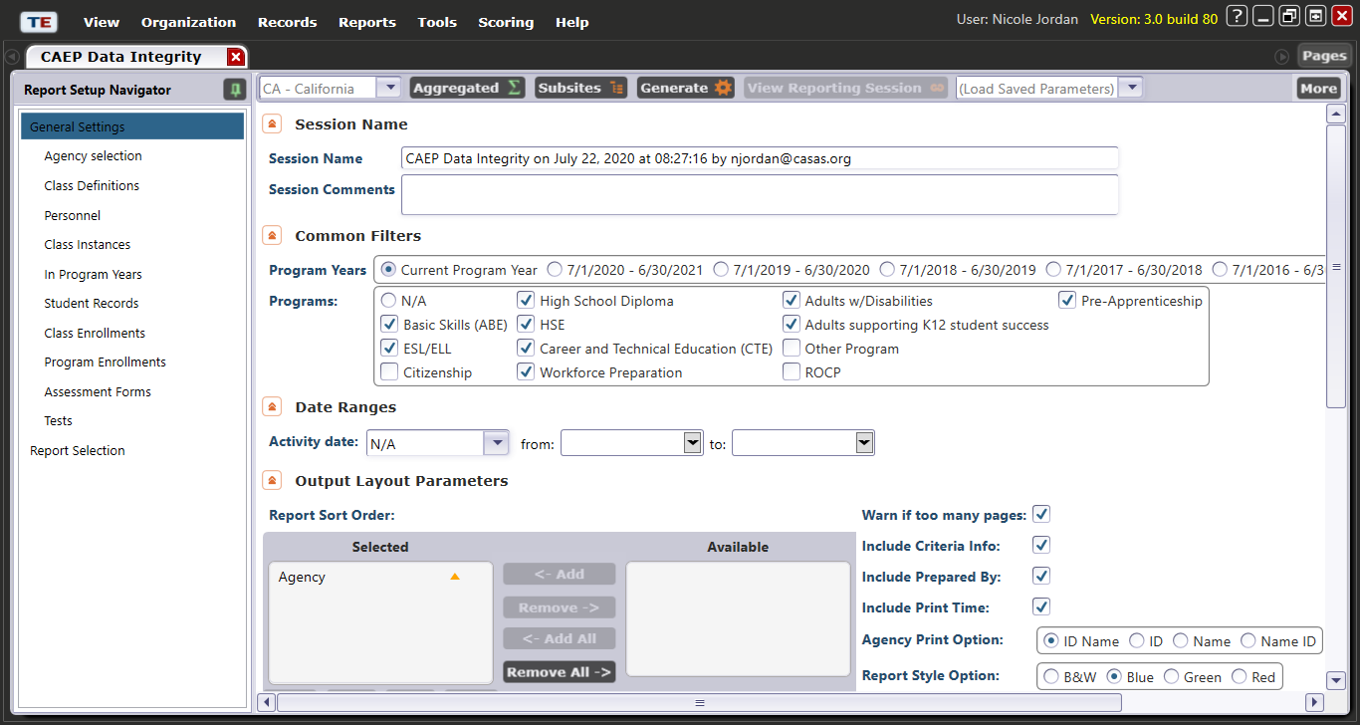
CAEP Data Integrity Report
Generate in TE: Reports > State Reports > California > CAEP Data Integrity
© CASAS 2020

Slide 11
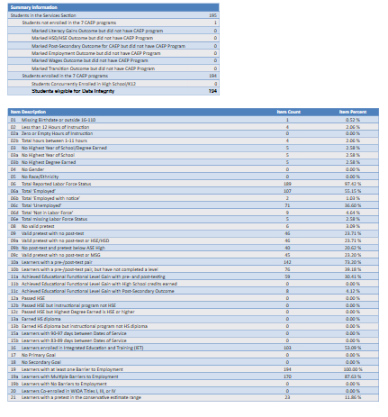
CAEP data integrity report
Keep all default filters
Default Program Year should be set to “7/1/2019 – 6/30/2020”
Click Generate
Export > Save as PDF on your computer
Send PDF attachment via email to caep@casas.org
© CASAS 2020

Slide 12
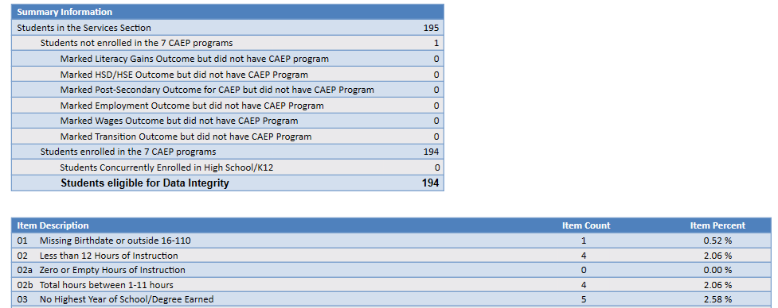
CAEP data integrity report
Item Description lists 27 data elements that may prevent or contribute to official CAEP outcomes.
The DIR displays the item count and percentage for each listed item.
Item Percent = Item Count ÷ # of Students Enrolled in 7 CAEP Programs
© CASAS 2020

Slide 13
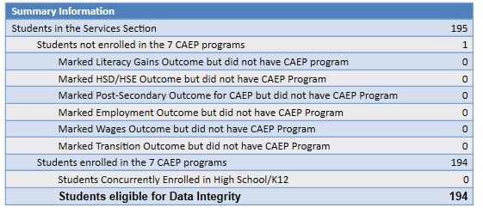
Summary Information reconciles all of the students included in CAEP reporting.
Students in the Services Section includes everyone reported for CAEP -- whether for official enrollment or for services only.
Students not enrolled in the 7 CAEP programs subtracts those who received services but are not enrolled in one of the 7 CAEP program areas.
The next 6 rows are subsets of those not enrolled in the 7 CAEP programs – showing students not enrolled in program but who earned outcomes and may need enrollment.
Students in the Services Section
− Students not enrolled in the 7 CAEP programs
= Students enrolled in the 7 CAEP programs
Students enrolled in the 7 CAEP programs is the total limited to students with official enrollment, and this number serves as the denominator for the 27 DIR items.
© CASAS 2020

Slide 14
CAEP Data Integrity Report: PY 19-20
Some items that may change significantly due to COVID-19/ Force Majeure issues:
  < 12 Hours of Instruction - Item 02
  No Post-Test/Pre-Post-Test pair - Items 09, 10
  Earned HSE/HS Diploma - Items 12, 13
  Earned outcome but did not qualify for CAEP - Items 23a-27
  Achieved CAEP outcome - Items 23b-27b
© CASAS 2020

Slide 15
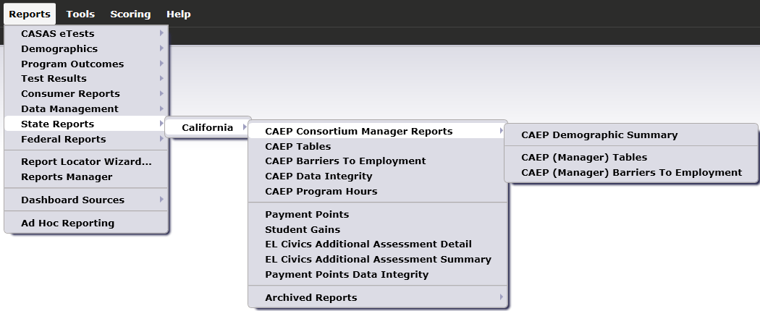
CAEP Consortium Manager Reports
CAEP Consortium Manager Reports allow a consortium level login to compare and contrast outcomes across agencies within one consortium.
Menu currently includes three reports options with this feature
© CASAS 2020

Slide 16
How to submit the deliverables?
End-of-Year TOPSpro® Enterprise (TE) Data
  Enter data electronically via TE only
  Nothing to send – Data already hosted on our Online Server
End-of-Year CAEP Data Integrity Report (DIR)
  Generate in TE
  Email CAEP DIR to: caep@casas.org
© CASAS 2020

Slide 17
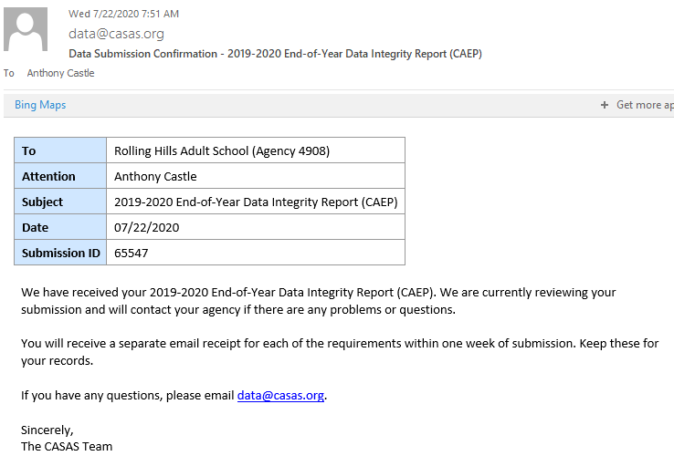
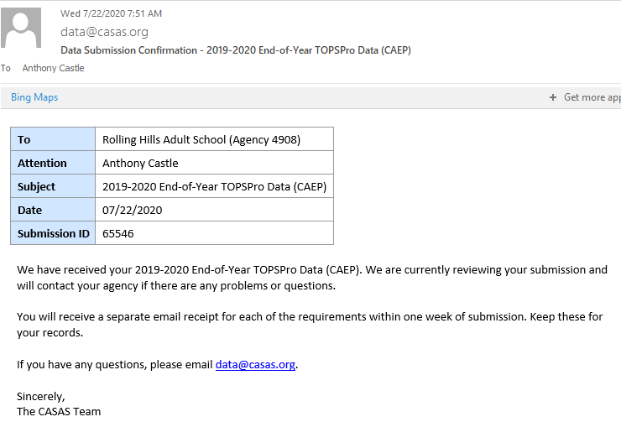
Data submission Confirmation emails
Your agency’s Primary Contact for CASAS will receive confirmation of your deliverables via email once deliverables are processed
If you have changes to your Primary Contact, Online Main Point of Contact, and other staff changes, email contactinfo@casas.org
© CASAS 2020

Slide 18
Important links
CAEP Beginning of the Year Letter: https://caladulted.org/DownloadFile/846
CAEP Data Dive Recorded Presentation and PowerPoint:
https://caladulted.org/Administrators/385
Regional Network Meetings
https://www.caadultedtraining.org
© CASAS 2020

Slide 19
Casas resources
CASAS Technology Support Team
Phone: 1-800-255-1036, Option 2
Email: techsupport@casas.org
Hours: Monday-Friday, 6:00 am to 5:00 pm
Other Resources:
caep@casas.org – Questions about your Deliverables/reports
data@casas.org – Questions about the status of your data
© CASAS 2020

Slide 20
QUESTIONS?

Slide 21
Thank you for participating!
© CASAS 2020
Notes:
We appreciate you taking the time to review these guidelines, Thank you very much!

