Slide 1
CAEP Office Hour
Neil Kelly – State CAEP Office
Veronica Parker – CAEP TAP
June 26, 2020

Slide 2
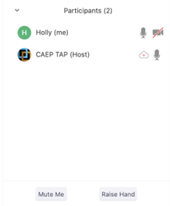
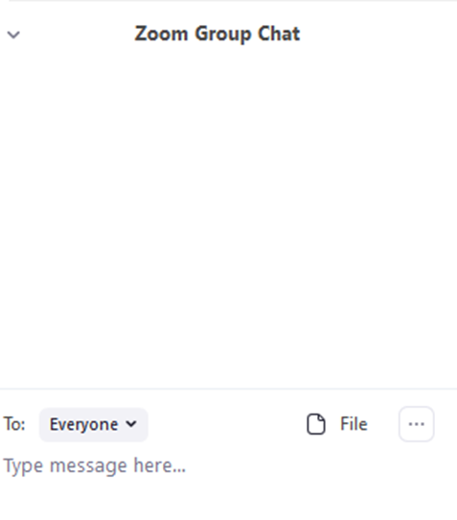
Zoom Room Controls
Everyone has the ability to speak…please raise your hand first
Everyone is muted upon entry
Feel free to communicate via the chat – even share files
You can use your camera…or not

Slide 3
New Budget Deal and What That Means for CAEP

Slide 4
Wrap Up and Questions

Slide 5
Request Support from CAEP TAP

