Slide 1
Hybrid IET: Creating Equitable Career Pathways in Healthcare for Adult ELLs
Peg Gould, Director/Community Education and Training
Mercer County Community College/Trenton, NJ
Miranda Loos/EnGen
Director, Partnerships

Slide 2
Post in chat about you!
What brings you to this session today?

Slide 3
Post in chat about your IET
What are your biggest frustrations?

Slide 4
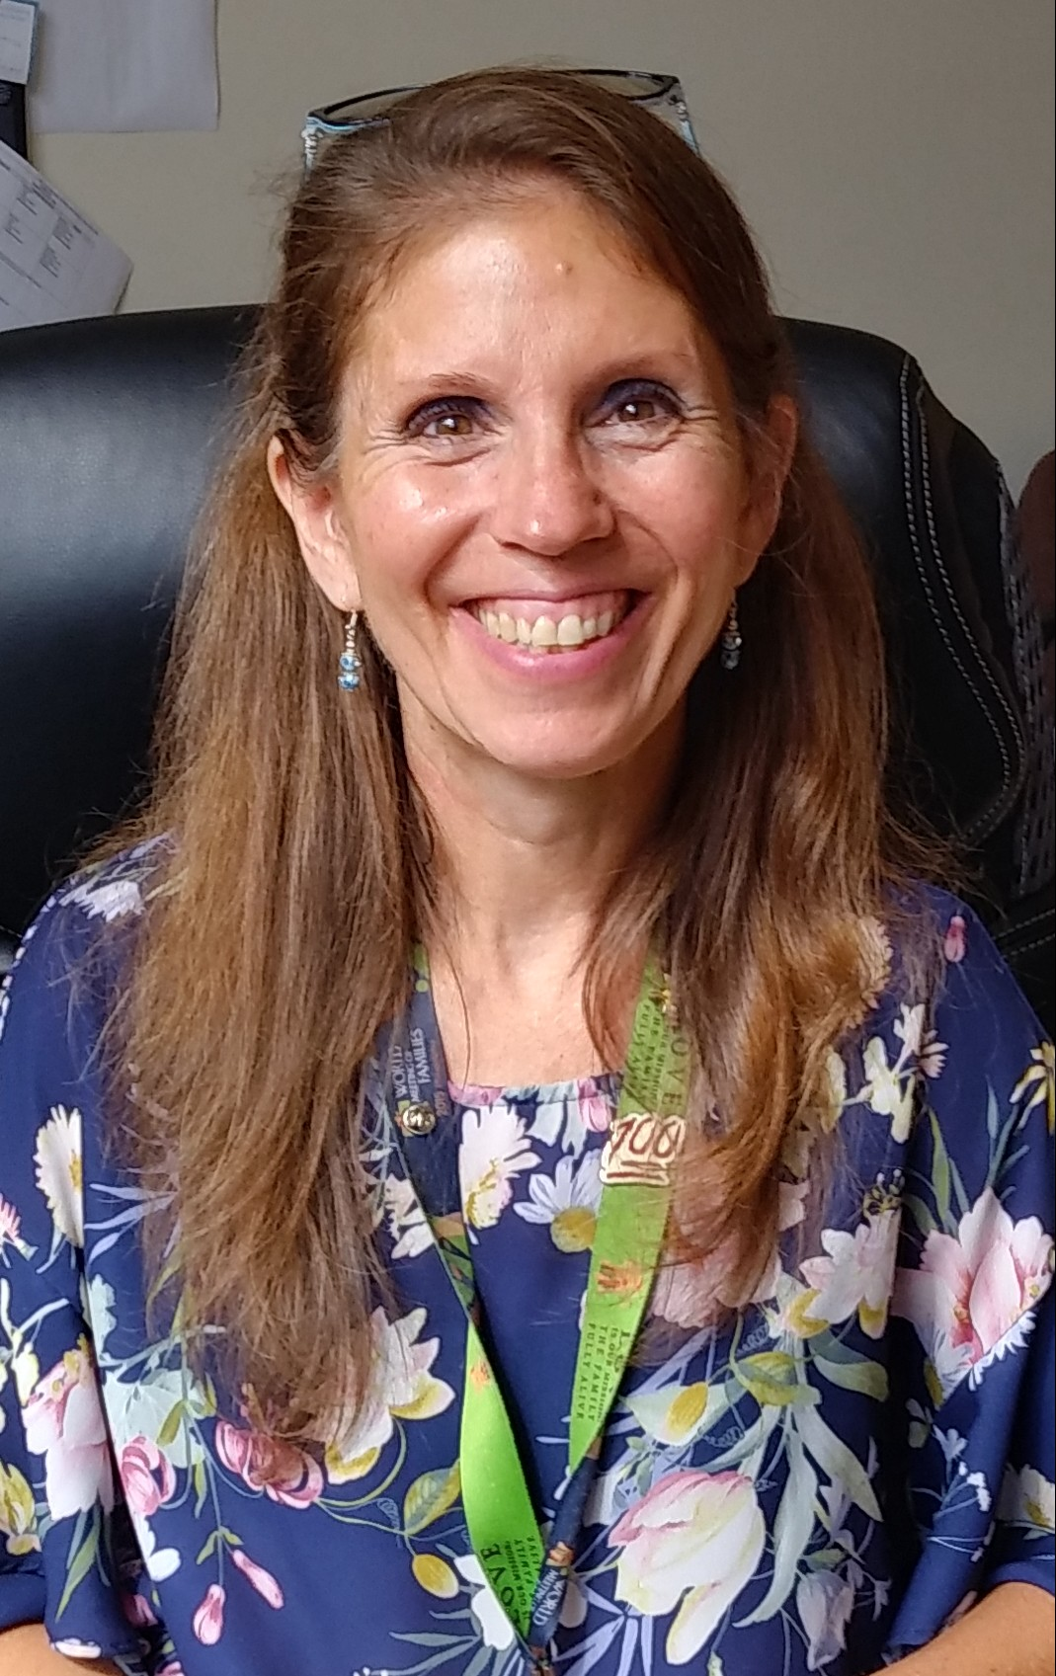
Highlights
Presenter background
What brings me here today??? YOU
Sharing our IET journey in Trenton, NJ
Our IET frustrations
Challenges and some solutions

Slide 5
A long and varied history
Early 2000’s
Factory training/car manufacturer
IBEST (integrated)
LAGCC – PCAP (contextualized)

Slide 6
Wasn’t it great???
“I could do this if you bought me a textbook to teach from.”
“It’s a great idea, but I’ll do this on a rainy day.”

Slide 7
What about you? What have you tried?
Post in chat about your progress with IET:
Who are your stakeholders?
Who are your students?
Are there jobs available?
What is realistic?

Slide 8
Dead ends
Before IET was a requirement, we tried:
Housekeeping/Hospitality for hotel workers
Waiters/Waitresses
First Aid/CPR/AED

Slide 9
Our prior starts and stops
After IET was a requirement, we tried:
OSHA and the phone call
Microsoft Suite

Slide 10
Facts and our realities
Population: ~83,000
25% (1 in 4): functionally illiterate
30% (~1 in 3): functionally innumerate
Foreign born population: 40% Hispanic/Latino
Foreign born population: 60% speak English less than well
HS graduation rate: 50-65%

Slide 11
We need help!
Looked for help through many channels
Academics
WDB
Employers
Professional network
Funders
Consortium partners
Nothing is permanent but change
Certification approved list

Slide 12
Trying dual attendance with Allied Health
Language acquisition/senior ed specialist assigned to initiative
Students attend AH in the evenings w/language spec
Students attend follow up ESL the next morning
Polled students
End result

Slide 13
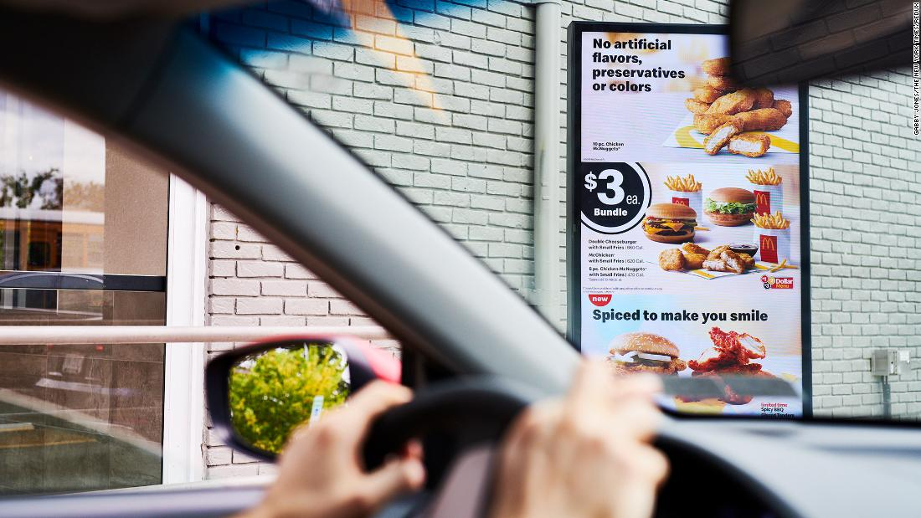
COVID-19, Title II, PY2021-2022
COVID crippled our programming but it was a blessing in disguise!
New Title II funding requirement: DOL market research
Depressing information

Slide 14
5 highest job openings Mercer County, NJ 2021-2026
RN (BSN or higher)
Computer Software Engineer (BS or higher)
Home health care (no certification necessary; no HSE needed)
Warehousing/ecommerce (no certification necessary; no HSE needed)
Fast food service (no certification necessary; no HSE needed)

Slide 15
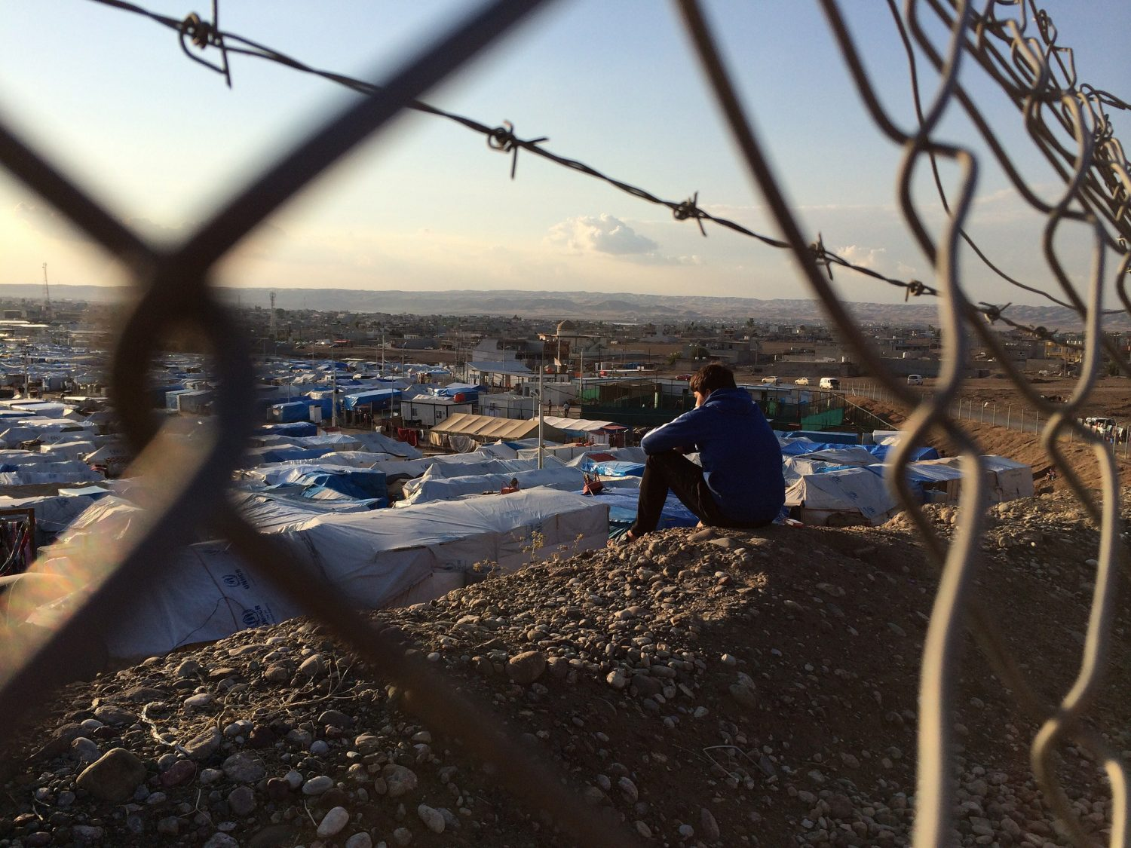
Remember
Trenton stats
IET in NJ is funded for ESL (civics) students
Language barriers
Documents to work
IDs
Welcome new neighbor refugees!

Slide 16
Fatigued, frustrated, pressured
Covid exhaustion
Frustrated with remote everything due to covid
Other stakeholders closing in
Funder

Slide 17
Another WDB meeting
CTE program was also crippled by covid
The blessing of COVID: employers in need
Here’s a pilot program we’re running
OneStop: we would maybe send some referrals
Employers

Slide 18
Here we go!
Assisted and Long Term Care
Largest county hospital
City based CBO
Our students + our CTE/IET cornerstone

Slide 19
Fostering student agency
Curriculum
Student glossary
EnGen
Case studies

Slide 20
About the class:
Originally designed for those considering employment in the health care sector
· Expected population: HSE/ABE students, ESL who exceeded a Level 6, adults “testing” the water seeking employment or further studies
· Most participants were newly arrived to the US and had experience or employment in healthcare in their native country.

Slide 21
Great……..what’s it look like?
FREE!!!
It looks like this………..
Moodle

Slide 22
How is this hybrid?
Students work on modules via Moodle portal 6+ hours weekly
Students have in person/via virtual ‘class’ 2 afternoons weekly
Teacher is available for in person or virtual office hours for individual student support or to conference with students
Learning is largely independent, but a cohort builds from in person (or virtual) instruction and thru assignments and discussion boards

Slide 23
Student experiences in their own words…
I have never used a QWERTY keyboard before. I felt relieved when the teacher provided typing practice websites – I practiced and my skills improved as items like discussion boards, vocabulary glossary entries, filing, responses in chat made me use my new keyboarding skills.

Slide 24
Student experiences in their own words…
I got a keyboard the day before class. I was scared, but some of my classmates helped me with peer tutoring. The teacher was helpful.
Moodle gave me other resources such as the zoom, medical terminology text, NJCan 360. It took a little while for me to understand, but now I love it.
Moodle gave me a chance to view or do work that I had missed.

Slide 25
Teacher’s reflections…
ENGEN provided good examples for material that I wanted students to research for our asynchronous discussion forums in Moodle or as great discussion starters for our synchronous class discussions.
ENGEN also provided a reference for students to easily identify words to put in our weekly glossary which fed into the main glossary.

Slide 26
Where are we now?
Everybody loves it but _________
Job previewing and documents
Federal glance

Slide 27
Would you consider this?
At least we got asked
Building Step Up to Green Jobs (launch September, 2022)
Brainstorming and the easy part of this whole process

Slide 28
There’s the employment piece too!
This was a really great part of the course. Iloved hearing about live opportunities. Kim did a wonderful job setting up speakers!
Some speakers shared good information to us. Examples were certification pathways in NJ and how to get transcripts reviewed.
Kim’s information about resumes, transcripts, NJCan 360 tools, and employment was extremely useful!!!
*Kim=career counselor

Slide 29
A learning experience FOR US!
Requiring work documents (ssn, visa, id, etc) at least started before entering the intensive prep instruction
Interview process with career coordinator: available right now to work; transportation; child care issues; ability to commit to this program and then to working or studying
Adding a capstone/session long capstone project
Tightening the follow up post program: goals, barriers/support, other needs

Slide 30
What can you take from this presentation?
Starting step: labor market analysis (local area)
Find state certifications matching above
Find jobs in that field and list competencies
Search online! YouTube, platforms, companies
Build weekly folders of work
Summarize/classify into a syllabus
Use your LMS or Google Classroom
Be flexible, be patient, be understanding

Slide 31
Got questions?

Slide 32
DON’T GIVE UP! NEVER, EVER
Thank you for coming today!
Peg Gould
gouldm@mccc.edu
609-570-3133 (o)
267-980-0323 (c)

